Slide 1
Fake Review Detection System
AI-based system using ML, DL, NLP & Explainable AI
Your Name : XYZ

Slide 2
Contents
Introduction
Problem Statement
Objectives
Dataset
Methodology
Models
Evaluation
Architecture
Results
Conclusion
References

Slide 3
Introduction
Online platforms depend on reviews
Fake reviews reduce trust
Hard to distinguish fake vs genuine
Uses NLP, ML, DL, Explainable AI

Slide 4
Problem Statement
Fake reviews manipulate ratings
Mislead users
Hard to detect manually
Need automated intelligent system

Slide 5
Objectives
Detect fake vs genuine reviews
Apply NLP for text analysis
Use ML & LSTM models
Use SHAP for explainability

Slide 6
Dataset Overview
Synthetic dataset (realistic reviews)
Includes fake & genuine data
Structured + unstructured data

Slide 7
Dataset Attributes
Review Text
Label (Fake/Genuine)
Rating (1–5)
Reviewer ID
Timestamp

Slide 8
Features
TF-IDF & N-grams
Word count
Sentiment (VADER)
Behavior patterns

Slide 9
Behavioral Features
Review frequency
Extreme ratings
Duplicate reviews
Readability score

Slide 10
Dataset Challenges
Class imbalance
Noisy data
Missing values
Different writing styles

Slide 11
Preprocessing
Remove noise & stopwords
Lowercase conversion
Tokenization & lemmatization

Slide 12
Feature Extraction
TF-IDF vectors
N-grams
Sentiment scores
Behavior features

Slide 13
ML Models
Logistic Regression
SVM
Random Forest

Slide 14
Deep Learning (LSTM)
Sequential text processing
Embedding + LSTM layers
Captures context

Slide 15
Explainable AI (SHAP)
Explains predictions
Highlights important features
Improves trust

Slide 16
Evaluation
Accuracy, Precision, Recall, F1
Confusion Matrix
Train-test split (80:20)

Slide 17
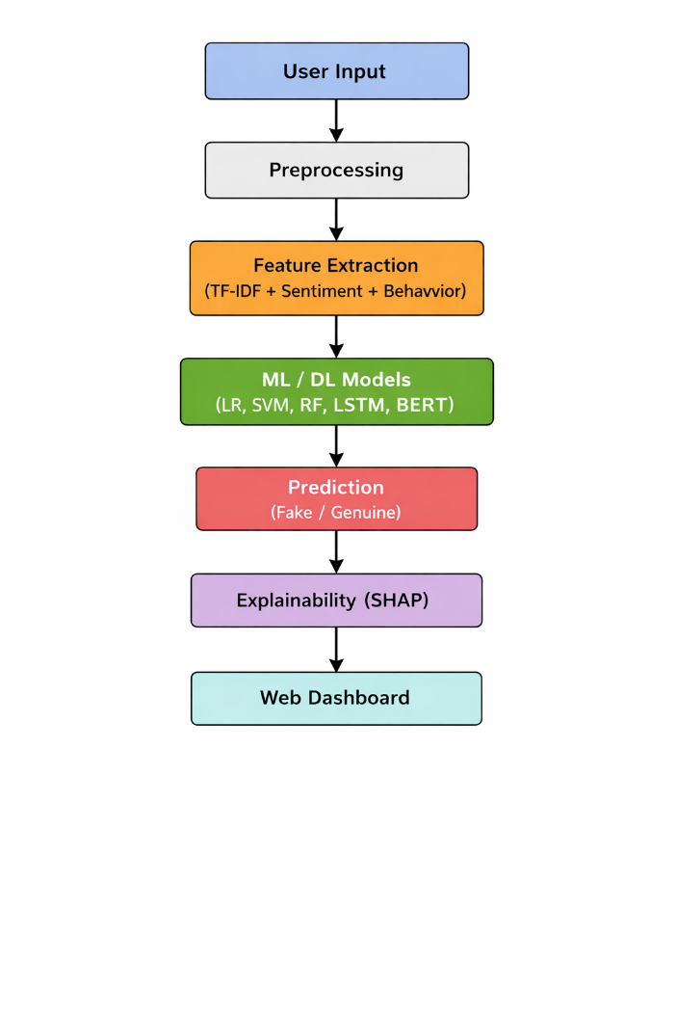
Architecture
Data → Features → Models → Prediction

Slide 18
Results
Detects fake reviews
Identifies patterns
Provides trust score

Slide 19
Conclusion
Combines NLP, ML, DL, SHAP
Improves accuracy & reliability
Useful for real-world systems

Slide 20
References
Jindal & Liu (2007)
Ott et al. (2011)
Mukherjee et al. (2013)
Devlin et al. (2019)
Lundberg & Lee (2017)

