Slide 1
24CC3046 — P100
Azure Subscription
Decommissioning &
Data Retention Plan
CLOUD OPERATIONS
Team T202 · 4 Members
September 2026
1 / 12

Slide 2
Meet the Team
AY
CK
AR
GK
Amara Yashwanth
Cherukuri Kusmitha
Ananthaneni Rakesh
Gangisetty Kalyan
Raghavendra
Team Leader
Team Member
Team Member
Team Member
ID: 2400030878
ID: 2400030776
ID: 2400030699
ID: 2400030595
2 / 12

Slide 3
Problem Statement
KEY BOTTLENECKS
THE CHALLENGE
Organizations accumulate Azure subscriptions over time — legacy environments, dev/test sandboxes, acquired infrastructure. When these subscriptions are no longer needed, simply deleting them risks breaking dependent workloads, losing audit evidence, and incurring unexpected data egress charges.
Without a structured decommissioning plan, teams face hidden dependencies, compliance violations, and uncontrolled costs.
!
Hidden Dependencies
Workloads silently depend on shared network or identity resources
$
Egress Costs
Data transfer charges are not budgeted before migration
⚠
Compliance Risk
Audit evidence and retention data may be lost permanently
3 / 12

Slide 4
Use Cases
01
Plan Safe Closure of a Legacy Subscription
Identify all resources, map their dependencies, evaluate costs, and schedule a phased decommission — ensuring zero unplanned downtime.
02
Preserve Required Data & Audit Evidence
Export and archive compliance-critical data before resource deletion. Generate audit reports with timestamps, cost history, and resource lineage.
4 / 12

Slide 5
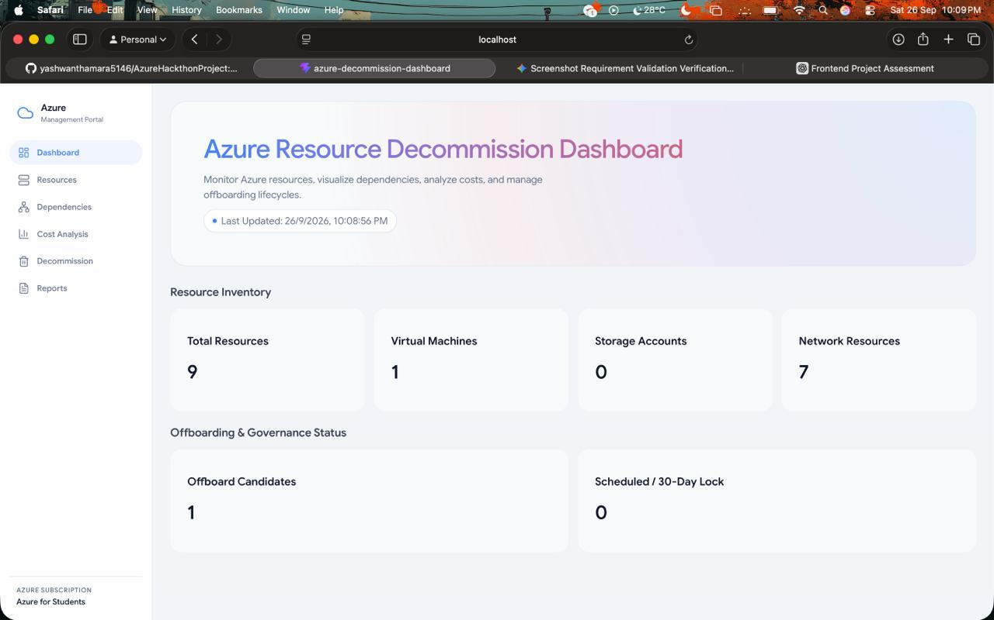
Our Solution
Azure Resource Decommission Dashboard
A unified web dashboard that connects to an Azure subscription to monitor resources, visualize dependencies, analyze costs, and manage offboarding lifecycles.
Real-time resource inventory with type & status
Interactive dependency tree visualization
Cost breakdown with savings estimates
Status-based decommission workflows
PDF audit report generation
Live sync from Azure for Students subscription
Dashboard — Home View
5 / 12

Slide 6
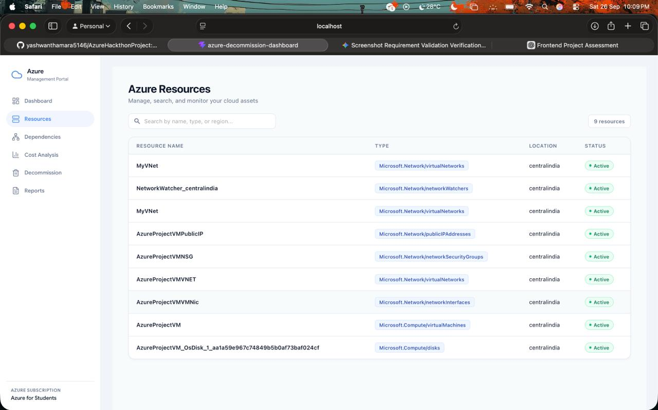
Resource Inventory
Total Resources
Virtual Machines
9
1
The Resources page lists every Azure resource in the subscription — virtual networks, network watchers, public IPs, security groups, NICs, VMs, and disks. Each row shows the resource name, Azure type, deployment region (centralindia), and live status. This gives the team a single view of everything that needs to be accounted for before any decommission action.
KEY INSIGHT
7 of 9 resources are network infrastructure — the VM is the core workload all others support.
Dashboard — Resources Page
6 / 12

Slide 7
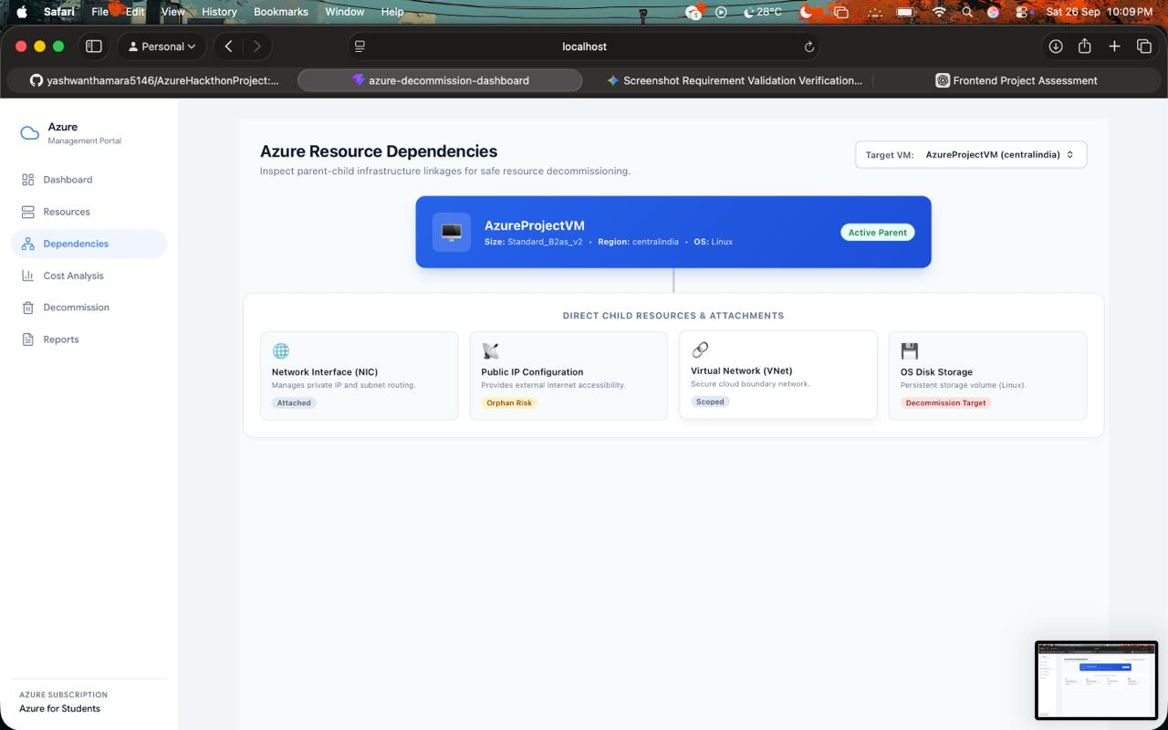
Dependency Mapping
WHAT THIS SHOWS
The dependency tree maps parent-child relationships between Azure resources. AzureProjectVM (Standard_B2as_v2, Linux) is the active parent resource in centralindia.
Network Interface (NIC)
Actively bound to the VM
Public IP Configuration
May be orphaned if VM is deleted
Virtual Network (VNet)
Shared resource — scoped to project
OS Disk Storage
WHY IT MATTERS
Flagged for deletion with VM
Deleting the VM without checking dependencies would orphan the Public IP and leave dangling network rules.
Dashboard — Dependencies View
7 / 12

Slide 8
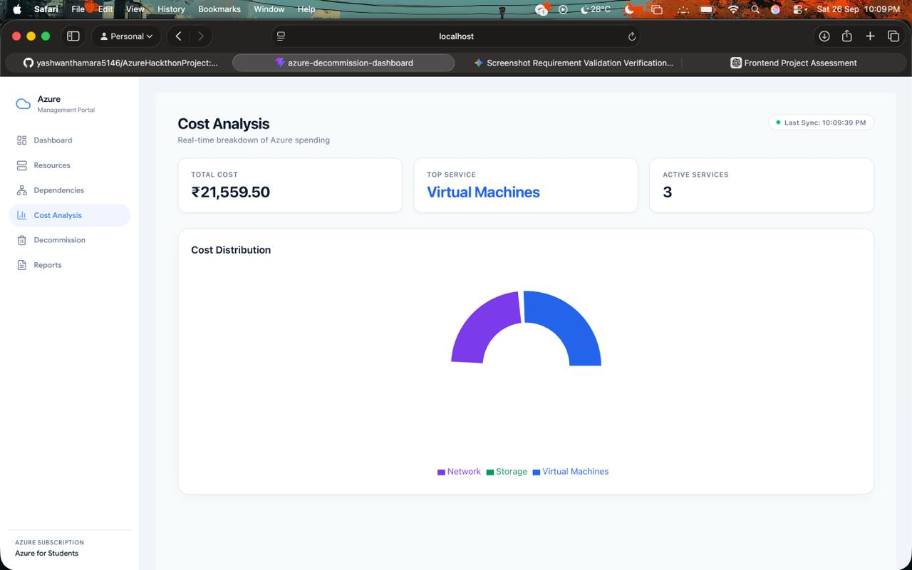
Cost Analysis
TOTAL COST
TOP SERVICE
ACTIVE SERVICES
POTENTIAL RECOVERY
₹21,559.50
Virtual Machines
3
₹15,551.59
COST BREAKDOWN
AzureProjectVM
₹13,654.35
63.3%
Highest cost — primary decommission target
OS Disk (Managed)
₹1,437.30
6.7%
Persistent storage attached to VM
Public IP Address
₹459.94
2.1%
Orphan risk — verify if still needed
Network Resources
₹0.00
0%
VNets, NSGs, NICs — no direct charges
Dashboard — Cost Analysis Page
Potential monthly savings by decommissioning: ₹15,551.59 (72%)
8 / 12

Slide 9
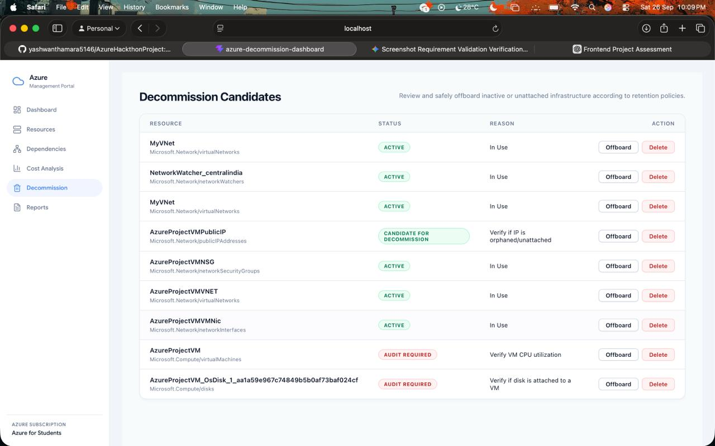
Decommission Engine
HOW IT WORKS
The Decommission page lets the team review and safely offboard inactive or unattached infrastructure according to retention policies. Each resource shows its current status and a recommended action.
STATUS CATEGORIES
Active (In Use)
6 resources
Currently serving workloads — VNets, NSG, NIC, etc.
Candidate for Decommission
1 resource
AzureProjectVMPublicIP — verify if IP is orphaned/unattached
Audit Required
2 resources
AzureProjectVM (verify CPU utilization) & OS Disk (verify attachment)
Dashboard — Decommission Page
9 / 12

Slide 10
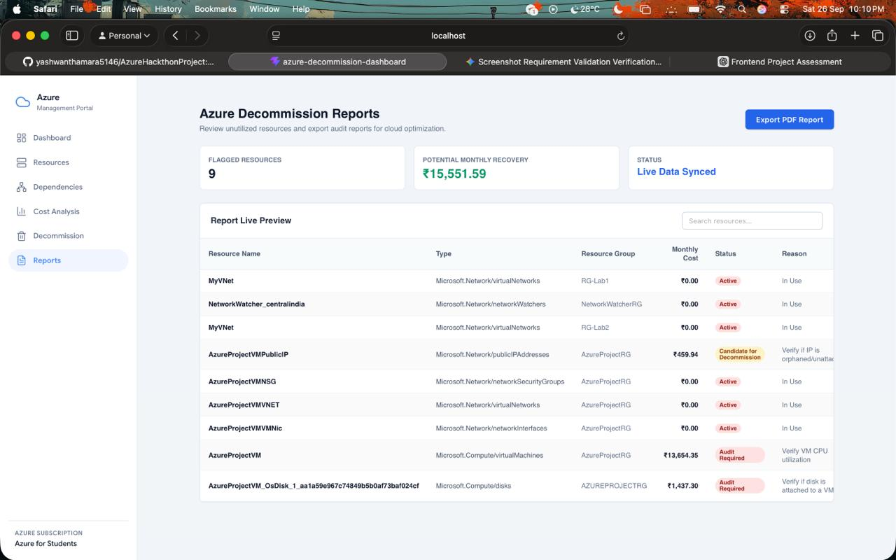
Audit Reports
REPORT CAPABILITIES
The Reports page provides a comprehensive view of all flagged resources, their monthly costs, status, and reasons for review. A one-click PDF export generates an audit-ready document for compliance teams.
Flagged Resources
9
Potential Monthly Recovery
₹15,551.59
Status
Live Data Synced
Dashboard — Reports Page
Export PDF Report — one click for audit-ready documentation
10 / 12

Slide 11
Technology Stack
FRONTEND
BACKEND
React.js
Node.js / Express
Tailwind CSS
Azure SDK for JS
Recharts
REST APIs
CLOUD PLATFORM
DATA & REPORTS
Microsoft Azure
PDF Export
Azure Resource Manager
Live Data Sync
Azure Cost Management
Cost Analytics Engine
11 / 12

Slide 12
Thank You!
Azure Subscription Decommissioning & Data Retention Plan
24CC3046 — P100 · Team T100
Questions & Discussion
12 / 12

