Slide 1
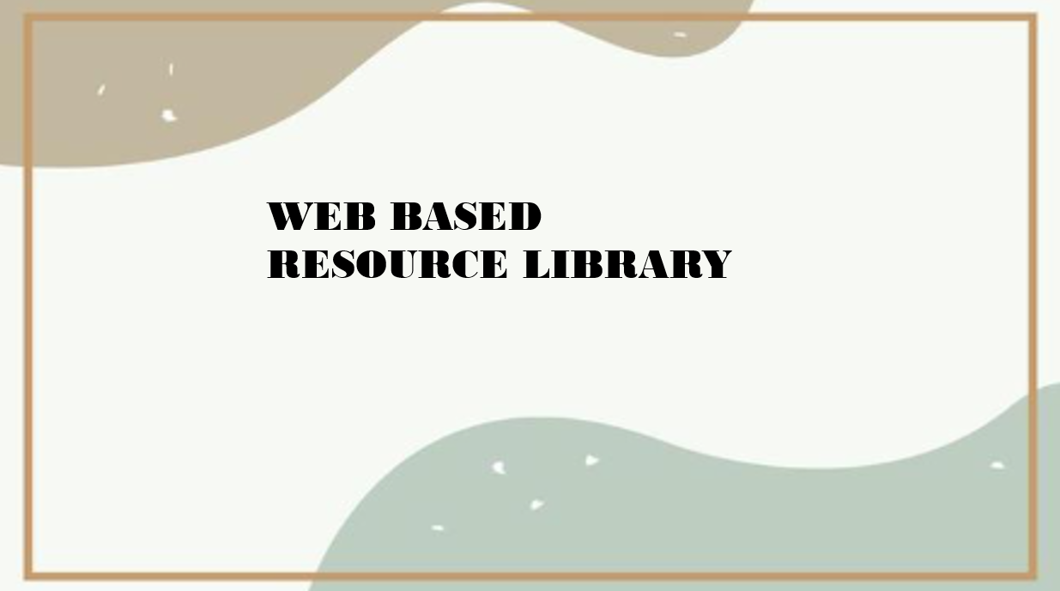
2400033319 Y.Naga Bhavana
2400030984 S.H.V.S.Sai Harshini
2400031721 M.Tejamrutha

Slide 2

Introduction And Objective
Traditional methods of accessing resources are scattered and inefficient.
A web-based library centralizes textbooks, research papers, and study guides with searchable categories.
Enables admins to manage resources and users while enhancing students and educators learning experience.

Slide 3

User Roles
Admin
Upload and categorize resources.
Manage user accounts and permissions.
Track usage and feedback.
User
Search and download resources.
Access categorized materials.
Provide feedback on materials.

Slide 4

Key Features
Centralized Resource Repository: Store all educational materials in one platform.
Advanced Search & Filters: Quickly find resources by keyword, category, or subject.
Download Option: Easy access to required materials.
Feedback System: Users can rate and provide suggestions.

Slide 5

Benefits & Conclusion
Students: Quick access to resources, better performance.
Educators: Easy sharing of materials, improved teaching support.
Institutions: Organized resources, reduced duplication.
Conclusion: A web-based library ensures efficiency, accessibility, and collaboration, strengthening learning and research outcomes.

Slide 6

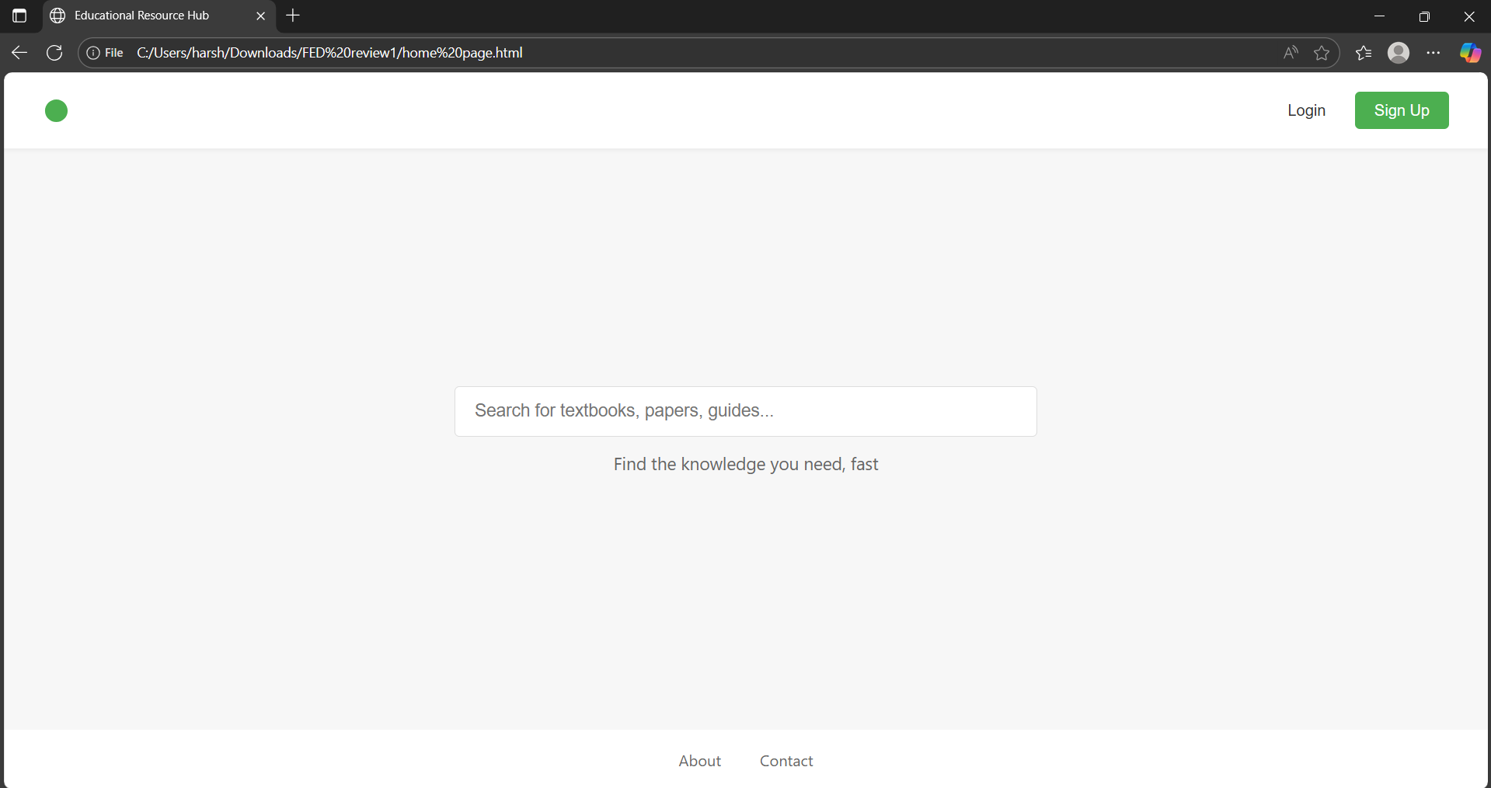
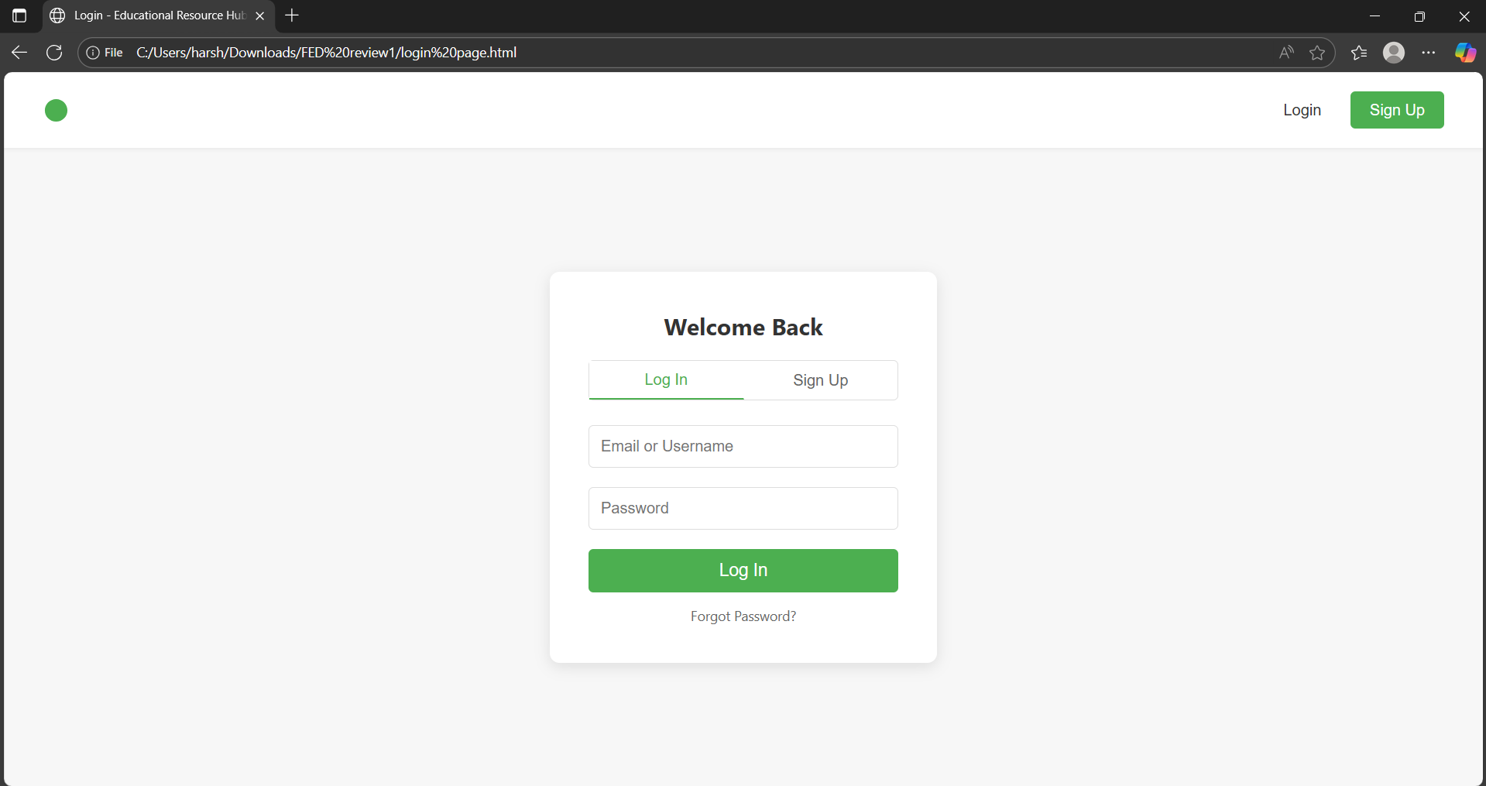
HOME PAGE
LOGIN PAGE

