Slide 1

A
AZURE LOAD BALANCER VERSUS
APPLICATION GATEWAY
DESIGN COMPARISON
ID NO
2400031033
2400030943
2400031005
2400031084
Name
M MADHU KRISHNA SAI
SYED AYAZ
AKURATHI SAHITHI
A NIKHIL SAI NATH

Slide 2
INTRODUCTION
Cloud applications require high availability, scalability, and reliable traffic management to serve users efficiently.
Microsoft Azure provides networking services that help distribute incoming traffic across multiple backend resources.
Azure Load Balancer and Azure Application Gateway are two important Azure traffic distribution services.
Azure Load Balancer operates at Layer 4 (Transport Layer) and distributes TCP/UDP traffic across virtual machines and servers.
Azure Application Gateway operates at Layer 7 (Application Layer) and provides intelligent routing for HTTP/HTTPS web traffic.
Application Gateway offers advanced features such as URL-based routing, SSL termination, session affinity, and Web Application Firewall (WAF).
Both services improve application performance, availability, and reliability but are designed for different use cases.

Slide 3
KEY COMPONENTS
Azure Load Balancer
○ Layer 4 TCP/UDP traffic distribution
○ Frontend IP Configuration
Public or private entry point
○ Backend Pools
VMs or instances receiving traffic
○ Health Probes
Monitor endpoint availability
Azure Application Gateway
○ Layer 7 HTTP/HTTPS routing
○ Listeners & Rules
Route traffic by URL/host rules
○ SSL/TLS Handling
Offload encryption at gateway
○ Optional WAF
Web Application Firewall protection

Slide 4
ABSTRACT
• Architecture: Load Balancer operates at Layer 4 (TCP/UDP) with a simple pass-through model; Application Gateway operates at Layer 7 (HTTP/HTTPS) with advanced request inspection and routing logic.
• Traffic Layer & Routing: Load Balancer distributes traffic by IP and port; Application Gateway routes by URL path, hostname, and HTTP headers for granular control.
• Security & SSL: Application Gateway offers built-in SSL/TLS termination and optional WAF; Load Balancer provides no application-layer security features.
• Performance & Cost: Load Balancer delivers ultra-low latency at high throughput with lower cost; Application Gateway suits complex web workloads where advanced routing and security justify higher spend.
• Project Suitability: Use Load Balancer for non-HTTP, high-volume TCP/UDP traffic; use Application Gateway for web apps requiring URL routing, SSL offload, or WAF protection.

Slide 5
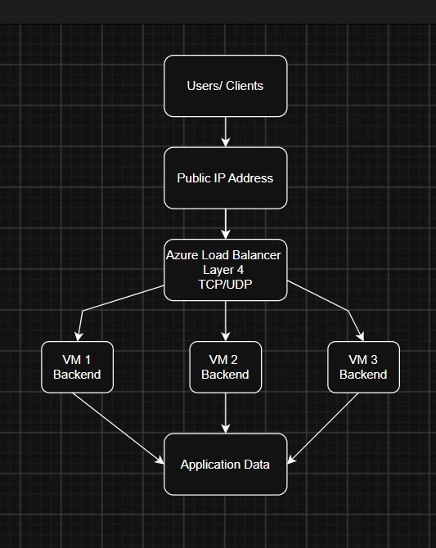
Azure Load Balancer Architecture

Slide 6
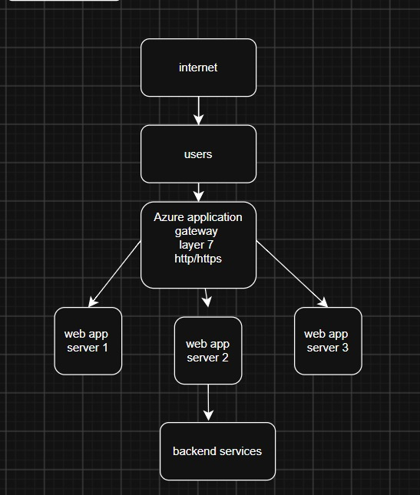
Application Gateway

Slide 7
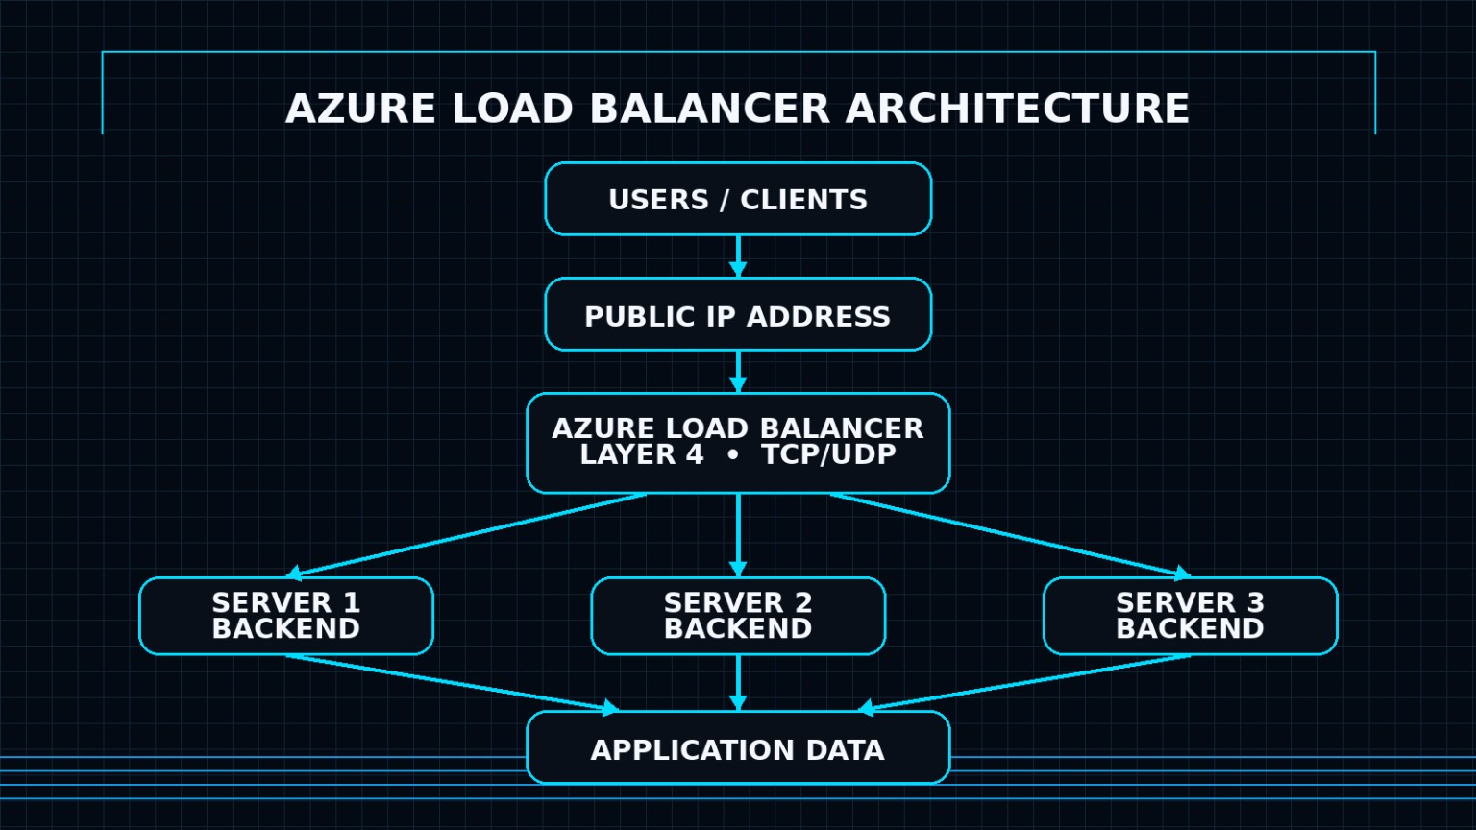

Slide 8
ARCHITECTURE DEEP DIVE
Azure Load Balancer Architecture:
• Operates at OSI Layer 4 (TCP/UDP), forwarding packets without inspecting content
• Uses a 5-tuple hash (source IP, source port, destination IP, destination port, protocol) for distribution
• Frontend IP configuration receives inbound traffic from public or private endpoints
• Backend pools contain VMs or VM Scale Sets that serve requests

Slide 9
TRAFFIC LAYER COMPARISON
Layer 4 — TCP/UDP (Azure Load Balancer):
Operates at the Transport Layer, routing traffic based on IP address and port number. Handles high-throughput TCP and UDP connections with ultra-low latency. No awareness of application content or HTTP headers — purely network-level forwarding. Ideal for non-HTTP workloads such as databases, gaming servers, and raw socket connections.
Layer 7 — HTTP/HTTPS (Azure Application Gateway):
Operates at the Application Layer, making intelligent routing decisions based on URL paths, hostnames, and HTTP headers. Supports SSL/TLS termination, cookie-based session affinity, and Web Application Firewall (WAF). Designed for web applications requiring content-aware traffic distribution and advanced security filtering.

Slide 10
ROUTING MECHANISMS
Azure Load Balancer
(Layer 4 Hash-Based Routing)
• Uses a 5-tuple hash: source IP, source port, destination IP, destination port, and protocol
• Distributes traffic evenly across backend VM pool
• No awareness of HTTP headers, URLs, or cookies
• Session persistence via client IP affinity (optional)
• Ideal for TCP/UDP workloads requiring fast, stateless distribution
Azure Application Gateway
(Layer 7 Path-Based Routing)
• Routes based on URL path, hostname, HTTP headers, and query strings
• Supports path-based rules (e.g., /images → Pool A, /api → Pool B)
• Enables multi-site hosting on a single gateway
• Cookie-based session affinity for stateful applications
• Ideal for HTTP/HTTPS workloads requiring intelligent, content-aware routing

Slide 11
SECURITY COMPARISON
Azure Load Balancer
• Network-level (Layer 4) security only
• No built-in SSL/TLS termination
• Basic DDoS protection via Azure platform
• No Web Application Firewall (WAF)
• Relies on NSGs and Azure Firewall for access control
• Pass-through traffic — no packet inspection
Azure Application Gateway
• Application-level (Layer 7) security
• Built-in SSL/TLS termination and re-encryption
• Optional Web Application Firewall (WAF v2)
• Protects against OWASP top 10 vulnerabilities
• End-to-end encryption support
• Deep packet inspection and request filtering

Slide 12
PERFORMANCE COMPARISON
Azure Load Balancer is a Layer 4 service that distributes TCP/UDP traffic across multiple backend VMs.It provides high throughput and very low latency, making it suitable for applications handling huge amounts of traffic.It requires minimal processing because it doesn't inspect the actual packet content.It can scale automatically to handle millions of network flows efficiently.
Azure Application Gateway is a Layer 7 load-balancing service that intelligently routes HTTP/HTTPS requests.
It supports features like URL-based routing, SSL/TLS termination, session affinity, and WAF security.
It provides more flexibility and security by inspecting application-level requests.
Compared with Layer 4, it may have slightly higher latency due to deeper request processing.
It is especially useful for web applications that require intelligent traffic management.
It can route requests based on URLs, headers, and other application-level information.

Slide 13
COST COMPARISON
Azure Load Balancer — Predictable Tier-Based Pricing: Available in Basic (free) and Standard tiers. Standard Load Balancer is billed by the number of rules and data processed (GB). Costs are predictable and scale linearly with usage, making it cost-efficient for high-throughput Layer 4 TCP/UDP workloads with minimal overhead.
Azure Application Gateway — Consumption-Based Pricing: Billed on a fixed hourly rate plus capacity units (CUs) consumed. CUs account for compute, persistent connections, and throughput. WAF tier adds additional cost. Best suited for Layer 7 HTTP/HTTPS routing where advanced features such as SSL termination, URL-based routing, and WAF justify the higher per-unit expense.

Slide 14
USE CASES
Choose Azure Load Balancer when:
● High-throughput TCP/UDP traffic at Layer 4 is required
● Low-latency, non-HTTP workloads (e.g., gaming, streaming)
● Internal VM-to-VM load distribution is needed
● Simple, cost-effective balancing without HTTP inspection
● Infrastructure-level redundancy across availability zones
Choose Application Gateway when:
● HTTP/HTTPS routing with URL or host-based rules is needed
● SSL/TLS termination at the gateway is required
● Web Application Firewall (WAF) protection is a priority
● Cookie-based session affinity is necessary
● Multi-site hosting or microservices routing is involved

Slide 15
FINAL DECISION FRAMEWORK
Protocol & Routing: Choose Azure Load Balancer for high-throughput Layer 4 TCP/UDP traffic requiring fast, low-latency distribution. Choose Azure Application Gateway for Layer 7 HTTP/HTTPS routing with URL-based rules, host headers, and path-based traffic steering across backend pools.
Security, Performance & Budget: Application Gateway provides SSL/TLS termination and optional WAF for application-layer protection. Load Balancer offers lower cost and higher raw throughput. Use both together when layered network and application-level security is required. Final decision depends on protocol, routing needs, security requirements, performance targets, and project budget.

Slide 16
KEY TAKEAWAYS
• Choose Azure Load Balancer for high-throughput Layer 4 TCP/UDP traffic requiring speed and simplicity.
• Choose Azure Application Gateway for Layer 7 HTTP/HTTPS routing, SSL/TLS termination, and WAF protection.
• Use both together when a project requires layered network and application-level security.
• The final decision depends on protocol needs, routing complexity, security requirements, performance targets, and budget.
Thank You | Questions?

Slide 17
THANK YOU

