Slide 1


Slide 2
SUPPORTING BACKGROUND
N. MOUNIKA - 2400032180
CH .BHAVYA MADHURIMA - 2400032065
V . LAKSHMI TRIVENI - 2400031813

Slide 3
PROBLEM STATEMENT
Students often feel confused about choosing the right career because they don’t clearly know their skills, interests, or strengths.
They need a simple online tool that can guide them to suitable career options based on their abilities and preferences.
Explore suitable career options.

Slide 4
CODE
<!DOCTYPE html>
<html>
<head>
<title>Career Assessment Tool</title>
<style>
body {
font-family: Arial, sans-serif;
background-color: #f2f2f2;
padding: 20px;
}

Slide 5
.question {
margin-bottom: 20px;
}
button {
margin: 5px;
padding: 10px 20px;
border: none;
background-color: #4CAF50;
color: white;
border-radius: 5px;
cursor: pointer;
}
button:hover {
background-color: #45a049;
}

Slide 6
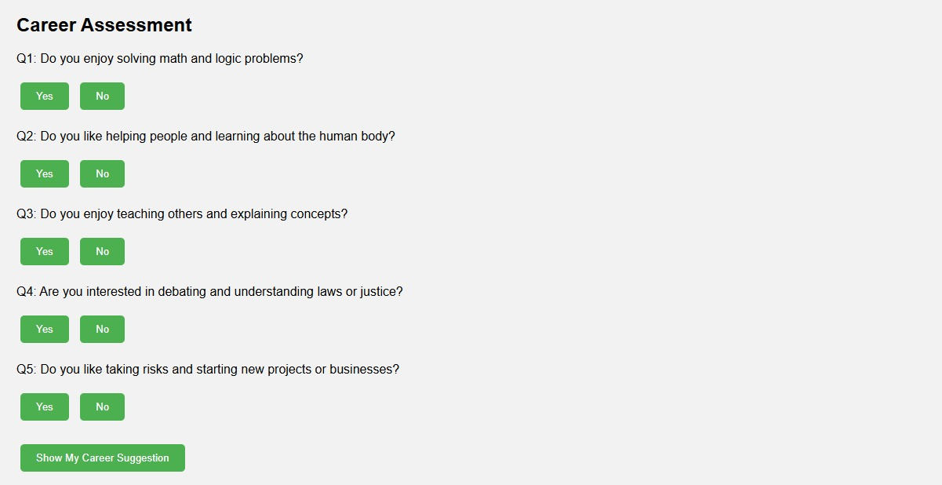
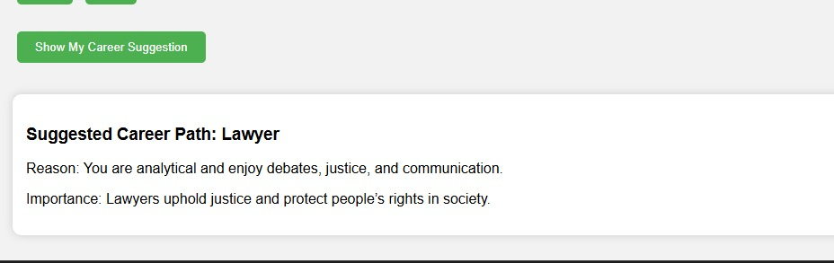
OUTPUT :

Slide 7
DESIGN THINKING INNOVATION
Empathize: Understand students’ career doubts and needs.
Define: Identify the main problem — career confusion.
Ideate: Think of ideas like a web quiz or AI-based career suggestions.
Prototype: Create a simple model showing career matches.
Test: Get student feedback and improve the tool.

Slide 8
THANK YOU

