Slide 1
PROJECT P054 | TEAM T156 | DEPT. CSE
Azure Blob Versioning &
Point-in-Time Restore
A cloud data-protection and recovery project built on Microsoft Azure Blob Storage
TEAM MEMBERS
K. Hansika — 2400033291
C.L. Madhuri — 2400033322
N. Bhavya Sri — 2400030307
K. Pujith Kalyan — 2400030513

Slide 2
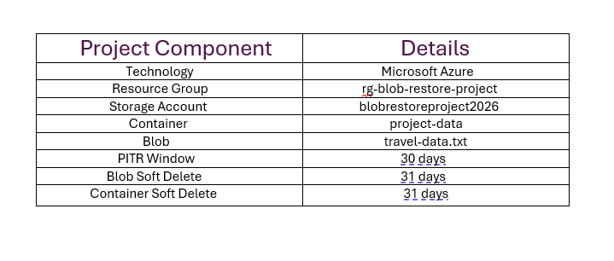
01 · OVERVIEW
Project Overview
A cloud-based data protection project built on Microsoft Azure Blob Storage.
Protects cloud data against accidental overwriting, modification, and deletion by retaining previous blob versions.
Implemented with a Storage Account containing a private blob container and a travel-data text file.
Blob Versioning keeps previous file versions; Blob Soft Delete and Container Soft Delete protect against deletion.
Change Feed records blob activity; Point-in-Time Restore is configured with a 30-day recovery window.
Lifecycle Management controls older blob versions and storage cost.
Azure Storage Account overview
Versioning
Soft Delete
Change Feed
Keeps history
31-day undo
Activity log
Azure Blob Versioning & Point-in-Time Restore
02

Slide 3
02 · OBJECTIVE
Project Objectives
1
Protect blob data from accidental overwriting and modification.
5
Track blob changes using Change Feed.
2
Maintain previous versions of blob data using Blob Versioning.
6
Configure Point-in-Time Restore with a 30-day window.
3
Protect deleted blobs with Blob Soft Delete.
7
Manage older blob versions via Lifecycle Management.
4
Protect deleted containers with Container Soft Delete.
8
Simulate an overwrite and recover the original data.
Azure Blob Versioning & Point-in-Time Restore
03

Slide 4
03 · APPROACH
Problem & Solution
PROBLEM
SOLUTION
Data stored in the cloud can be accidentally modified, overwritten, or deleted.
If previous versions are not maintained, the original information can be difficult to recover.
A data protection mechanism is required to retain historical versions and provide recovery options.
Blob Versioning
Blob & Container Soft Delete
Change Feed
Point-in-Time Restore (30-day window)
Recovery is demonstrated using Blob Versioning to restore the original data after an accidental overwrite.
Azure Blob Versioning & Point-in-Time Restore
04

Slide 5
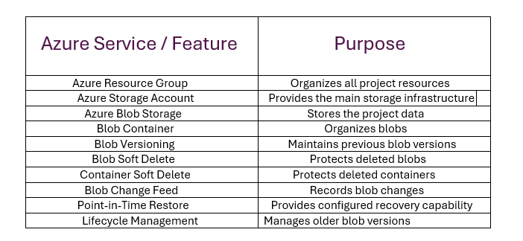
04 · SERVICES
Azure Services & Features Used
Azure Blob Versioning & Point-in-Time Restore
05

Slide 6
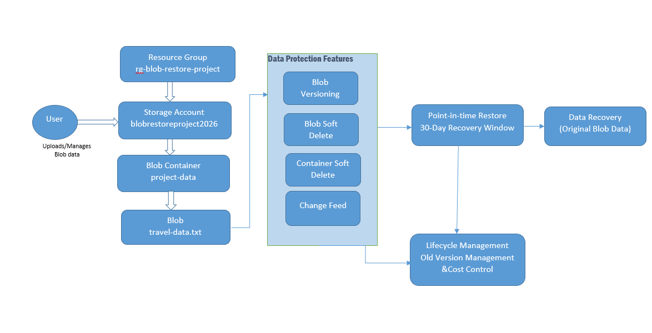
05 · ARCHITECTURE
Project Architecture
Resource Group rg-blob-restore-project organizes the project.
Storage Account blobrestoreproject2026 holds the project-data container and travel-data.txt blob.
Versioning, Soft Delete & Change Feed protect the blob at storage level; Lifecycle Management controls old versions.
Architecture of Azure Blob Versioning and Point-in-Time Restore
Azure Blob Versioning & Point-in-Time Restore
06

Slide 7
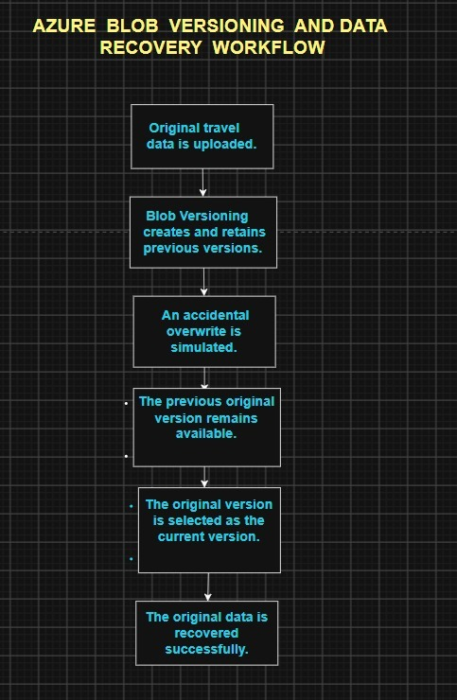
06 · WORKFLOW
Data Recovery Workflow
Original travel data is uploaded to Azure Blob Storage.
Blob Versioning automatically retains the previous version whenever the blob is modified.
An accidental overwrite is simulated — since the previous version is retained, the original remains available.
The original version is selected and made current, then verified as successfully recovered.
Blob Versioning & data recovery workflow
Azure Blob Versioning & Point-in-Time Restore
07

Slide 8
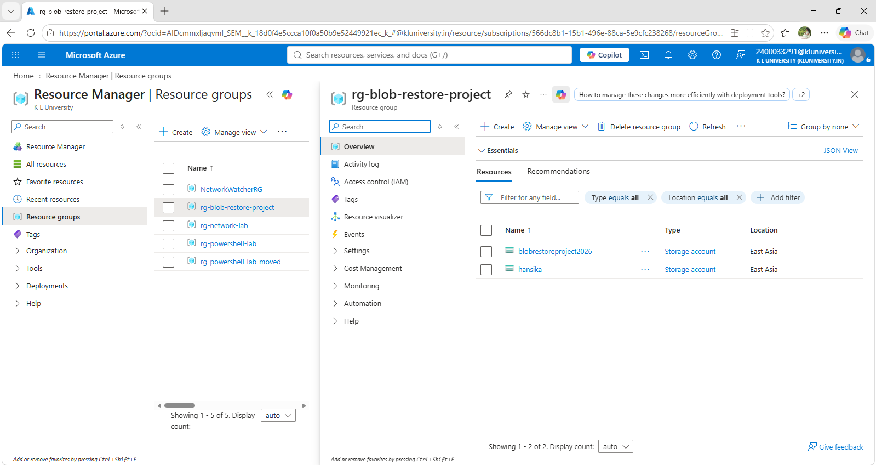
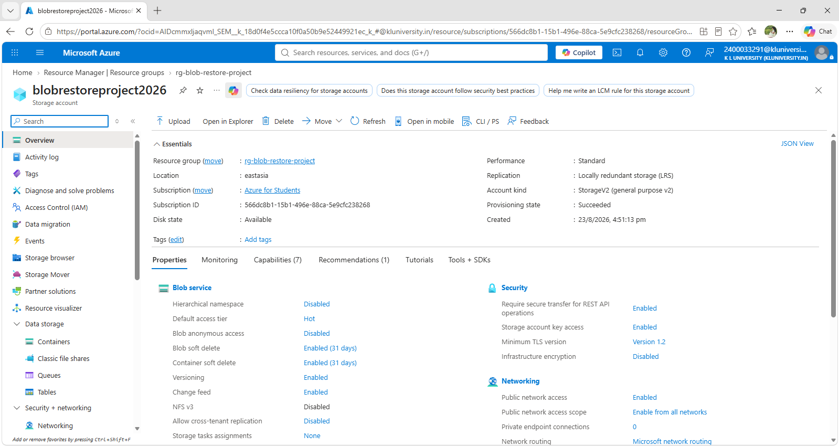
07 · SETUP
Resource Group & Storage Account
Resource Group: rg-blob-restore-project | Region: East Asia
Storage: blobrestoreproject2026 | Standard, LRS, HNS disabled
Resource Group: rg-blob-restore-project
Storage Account: blobrestoreproject2026
Azure Blob Versioning & Point-in-Time Restore
08

Slide 9
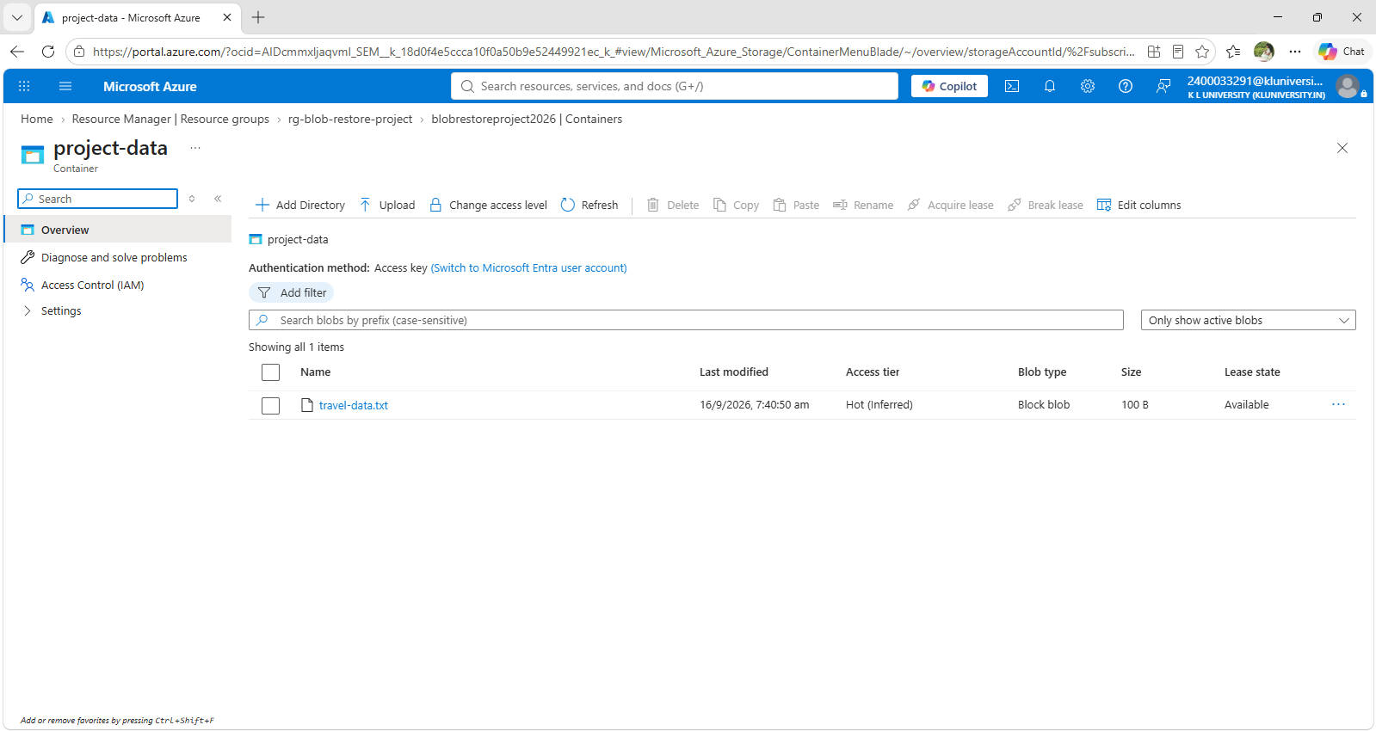
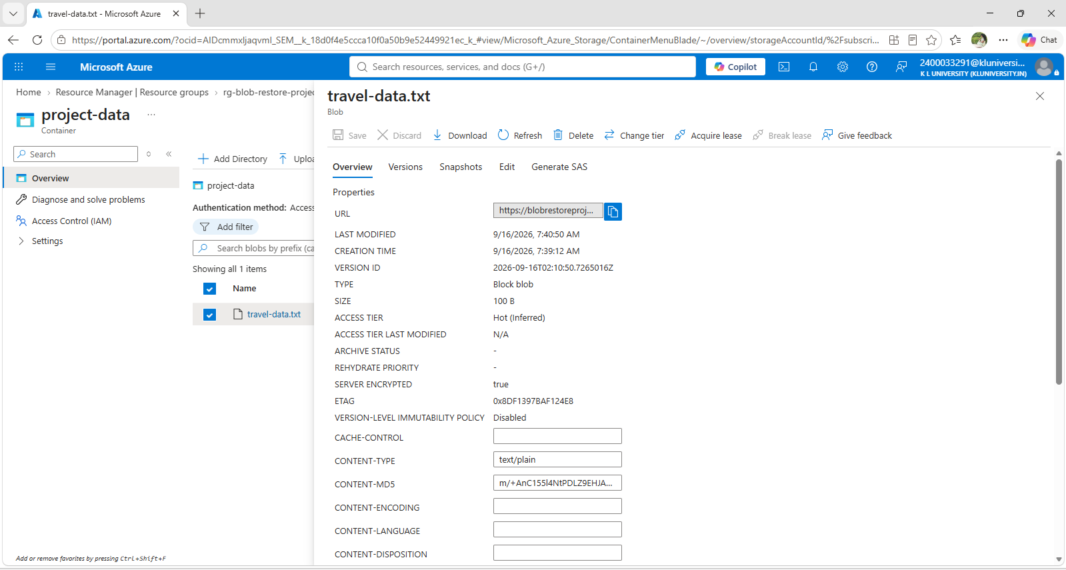
07 · SETUP
Blob Container & File Upload
A private blob container 'project-data' organizes the stored data.
travel-data.txt uploaded to demonstrate versioning & recovery.
Private container: project-data
travel-data.txt stored in the container
Azure Blob Versioning & Point-in-Time Restore
09

Slide 10
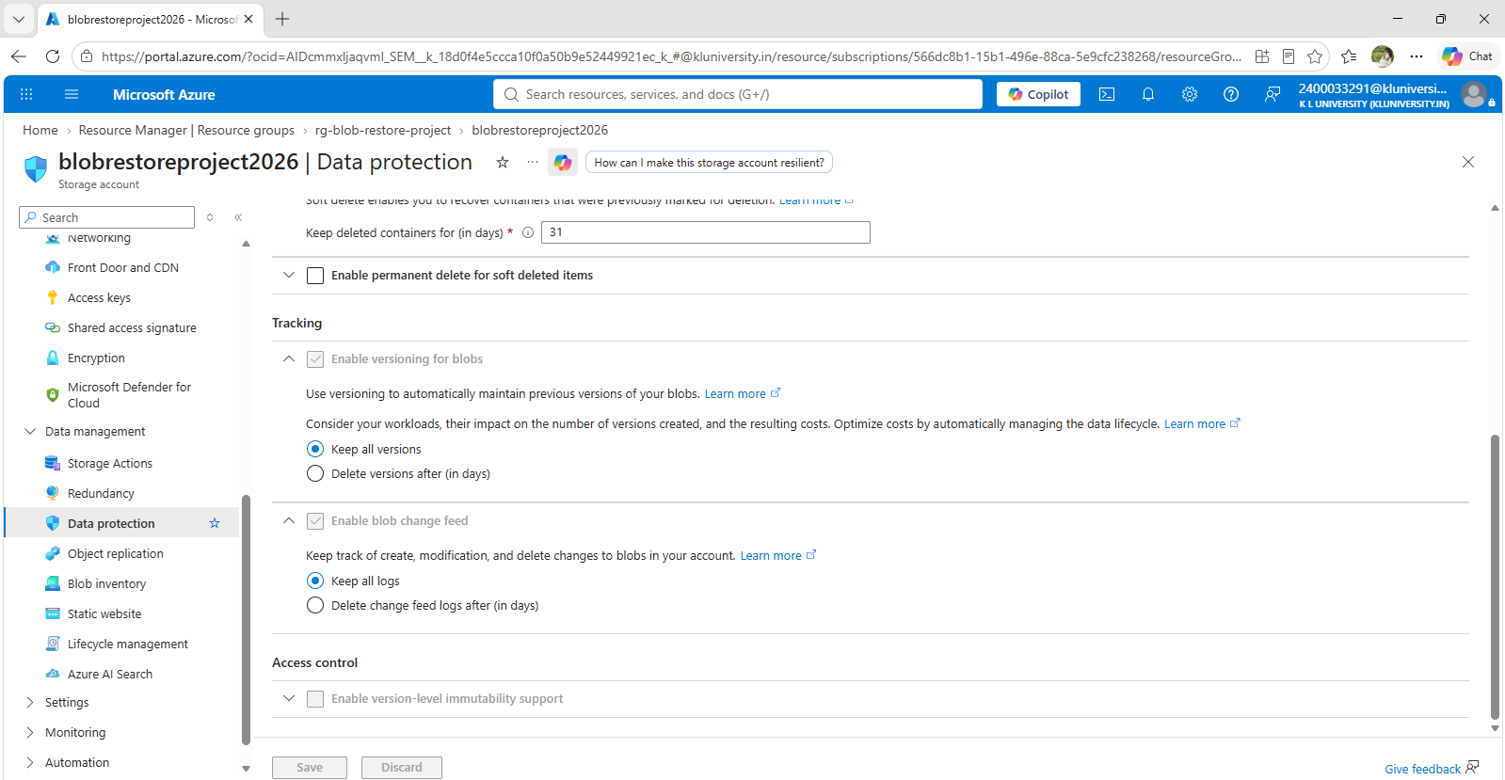
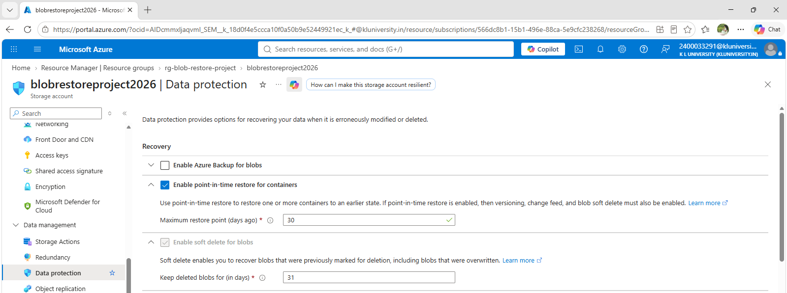

08 · CONFIGURATION
Configuring Data Protection Features
Blob Soft Delete — 31-day retention
Blob Versioning enabled
Change Feed enabled
Azure Blob Versioning & Point-in-Time Restore
10

Slide 11
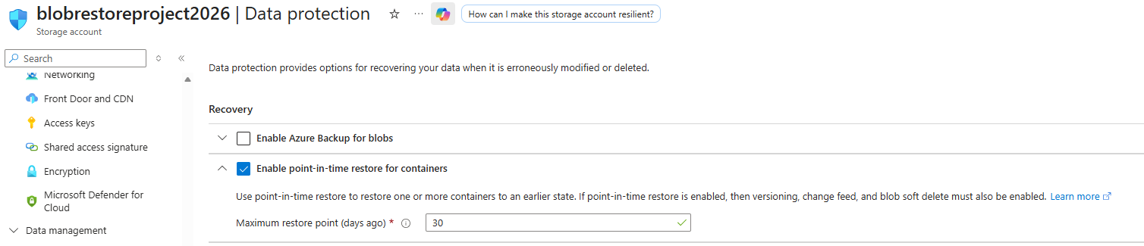
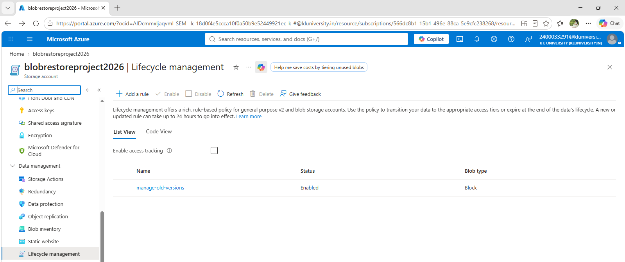
08 · CONFIGURATION
Point-in-Time Restore & Lifecycle Management
Point-in-Time Restore — 30-day recovery window
Lifecycle Management rule: manage-old-versions
Container Soft Delete — 31-day retention
Point-in-Time Restore configured with a 30-day window; hands-on recovery is demonstrated via Blob Versioning.
Lifecycle Management rule controls older blob versions and unnecessary storage cost.
Azure Blob Versioning & Point-in-Time Restore
11

Slide 12
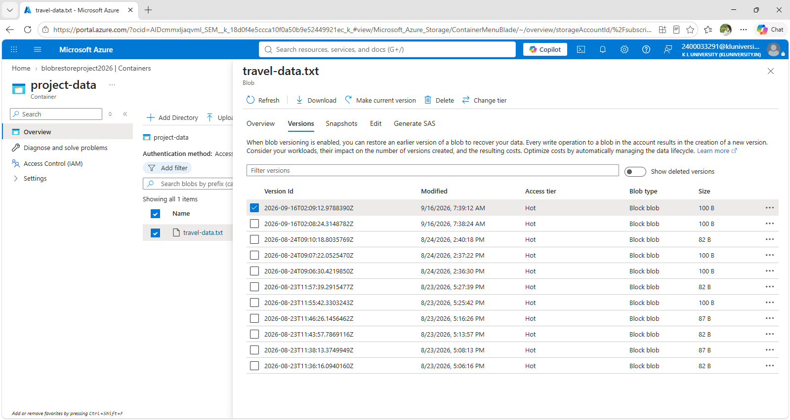
09 · TESTING
Blob Versioning Test
travel-data.txt was modified to generate multiple blob versions.
Original version — Version: 1, Status: Original, Recovery Test: Initial Data.
Later version — Version: 2, Status: Updated, Recovery Test: First Modification.
The presence of multiple versions confirmed Blob Versioning was working correctly.
Multiple versions of travel-data.txt
Azure Blob Versioning & Point-in-Time Restore
12

Slide 13
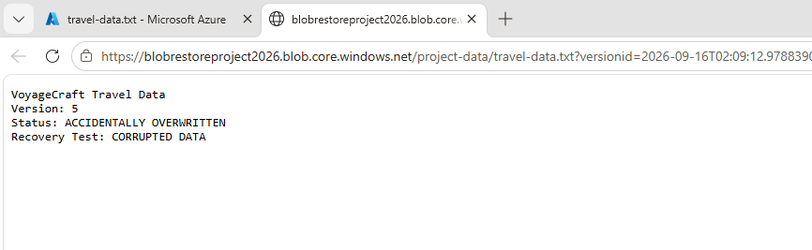
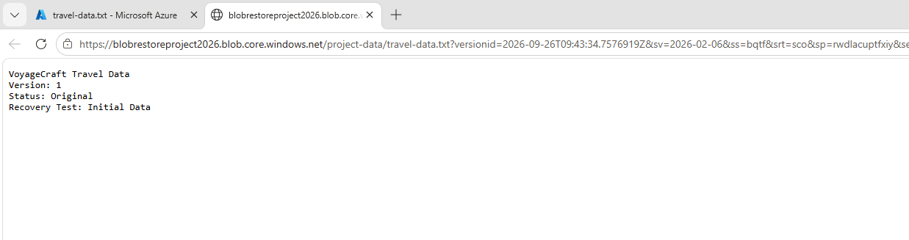
10 · RECOVERY
Accidental Overwrite & Data Recovery
The blob content was changed to simulate corrupted / overwritten data (Version: 4, Status: ACCIDENTALLY OVERWRITTEN).
The previously stored original version was located among the retained blob versions.
It was selected and set as the current version using 'Make current version'.
The original data was verified as successfully restored.
Simulated accidental blob overwrite
Selecting the original version to recover
Azure Blob Versioning & Point-in-Time Restore
13

Slide 14
11 · RESULT
Project Result
Storage Account, Blob Container, and travel-data.txt were successfully created.
Blob Versioning was enabled; multiple versions were generated during testing.
Blob Soft Delete & Container Soft Delete were configured for deletion protection.
Change Feed was enabled to record blob activity.
Point-in-Time Restore was configured with a 30-day recovery window.
Lifecycle Management was configured to manage older blob versions.
An accidental overwrite was simulated and the original data recovered successfully.
30-DAY
Point-in-Time Recovery Window
Recovery verified: the original data was successfully restored after an accidental overwrite.
Azure Blob Versioning & Point-in-Time Restore
14

Slide 15
Thank You
Azure Blob Versioning & Point-in-Time Restore · Team T156

