Slide 1
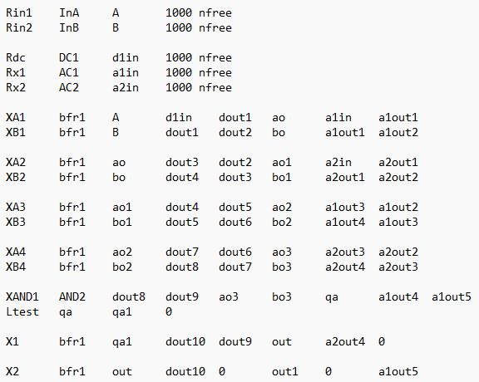
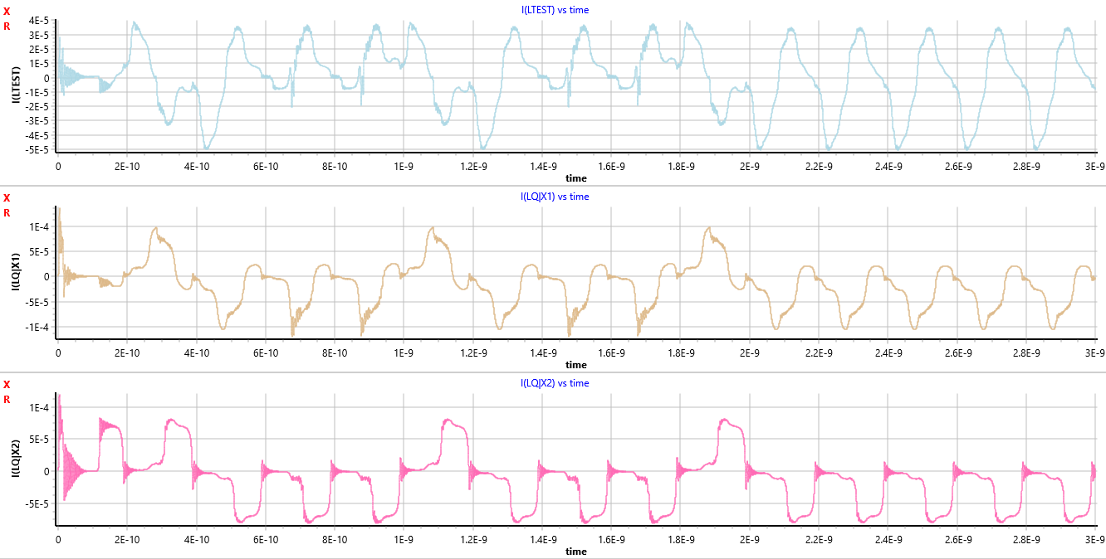
Progress Slides
The following images shows the layout leading up to the AND gate, the immediate output and the outputs of the following Buffers in series with the AND gate.

Slide 2
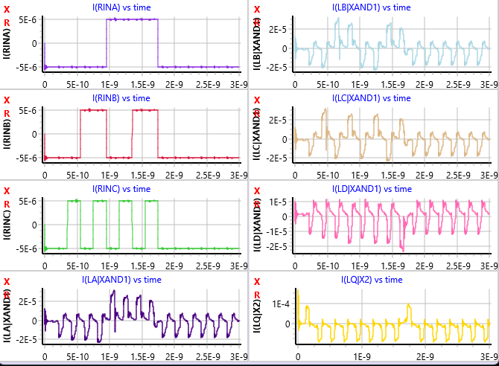
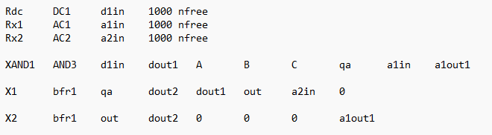
3 input AND gate working with no buffers preceding input

Slide 3
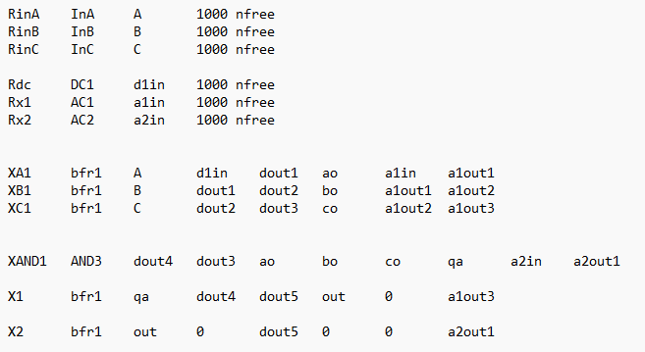
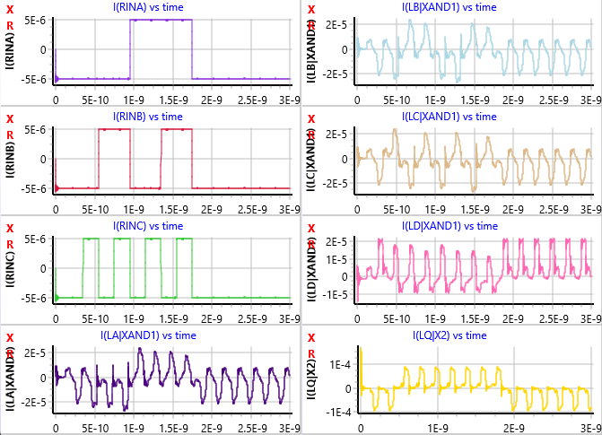
3 input and gate not working with 1 buffer preceding the input

Slide 4
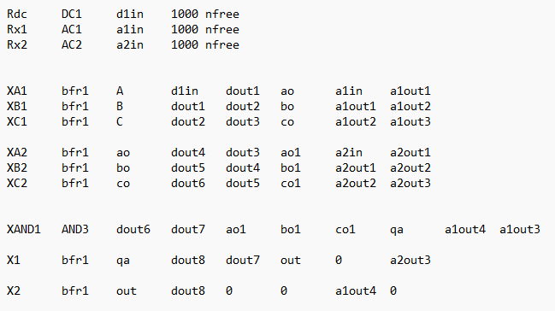
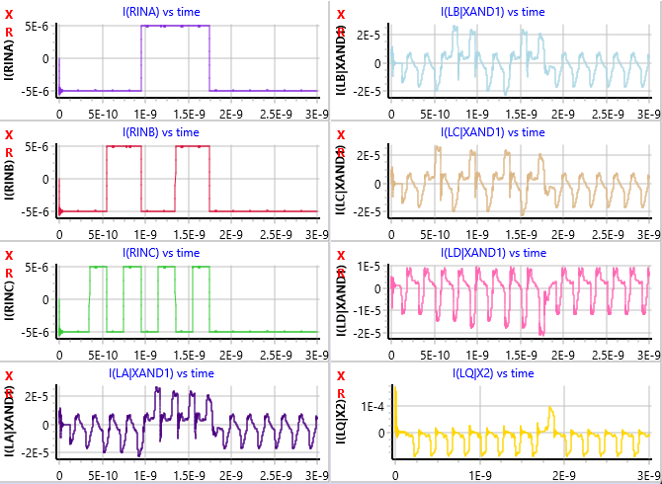
3 input AND gate working with 2 buffers preceding input

Slide 5
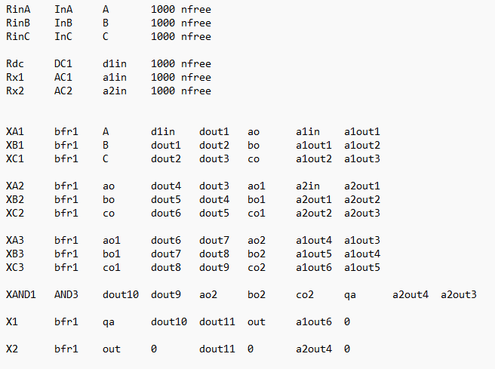
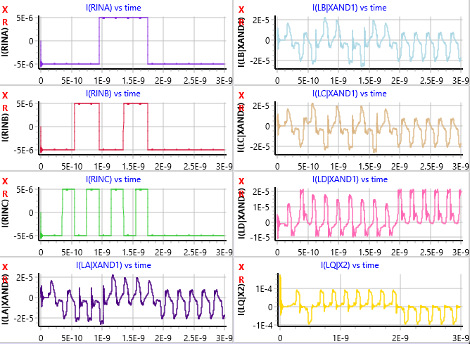
3 input AND gate not working with 3 buffers preceding input

Slide 6
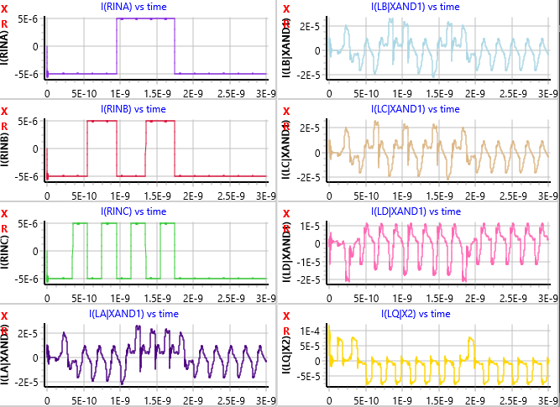
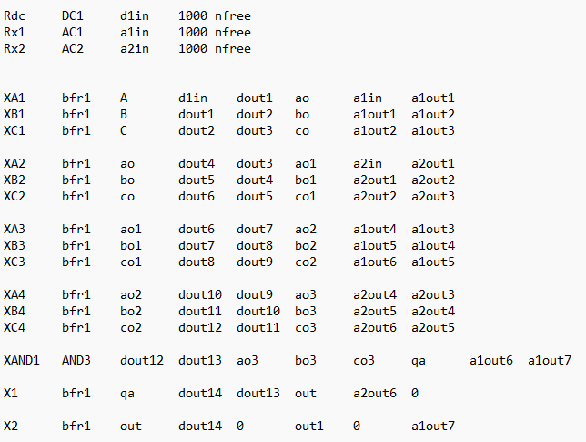
3 input AND gate working with 4 buffers preceding input

Slide 7
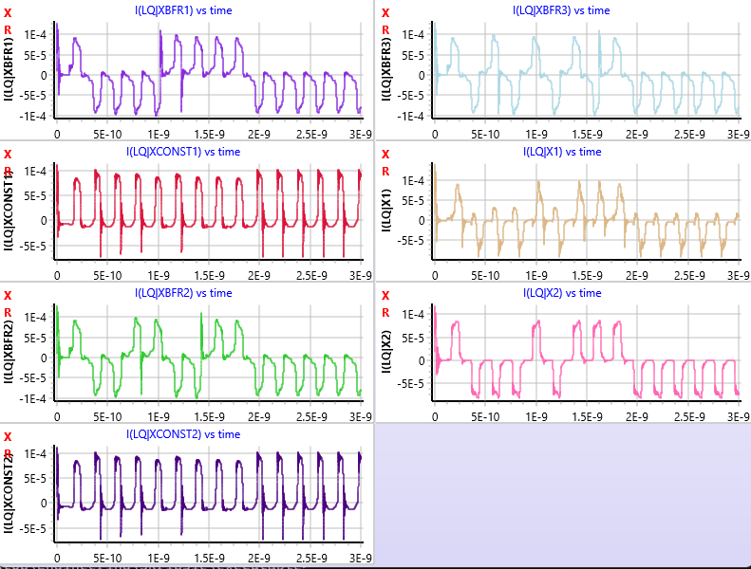
This is the output of the 3 input AND Gate when it is in series with an odd number of buffers
As seen in LQ|Xbfr1, LQ|Xbfr2 and LQ|Xbfr3
There is an impulse looking signal at 1E-9.
My assumption is this adds to the logical 1’s and the sum ends up closer to 1 than to 0.
Not sure how to rid the signal of those impulses.

Slide 8
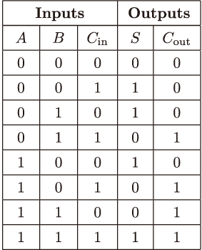
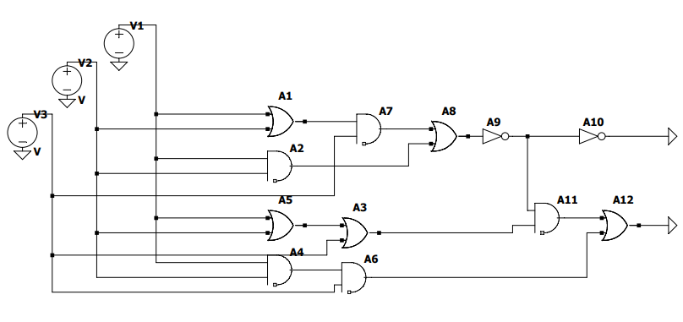
Layout of Full Adder hence no 3 input AND gate and truth table for Full Adder
I would Also like to know what software you used to draw circuit schematics in Electronics as this was made using LtSpice and it is not very pretty.

Slide 9
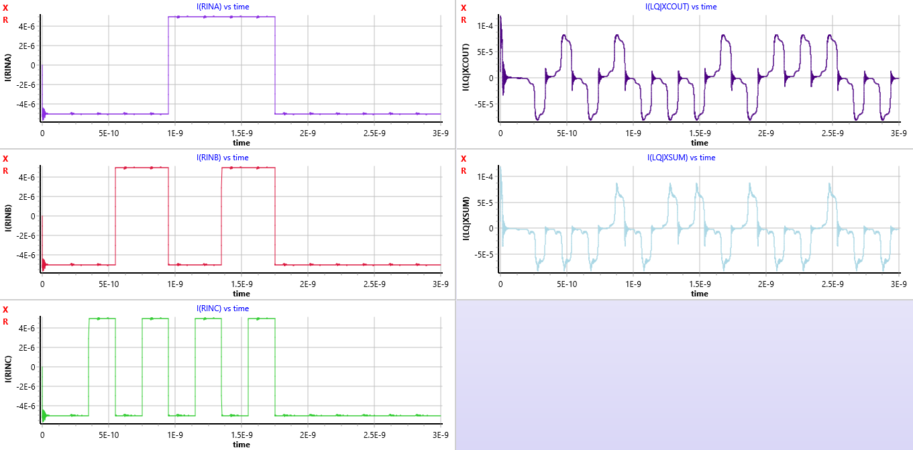
Full Adder Input vs Output

Slide 10
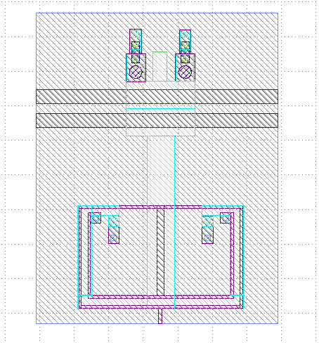
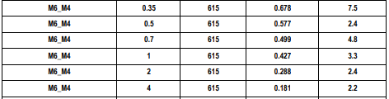
Progress with Klayout: following circuit is the basic buffer most inductances are as close to as possible according to how I understand you work out the inductance.
Problems:
The connection of the JJ’s is blurry to me.
Mutual Inductance between two inductors.
I have not tried to run any Klayout design on Absynth.
This image is taken from:
“MITLL_SCE_Fabrication_Process_SFQ5eg_Design_Guide_r1”
Explain how I calculate inductance.

Slide 11
Apart from these issues I have been working on my report

