Slide 1


Final Report
Latent Manipulation of
Brain MRI
using Volume-Preserving GANs
Group 7 | VNU UET — Institute for Artificial Intelligence
• Nguyễn Đức Minh
• Vũ Bảo Chinh
• Lường Minh Trí
• Trần Văn Dy
• Lê Hồng Anh
• Nguyễn Quang Huy

Slide 2
Table of Contents
01 Introduction & Overall Pipeline
02 Data & Preprocessing
03 GAN Model Architecture
04 Model Evaluation
05 Latent Space Analysis
06 Conclusion
VNU UET
2/20
VNU UET - Institute for Artificial Intelligence 1

Slide 3
01
Introduction & Overall Pipeline
VNU UET
3/20
VNU UET - Institute for Artificial Intelligence 1
Notes:
1.7.2013
‹#›

Slide 4
1.1
Introduction
- Brain aging causes cortical thinning and ventricular enlargement — biomarkers for Alzheimer's disease and Multiple Sclerosis.
- Acquiring longitudinal MRI (same subject, across decades) is impractical and costly.
-> Generative models offer a data-efficient surrogate: given one scan, synthesise the same brain at different ages.
There art two key challenges
P1 — High anatomical variance
P2 — Latent space interpretability
Without volume normalisation, grey-matter volumes differ >200 ml across scanners. GAN learns head size instead of ageing → blurry outputs.
Even visually plausible outputs are a black box without knowing which latent dimensions encode ageing and which brain regions they control.
VNU UET
4/20
VNU UET - Institute for Artificial Intelligence 1

Slide 5
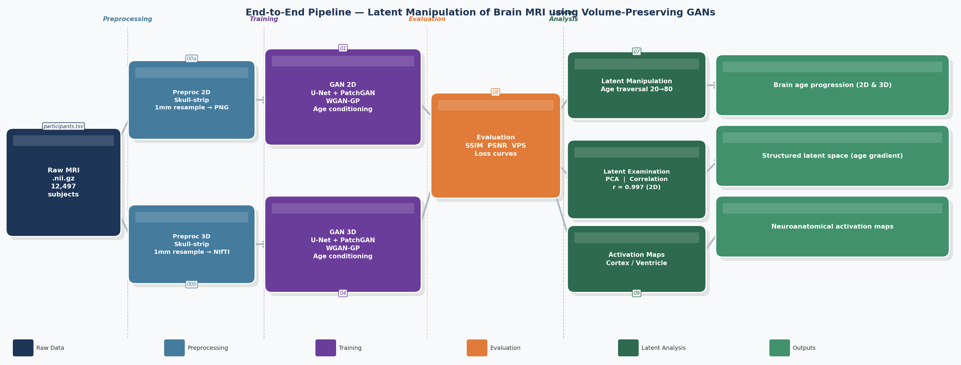
1.2
Overall Pipeline
Stage 1
Stage 2
Stage 3
1.2 Proposed Approach
Skull strip · 1mm resample · 12,497 scans
U-Net + PatchGAN + WGAN-GP · 2D & 3D
PCA · Correlation · Activation maps
VNU UET
5/20
VNU UET - Institute for Artificial Intelligence 1

Slide 6
02
Data & Preprocessing
VNU UET
6/20
VNU UET - Institute for Artificial Intelligence 1
Notes:
1.7.2013
‹#›

Slide 7
2.1
Dataset
Source
214 open-access studies — OpenNeuro, INDI, ADNI, OASIS-3, IXI, CamCAN, among others.
Format
T1-weighted MRI in NIfTI format (.nii.gz), organised following BIDS convention. One volume per subject.
Scale
12,497 subjects successfully downloaded and processed. Age range 18–97 years, median 25 years.
Demographics
Female 6,686 · Male 5,810
Limitation
Entirely cross-sectional — each subject contributes exactly one scan at one age. No longitudinal pairs.
VNU UET
7/20
VNU UET - Institute for Artificial Intelligence 1

Slide 8
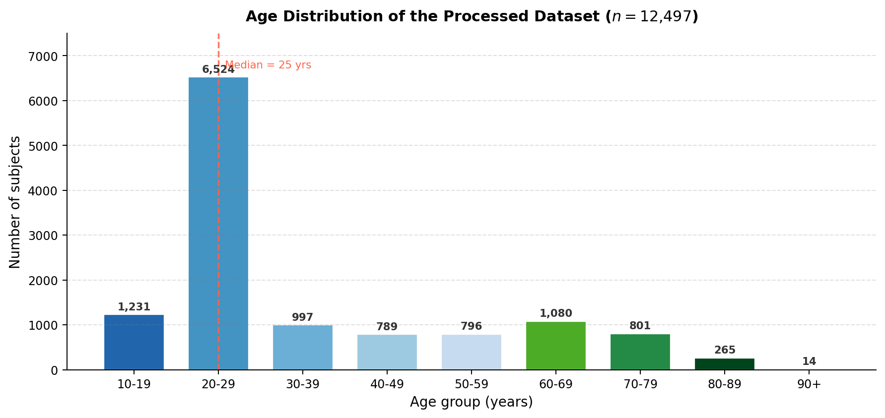
VNU UET
8/20
VNU UET - Institute for Artificial Intelligence 1

Slide 9
2.2
Preprocessing Pipeline
Raw MRI (.nii.gz)
Raw brain scans from 214 sources, varying formats and sizes
▼
Skull Stripping
Removes skull, scalp and dura — retains only brain tissue
▼
Intensity Normalisation
Rescales all scans to [0, 1] — removes scanner artefacts
▼
Voxel Size Normalisation
Resample to 1 mm isotropic — physical brain size faithfully represented
▼
▼
2D — Extract Axial Mid-Slice
3D — Retain Full Volume
Axial mid-slice → PNG 256×256 · Fast training, high spatial detail
Full volume → NIfTI 64×64×64 · Captures cross-slice spatial context
VNU UET
9/20
VNU UET - Institute for Artificial Intelligence 1

Slide 10
03
GAN Model Artitecture
VNU UET
10/20
VNU UET - Institute for Artificial Intelligence 1
Notes:
1.7.2013
‹#›

Slide 11
3.1
GAN Architecture
A GAN (Generative Adversarial Network, Goodfellow et al. 2014) trains two networks against each other: a Generator that produces fake images, and a Discriminator that tries to tell real from fake. Training stops when the Generator fools the Discriminator consistently.
A Conditional GAN is a GAN with one small addition: both networks also receive a condition as input, so the Generator learns to produce output that matches the condition rather than random samples.
=> This project uses a Conditional U-Net GAN conditioned on target age, trained with Wasserstein distance + Gradient Penalty (WGAN-GP) — a method that only changes how the loss is computed, making training more stable:
· Wasserstein loss — measures the "distance" between real and fake distributions, giving smoother gradients than binary cross-entropy
· Gradient penalty — penalises the Discriminator when its gradients grow too large, preventing training collapse
VNU UET
11/20
VNU UET - Institute for Artificial Intelligence 1

Slide 12
3.2
Model Architecture
Age Embedding
(MLP → 512-dim)
Input (Preprocessed Data)
▼
E1
▶
E2
▶
E3
▶
E4
▶
Bottleneck
64 ch
128 ch
256 ch
512 ch
512 ch
D4
D3
D2
▼
◀
◀
◀
D1
256 ch
128 ch
64 ch
1 ch
Output
(Tanh)
Both 2D and 3D models share this U-Net architecture. The only differences are:
· 2D model: Input = axial mid-slice PNG (256×256) · Conv2d · 8 encoder levels · Output = synthetic 2D slice (256×256)
· 3D model: Input = full NIfTI volume (64×64×64) · Conv3d · 4 encoder levels · Output = synthetic 3D volume (64×64×64)
VNU UET
12/20
VNU UET - Institute for Artificial Intelligence 1

Slide 13
04
Model Evaluation
VNU UET
13/20
VNU UET - Institute for Artificial Intelligence 1
Notes:
1.7.2013
‹#›

Slide 14
4.1
Model Evaluation
SSIM
Structural Similarity Index — measures how similar the generated image looks compared to the real scan. Combines brightness, contrast, and fine structure. Range 0→1, higher is better.
PSNR
Peak Signal-to-Noise Ratio — measures pixel-level reconstruction accuracy in decibels. Typical MRI values sit between 30–40 dB. Higher is better.
VPS
Volume Preservation Score — measures whether the generated brain preserves the same grey-matter volume as the input. VPS = 1.0 means perfect preservation. This is the most important metric for this project.
Model | SSIM | PSNR (dB) | VPS
2D | 0.9801 | 35.11 | 0.9984
3D | 0.9734 | 30.95 | 0.9915
Both models: SSIM > 0.97 · VPS > 0.99 — volume-preserving preprocessing translates directly into volume-stable synthesis
VNU UET
14/20
VNU UET - Institute for Artificial Intelligence 1

Slide 15
05
Latent Space Analysis
VNU UET
15/20
VNU UET - Institute for Artificial Intelligence 1
Notes:
1.7.2013
‹#›

Slide 16
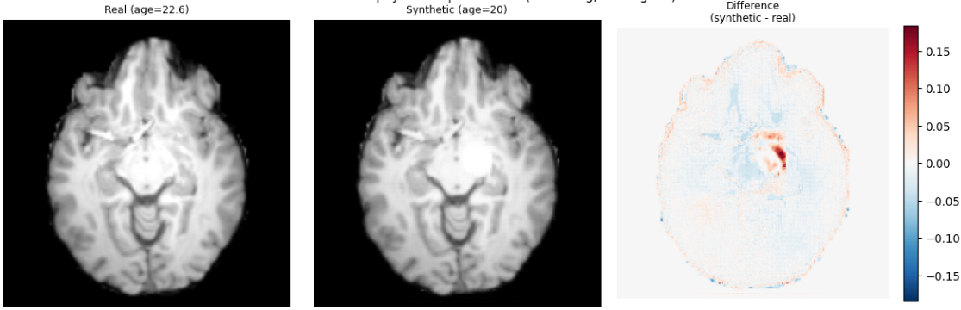
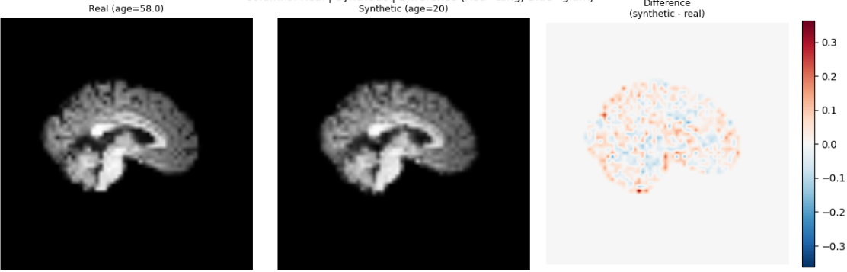
5.1
Latent Manipulation
We manipulate the latent space by conditioning the generator of the 2 models on a target age, the input anatomy is held fixed while only the age signal changes.
2D model: Real scan | Synthetic (age 20) | Difference map
3D model: Real scan | Synthetic (age 20) | Difference map
VNU UET
16/20
VNU UET - Institute for Artificial Intelligence 1

Slide 17
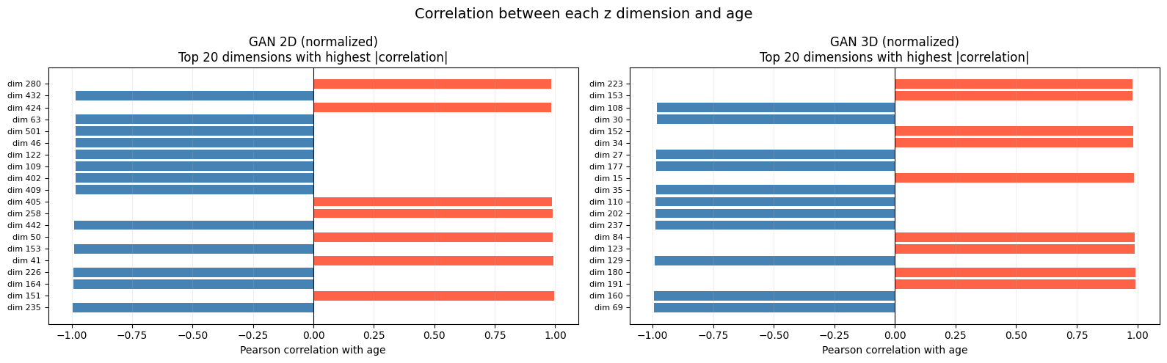
5.2
Which Latent Dimensions Encode Age
We compute the Pearson correlation between each of the 256 latent dimensions and chronological age across all test subjects. Dimensions with high |r| are the ones the model has learned to associate with ageing.
VNU UET
17/20
VNU UET - Institute for Artificial Intelligence 1

Slide 18
5.3
Per-Dimension Activation Maps
Knowing which dimensions correlate with age is only half the picture, we also need to know which brain regions they control.
Method — for each of the top-5 age-correlated dimensions:
1
Take a representative subject's latent code z.
2
Perturb only that dimension d* by +2σ, leaving all other dimensions unchanged.
3
Decode both the original and perturbed codes to obtain images x̂ and x̂⁺.
4
Compute the absolute pixel-wise difference Δ = |x̂⁺ − x̂|, smoothed with a Gaussian kernel.
VNU UET
18/20
VNU UET - Institute for Artificial Intelligence 1

Slide 19
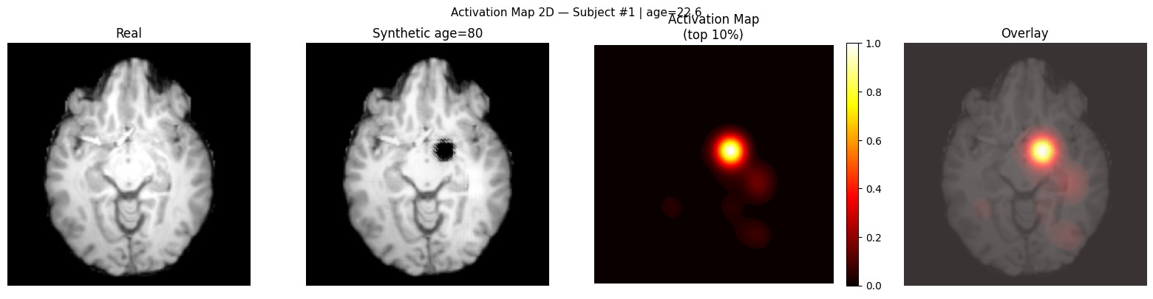
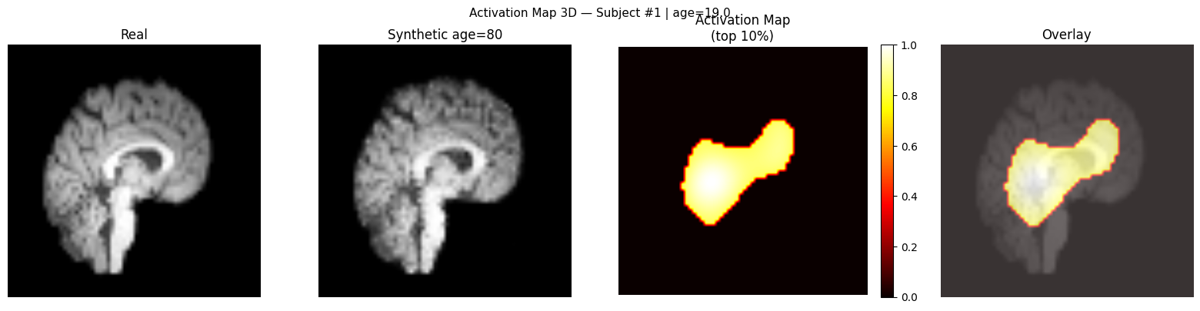
Future direction: Instead of processing the entire brain, future models could focus specifically on these identified regions, reducing computation and improving diagnostic precision for AD and MS.
Model validation: The activation maps align with real-world brain ageing, parietal cortex thinning and ventricular expansion are well-documented hallmarks of ageing (Fjell 2010, Raz 2005). The GAN learned true biology, not noise.
VNU UET
19/20
VNU UET - Institute for Artificial Intelligence 1

Slide 20
VNU UET
20/20
VNU UET - Institute for Artificial Intelligence 1

