Slide 1
CLASSROOM ISSUE TRACKER
Team members: .
Name Roll number
V. Shari Punnisa 2403A51038
R. Maneesha 2403A51040
S. Mani Chandana 2403A51043

Slide 2
OBJECTIVES:
Students and faculty can easily report classroom issues without paperwork.
All reported problems are collected in one place for easy tracking.
Everyone can view the status of reported issues, ensuring transparency.
Administrators get a dashboard to manage, assign, and update issues.
Problems reach the right staff quickly for faster resolution.
The system generates insights to help prioritize long-term fixes.
The interface is simple and accessible for all users.

Slide 3
STAKEHOLDERS:
Students report classroom issues like AC or projector problems.
Faculty report teaching-related issues and monitor classroom conditions.
Administrators manage reports, assign tasks, and track issue resolution.
Maintenance staff fix reported problems and update their status.
University management reviews reports and uses data for planning.
IT support maintains the system and ensures technical reliability.

Slide 4
PROGRAMMING LANGUAGES , TOOLS , AND SOFTWARE:
Programming Languages:
HTML
CSS
JavaScript
Tools:
Local Storage
Chatgpt
Text Editor
Software Required:
Web Browser
VS Code
No server or database installation needed

Slide 5
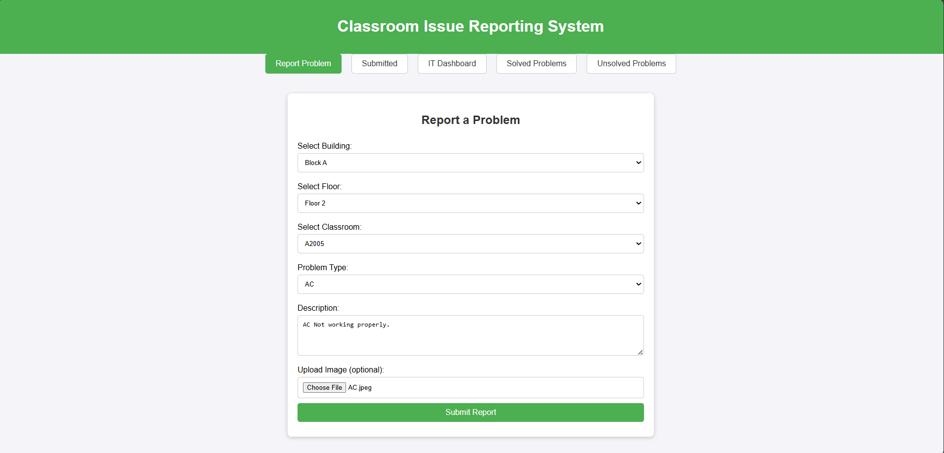
FRONT-END VIEW OF YOUR WEB/MOBILE APPLICATION:

Slide 6
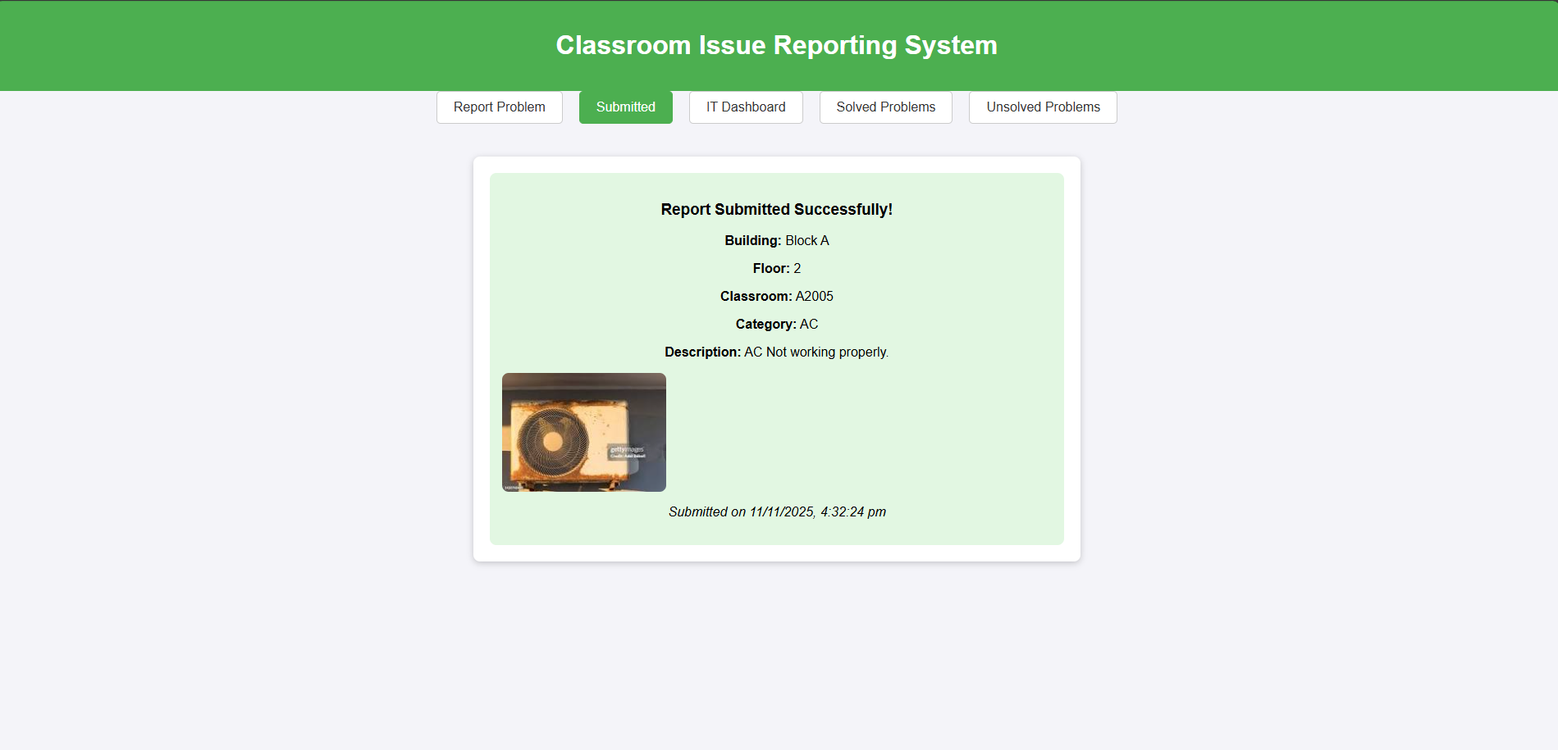
.

Slide 7
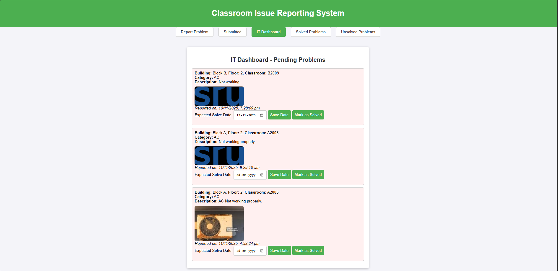
.

Slide 8
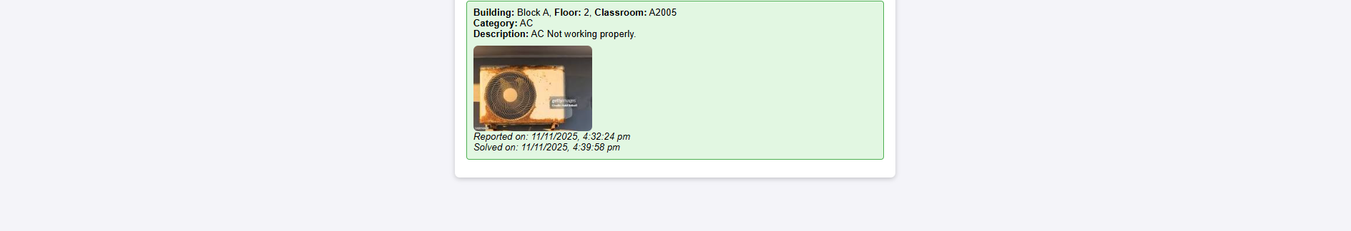
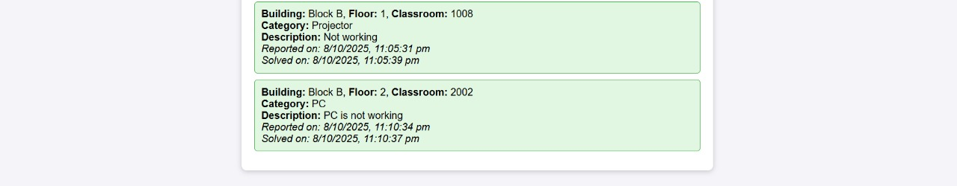

Slide 9
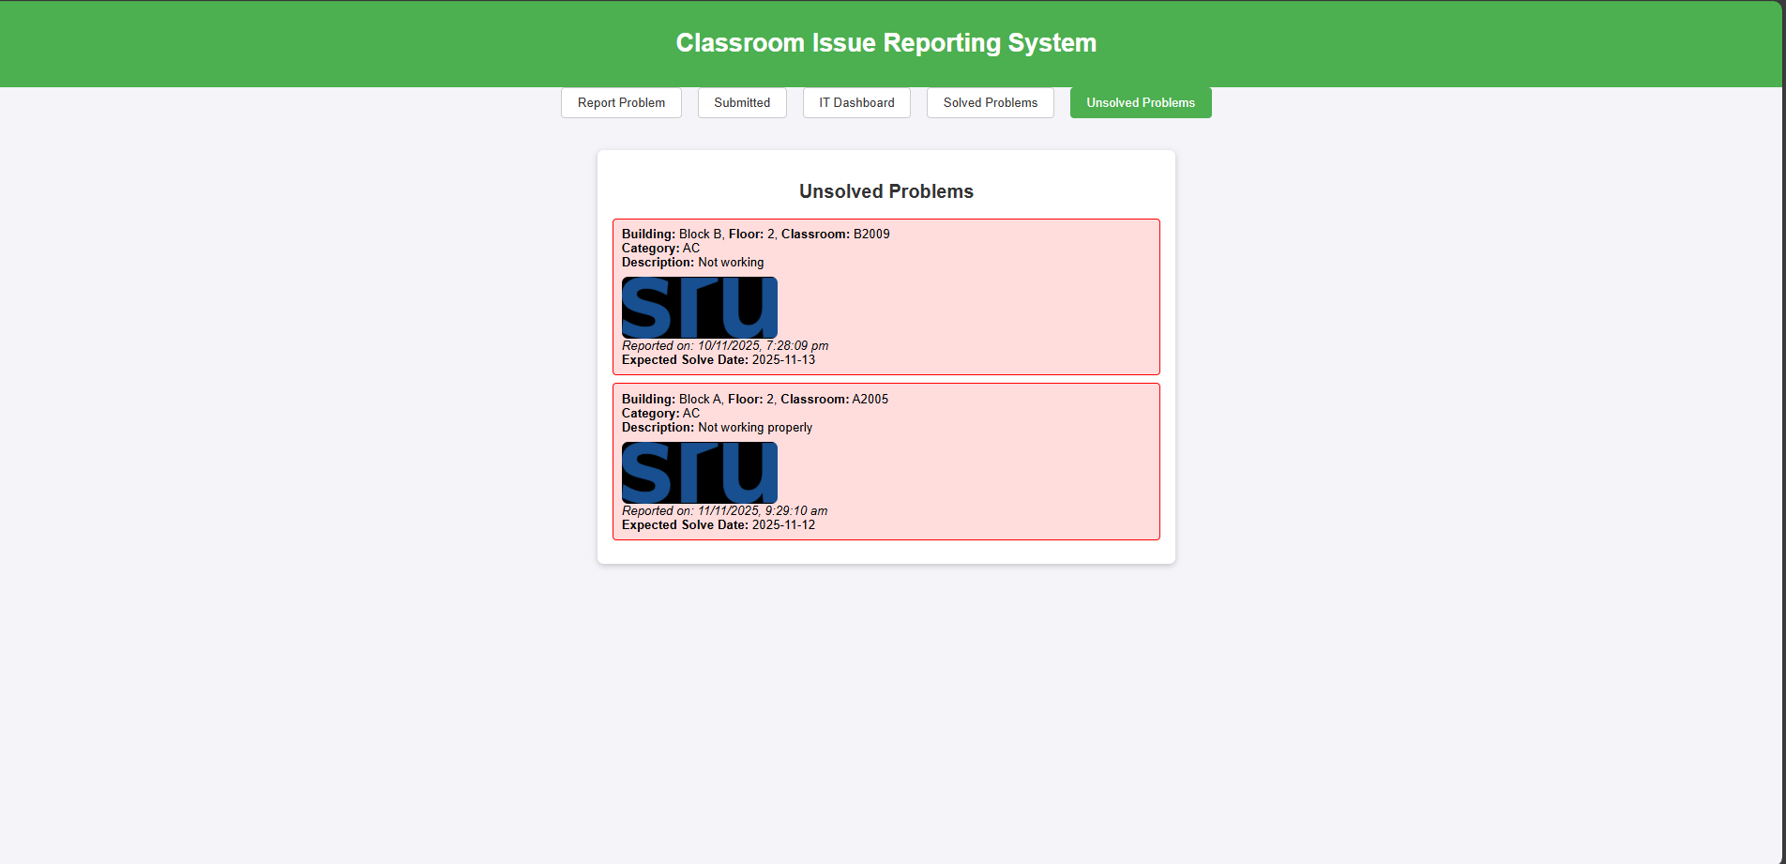
.

Slide 10
THANK YOU

