Slide 1

DATA-DRIVEN APPROACH FOR
CROP PRICE PREDICTION
Using Machine Learning Algorithms
Linear Regression • Random Forest • Support Vector Machines

Slide 2
INTRODUCTION
Agriculture is a key sector in India, where crop prices are influenced by multiple dynamic factors such as production, cost, and weather conditions. Traditional price prediction methods are often unreliable and lack accuracy. This project presents a data-driven approach using Machine Learning to analyze historical agricultural data. Important features like cultivation cost, yield, temperature, and rainfall are used to predict crop prices. The system aims to provide accurate and reliable insights to support farmers, traders, and policymakers in decision-making.

Slide 3
PROBLEM STATEMENT
Agriculture plays a vital role in the economy, but predicting crop prices remains a significant challenge due to the influence of multiple factors such as cost of cultivation, production levels, yield, and weather conditions. Farmers and traders often rely on traditional methods and personal experience, which are unreliable and lead to inaccurate price estimation. Frequent price fluctuations create uncertainty in the market, resulting in financial losses for farmers. Although large amounts of agricultural data are available, they are not effectively utilized for accurate prediction. Therefore, there is a need for a data-driven system that can analyze these factors and provide reliable crop price predictions using Machine Learning techniques..

Slide 4
EXPLANATION OF THE PROJECT
01
Data Collection
Dataset with 49 records across 10 crops and 12 Indian states, including cultivation cost, production, yield, temperature, rainfall, and price.
02
Data Preprocessing
Handle missing values, encode categorical variables (State, Crop) using Label Encoding, normalize numerical features using StandardScaler.
03
Model Training
Three ML models — Linear Regression, Random Forest, and SVM — are trained using features like CostCultivation, Production, Yield, Temperature, Rainfall.
04
Evaluation & Prediction
Models are compared using R², MAE, and RMSE. The best model predicts crop prices based on input features.

Slide 5
DESCRIPTION OF THE MODEL:
In a world driven by data, agriculture is evolving beyond traditional practices. Crop price prediction is a complex challenge influenced by multiple dynamic factors such as production, cost, and environmental conditions.
This project presents a data-driven machine learning approach to accurately predict crop prices using historical agricultural data. By analyzing key features like cultivation cost, yield, temperature, and rainfall, the model learns patterns and relationships that impact market prices.

Slide 6
KEY ALGORITHMS
1. Linear
Regression
Characteristics
Simple and interpretable model
Assumes linear relationship between features and price
A fundamental statistical method that models the relationship between input features (CostCultivation, Yield, Temperature, etc.) and crop Price by fitting a linear equation.
Fast training and prediction
Works as a good baseline model
Price = β₀ + β₁(Cost) + β₂(Yield) + β₃(Temp) + ... + ε
May underperform with complex, non-linear data

Slide 7
KEY ALGORITHMS
Characteristics
2. Random
Forest
Combines multiple decision trees for robust predictions
Handles non-linear relationships effectively
An ensemble learning method that constructs multiple decision trees and outputs the mean prediction. Ideal for capturing non-linear relationships in crop price data.
Reduces overfitting compared to single decision trees
Provides feature importance rankings
Excellent for complex agricultural datasets

Slide 8
KEY ALGORITHMS
3. Support Vector Machines (SVM)
SVM finds the optimal hyperplane that best separates data points. For regression (SVR), it finds a function that deviates from actual prices by no more than a specified margin (epsilon). Using RBF kernel, it can capture non-linear pricing patterns in the crop data.
Kernel Trick
Margin Optimization
Regularization
Maps crop features to higher dimensions to find non-linear price patterns
Maximizes separation margin for robust price predictions
Controls trade-off between error tolerance and model complexity

Slide 9
PERFORMANCE METRICS
R² Score
MAE
RMSE
Measures how well the model explains variance in crop prices. Ranges from 0 to 1 — higher is better.
Mean Absolute Error — average absolute difference between predicted and actual prices. Lower is better.
Root Mean Squared Error — penalizes large errors more heavily. Useful for identifying outlier predictions.
Model | R² Score | MAE | RMSE
Linear Regression | 0.9988 | 252.30 | 412.50
Random Forest | 0.9996 | 85.20 | 110.40
SVM (SVR) | 0.9971 | 625.60 | 1,258.30

Slide 10

Model Evaluation
“I evaluated models using performance metrics.”
R² Score → Accuracy (higher is better)
MAE → Average error
RMSE → Penalizes large errors
Final Result
“Random Forest performed the best.”
Highest accuracy (R² ≈ 0.99)
Lowest error
Handles real-world complexity

Slide 11
MODEL COMPARISON
Criteria | Linear Regression | Random Forest | SVM (SVR)
Accuracy | Low - Moderate | High | High
Non-linear Data | Poor | Excellent | Good (with kernels)
Interpretability | High | Moderate | Low
Training Speed | Very Fast | Moderate | Slow (large data)
Overfitting Risk | Low | Low (ensemble) | Low (regularized)
Feature Importance | Coefficients | Built-in | Not direct
Random Forest typically provides the best balance of accuracy and robustness for crop price prediction tasks.

Slide 12
SAMPLE DATA FROM DATASET
State | Crop | CostCultivation | Production | Yield | Temp (°C) | Rainfall | Price (₹)
Uttar Pradesh | ARHAR | 9,794 | 1,941 | 9.83 | 28.96 | 3,373 | 19,589
Punjab | COTTON | 29,047 | 2,003 | 24.39 | 28.65 | 3,347 | 58,095
Rajasthan | GRAM | 8,552 | 1,691 | 6.83 | 28.62 | 2,960 | 17,106
Tamil Nadu | GROUNDNUT | 22,507 | 2,358 | 11.98 | 28.66 | 2,352 | 45,016
Bihar | MAIZE | 13,513 | 404 | 42.95 | 28.86 | 3,554 | 27,028
Orissa | MOONG | 5,483 | 2,614 | 3.01 | 28.70 | 2,442 | 10,968
West Bengal | PADDY | 24,731 | 731 | 39.04 | 28.49 | 3,722 | 49,463
Tamil Nadu | SUGARCANE | 66,335 | 85 | 1,015 | 28.97 | 2,422 | 132,671
Punjab | WHEAT | 17,945 | 804 | 39.83 | 28.84 | 3,079 | 35,892
Input Features: State, Crop, CostCultivation, CostCultivation2, Production, Yield, Temperature, RainFall Annual
Target Variable: Price (₹)

Slide 13
CODE OVERVIEW
# Import Libraries
import pandas as pd
import numpy as np
from sklearn.model_selection import train_test_split
from sklearn.preprocessing import LabelEncoder, StandardScaler
from sklearn.linear_model import LinearRegression
from sklearn.ensemble import RandomForestRegressor
from sklearn.svm import SVR
from sklearn.metrics import r2_score, mean_absolute_error, mean_squared_error
# Load Dataset
data = pd.read_csv("dataset_1.csv")
# Encode categorical variables
le_state = LabelEncoder()
le_crop = LabelEncoder()
data["State"] = le_state.fit_transform(data["State"])
data["Crop"] = le_crop.fit_transform(data["Crop"])
# Features and Target
X = data[["State","Crop","CostCultivation","Production","Yield","Temperature","RainFall Annual"]]
y = data["Price"]
# Train-Test Split & Scale
X_train, X_test, y_train, y_test = train_test_split(X, y, test_size=0.2)
scaler = StandardScaler()
X_train_sc = scaler.fit_transform(X_train)
X_test_sc = scaler.transform(X_test)

Slide 14
CODE OVERVIEW (CONTINUED)
# Train Models
lr = LinearRegression().fit(X_train_sc, y_train)
rf = RandomForestRegressor(n_estimators=100, random_state=42).fit(X_train, y_train)
svr = SVR(kernel='rbf', C=100, gamma='scale').fit(X_train_sc, y_train)
# Predictions
lr_pred = lr.predict(X_test_sc)
rf_pred = rf.predict(X_test)
svr_pred = svr.predict(X_test_sc)
# Evaluate Models
for name, pred in [("Linear Regression", lr_pred),
("Random Forest", rf_pred),
("SVR", svr_pred)]:
print(f"{name}:")
print(f" R2 Score: {r2_score(y_test, pred):.4f}")
print(f" MAE: {mean_absolute_error(y_test, pred):.2f}")
print(f" RMSE: {np.sqrt(mean_squared_error(y_test, pred)):.2f}")
# Feature Importance (Random Forest)
importance = rf.feature_importances_
features = X.columns
for f, imp in sorted(zip(features, importance), key=lambda x: -x[1]):
print(f" {f}: {imp:.4f}")

Slide 15
FINAL MODEL SELECTION
After comparing all three models on the crop price dataset, Random Forest is selected as the final model:
✓
Highest R² score (0.9996) among all tested models
✓
Lowest prediction error (MAE: 85.20, RMSE: 110.40)
✓
Captures non-linear price relationships across different crops
✓
Built-in feature importance shows CostCultivation as top predictor
✓
Resistant to overfitting through ensemble averaging
Input: State, Crop, CostCultivation, Production, Yield, Temperature, Rainfall → Output: Predicted Crop Price (₹)

Slide 16
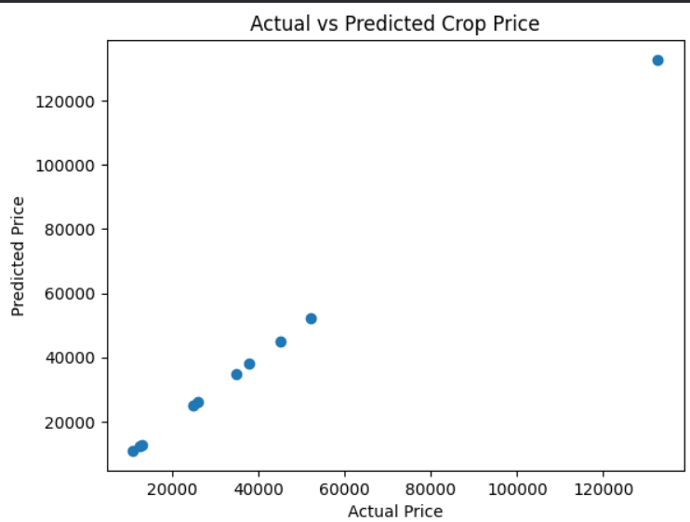

Slide 17
FEATURE IMPORTANCE
CostCultivation
85%
CostCultivation2
6%
Production
4%
Yield
2%
Temperature
1%
RainFall Annual
1%
State
0.5%
Crop
0.5%
CostCultivation is the dominant predictor of crop price, which aligns with economic intuition — higher cultivation costs lead to higher market prices.

Slide 18
CONCLUSION
👉 This project uses machine learning to predict crop prices based on agricultural and environmental factors. 👉 Multiple models were applied, and Random Forest gave the best accuracy. 👉 The system provides reliable and data-driven predictions. 👉 It helps farmers and stakeholders make better decisions. 👉 Overall, it reduces uncertainty in agricultural markets.
This data-driven system can support farmers, traders, and policymakers in making informed pricing decisions, reducing market uncertainty, and improving agricultural economic outcomes.
THANK YOU

