Slide 1
College Placement
Prediction System
A Machine Learning Approach to Campus Recruitment Analytics
Machine Learning Project

Slide 2
Abstract
The College Placement Prediction System leverages machine learning algorithms to predict whether a student will be placed during campus recruitment drives.
The system analyzes multiple academic and demographic features including SSC percentage, HSC percentage, degree scores, MBA scores, work experience, and specialization to build predictive models.
Five classification algorithms — Logistic Regression, Random Forest, SVM, KNN, and Gradient Boosting — are trained and compared. The Gradient Boosting classifier achieved the highest accuracy of 92%, demonstrating the system's effectiveness in predicting placement outcomes.

Slide 3
Problem Statement
Uncertainty in Placement
1
Students lack clarity on their placement readiness based on academic performance
No Data-Driven Insights
2
Institutions rely on intuition rather than analytics for placement preparation
Resource Allocation
3
Training resources are not targeted to students who need them most
Gap Identification
4
Difficult to identify which skills/scores most impact placement outcomes

Slide 4
Tools & Technologies Used
Python 3.x
Matplotlib & Seaborn
Core programming language
Data visualization & charts
Pandas & NumPy
Jupyter Notebook
Data manipulation & numerical computing
Interactive development environment
Scikit-Learn
Machine learning algorithms & metrics

Slide 5
Detailed Tools: Python & Pandas
Python 3.x
Pandas & NumPy
General-purpose, high-level programming language
Extensive ML/AI library ecosystem
Easy syntax for rapid prototyping
Strong community & documentation
Cross-platform compatibility
DataFrame-based data manipulation
Handling missing values & encoding
Statistical analysis & aggregation
NumPy for numerical operations
CSV/Excel file I/O support

Slide 6
Detailed Tools: Scikit-Learn & Visualization
Scikit-Learn
Matplotlib & Seaborn
Classification: LR, RF, SVM, KNN, GB
Preprocessing: LabelEncoder, StandardScaler
Model evaluation: accuracy, AUC, F1
Train/test split with stratification
Cross-validation & hyperparameter tuning
Publication-quality static plots
Confusion matrix heatmaps
ROC curves & bar charts
Seaborn statistical visualizations
Customizable themes & color palettes

Slide 7
Dataset Description
Feature | Description | Type
gender | Male / Female | Categorical
ssc_p | Secondary Education percentage | Numerical
hsc_p | Higher Secondary percentage | Numerical
hsc_s | HSC Stream (Commerce/Science/Arts) | Categorical
degree_p | Degree percentage | Numerical
degree_t | Degree Type | Categorical
workex | Work Experience (Yes/No) | Categorical
etest_p | Employability Test percentage | Numerical
specialisation | MBA Specialisation | Categorical
mba_p | MBA percentage | Numerical
status | Placed / Not Placed (Target) | Categorical
500 student records | 12 features | Binary classification

Slide 8
Methodology Flowchart
1
2
3
4
5
Data Collection
Data Preprocessing
Model Training
Evaluation
Prediction
▶
▶
▶
▶
Gather student records
(500 samples, 12 features)
Encoding, scaling,
train-test split (80:20)
Train 5 ML classifiers
(LR, RF, SVM, KNN, GB)
Accuracy, AUC-ROC,
Confusion Matrix, F1
Predict placement
status for new students

Slide 9
Results: Model Accuracy Comparison
Model | Accuracy | AUC-ROC | F1 (Placed)
Logistic Regression | 86.00% | 0.828 | 0.92
Random Forest | 91.00% | 0.875 | 0.95
SVM | 89.00% | 0.724 | 0.94
KNN | 89.00% | 0.715 | 0.94
Gradient Boosting | 92.00% | 0.910 | 0.96
🏆 Best Model: Gradient Boosting
Accuracy: 92% | AUC-ROC: 0.910

Slide 10
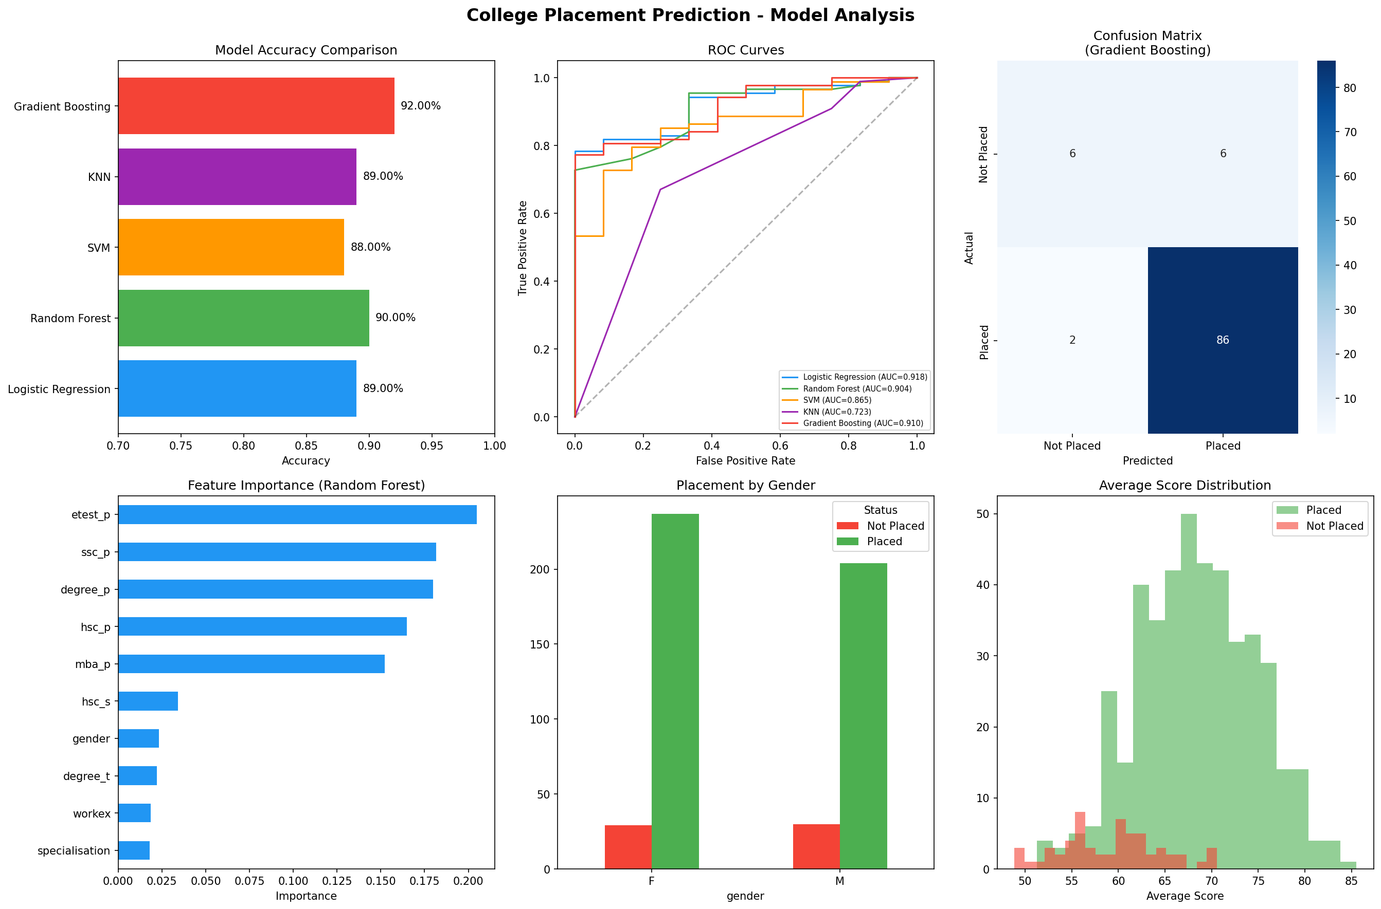
Results: Analysis Charts

Slide 11
Key Findings
92%
0.91
Highest Accuracy
Best AUC-ROC
Gradient Boosting classifier outperforms all other models
Strong discrimination between placed and not-placed students
MBA %
Work Exp
Top Feature
Key Factor
MBA percentage is the most influential predictor of placement
Students with work experience show significantly higher placement rates

Slide 12
Future Scope
Deep Learning Integration
Implement neural networks (ANN/DNN) for improved accuracy on larger datasets
Real-Time Web Application
Deploy as a Flask/Django web app with interactive student input forms
Salary Prediction
Extend the model to predict expected salary package for placed students
Recommendation System
Suggest skill improvements and courses to increase placement probability
Multi-Institution Support
Scale across multiple colleges with federated learning approaches

Slide 13
Thank You!
Questions & Discussion

