Slide 1
MACHINE LEARNING TITLE:Heart Disease Prediction using Machine Learning Name: siri rollno:2403a51228

Slide 2
Abstract Heart disease is one of the leading causes of death in the world. Early detection can help doctors provide better treatment and reduce the risk of serious health problems. This project focuses on predicting whether a person has heart disease or not using machine learning techniques. The system analyzes medical data such as age, blood pressure, cholesterol level, and other health parameters. Different machine learning algorithms like Logistic Regression, Decision Tree, and Random Forest are used to build prediction models. The models are trained using a dataset and their performance is evaluated using metrics like accuracy, precision, recall, and F1-score. The results show that machine learning can help in early diagnosis and improve healthcare decision-making.

Slide 3
Heart disease is one of the leading causes of death worldwide and affects millions of people every year. It includes various conditions such as coronary artery disease, heart attack, and other cardiovascular problems that affect the normal functioning of the heart. Factors like high blood pressure, high cholesterol, unhealthy lifestyle, smoking, and lack of physical activity increase the risk of heart disease. Early detection of heart disease is very important to reduce serious health complications and improve patient survival. Traditionally, doctors diagnose heart disease using different medical tests and patient reports. However, this process may take time and depends on the experience of medical experts. With the advancement of technology, Machine Learning has become an important tool in the healthcare field. Machine Learning allows computers to analyze medical data, learn patterns, and make predictions. By using patient health information such as age, blood pressure, cholesterol level, and heart rate, machine learning models can help predict whether a person has heart disease . In this project, machine learning algorithms such as Logistic Regression, Decision Tree, and Random Forest are used to build prediction models. These models are trained using a heart disease dataset and evaluated using performance metrics like accuracy and precision. The main aim of this project is to develop a system that can assist doctors in predicting heart disease quickly and accurately, helping in early diagnosis and better healthcare decisions.

Slide 4
Problem Statement Heart disease diagnosis usually requires multiple medical tests and the expertise of specialized doctors. These tests include blood tests, ECG, stress tests, and other medical examinations. In many regions, especially rural or underdeveloped areas, proper medical facilities and experienced cardiologists may not always be available. Because of this, early detection of heart disease becomes difficult, and patients may not timely treatment. Another challenge is that doctors must analyze many different health parameters such as age, cholesterol level, blood pressure, chest pain type, and heart rate to determine whether a patient has heart disease. Manually analyzing all these factors can be time-consuming and may sometimes lead to errors or delayed diagnosis. Therefore, there is a need for an intelligent system that can assist medical professionals in predicting heart disease quickly and accurately. The problem addressed in this project is to develop a machine learning model that can predict the presence of heart

Slide 5
Objectives The main objectives of this project are: To analyze heart disease datasets containing patient health information. To preprocess and clean the dataset for machine learning models. To implement machine learning algorithms such as Logistic Regression, Decision Tree, and Random Forest for heart disease prediction. To train and test the machine learning models using the dataset. To evaluate and compare the performance of different algorithms using metrics like accuracy, precision, recall, and F1-score. To assist doctors in early detection and diagnosis of heart disease using predictive analysis.

Slide 6
Algorithms Used In this project, three machine learning algorithms are used: 1. Logistic Regression Logistic Regression is used for binary classification problems. It predicts whether the output is 0 or 1, meaning No Heart Disease or Heart Disease. 2. Decision Tree Decision Tree works like a flowchart where decisions are made based on different conditions of the data. 3. Random Forest Random Forest is an ensemble learning method that combines multiple decision trees to improve prediction accuracy.

Slide 7
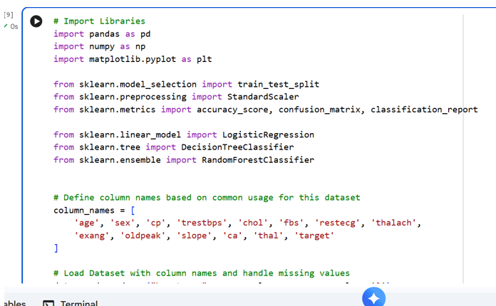
Implementation Implementation (Dataset + Models) code

Slide 8
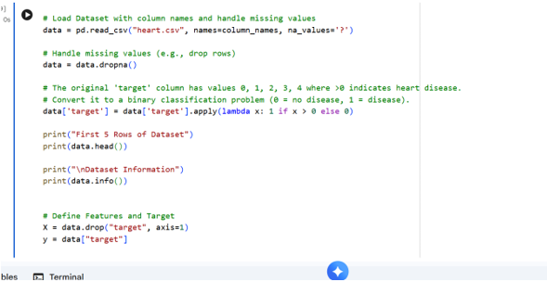
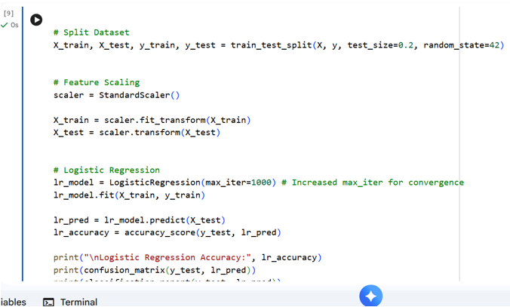

Slide 9
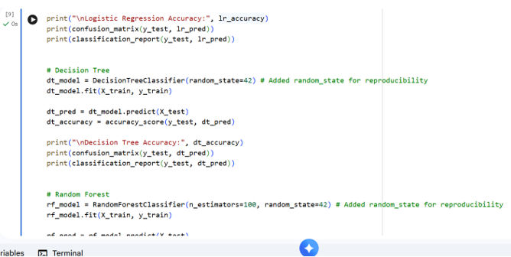
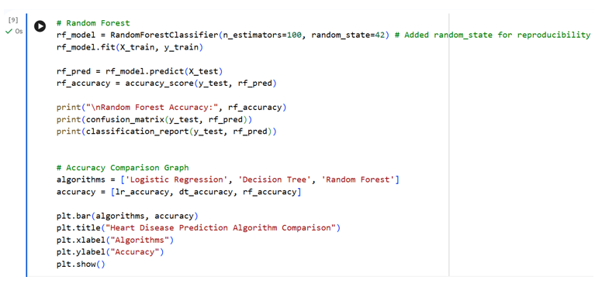

Slide 10
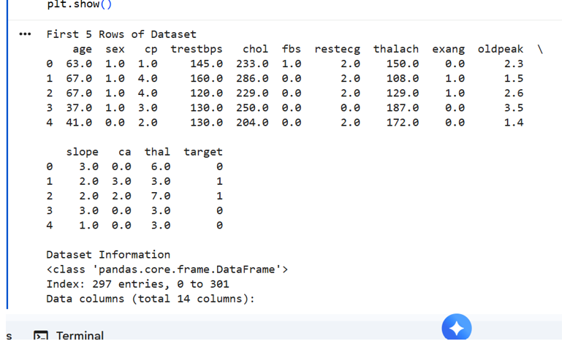
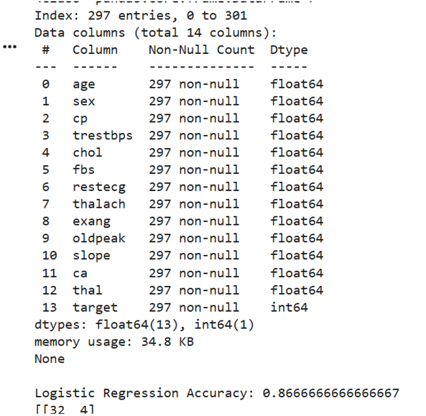
OUTPUT:

Slide 11
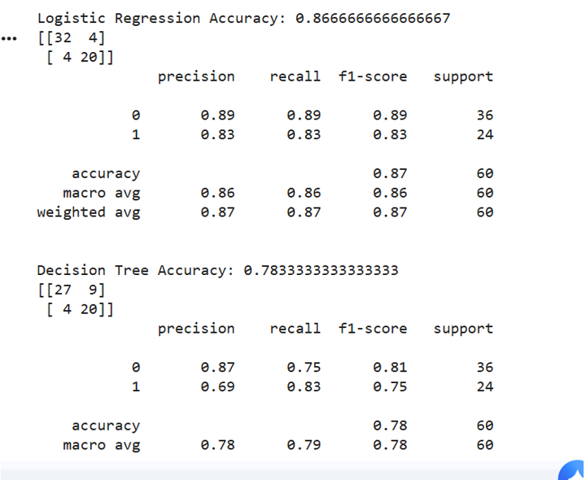
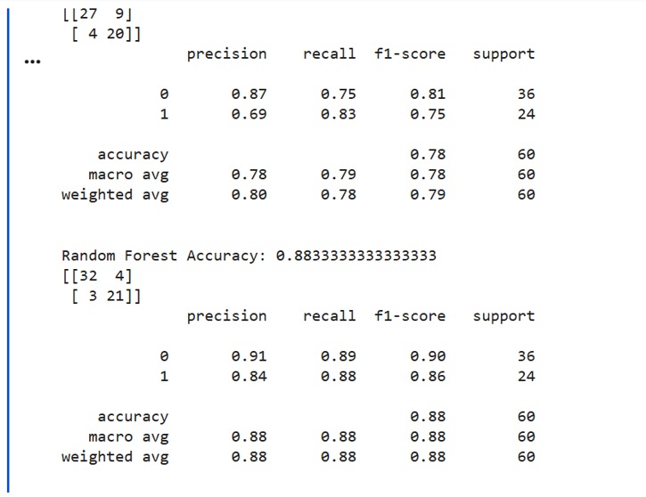

Slide 12
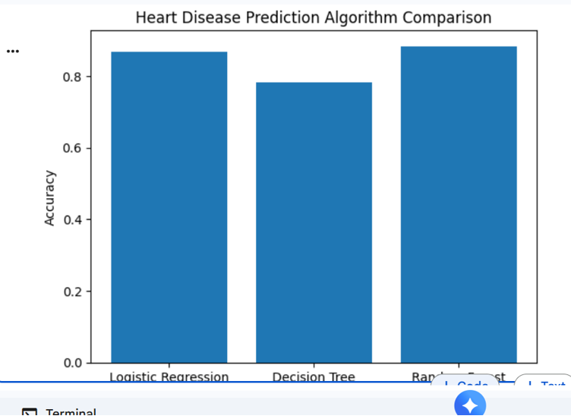
GRAPH

Slide 13
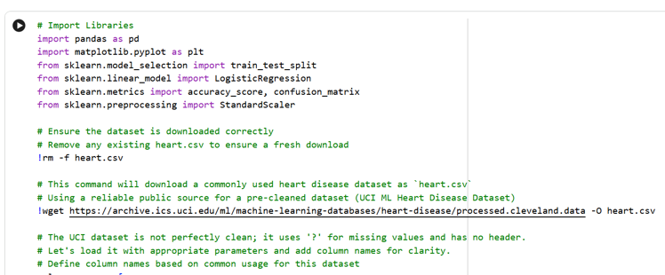
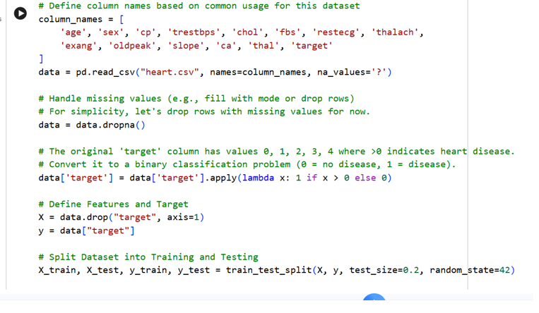
1ST Algorithm : Logistic Regression: Code

Slide 14
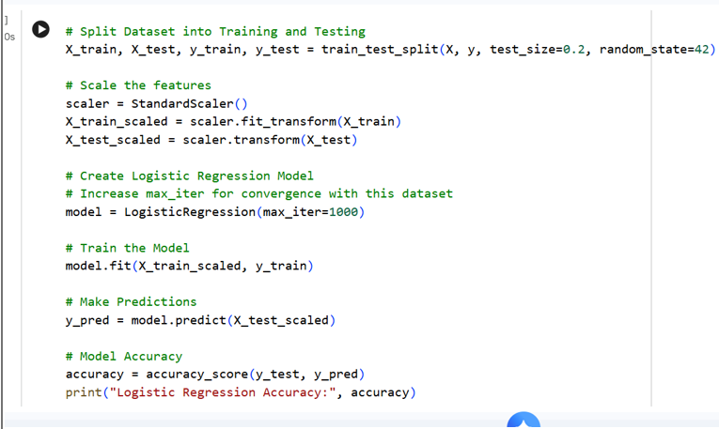
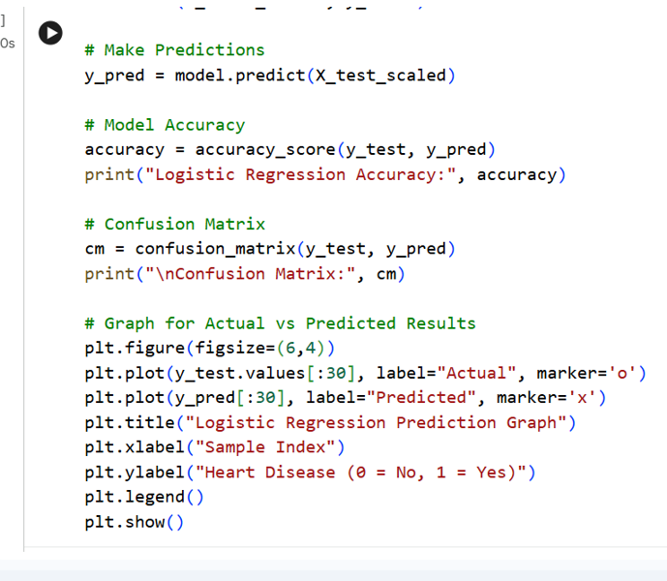

Slide 15
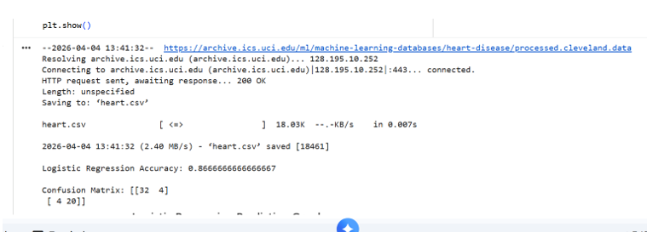
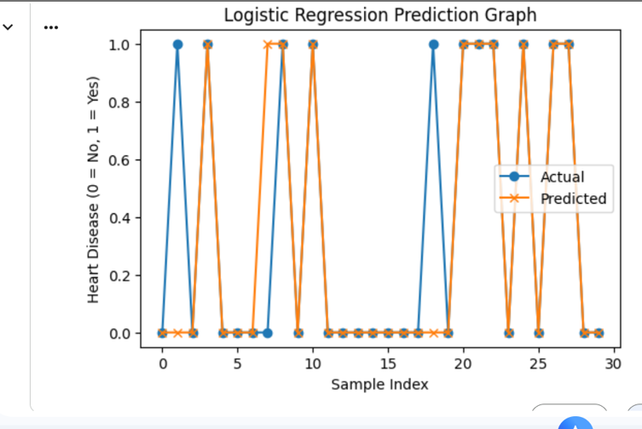
OUTPUT GRAPH

Slide 16
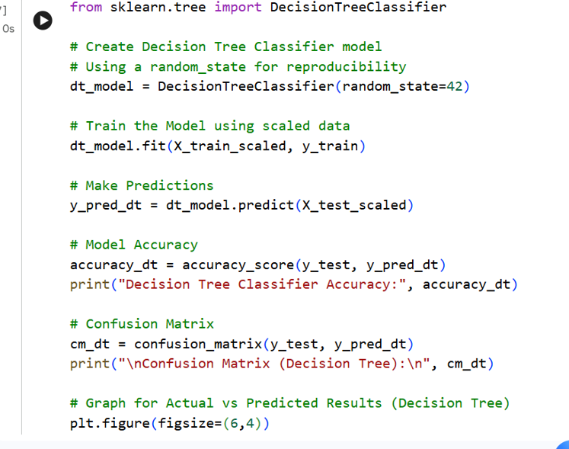
2nd Algorithm:Decision Tree: Code

Slide 17
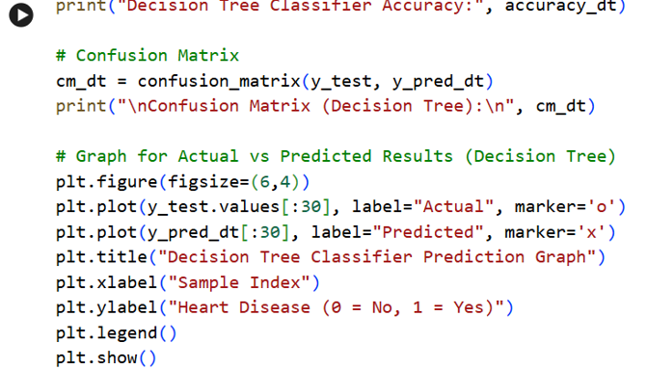
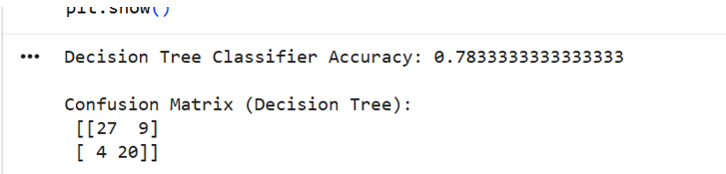
OUTPUT

Slide 18
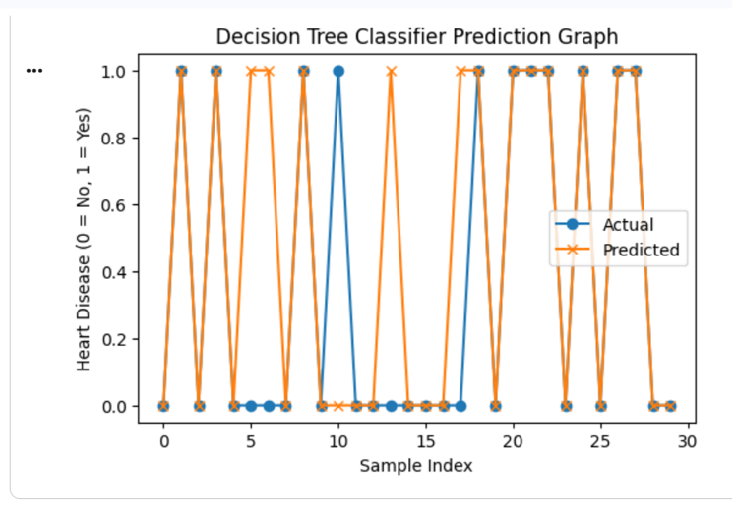
GRAPH

Slide 19
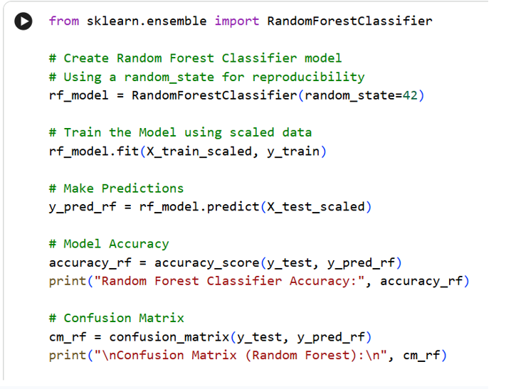
3rd Algorithm: Random Forest: Code:

Slide 20
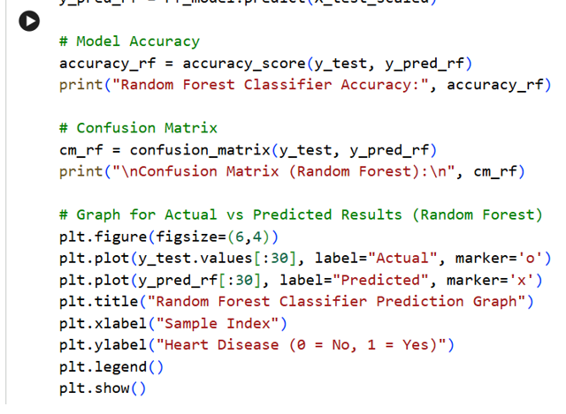
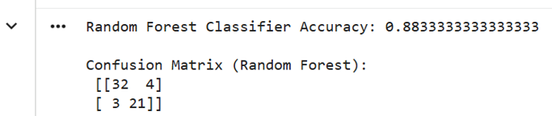
output

Slide 21
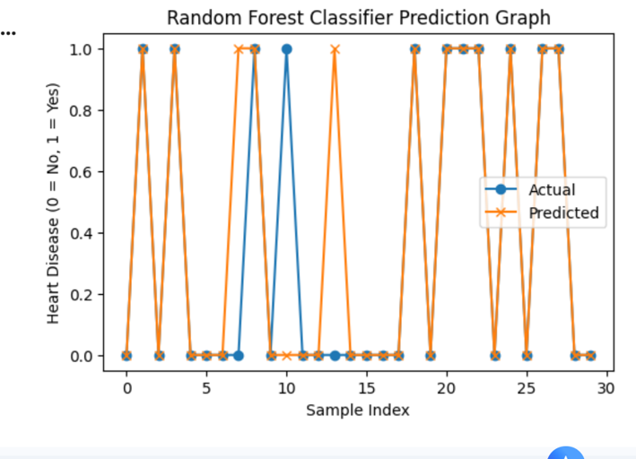
GRAPH:

Slide 22
Conclusion The Heart Disease Prediction using Machine Learning project demonstrates how machine learning techniques can be used to predict the presence of heart disease using patient medical data. In this project, different machine learning algorithms such as Logistic Regression, Decision Tree, and Random Forest were implemented and tested using a heart disease dataset. The dataset was first preprocessed and divided into training and testing data. The models were then trained using the training dataset and evaluated using performance metrics such as accuracy, confusion matrix, precision, recall, and F1-score. After comparing the results, it was observed that some algorithms perform better than others in predicting heart disease. Machine learning models are useful because they can analyze large amounts of medical data quickly and identify patterns that may not be easily detected by humans. This helps in making faster and more accurate predictions about whether a patient is likely to have heart disease.

