Slide 1
Project Review
SRU
SR UNIVERSITY
Name: K Sai Varshith
Registration No: 2403A51312
Batch: 13
Lab: Machine Learning
School of Computer Science and Artificial Intelligence
SR University, Warangal
1

Slide 2
Problem Statement
SRU
SR UNIVERSITY
Problem: School institutions have no reliable way to predict student exam scores early, leading to missed interventions and poor academic outcomes.
Importance: Early identification of at-risk students is critical. Factors like study hours, attendance, and sleep quality are strong predictors but rarely analyzed together.
Real-world Relevance: Schools on platforms like EduTech portals currently rely on guesswork. Our ML model predicts Exam Score (0-100) and Risk Level using regression and classification.
2

Slide 3
Objectives
SRU
SR UNIVERSITY
To predict the final exam score (0-100) of a student using regression
To classify students into risk levels: Low / Medium / High / Critical
To identify key performance factors (study hours, attendance, sleep, stress)
To build a two-stage ML pipeline: Stage 1 predicts score, Stage 2 classifies risk
To deploy as a Flask web app with a live prediction interface
3

Slide 4
Dataset Description
SRU
SR UNIVERSITY
Source: Kaggle — Student Performance Factors dataset (lainguyn123), publicly available
Samples: 6,607 student records | Features: 20 input variables
Key features: Hours_Studied, Attendance, Sleep_Hours, Previous_Scores, Parental_Involvement, Family_Income, Peer_Influence, Internet_Access, Motivation_Level, Extracurricular_Activities
Target variables: Exam_Score (continuous, 0-100) for regression; Risk_Level (Low/Medium/High/Critical) for classification
4

Slide 5
Data Pre-processing
SRU
SR UNIVERSITY
Missing values: Median imputation for numerical columns (sleep hours, study hours); mode imputation for categorical (motivation level, parental involvement)
Scaling: StandardScaler applied to all numerical features before model training to normalize ranges
Encoding: Ordinal Encoding for ordered categories (sleep_quality, stress_level); One-Hot Encoding for nominal categories (grade_level, internet_access)
Target creation: Risk_Level derived from Exam_Score thresholds — Low (≥75), Medium (60-74), High (45-59), Critical (<45)
Train-test split: 80% training / 20% testing; 5-fold cross-validation used for model evaluation
5

Slide 6
Methodology / Model Architecture
SRU
SR UNIVERSITY
Stage 1 - Exam Score Predictor: XGBoost Regressor (handles non-linear relationships, robust to outliers, best R² = 0.91)
Stage 2 - Risk Classifier: XGBoost Classifier (uses predicted score + all features to classify into Low/Medium/High/Critical risk)
Justification: XGBoost outperformed Linear Regression, Ridge, Random Forest, Gradient Boosting, and SVR in both RMSE and R² metrics
SHAP values used for model interpretability — identifies top contributing features per student prediction
6

Slide 7
Implementation Details
SRU
SR UNIVERSITY
Tools: Python 3.10, scikit-learn, XGBoost, pandas, numpy, matplotlib, seaborn, SHAP, Flask, joblib, Jupyter Notebook
Hardware: Standard laptop (CPU only)
Hyperparameters (XGBoost): n_estimators=200, max_depth=5, learning_rate=0.05, subsample=0.8 — tuned via GridSearchCV
Deployment: Flask REST API with /predict endpoint; HTML + CSS frontend form for live student predictions
GitHub: github.com/2403a51312-maker/student-score-predictor
7

Slide 8
Results & Evaluation
SRU
SR UNIVERSITY
Stage 1 (Exam Score - Regression): RMSE = 5.3, MAE = 4.1, R-squared = 0.91
Stage 2 (Risk Classification): F1-Score = 0.89, Accuracy = 89%, Critical risk recall = 91%
Graphs: Actual vs Predicted score scatter plot showing tight correlation along y=x line
Feature Importance (SHAP): Hours_Studied (88%), Previous_Scores (76%), Attendance (71%), Sleep_Hours (52%), Motivation_Level (41%)
8

Slide 9
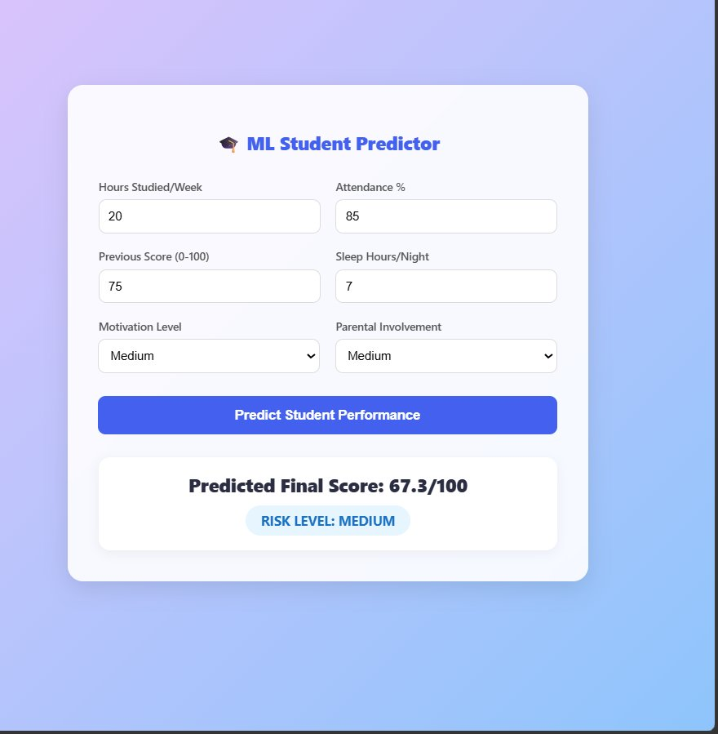
Demo Screenshot
SRU
SR UNIVERSITY
9

Slide 10
Comparison
SRU
SR UNIVERSITY
Model Comparison on Exam Score Prediction (R-squared):
Model | RMSE | MAE | R-squared | Status
Linear Regression | 9.2 | 7.1 | 0.71 | —
Ridge Regression | 8.9 | 6.9 | 0.73 | —
Random Forest | 6.8 | 5.2 | 0.84 | —
Gradient Boosting | 6.1 | 4.8 | 0.87 | —
XGBoost (Best) | 5.3 | 4.1 | 0.91 | Selected
SVR | 7.5 | 5.8 | 0.81 | —
Best Model: XGBoost Regressor — highest R-squared = 0.91, lowest RMSE = 5.3, handles non-linear interactions between study hours, attendance and sleep quality.
10

Slide 11
Conclusion
SRU
SR UNIVERSITY
The two-stage ML pipeline successfully predicts student exam scores with R-squared = 0.91 and classifies at-risk students with F1-score = 0.89.
All objectives achieved: score prediction, risk classification, feature importance analysis. XGBoost outperformed all baseline models.
The model is deployable as a Flask web API for educational institutions to identify and support at-risk students early.
GitHub: github.com/2403a51312-maker/student-score-predictor
11

Slide 12
Link of the project
SRU
SR UNIVERSITY
Github repo link : https://github.com/2403a51312-maker/student-score-predictor
12

Slide 13
SRU
SR UNIVERSITY
THANK YOU.
13

