Slide 1
Fake News Analyzer
Team Members:
1. 2403A52227 - G. Naveen
2. 2403A52232 - K. Rathan Dattu
3. 2403A52253 - B. Eshwar

Slide 2
Problem Statement
With the rapid spread of information through social media and digital platforms,
distinguishing between real and fake news has become increasingly difficult.
Fake news can mislead people, influence public opinion, and impact elections and public safety.
Objective:
To build an NLP model to classify news as real or fake.

Slide 3
Stakeholders
• General Public
• Social Media Platforms
• News Agencies
• Government & Policy Makers
• Researchers

Slide 4
Dataset & Model
Dataset: Fake and Real News Dataset (Kaggle)
Model: TF-IDF + Logistic Regression

Slide 5
Results
• Accuracy: ~90-95%
• Good precision & recall
• Detects fake patterns effectively

Slide 6
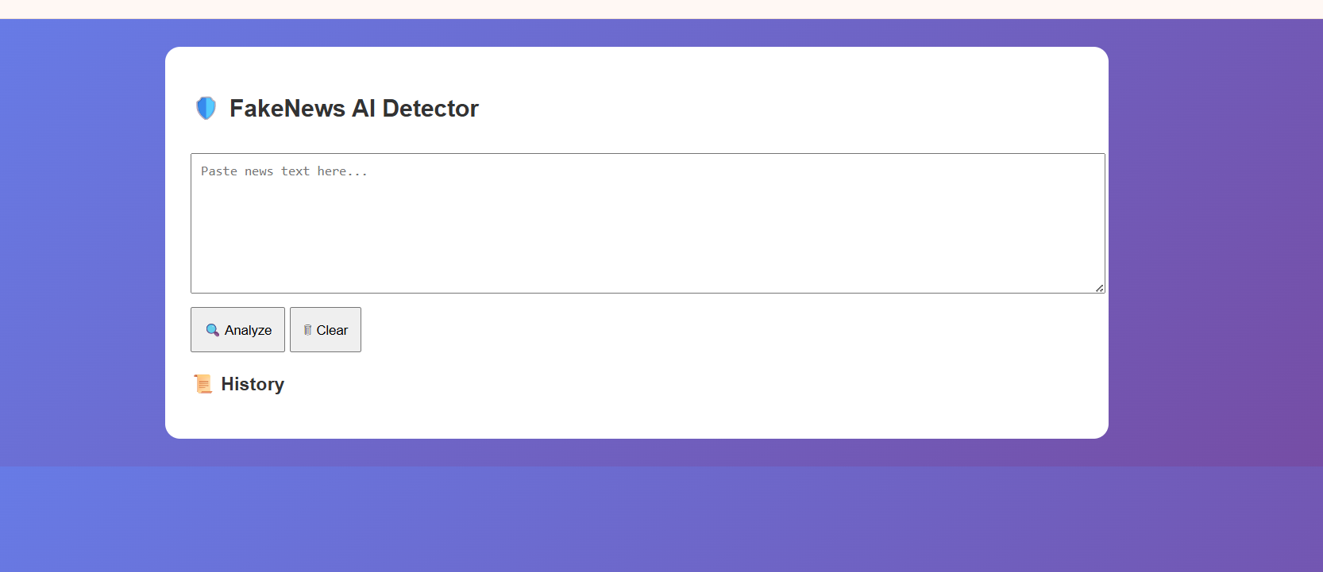
Application (Cloud Hosted)
• Web-based Fake News Detection System
• Can be deployed on cloud platforms
• Helps users verify news instantly

Slide 7
Conclusion
• NLP helps detect fake news
• Reduces misinformation
• Future: Deep Learning models

Slide 8
References
• Kaggle Dataset
• Research papers
• NLP resources

