Slide 1

SR UNIVERSITY Bus Management System
A Web-Based Transport Monitoring Solution
Team Members
Department & Academic Year
V. Gagan Chandra Tej
K. Rathan Dattu
Department: CSE
T. Ganesh Reddy
Academic Year: 2024–2025

Slide 2

Addressing Campus Transport Challenges
Campus transportation often encounters various hurdles that impact student experience and administrative efficiency. Our system aims to resolve these pain points for a smoother daily commute.
No Real-time Tracking
Communication Gaps
Students and staff remain unaware of bus locations or estimated arrival times.
Manual communication methods lead to delays and misinformation between administration and drivers.
Lack of Centralised Data
Absence of a unified dashboard hinders efficient management and strategic decision-making.

Slide 3






Our Project Objectives
Our solution is designed to transform campus transportation into a highly efficient, transparent, and user-friendly experience for everyone involved.
Digitise Management
Streamline bus, route, and driver data management.
Real-time Updates
Provide precise bus location updates to students and management.
Instant Alerts
Notify users promptly about delays or schedule changes.
Easy Information Access
Empower students to effortlessly check bus information.
Summary Reports
Equip college management with comprehensive operational data.
Intuitive Web Interface
Ensure a clean and simple user experience across all modules.

Slide 4
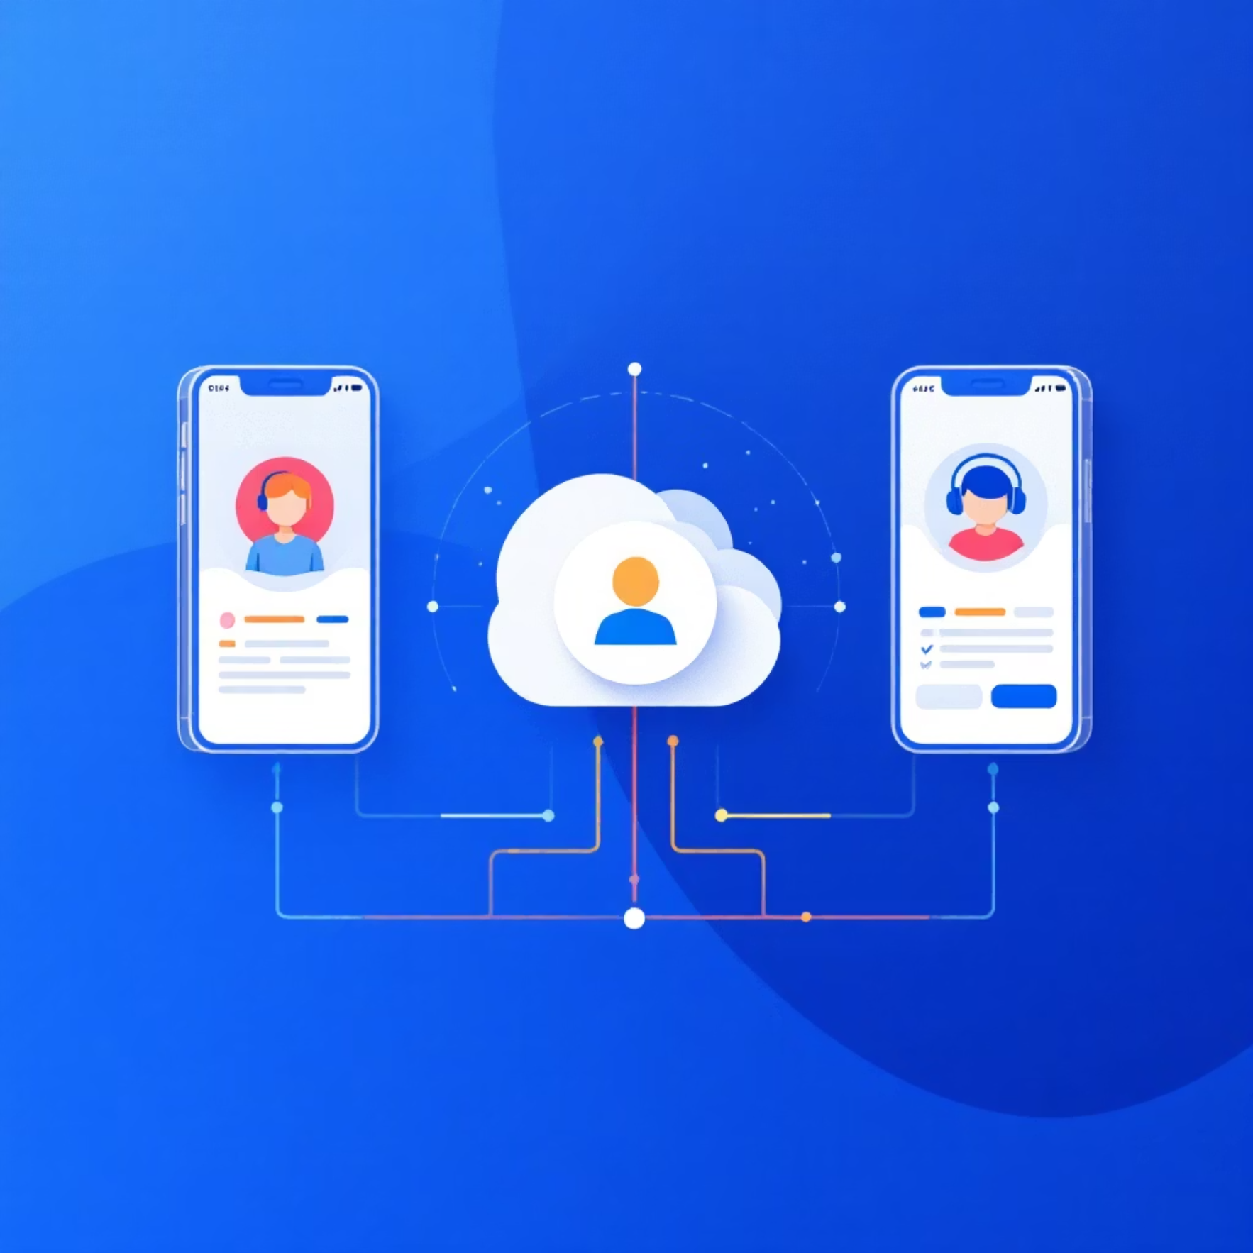
System Architecture Overview
Our system leverages modern web technologies to ensure responsiveness, reliability, and ease of use.
Technology Stack
Frontend: HTML, CSS (premium design), JavaScript for an engaging user interface.
Backend: Node.js + Express.js for robust server-side operations.
Database: JSON file storage for lightweight and efficient data handling.
Real-time Updates: Seamless data flow from Driver → Server → Student Panel.
Deployment: Optimised for localhost testing and lightweight hosting environments.
Operational Flow Diagram
Admin: Manages buses, routes, and drivers with full control.
Driver: Updates status and real-time location effortlessly.
Student: Accesses live bus status and tracking information.
College Management: Receives insightful operational reports for informed decisions.

Slide 5





Key System Modules & User Roles
Our Bus Management System is structured around four distinct user roles, each with tailored functionalities to ensure efficient operations.
Admin
Manages buses, drivers, and routes (add, delete, edit). Also has the ability to reset system data for maintenance or fresh starts.
Driver
Selects assigned bus, updates current location, and sets status (On-time, Delayed, Completed) for real-time communication.
Student
Selects their travel bus, views available routes, and tracks real-time bus status and driver location for convenience.
College Management
Monitors total buses, drivers, and routes. Generates comprehensive operational reports and accesses an overview dashboard.

Slide 6
Highlighting Key Features
Our system integrates a suite of features designed to enhance user experience and administrative control, ensuring a seamless campus transport solution.
1
2
Responsive & Modern UI
Role-Based Access
A user interface that adapts to any device, ensuring accessibility and a pleasant user experience.
Secure and customised panel access for Admin, Driver, Student, and College Management.
3
4
Real-time Bus Updates
CRUD for Admin
Instantaneous location and status updates for all buses, ensuring timely information.
Full Create, Read, Update, Delete capabilities for buses, drivers, and routes.
5
6
Separate Interfaces
Bus-wise Data Storage
Dedicated dashboards for students and drivers, tailored to their specific needs.
Efficient storage and retrieval of status and location data for each bus.

Slide 7
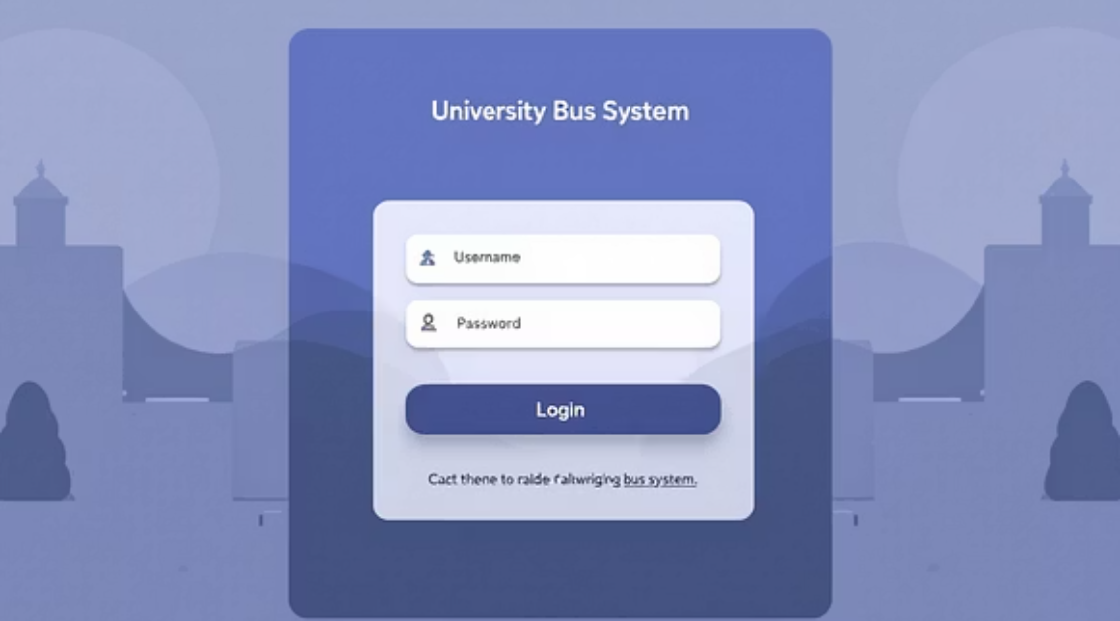
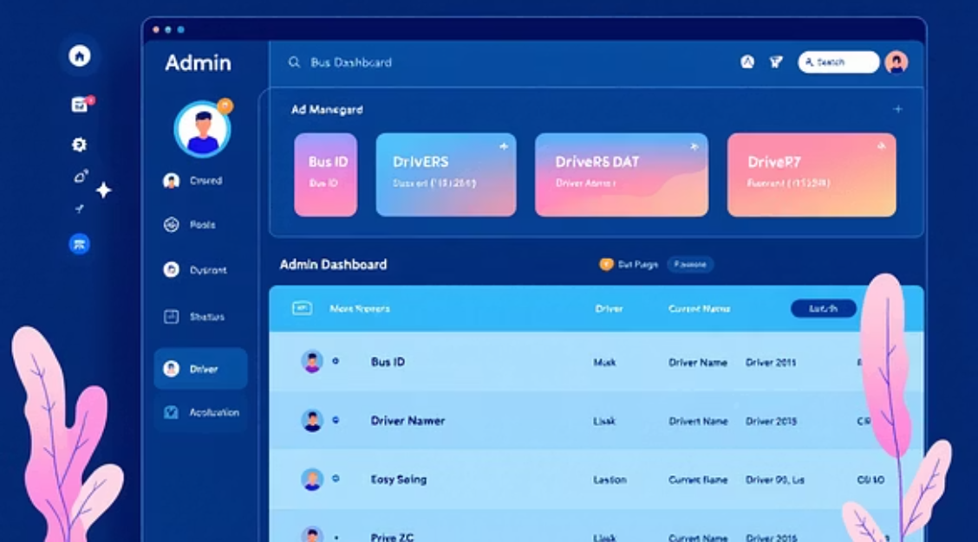
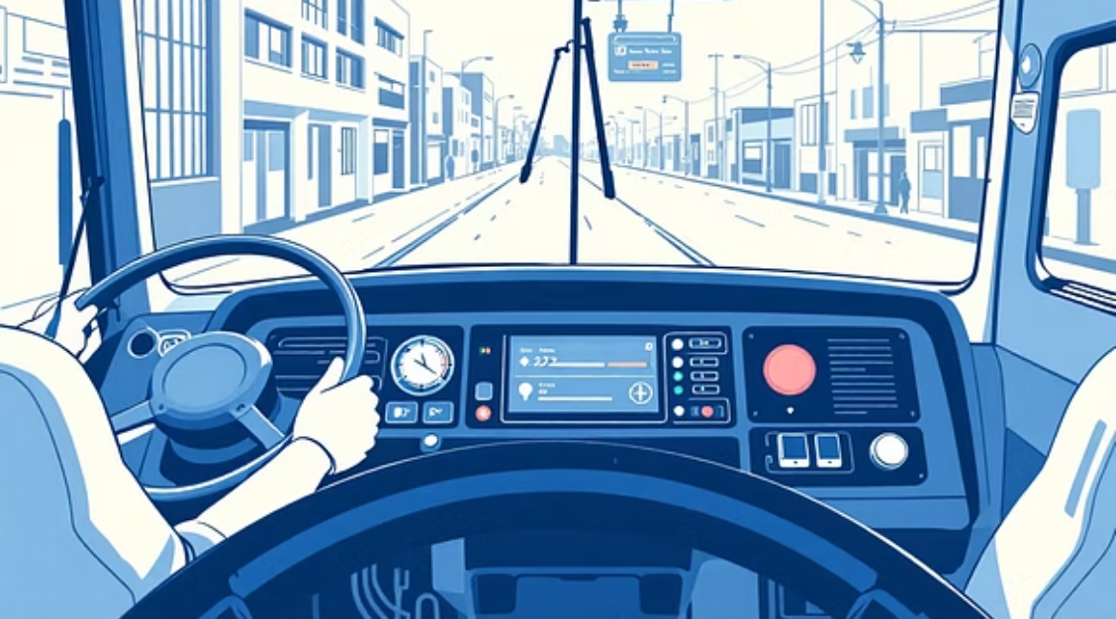
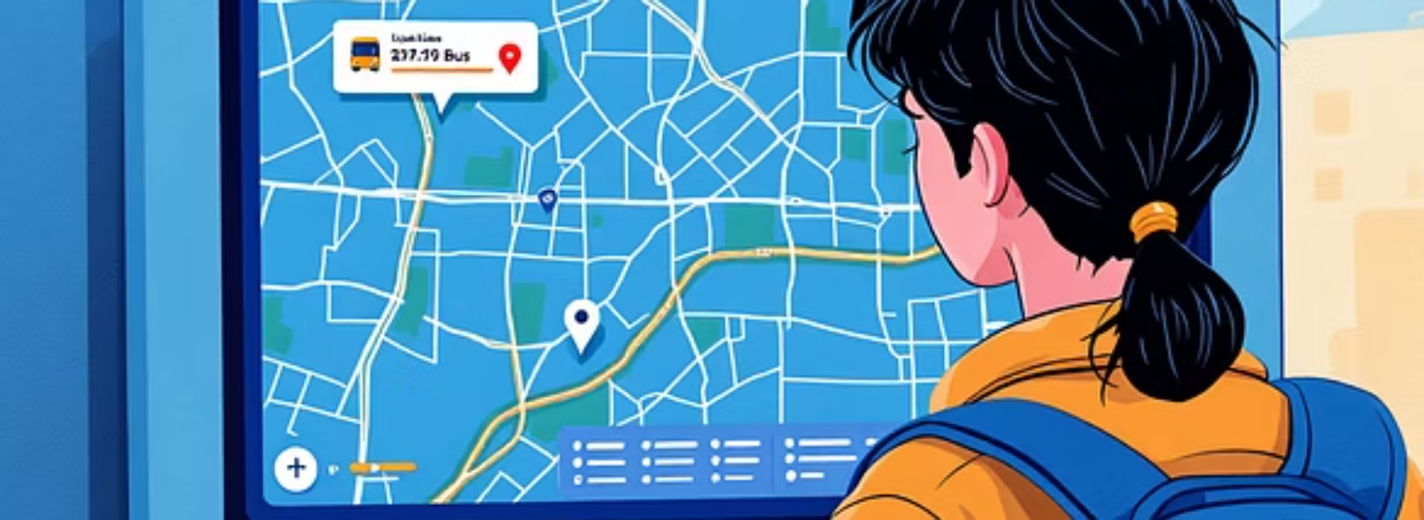
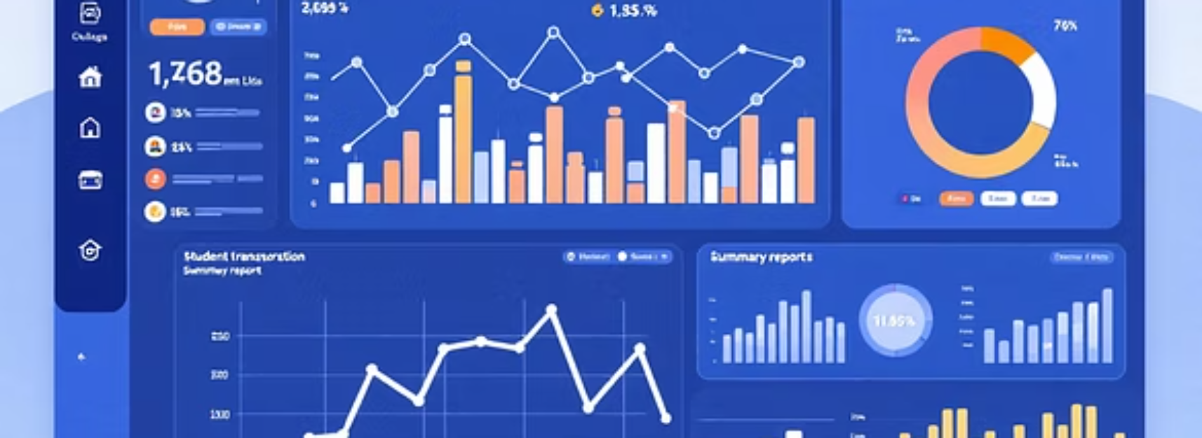
Visualising User Interfaces
Our intuitive design ensures ease of navigation and clear information display across all user roles, from logging in to managing operations and tracking buses.

Slide 8









Our Robust Technology Stack
Built with a focus on modern, efficient, and scalable technologies, our system ensures optimal performance and maintainability.
HTML5
CSS3
JavaScript
The foundational language for structuring web content, ensuring semantic and accessible markup.
Used for crafting a premium, responsive, and aesthetically pleasing user interface.
Enables dynamic and interactive functionalities on the client-side for a rich user experience.
Node.js
Express.js
JSON File
A powerful JavaScript runtime for building fast and scalable network applications on the server-side.
A minimal and flexible Node.js web application framework that provides a robust set of features for web and mobile applications.
Utilised as a lightweight local database solution for efficient data storage and retrieval, especially suitable for initial deployment.
VS Code
NPM
GitHub (Optional)
The primary integrated development environment (IDE) used for efficient code writing and project management.
Node Package Manager, essential for managing project dependencies and streamlining development workflows.
Platform for version control and collaborative development, ensuring code integrity and team coordination.

Slide 9
Advantages of Our System
Our Bus Management System offers a multitude of benefits, ensuring an enhanced transport experience for students and streamlined operations for the administration.
Simple & Stable
Real-time Updates
A straightforward and robust system designed for reliability and ease of use.
Students receive instant notifications, keeping them informed and reducing anxiety.
No External Dependencies
Admin Control
Self-contained system ensures minimal external risks and greater control.
Provides the administration with comprehensive control over the entire transport system.
Easy to Deploy & Maintain
Clean, Modern UI
Designed for quick deployment and hassle-free ongoing maintenance.
An intuitive interface that encourages adoption and enhances user satisfaction.

Slide 10
Conclusion & Future Outlook
Our Bus Management System is more than just a tracking tool; it's a comprehensive solution for modern campus transportation.
Streamlined Administration
Enhanced Visibility
Automates bus, driver, and route management, significantly reducing manual effort.
Offers real-time tracking, giving everyone precise information and peace of mind.
Student Convenience & Safety
Actionable Analytics
Improves student experience with timely information and contributes to a safer commute.
Generates reports that empower college management with data-driven insights for better decision-making.
This lightweight, efficient, and user-friendly system represents a significant step towards optimising campus transport for SR University.

Slide 11
Thank You!

