Slide 1
Student Feedback Sentiment Analysis using NLP
Team Members:
2403A52222-V.Gagan Chandra Tej
2403A52233-T.Ganesh
2403A52245-S.Sathwik
Guide: Dr .V. Venkataramana
Institution: SR-University

Slide 2
Problem Statement
Manual feedback analysis is inefficient and biased
Large volumes of feedback difficult to process
Need automated sentiment classification system
Goal: Improve decision-making using insights

Slide 3
Stakeholders
Students: Provide feedback
Faculty: Improve teaching methods
Administration: Policy decisions
Institutions: Quality enhancement

Slide 4
Dataset & Model Discussion
Dataset: Student feedback text data
Preprocessing: Tokenization, Stopword removal, Lemmatization
Feature Extraction: TF-IDF Vectorization
Model: Logistic Regression (supervised learning)
Reason: Fast, interpretable, good baseline accuracy

Slide 5
Results & Evaluation
Accuracy achieved: ~85-90% (approx)
Evaluation metrics: Precision, Recall, F1-score
Confusion matrix analysis
Balanced performance across sentiment classes

Slide 6
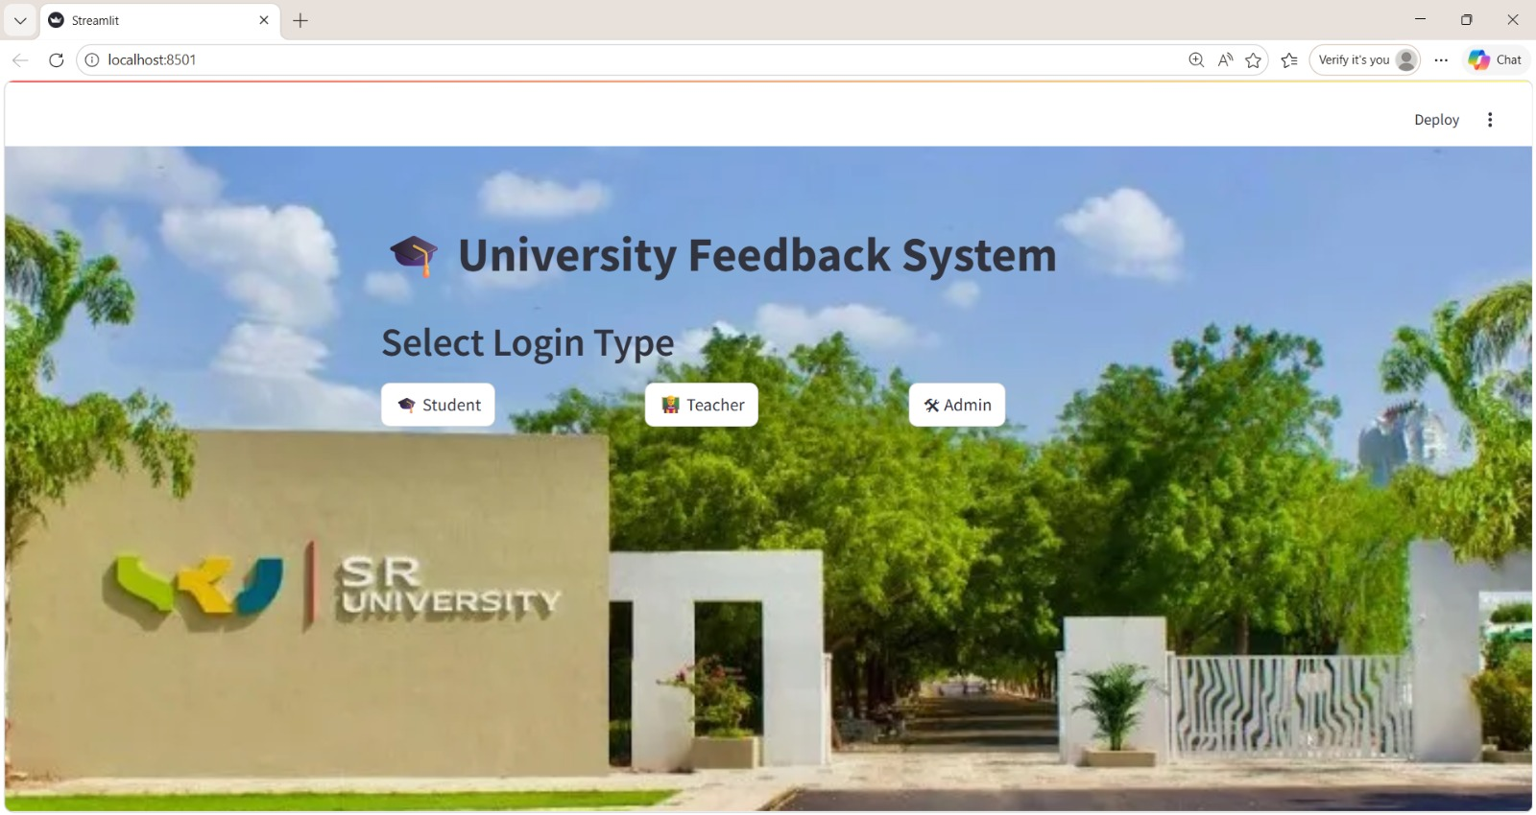
Frontend-Screenshot

Slide 7
Application (Cloud Hosted)
Frontend: Simple web interface
Input: Single or bulk feedback
Backend: NLP model integration
Deployment: Cloud (e.g., Render / AWS / Heroku)
Real-time sentiment prediction

Slide 8
Conclusions
Automated system reduces manual effort
Improves feedback analysis efficiency
Provides actionable insights
Future Work: Deep learning models (LSTM, BERT)

Slide 9
References
Scikit-learn Documentation
Research Papers on Sentiment Analysis
Kaggle Datasets
NLTK Documentation

