Slide 1

The Lost & Found Portal
Revolutionizing Campus Item Recovery
2403A52241-AKHIL
2403A52239-GANESH
2403A52242-HEMANTH

Slide 2
objective
To develop a centralized digital platform that enables students and staff to report, search, and recover lost items efficiently.
The portal aims to reduce manual tracking, improve recovery rates, and foster a more connected campus environment.

Slide 3




Key Stakeholders: Who Benefits?
A successful Lost & Found Portal requires collaboration and will significantly benefit various groups within the university.
Students
The primary beneficiaries, gaining a reliable way to recover personal belongings swiftly.
Faculty & Staff
Reduced burden of managing lost items, focusing more on their core responsibilities.
Campus Security
Streamlined process for handling found items and verifying claims, improving efficiency.
Administrative Office
Enhanced campus service reputation and improved operational flow regarding lost property.

Slide 4
Programming Languages, Tools, and Software
Frontend: HTML, CSS, JavaScript
Backend: Flask (Python) or Node.js with Express
Database: MongoDB
Authentication: JWT (JSON Web Tokens)

Slide 5
The Campus Conundrum: Lost & Found Inefficiencies
.
Informal & Slow Processes
Lack of Visibility
Current recovery methods rely on word-of-mouth or fragmented departmental efforts, making the process cumbersome and lengthy.
Without a centralized system, there's no clear way for individuals to track their lost items or know where to report found ones.
No Centralized System
The absence of a unified platform exacerbates the problem, creating confusion and reducing the likelihood of successful item reunification.

Slide 6
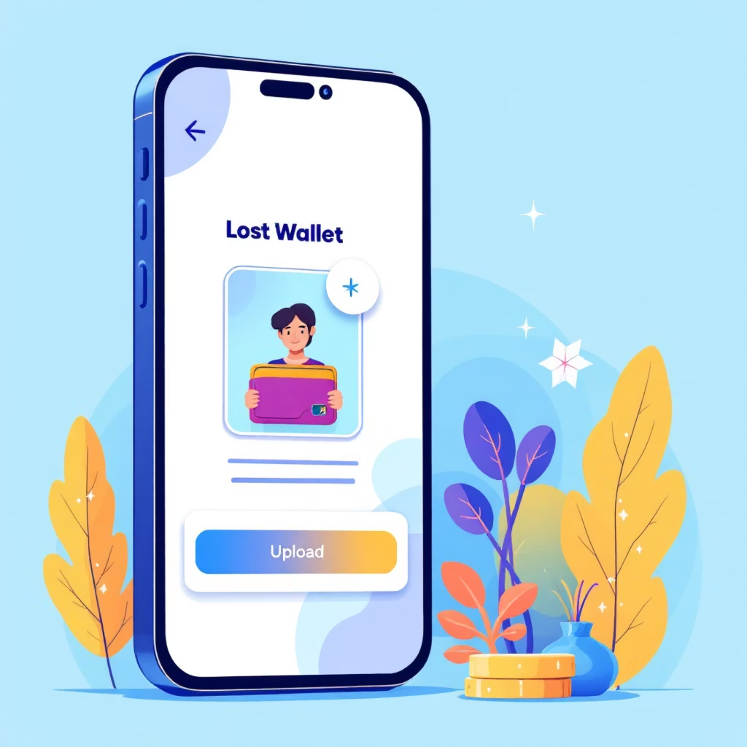
Key Features in Focus
User-Friendly Reporting
Our intuitive forms make reporting a lost or found item straightforward. Users can upload multiple photos and provide comprehensive details to increase matching accuracy.
Example Fields:
Item Name & Category
Detailed Description
Last Seen/Found Location
Date & Time
Photo Upload (multiple)

Slide 7
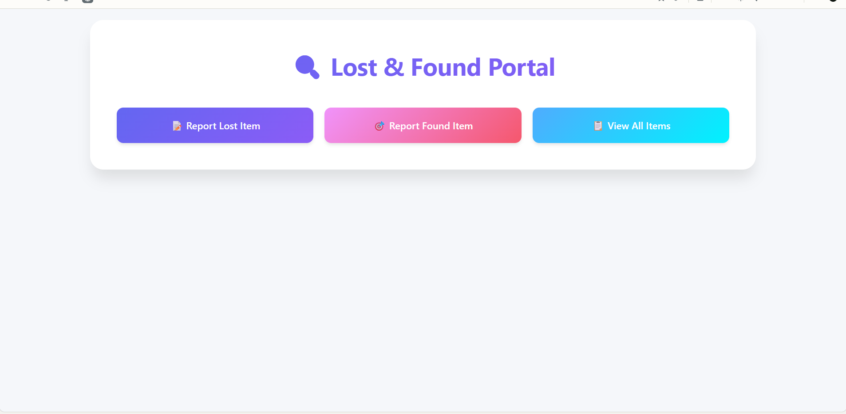
Frontend View of Your Web Application

Slide 8
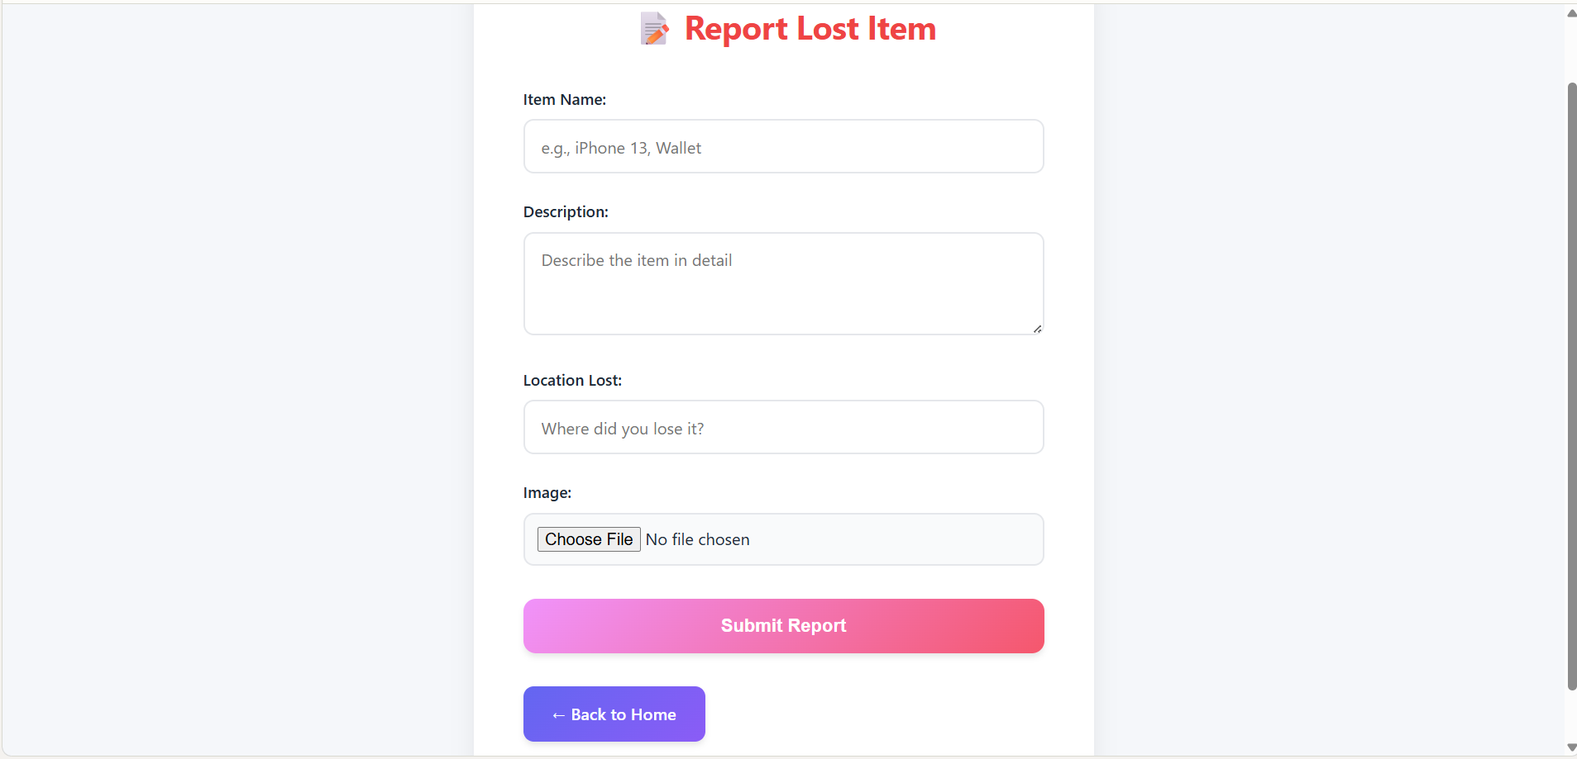

Slide 9
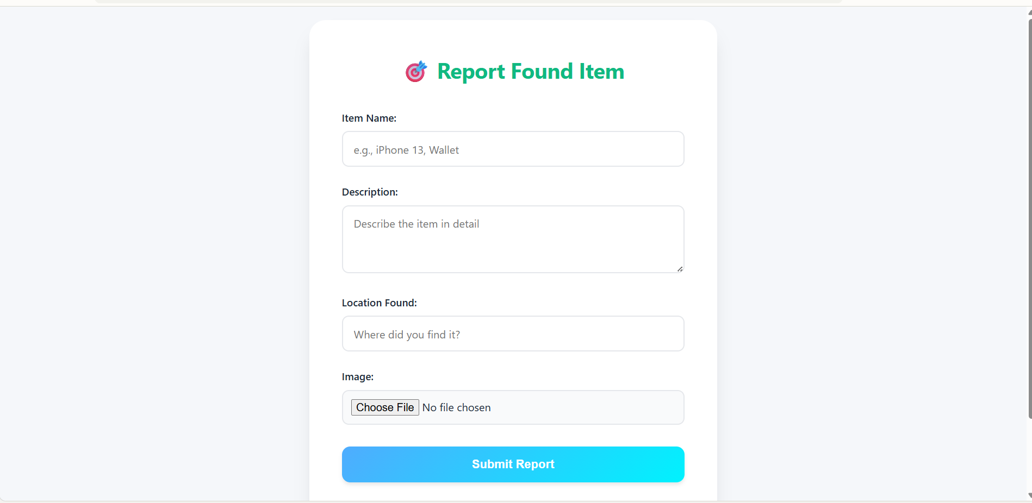

Slide 10
