Slide 1

Smart Grammar Correction & Writing Optimization Tool
AI-powered assistant that detects errors, suggests style improvements, and gives real-time feedback—built for students, professionals, content creators, and educational platforms.

Slide 2
Team
2403A52239
2403A52254
2403A52242

Slide 3
Problem Statement
Manual proofreading is time-consuming and prone to human oversight.
Grammatical errors in professional communication lead to loss of credibility.
Non-native speakers face linguistic barriers in formal writing.
Existing premium tools are often expensive and act as 'black boxes'.

Slide 4



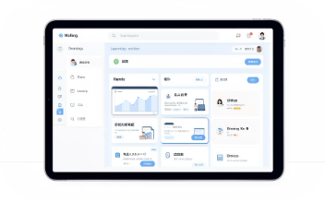
Key Stakeholders
Students
Professionals
Content Creators
Educational Platforms
Improve essays, assignments, and reports with clear explanations of errors and revision suggestions.
Polish emails, proposals, and presentations to ensure clarity and professional tone.
Produce cleaner articles and posts faster with style tips and headline suggestions.
Embed writing assistance into LMS to boost student outcomes and reduce instructor marking load.

Slide 5
Dataset and Model Discussion
Datasets: from kaggle
Hybrid Engine: Combines Statistical N-grams with Rule-Based Logic.
POS Tagging: Deep morphological analysis to identify nouns, verbs, etc.
Flask Integration: Real-time processing through a Python backend.

Slide 6
Results
Speed: Real-time response (< 1.5 seconds).
Accuracy: High precision in catching subject-verb agreement and typos.
Educational Value: Provides detailed linguistic explanations for every correction.
Usability: Dual-pane interface for instant comparison.

Slide 7
Application (Cloud Hosted)
Tech Stack: Python, Flask, HTML5, CSS3.
Architecture: Client-Server model optimized for web deployment.
Cloud Ready: Compatible with AWS, Heroku, and Azure environments.
Scalable: Lightweight backend capable of handling multiple requests.

Slide 8

Technology Stack — Frontend & Backend
Frontend
Backend
HTML, CSS, JavaScript (responsive UI, Flask templates)
Accessible design for students and screen readers
Python + Flask for API endpoints and web serving
Language processing via language_tool_python (public API)

Slide 9
Conclusion
Developed a robust alternative to premium writing software.
Successfully integrated complex NLP logic into a user-friendly web app.
Future Scope: Adding 'Style Tone' detection and Browser Extension development.

Slide 10
References
Naber, D. (2003). 'A Rule-Based Style and Grammar Checker' (LanguageTool).
Napoles, C., et al. (2017). 'There’s No Comparison: Reference-less Evaluation Metrics for GEC.'
Vaswani, A., et al. (2017). 'Attention Is All You Need' (Transformer Models).
Flask Framework Documentation (2026).

Slide 11
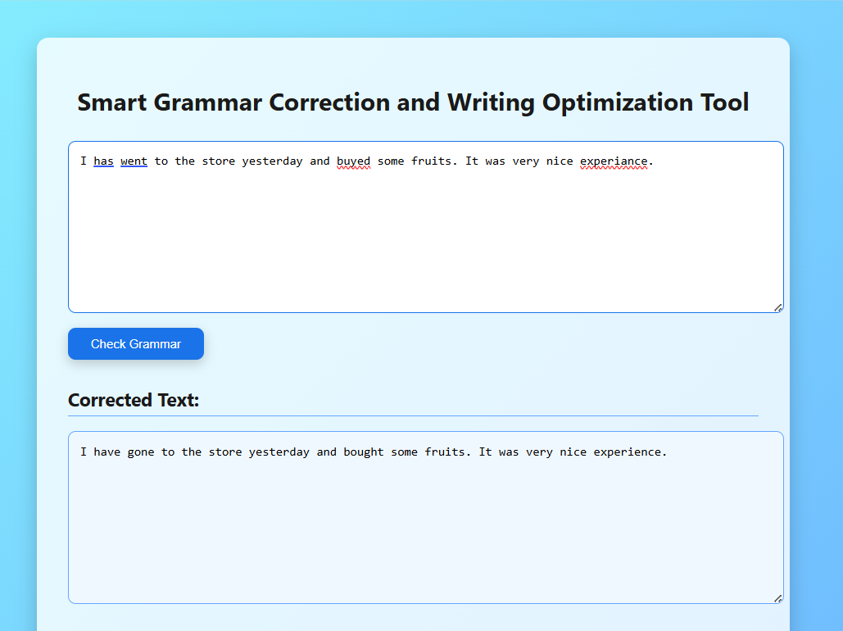

Slide 12
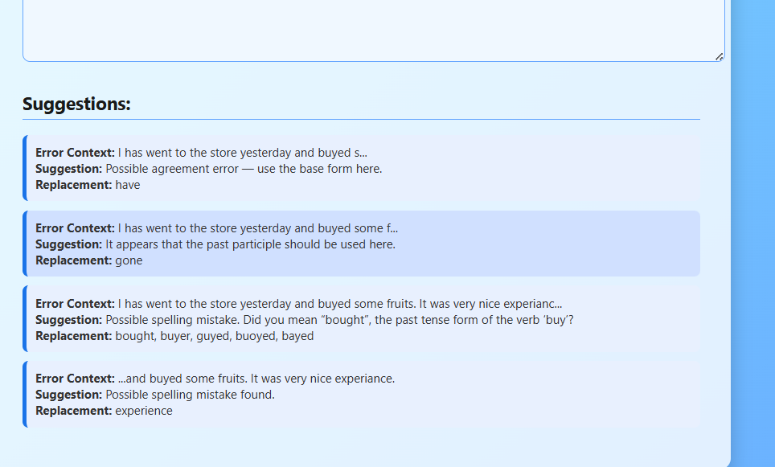

Slide 13
Thank you…

