Slide 1
SKILL SWAP – HYPERLOCAL SKILL EXCHANGE WEB APPLICATION.

Slide 2
TEAM DETAILS: GUIDE NAME : DR.V.VENKATARAMANA.
2403A52260 – VEMULA AKSHAYA REDDY
2403A52267 – GUNDU DEEKSHITHA VARMA
2403A52273 – THANGALAPALLY HASINI
BATCH - 10

Slide 3
Problem Statement
Many students want to learn new skills but cannot afford paid courses
Skilled individuals lack a platform to share their knowledge
Existing platforms focus on one-way learning
No proper system for local skill exchange

Slide 4
OBJECTIVES ->To create a platform for skill exchanging without money. -> To encourage peer-to-peer learning. ->To connect students and local community members based on skills. ->To provide a digital portfolio for users. ->To promote collaborative learning in local areas. ->To reduce dependency on paid learning platforms.

Slide 5
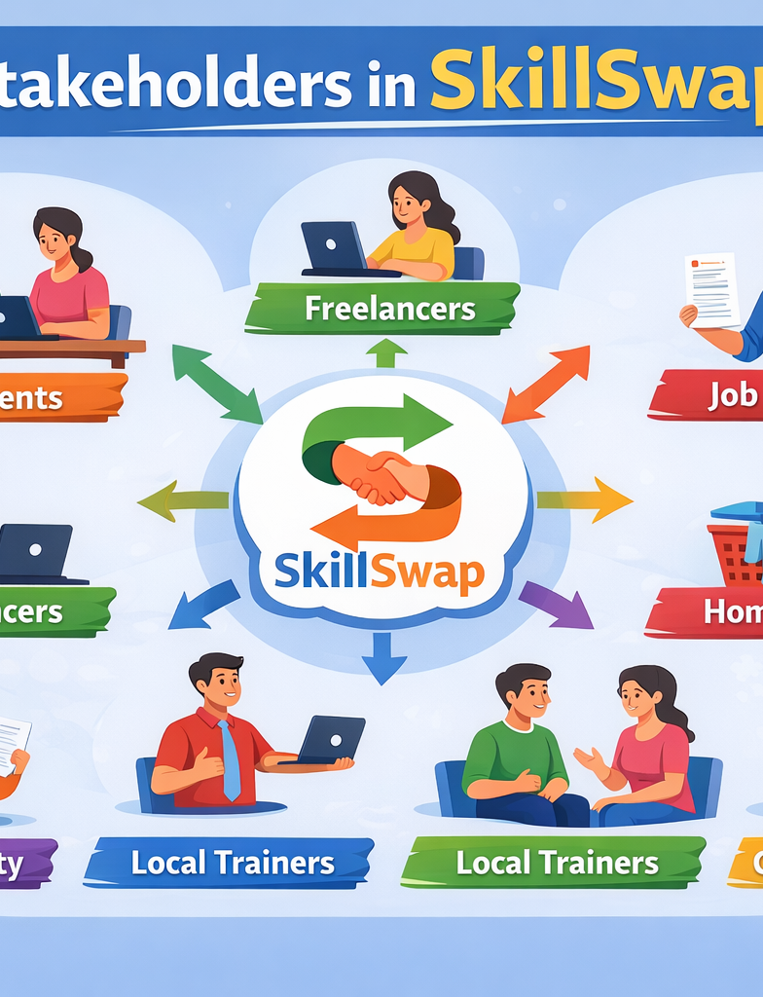
Stakeholders:
Students
2) Homemakers
3) Job seekers
4) College faculty
5)Local trainers
6)Community- learners

Slide 6
Programming Languages, Tools & Software:
Frontend:
HTML
CSS
JavaScript
React.js (Optional Advanced)
Bootstrap
Backend:
Python (Flask / Django) OR
Node.js

Slide 7
Database:
MySQL OR
MongoDB
Tools:
VS Code
GitHub
Figma (UI design)
Postman (API testing)
Deployment:
Render / Netlify / Heroku

Slide 8
Front-End View (Web Application)
1️⃣ Home Page
Logo: SkillSwap
Search skills
Register / Login button
Featured skills section
2️⃣ User Dashboard
Profile picture
Skills I Can Teach
Skills I Want to Learn
Match Suggestions
Exchange Requests
3️⃣ Skill Matching Page
Skill Name
Nearby Users
Rating
Request Exchange Button
4️⃣ Exchange Tracker
Ongoing Exchanges
Completed Exchanges
Reviews
Feedback.

Slide 9
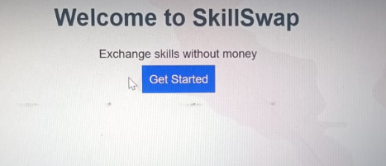
Results
Users can register their skills
System stores user data
Dashboard displays skill exchange options
Simple and user-friendly interface

Slide 10
Future Scope
The SkillSwap platform can be further enhanced by adding advanced features to improve user experience and functionality. In the future, artificial intelligence can be integrated to provide automatic skill matching based on user interests and behavior. Location-based services can be added to connect users within nearby areas more effectively. A chat or messaging system can also be included to allow users to communicate and schedule learning sessions easily. Additionally, the platform can be developed into a mobile application for better accessibility. Features like user ratings, reviews, and certification can further improve trust and engagement. With these improvements, SkillSwap can grow into a large-scale community platform for collaborative learning and skill development.

Slide 11
References
Flask Documentation
W3Schools
Research articles
Google

Slide 12
Conclusion
In conclusion, SkillSwap is a simple web application that helps people learn and share skills without money. It connects users and makes learning easy, useful, and interactive. This project shows how technology can solve real-life problems in a simple way.

Slide 13
Thank you.

