Slide 1
Roadside Rescue
Team Details:
2403A52271 - Amruth Reddy
2403A52270 - Manoj Kumar

Slide 2
Objectives
- Enhance Roadside Safety
- Reduce Response Time
- Facilitate Seamless Assistance
- Improve User Experience
- Minimize Traffic Disruptions
- Promote Awareness & Preparedness

Slide 3
Stakeholders
- Stranded Motorists / Users
- Rescue Team / Field Technicians
- Towing Service Providers
- Vehicle Repair & Service Centers
- Traffic Police & Highway Authorities
- Insurance Companies
- System Administrators / Support Team

Slide 4
Programming Languages,Tools, Softwarwe.
Programming languages: JavaScript, Java, Kotlin, Swift, Python.​
Tools/Frameworks: Android Studio, Xcode, React.js, Node.js, Express.js, Docker, Firebase, PostgreSQL.​
Software/Platforms: OctopusPro, MobiWork, Urgently, Swoop, DriveRescue.

Slide 5
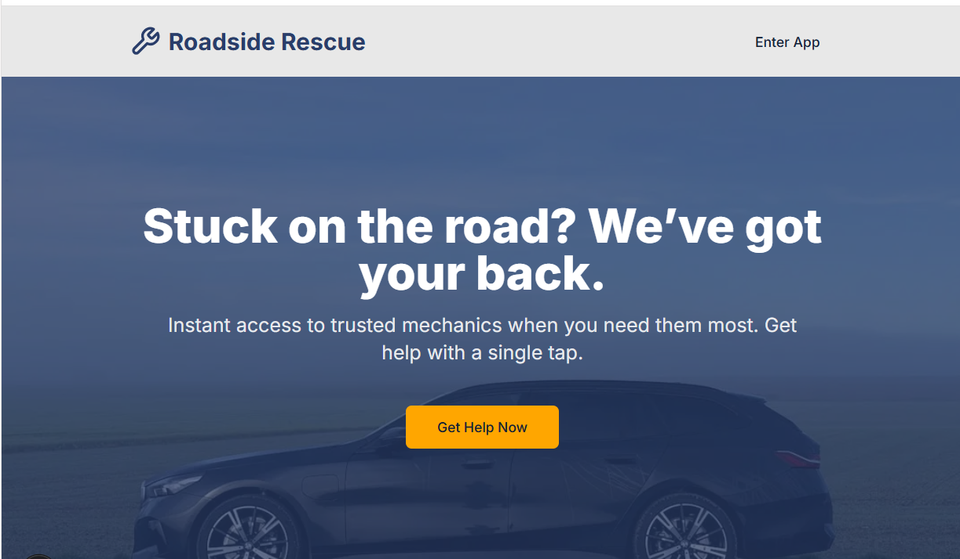
Front-end view of the web/Mobile Application.

Slide 6
