Slide 1

Department of Computer Science and Engineering
CS23533-FOUNDATIONS OF ARTIFICIAL INTELLIGENCE
AI-BASED SMART BANK QUEUE BALANCER SYSTEM
College Name: RAJALAKSHMI ENGINEERING COLLEGE
Presented By: HEMALATHA ST (240701189)
HEMASHREE R(240701190)

Slide 2
List of Content
Abstract
Introduction
Literature Survey
Problem Statement
Proposed work
System Architecture
Methodology
Results and Discussions
Conclusion
References

Slide 3
Abstract
AI-BASED SMART BANK QUEUE BALANCER SYSTEM is a web-based system designed to improve customer flow and reduce waiting time in banks. Customers can register, log in, scan a permanent QR code at the bank entrance, and select their required banking service. The system displays available queues and their current customer counts. Artificial Intelligence techniques are used to evaluate queue conditions and recommend a suitable queue based on factors such as waiting count and queue capacity. Staff members can manage their assigned queues through a separate login, while administrators monitor queue activities and reset counts daily. The proposed system aims to reduce congestion, improve queue distribution, and provide an organized and efficient banking experience.

Slide 4
Introduction
AI-BASED SMART BANK QUEUE BALANCER SYSTEM is a web-based system designed to improve queue management and reduce customer waiting time in banks. Traditional banking systems often face problems such as long queues, overcrowding, and uneven distribution of customers among service counters. The proposed system uses a permanent QR code placed at the bank entrance, allowing customers to access the application, select their required banking service, and view the current queue count. Artificial Intelligence techniques help evaluate queue conditions and recommend a suitable queue based on factors such as customer count and queue capacity. Separate interfaces for customers, staff, and administrators support efficient queue monitoring and management. This system aims to improve customer flow, reduce congestion, and provide a more organized and convenient banking experience.

Slide 5
Literature Survey
Traditional Queue Management: Uses physical lines and manual token systems, which may cause congestion.
Digital Token Systems: Allow customers to obtain tokens electronically but may offer limited queue optimization.
QR-Based Systems: Provide convenient access to digital services through QR code scanning.
AI-Based Queue Management: Applies search strategies and decision-making techniques to improve resource allocation.
Research Gap: An integrated banking system combining QR-based access, live queue monitoring, staff management, and AI-based queue recommendations is needed.

Slide 6
Problem Statement
Traditional banking systems often face challenges such as long waiting times, overcrowded service areas, and uneven distribution of customers among different service queues. Customers may find it difficult to identify less crowded queues due to the lack of real-time information about the number of waiting customers. Manual queue management also increases the workload of bank staff and may lead to delays in service delivery. Therefore, there is a need for an intelligent and centralized queue management system that monitors queue conditions, provides real-time queue information, and recommends suitable queues based on customer count and queue capacity. The Smart Queue Balancer for Banking Services aims to address these problems by improving queue distribution, reducing congestion, and enhancing the efficiency of banking services.

Slide 7
Proposed Work
Develop a web-based smart queue management system exclusively for banks.
Provide separate login portals for customers and staff.
Use a permanent QR code placed at the bank entrance.
Display service options and live queue counts.
Apply AI-based decision-making to recommend suitable queues.
Allow staff to update queue counts while serving customers.
Enable administrators to monitor queues and reset counts daily.

Slide 8
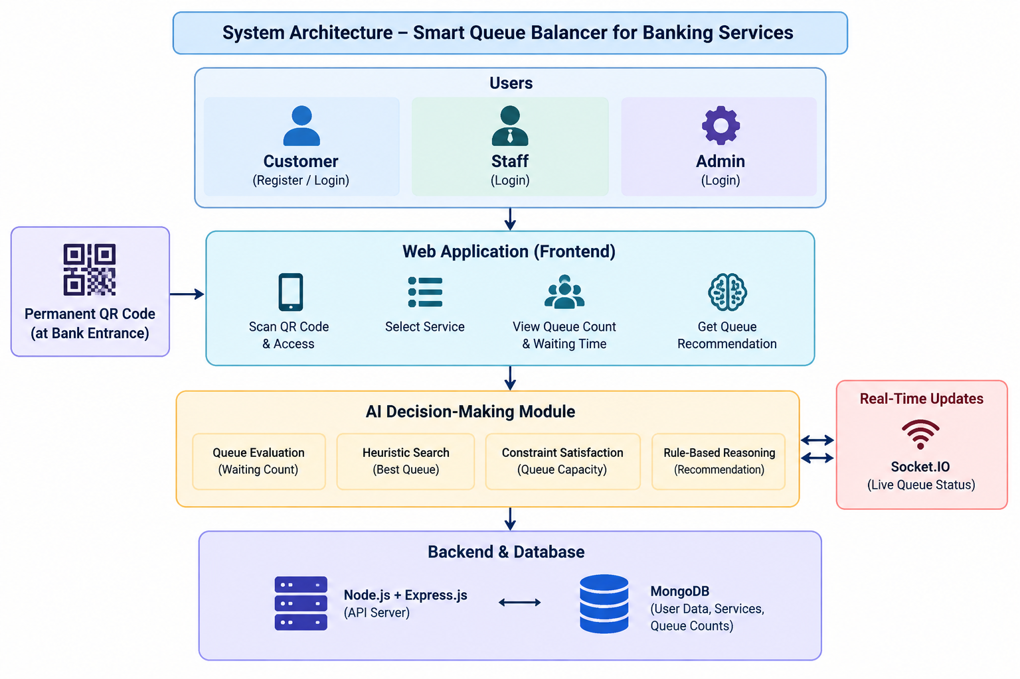
System Architecture

Slide 9
Methodology
Registration and Login: Customers and staff access their respective portals.
QR Code Scanning: Customers scan the permanent code at the bank entrance.
Service Selection: Customers select a required banking service.
Queue Monitoring: The system displays the current count for each queue.
Queue Recommendation: AI-based decision-making evaluates queue conditions.
Staff Queue Updates: Staff update queue counts after serving customers.
Daily Reset: The administrator resets queue counts at the end of the day.

Slide 10
Results and Discussions
Centralized monitoring of banking service queues.
Easy access to queue information through QR scanning.
Improved visibility of customer counts.
Intelligent recommendations for queue selection.
Digital queue updates by staff members.
Simplified administrative monitoring and daily reset.
Expected Outcome: Reduced congestion, improved customer distribution, and a better banking experience.

Slide 11
Conclusion
The Smart Queue Balancer for Banking Services provides an organized approach to managing customer queues in banks. By integrating permanent QR code access, queue monitoring, AI-based recommendations, and separate staff and administrator interfaces, the system aims to reduce waiting time and improve customer distribution. It can help banks manage service queues more efficiently and improve customer satisfaction. Future enhancements may include historical queue analysis and more accurate waiting-time prediction.

Slide 12
References
Russell, S. and Norvig, P., Artificial Intelligence: A Modern Approach, 4th Edition, Pearson, 2021.
Erlang, A. K., “The Theory of Probabilities and Telephone Conversations,” Nyt Tidsskrift for Matematik B, 1909.
React Documentation: https://react.dev/
Node.js Documentation: https://nodejs.org/docs/
MongoDB Documentation: https://www.mongodb.com/docs/
Research articles on AI-based queue management and customer service optimization.

