Slide 1
Easy Web Service on Android with Nano
-by William http://bulldog2011.github.com/

Slide 2
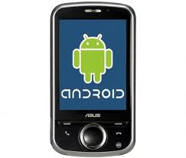
Problem Domain
There is a gap between Android device and traditional SOAP/XML based web service
SOAP/XML Web Service

Slide 3
Nano to Fill the Gap
Nano is a light client-side web service framework tailored for Android platform.
Feature Highlight:
Support WSDL driven development, auto-generate strongly typed proxy from WSDL.
Support SOAP 1.1/1.2 and XML based Web service.
Automatic XML to Java binding, performance comparable to Android native XML parser.
Verified with industrial grade Web Services like Amazon and eBay Web Services.
Asynchronous service invocation, flexible HTTP/SOAP header, timeout, encoding setting, logging, etc.
Can be used as a standalone XML and JSON binding framework.

Slide 4
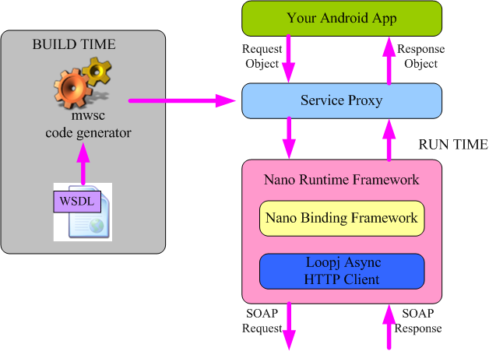
The Big Picture

Slide 5
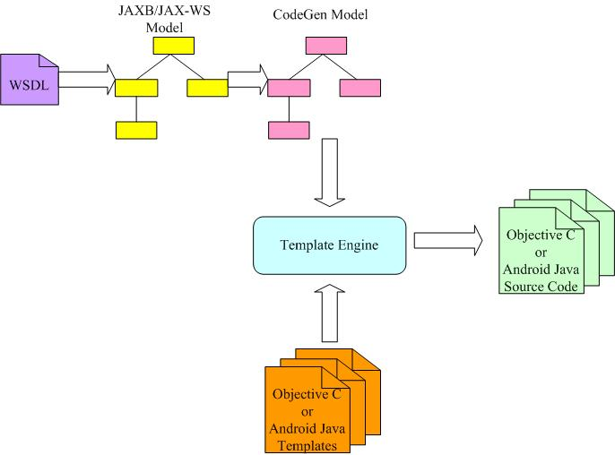
Code Generation from WSDL

Slide 6
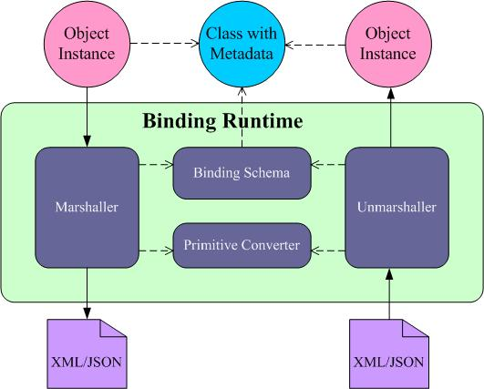
Automatic XML<>Object Binding

Slide 7
WSDL Driven Dev Flow on Android
Generate Android Java proxy from WSDL,
Create new Android project, add Nano runtime and generated proxy into the project,
Implement application logic and UI, call proxy to invoke web service as needed.

Slide 8
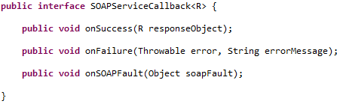
Simple Service Invocation Paradigm
Invoke service with:
Request object
Callback object with success, failure and SOAP fault handling logic

Slide 9
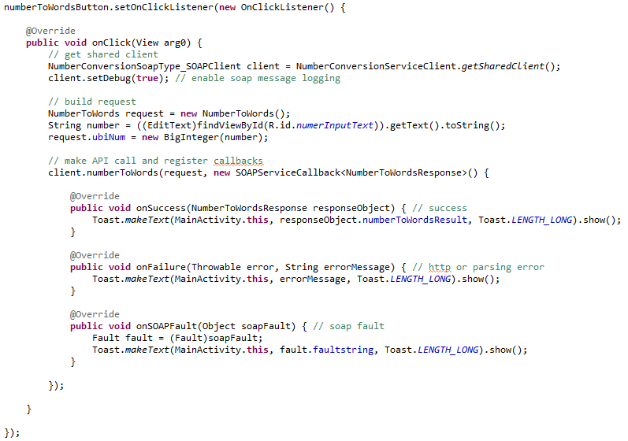
A Service Call Sample

Slide 10
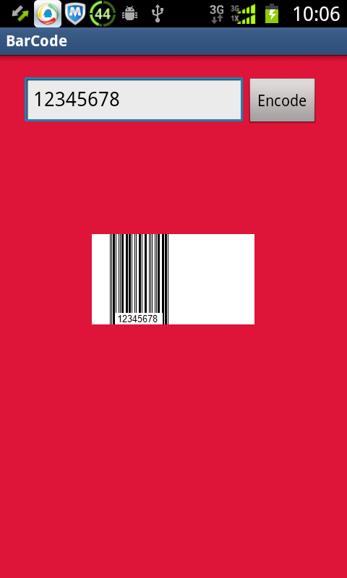
Demo 1 – BarCode

Slide 11
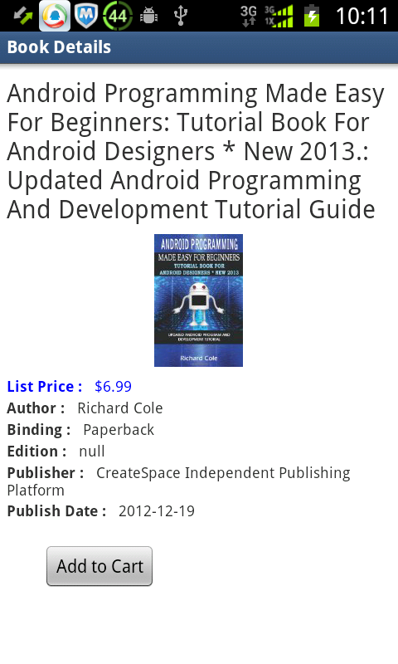
Demo 2 – Amazon Book Finder
Amazon Product Advertising
API used:
itemSearch for book search
cartCreate to add chosen book into shopping cart

Slide 12
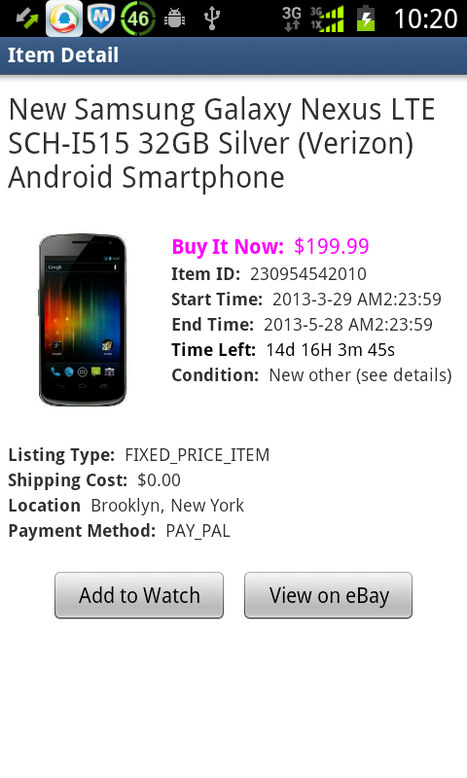
Demo 3 – eBay Demo App
eBay Finding API used:
findItemsByKeywords for item search
eBay Shopping API used:
getSingleItem for item details
eBay Trading API used:
addToWatchList for adding item to watch list

Slide 13
Source, Samples and Tutorials
For Android:
https://github.com/bulldog2011/nano
Similar framework for iOS:
https://github.com/bulldog2011/pico

