Slide 1

Edu-Craft Project
| Front End Development Frameworks |
| Title: Edu Craft - Online Course Builder with Video & Quiz Module |
| Team Members: 2410030355 Oruganti Harshitha, 2410030356 Srujana Sadhu, 2410030357 Ashrita Sri Gayatri V, 2410040126 Annam Sravani |
|Guide: Ms P Sree Lakshmi Ma’am | Department: CSE|

Slide 2
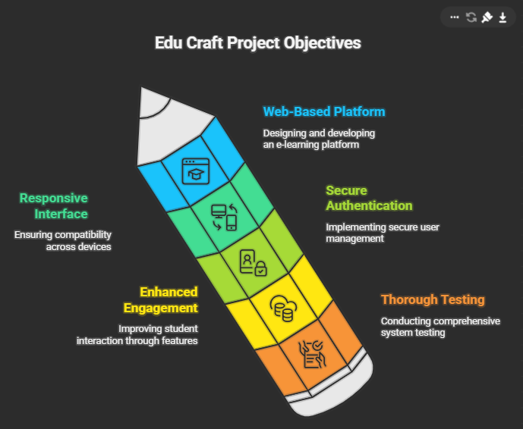
1. Problem Statement & Objective
Problem -
Students rely on multiple scattered platforms for videos, notes, and mind maps, resulting in disorganisation and limited collaboration.

Slide 3
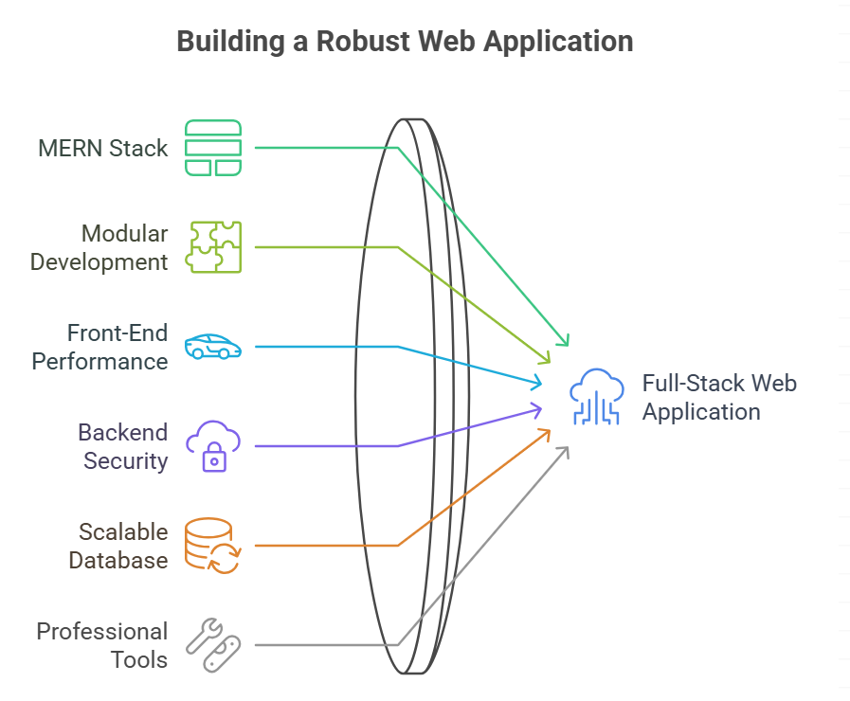
2. Technology Stack & Architecture
Frontend Tools Used
React
React Router (react-router-dom)
Axios
React Icons
CSS / CSS Modules
React State / Hooks (useState, useEffect)
FormData API
Backend Tools Used
Node.js
Express.js
MongoDB
Mongoose
Cors
Express-session
Passport.js
Passport Google OAuth20 Strategy
dotenv
Body-parsing middleware (express.json, express.urlencoded)

Slide 4
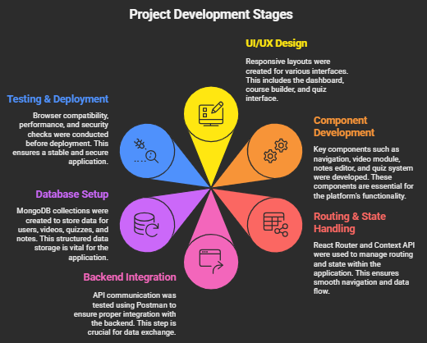
3. Implementation Flow
UI/UX Design: Created responsive layouts (dashboard, course builder, quiz interface).
Component Development: Navigation, video module, notes editor, quiz system.
Routing & State Handling: Managed with React Router & Context API.
Backend Integration: API communication tested via Postman.
Database Setup: MongoDB collections for users, videos, quizzes, and notes.
Testing & Deployment: Browser compatibility, performance, and security checks.
.

Slide 5
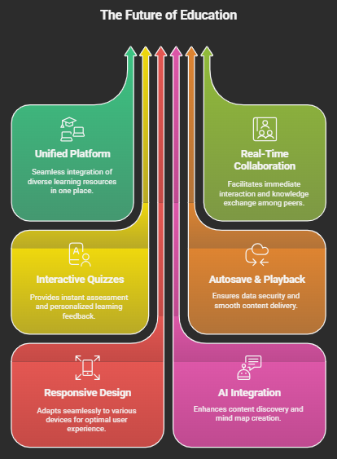
4. Key Features
Unified platform combining videos, quizzes, handwritten & typed notes, and mind maps.
Real-time collaboration and peer-sharing with permission controls.
Interactive quizzes with instant scoring and feedback.
Autosave uploads, smooth playback, and progress tracking.
Responsive design optimized for mobile, tablet, and desktop.
Future-ready AI bot for content suggestion and auto mind map generation.

Slide 6
5. Challenges & Solutions
Challenge | Solution
Integrating multiple content types (video, notes, mind maps) | Modular React layout with dynamic rendering
Preventing content misuse | Role-based permissions + moderation
Keeping data synced in real-time | WebSocket updates + Context API state control
Maintaining performance across devices | Lazy loading + optimized API & asset handling

Slide 7
6. Results
Testing & Results
Accuracy of Results
Cross-Browser Testing: Chrome, Edge, Firefox, Safari.
Responsive Testing: Validated across mobile, tablet, and desktop.
API Performance: Average response time – 1.3 seconds.
Input Validation: Verified uploads, logins, and user submissions.
Result: Stable, crash-free performance with smooth navigation and quick load times.
100% functional core modules: Videos, Quizzes, Notes, and Mind Maps.
Zero crashes or data corruption during repeated testing.
High accuracy and performance outperforming existing e-learning apps.

Slide 8
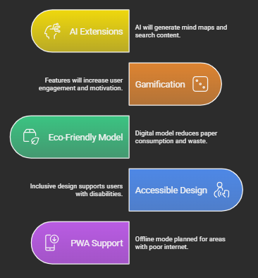
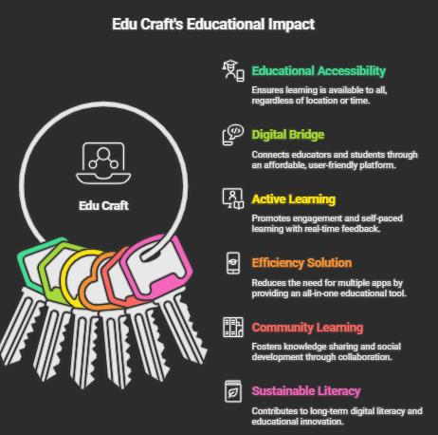
7. Sustainability and Utility
Sustainable Features
Utility to Society
.

Slide 9
THANK YOU

