Slide 1

Project Review-3
(Methodology / Application Development)
| Front-End Development Frameworks |
| Title - Edu Craft - Online Course Builder with Video & Quiz Module |
| Team Members - 2410030355-Oruganti Harshitha, 2410030356-Srujana Sadhu, 2410030357-Ashrita Sri Gayatri V, 2410040126-Annam Sravani |
|Guide - Ms P Sree Lakshmi Ma’am | Department - CSE|

Slide 2
Problem Statement & Objective
1) Problem:
Students rely on scattered platforms for videos, notes, and mind maps - disorganised and limited collaboration.
2) Project Objective:
Primary: Unified, responsive web platform for videos, notes, and mind maps; stable & crash-free.
User-Facing: Fast search & browsing, easy uploads, commenting, ratings, collaborative editing.
Non-Functional: Mobile-first UI, secure storage, smooth performance, basic accessibility.
3) Application Idea - Edu Craft:
A modular web app that unifies curated and student-uploaded content (typed, handwritten, or video). Enables seamless learning, content sharing, and collaboration in one place.
4) Minimal Acceptance Criteria:
Responsive layout (mobile → desktop)
Smooth video playback & reliable uploads with autosave
Clear error messages, secure login & privacy controls
Fast, crash-free performance

Slide 3
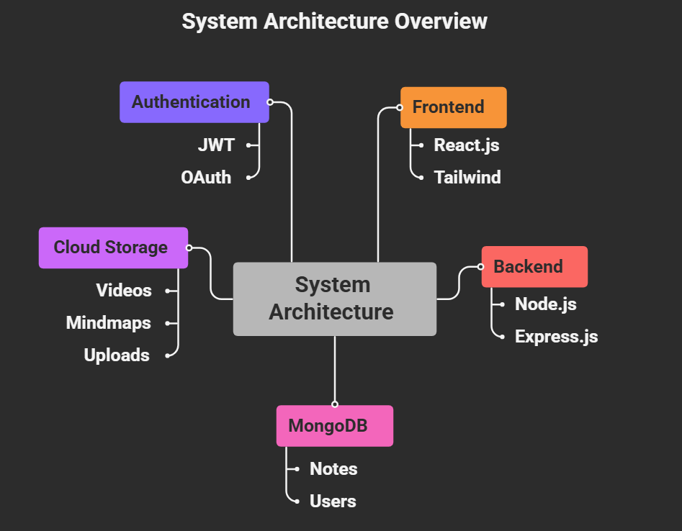
Technology Stack & Architecture
1) Frameworks, languages and tools used
- React.js: Best for modular, reusable components (videos, notes, mind maps).
- HTML5, CSS3: Core structure & styling.
2) Framer Motion: Smooth animations & transitions.
3) Backend (APIs, Auth, Data Handling)
- Node.js + Express.js: Fast, lightweight backend for handling API requests.
- MongoDB (with Mongoose ORM): Flexible document DB for notes, mind maps, and user uploads.
4) Development Tools
- VS Code: IDE with extensions for React, Git, and debugging
- GitHub/GitLab: Version control + CI/CD.

Slide 4
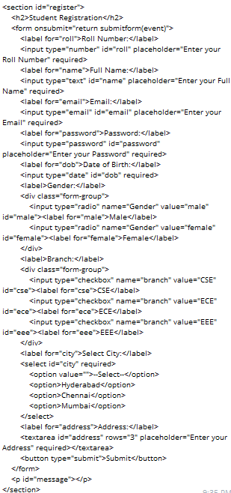
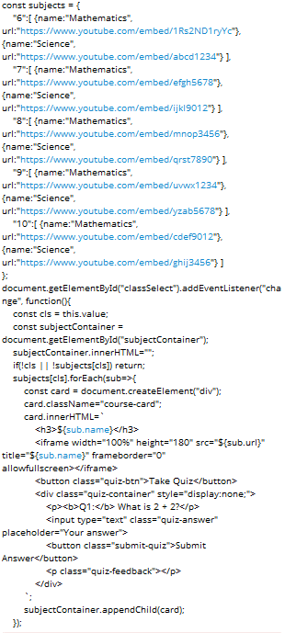
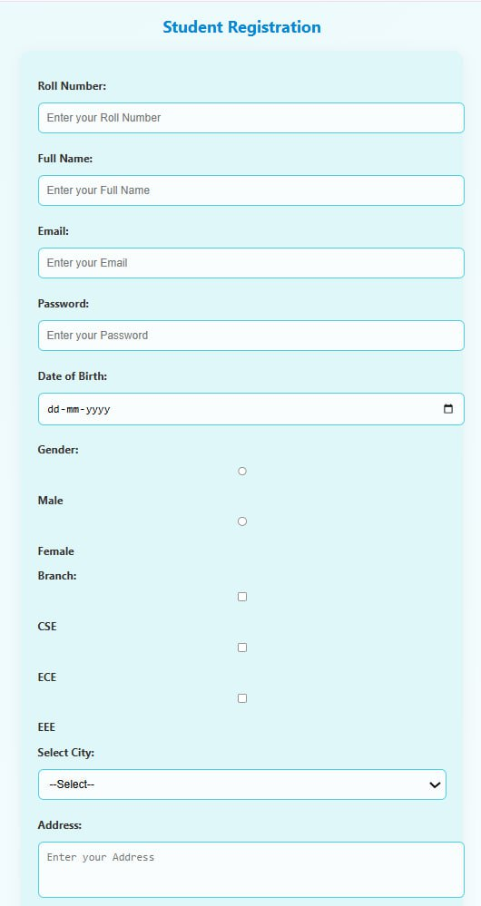
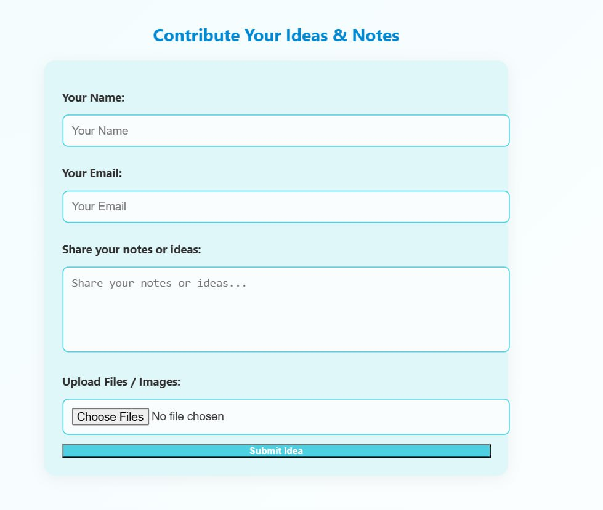
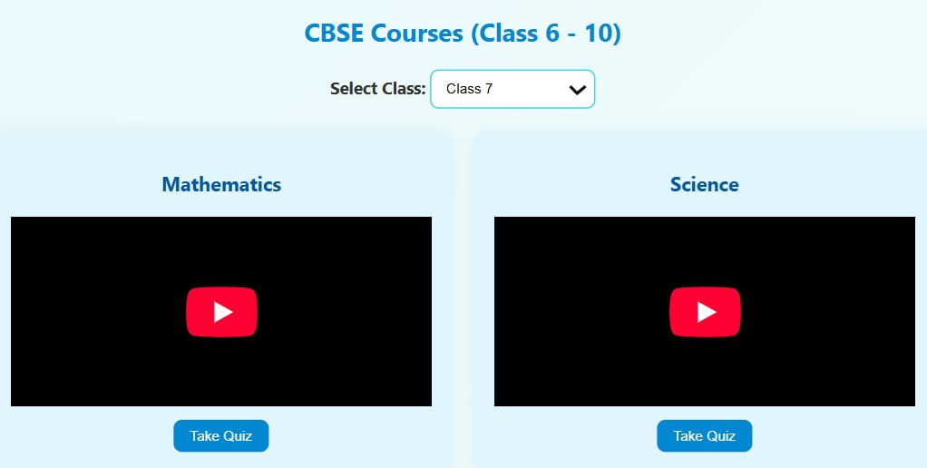
Implementation Snapshots

Slide 5
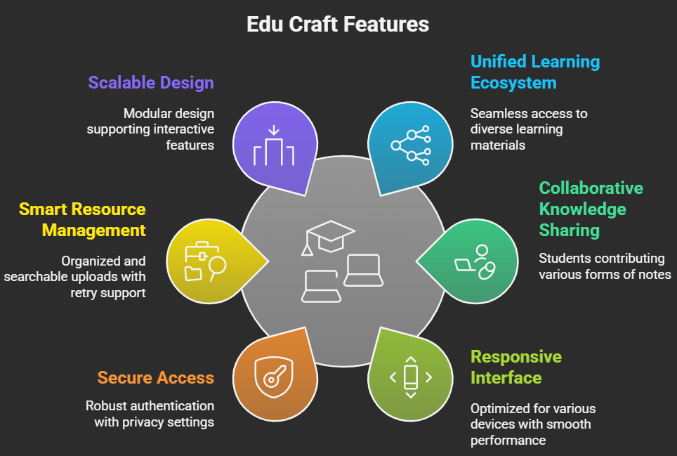
Key Features

Slide 6
Challenges & Solutions
2–3 major challenges faced + solutions
1) Seamless Multi-Content Integration
Combine videos, typed notes, handwritten scans, and mind maps without clutter
Solution: Modular, card-based React layout with dynamic rendering.
2) Safe Peer-to-Peer Sharing
Enable uploads and sharing while preventing misuse
Solution: Content moderation + fine-grained permission controls.
3) Real-Time Collaboration Consistency
Keep shared notes and mind maps synchronised for all users
Solution: State management with Redux/Context API + WebSocket updates.

Slide 7
Testing Results & Conclusion
1) Testing methods used (browser, responsive, validation)
- Cross-Browser Testing: Verified functionality on Chrome, Firefox, Edge, and Safari.
- Responsive Testing: Ensured smooth UI on mobile, tablet, and desktop screens.
- Input Validation: Checked form fields, file uploads, and content submission for errors and security.
2) Current status of the project
- Core features implemented: video streaming, notes & mindmap viewing, student uploads, authentication, and responsive UI.
- Stable, crash-free performance achieved across major devices.
3) Future scope (features to add later)
- Interactive quizzes and course previews
- Real-time collaboration on notes and mind maps
- A flexible AI-based bot will help in creating mind maps and perfect flowcharts, along with content recommendations and smart search
- Offline access and Progressive Web App (PWA) support

Slide 8
THANK YOU

