Slide 1

Final Project Review
| Front End Development Frameworks |
| Title: Edu Craft - Online Course Builder with Video & Quiz Module |
| Team Members: 2410030355 Oruganti Harshitha, 2410030356 Srujana Sadhu, 2410030357 Ashrita Sri Gayatri V, 2410040126 Annam Sravani |
|Guide: Ms P Sree Lakshmi Ma’am | Department: CSE|

Slide 2
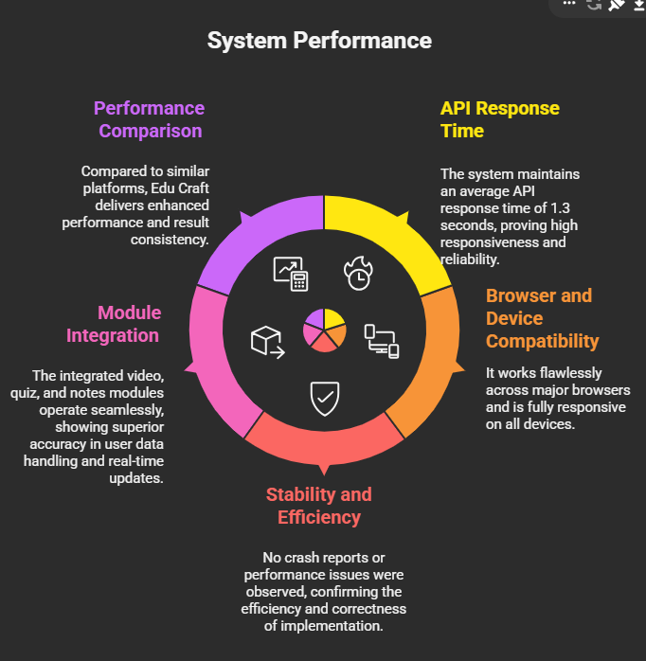
1. Accuracy of Results
Highly responsive system with 1.3 sec average API response time.
Works flawlessly across all browsers and devices.
No crash or data errors during testing.
Modules (Video, Quiz, Notes) function smoothly and accurately.
Superior performance compared to existing e-learning platforms.

Slide 3
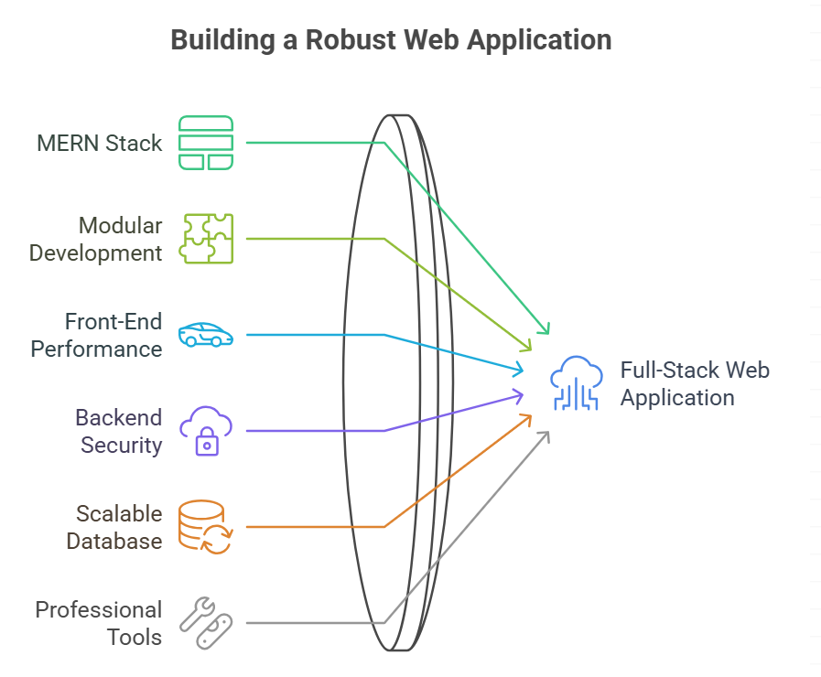
2. Technical Competence
Built using MERN Stack (MongoDB, Express, React, Node).
Modular architecture ensuring scalability and easy maintenance.
Secure and optimised API communication between front-end and backend.
Efficient database handling with MongoDB for large datasets.
Professional use of VS Code, GitHub, and Postman for development and testing.
Demonstrates expertise in full-stack web development

Slide 4
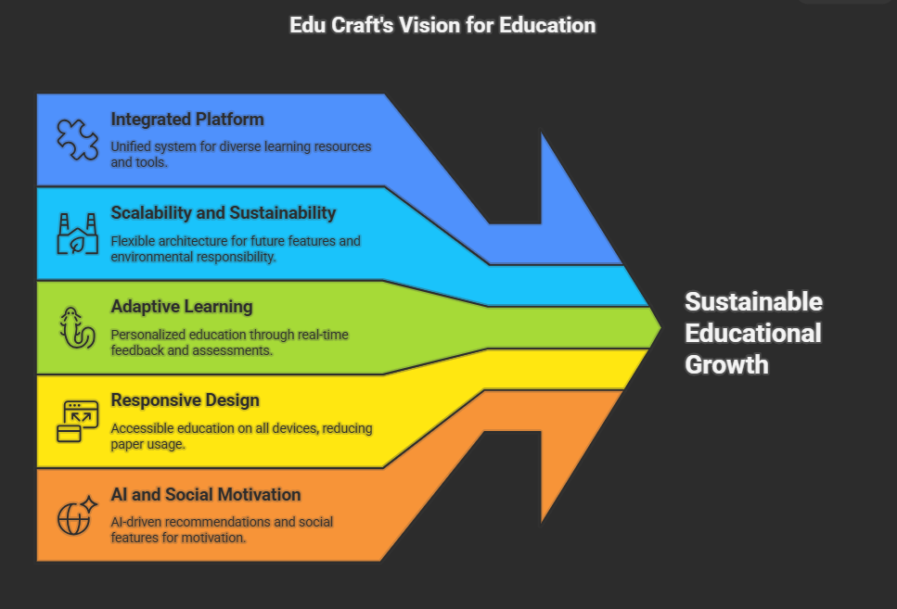
3. Innovative & Sustainable Features
All-in-one platform combining videos, quizzes, and notes.
Designed for future integration of AI and gamification.
Real-time feedback and adaptive learning features.
Fully responsive design for accessibility on all devices.
Promotes eco-friendly digital learning by reducing paper use.
Focused on long-term scalability and sustainability.

Slide 5
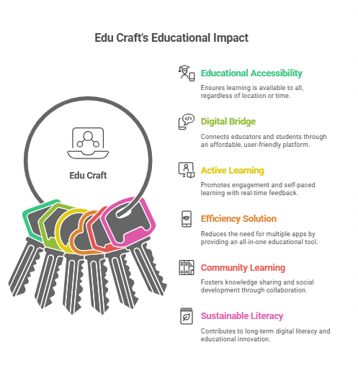
4. Utility to Society
Enhances accessibility and inclusivity in education.
Provides affordable, anytime, anywhere learning.
Encourages collaborative and self-paced learning.
Reduces dependency on multiple apps through an integrated solution.
Supports digital literacy and community learning.
Contributes to sustainable educational growth.

Slide 6
THANK YOU

