Slide 1
s
Maze Solver using A* Search
Presented by: E SOWMYA
Roll No: 07
Department: BCA
College: KLH
A shortest-path solution for a grid maze

Slide 2
1. Objective
• Represent a maze as a grid of nodes.
• Identify the start position, goal position, open cells, and walls.
• Use the A* Search Algorithm to find the shortest path.
• Use Manhattan Distance as the heuristic.
• Handle cases where the goal is unreachable.
• Visualize the final shortest path.
2

Slide 3
2. Maze / Grid Representation
• Each cell in the grid is treated as a node.
• 0 represents an open cell that can be visited.
• 1 represents a wall or obstacle.
• Start = (0, 0) and Goal = (4, 5).
• Movement is allowed in four directions: up, down, left, and right.
3

Slide 4
3. A* Search Algorithm
• A* combines the cost already travelled with an estimate of the remaining distance.
• For every node n, it calculates:
• f(n) = g(n) + h(n)
  – g(n) = actual cost from the start node to n
  – h(n) = estimated cost from n to the goal
  – The node with the lowest f(n) is explored first.
• When the goal is reached, the parent links are used to reconstruct the shortest path.
4

Slide 5
4. Heuristic – Manhattan Distance
• Manhattan Distance is suitable when movement is limited to four directions.
• Formula:
• h(n) = |x₁ − x₂| + |y₁ − y₂|
• It estimates how many horizontal and vertical moves remain.
• The heuristic helps A* search efficiently instead of exploring the entire maze.
5

Slide 6
5. Python Implementation
import heapq
def heuristic(a, b):
return abs(a[0]-b[0]) + abs(a[1]-b[1])
def a_star(maze, start, goal):
open_list = [(0, start)]
came_from = {}
g_score = {start: 0}
while open_list:
_, current = heapq.heappop(open_list)
if current == goal:
path = []
while current in came_from:
path.append(current)
current = came_from[current]
path.append(start)
return path[::-1]
for neighbor in get_neighbors(current, maze):
new_cost = g_score[current] + 1
if neighbor not in g_score or new_cost < g_score[neighbor]:
g_score[neighbor] = new_cost
priority = new_cost + heuristic(neighbor, goal)
came_from[neighbor] = current
heapq.heappush(open_list, (priority, neighbor))
return None
6

Slide 7
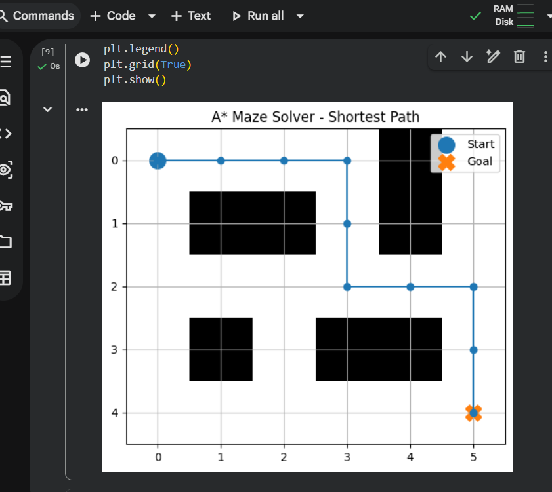
6. Output / Visualization
7

Slide 8
7. Result
• The A* algorithm successfully finds a path from the start to the goal.
• Walls and obstacles are avoided during the search.
• The returned path is reconstructed from the goal back to the start.
• If no valid route exists, the program reports that no path exists.
• The final path is displayed graphically for easy understanding.
8

Slide 9
8. Conclusion
• The Maze Solver successfully finds the shortest path using the A* Search Algorithm.
• Manhattan Distance provides an effective heuristic for a four-directional grid.
• The project demonstrates how A* can be used for pathfinding and navigation problems.
• The final solution is both computationally useful and visually easy to understand.
9

Slide 10
Thank You
Questions?

