Slide 1
Introduction
Theory of Computation
Course Code: CS110 Credit: 4
L-T-P Scheme: 3-1-0
Course Coordinator:- Dr. Ajay Kumar
Department of CSE

Slide 2
Textbook
K.L.P.Mishra: Theory of Computer Science 3rd Edition.
Michael Sipser: Introduction to the Theory of Computation, second edition, 2006
Supplementary Readings:
  J. Hopcroft, R. Motwani and J. Ullman, Introduction to Automata, Languages, and Computation, Third edition, China Machine Press, 2007
  C. Baier and J. Katoen, Principles of Model Checking, 2008, MIT Press.

Slide 3
Prerequisites:
Discrete Mathematics and
basic knowledge of algorithms

Slide 4
Focus
Automata
Computability
Complexity
Each area is interpreted differently and the answer varies according to the interpretation.

Slide 5
Why study Theory of Computing?
What are the fundamental capabilities and limitations of computers?
( All the previous area can be link to this question)

Slide 6
Complexity
What makes some problems computationally hard and others easy?
Example : Sorting problem and scheduling problem
Scheduling thousand classes make take centuries in order to find best schedule
We do not know the exact answer (past 35 year)

Slide 7
Outcome of Complexity Theory
We can demonstrate that certain problem are computationally hard
If not:
Which aspect of the problem is at the root of the difficulty(we can alter it)
Settle for less perfect solution
Some problem are hard in only in the worst case situation and easy most of the time
( Helps in designing hard problem by cryptographer)

Slide 8
Computability theory
What can and can not be computed?
Example: The problem of determining whether a mathematical statement is true or false
(Can be solved by mathematician but no computer algorithm can solve it)

Slide 9
Outcome of both studies
Complexity: Classifying problem into easy and hard
Computability: Solvable and non-solvable problem

Slide 10
Automata theory
Definition, properties of mathematical model of computation
FSM: Text processing, complier design and hardware design
CFG: Programming language and AI

Slide 11
Outcome
What is a computer?
  Formal definition of computation
Computational models
  Turing machines (= real computers)
  Simpler computing devices: finite state automata, push-down automata

Slide 12
What is Theory Good for?
Elegant way of thinking
Expanding your minds
Useful tools in practice
  finite automata, regular expressions: text processing
  grammars: programming language design and specification
  NP-hardness: approximate solutions or randomized computation

Slide 13
A Brief History: Hilbert’s Program
Hilbert’s program (1920’s)
Axiomatization of all mathematics
Completeness: all true mathematical statements can be proved in the formalism
Consistency: no contradiction can be obtained in the formalism of mathematics
Decidability: there should be an algorithm for deciding the truth or falsity of any mathematical statement
“We must know. We will know”.

Slide 14
History: Godel’s Incomplete Theorems
Godel’s first incomplete Theorem (1931)
no consistent system of axioms whose theorems can be listed by an "effective procedure" (essentially, a computer program) is capable of proving all facts about the natural numbers.
However, in 1940’s Tarski showed that the first order theory of the real numbers with addition and multiplication is decidable. In this sense, number theory is more difficult than real analysis to computer scientists.

Slide 15


Goedel and Turing (1931-1936)
Goedel (1906-1978)
Turing (1912-1954)

Slide 16
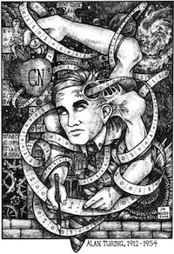
History: Turing Machine (1936)
Action: based on
the state and the
tape symbol under
the head: change
state, rewrite the
symbol and move the
head one square.
State
. . .
A
B
C
A
D
. . .
Infinite tape with
squares containing
tape symbols chosen
from a finite alphabet

Slide 17
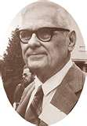
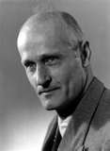
Church and Kleene
(1903-1995)
(1909-1994)

Slide 18
History: Church-Turing Thesis
Intuitive notion = Turing machine
of algorithm of Algorithm
An algorithm is an effective method expressed as a finite list of well-defined instructions for calculating a function.

Slide 19
History: Automata
Scott & Rabin: Finite Automata and their Decision Problems, 1959
Kleene: Regular languages
In a nonderministic machine, several choices may exist for the next state at any point.

Slide 20
A Simple Automata
Automatic Door as an automaton
Front
Rear
Both
Rear
Both
Neither
Front
closed
closed
closed
closed
closed
Open
closed
closed
Neither
Neither Front Rear Both
Closed
open
Closed Open Closed Closed
Open Closed Open Open

Slide 21
History: P and NP
Classify into two kinds of problems:
Those that can be solved efficiently by computers
Those that can be solved in principles, but in practice take so much time that computers are useless for all but very small instances of the problem.

Slide 22
Why Study Automata Theory
Software for designing and checking the behavior of digit circuits
Software for verifying systems of all types that have a finite number of distinct states, such as communication protocols or protocols for secure exchange of information.

Slide 23
Why Study Computability Theory (1)
Halting Problem (Turing):
Given a description of a program, decide whether the program finishes running or will continue to run, and thereby run forever. This is equivalent to the problem of deciding, given a program and an input, whether the program will eventually halt when run with that input, or will run forever.

Slide 24
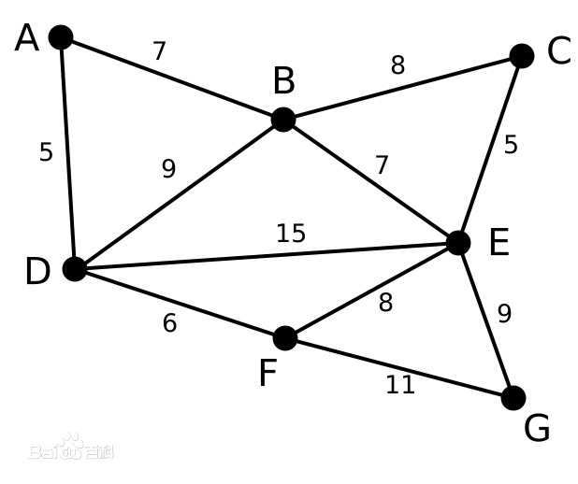
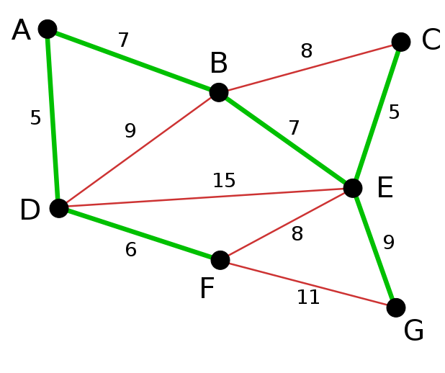
Why Study Complexity Theory (P)
Kruskal Algorithm (Minimal spanning tree problem)

Slide 25
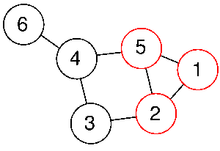
Why Study Complexity Theory (NP)
Clique Problem

Slide 26
Why Study Complexity Theory (Application)
Primality Testing and Cryptography
There are a number of techniques based on RSA codes that enhance computer security, for which the most common methods in use today rely on the assumption that it is hard to factor numbers, that is, given a composite number, to find its prime factors.
Shor’s algorithm and Quantum Computation

Slide 27
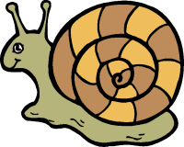
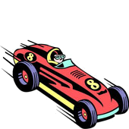
Classical Theory
Algorithm
Decidability
Efficiency (P vs. NP)
decidable
inefficient
efficient

Slide 28
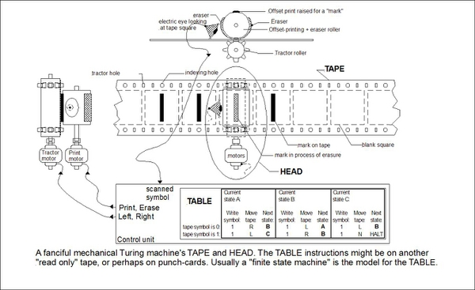
Welcome to Turing’s World

Slide 29
Automata Theory
Automata theory deals with the definitions and properties of mathematical models of computation.
The theories of computability and complexity require a precise definition of a computer. Automata theory allows practice with formal definitions of computation

Slide 30
Computability Theory And Complexity Theory
What can and can not be computed?
How quickly can a problem be computed?

Slide 31
Next Class
Basics of discrete Mathematics

