Slide 1
GitHub Workflow Activity
Darci Burdge Stoney Jackson
Copyright 2018 Darci Burdge and Stoney Jackson SOME RIGHTS RESERVED
This work is licensed under the Creative Commons Attribution-ShareAlike 4.0 International License. To view a copy of this license, visit http://creativecommons.org/licenses/by-sa/4.0/ .

Slide 2
Prepare to work on a project
GitHub

Slide 3
Navigate to project
project
(upstream)

Slide 4

Fork the project
project
(upstream)
Notes:
Fork image is from GitHub used for educational purposes.
Hand icon is in public domain from https://openclipart.org/detail/221114/hand-pointer-cursor-vectorized

Slide 5
Fork the project
project
(upstream)
your fork (origin)
Fork
Notes:
Fork image is from GitHub used for educational purposes.
Hand icon is in public domain from https://openclipart.org/detail/221114/hand-pointer-cursor-vectorized

Slide 6

GitHub maintains association
project
(upstream)
your fork (origin)
forked from

Slide 7
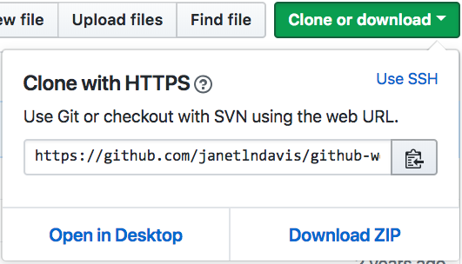
Clone your fork
project
(upstream)
your fork (origin)
forked from

Slide 8
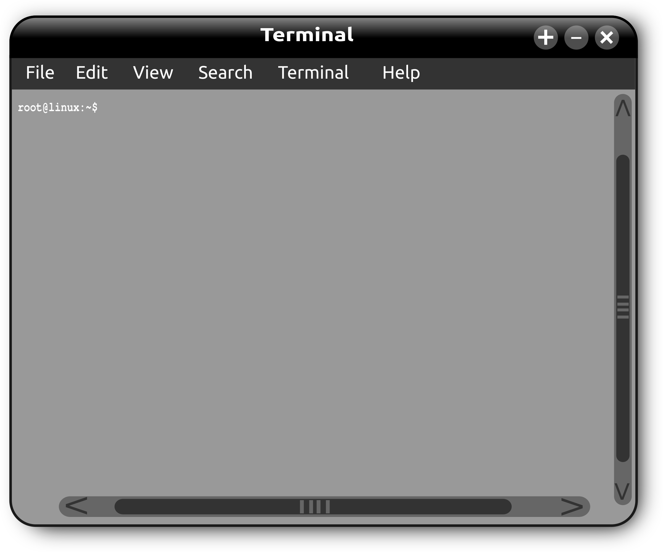
Clone your fork
project
(upstream)
your fork (origin)
forked from
$ git clone PASTE_IN_URL

Slide 9
Clone your fork
project
(upstream)
your fork (origin)
forked from
Clone
$ git clone PASTE_IN_URL
Cloning into `github-workflow...`
$
your local clone

Slide 10
Change into clone’s directory
project
(upstream)
your fork (origin)
forked from
Clone
$ cd github-workflow-activity
$
your local clone

Slide 11
Origin remote auto-created
project
(upstream)
your fork (origin)
forked from
$ git remote -v
origin https://github... (fetch)
origin https://github... (push)
$
origin
your local clone

Slide 12
Create upstream remote
project
(upstream)
your fork (origin)
forked from
your local clone

Slide 13
Create upstream remote
project
(upstream)
your fork (origin)
forked from
origin
your local clone
$ git remote add upstream PASTE_URL

Slide 14
Create upstream remote
project
(upstream)
your fork (origin)
forked from
upstream
origin
your local clone
$ git remote add upstream PASTE_URL
$

Slide 15
Ready to work
project
(upstream)
your fork (origin)
forked from
upstream
origin
your local clone

Slide 16
Contribute a change
project
(upstream)
your fork (origin)
forked from
upstream
origin
your local clone

Slide 17
Contribute a change
project
(upstream)
your fork (origin)
forked from
push
upstream
origin
your local clone

Slide 18
Contribute a change
project
(upstream)
your fork (origin)
forked from
push
upstream
origin
your local clone

Slide 19
Contribute a change
pull-request
project
(upstream)
your fork (origin)
forked from
push
upstream
origin
your local clone

Slide 20
Contribute a change
pull-request
project
(upstream)
your fork (origin)
forked from
push
upstream
origin
your local clone

Slide 21
Integrate a change
project
(upstream)
your fork (origin)
forked from
upstream
origin
your local clone

Slide 22
Integrate a change
project
(upstream)
your fork (origin)
forked from
pull
upstream
origin
your local clone

Slide 23
Integrate Changes
project
(upstream)
your fork (origin)
forked from
pull
upstream
origin
your local clone

Slide 24
Integrate Changes
project
(upstream)
your fork (origin)
forked from
push
pull
upstream
origin
your local clone

Slide 25
Integrate Changes
project
(upstream)
your fork (origin)
forked from
push
pull
upstream
origin
your local clone

Slide 26
Cycle of change
pull-request
project
(upstream)
your fork (origin)
forked from
push
pull
upstream
origin
your local clone

Slide 27
Cycle of change
pull-request
project
(upstream)
your fork (origin)
forked from
push
Setup
pull
upstream
origin
project
(upstream)
your fork (origin)
your local clone
Fork
Clone
upstream
your local clone

Slide 28
Branches
master
master
master

Slide 29
$ git branch feature $ git checkout feature
master
master
master
feature

Slide 30
$ git commit --allow-empty
master
master
feature
master

Slide 31
$ git push origin feature
feature
master
master
feature
master

Slide 32


feature
pull-request
master
master
feature
master

Slide 33
$ vim ... $ git add . ; git commit
feature
pull-request
master
master
feature
master

Slide 34
$ git push origin feature
feature
pull-request
master
master
feature
master

Slide 35
@StoneyJackson What do you think?
feature
pull-request
master
master
feature
master

Slide 36

Great idea! Can you add green?
feature
pull-request
master
master
feature
master

Slide 37
$ vim ... $ git add . ; git commit
feature
pull-request
master
master
feature
master

Slide 38
$ git push origin feature
feature
pull-request
master
master
feature
master

Slide 39
@StoneyJackson How about now?
feature
pull-request
master
master
feature
master

Slide 40
Looks great! Please update with new changes in master and I’ll merge it.
feature
master
pull-request
master
feature
master

Slide 41
$ git checkout master $ git pull upstream master $ git push origin master
feature
master
pull-request
master
feature
master

Slide 42
$ git checkout feature $ git merge master
feature
master
pull-request
master
feature
WARNING: Conflicts may occur.
master

Slide 43
$ git push origin feature
feature
master
pull-request
master
feature
master

Slide 44
@StoneyJackson OK?
feature
master
pull-request
master
feature
master

Slide 45

Perfect! Thanks!
feature
master
pull-request
master
feature
master

Slide 46
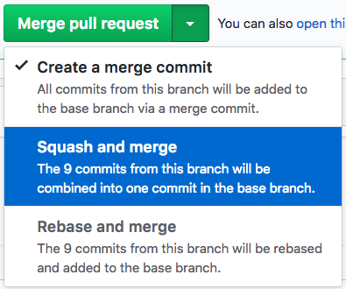
Maintainer merges PR

Slide 47
Time for beers?
feature
master
master
feature
master

Slide 48
Time to clean up!
feature
master
master
feature
master

Slide 49
$ git checkout master $ git pull upstream master
feature
master
master
feature
master

Slide 50
$ git branch -d feature $ git push -d origin feature
master
master
master
Notes:
Deleting the local branch might require a forced delete depending on how the maintainer ”merged”. `git push -D feature` (note the capital D).

Slide 51
$ git push origin master
master
master
master

Slide 52
Time for beers?
master
master
master

Slide 53
Time for beers!
master
master
master

Slide 54
Cycle of change
pull-request
project
(upstream)
your fork (origin)
forked from
push
Setup
pull
upstream
origin
project
(upstream)
your fork (origin)
your local clone
Fork
Clone
upstream
your local clone

Slide 55





foss2serve.org
Acknowledgement
This material is based on work supported by the National Science Foundation under Grants DUE-1225708, DUE-1225738, DUE-1225688, DUE-1525039 DUE-1524898, and DUE-1524877. Any opinions, findings and conclusions or recommendations expressed in this material are those of the author(s) and do not necessarily reflect the views of the National Science Foundation (NSF)
Copyright and Licensing
This work is copyrighted by Darci Burdge and Stoney Jackson, some rights reserved
This work is licensed under a Creative Commons Attribution-ShareAlike 4.0 International License http://creativecommons.org/licenses/by-sa/4.0/

