Slide 1
Basic Git
Working Locally

Slide 2
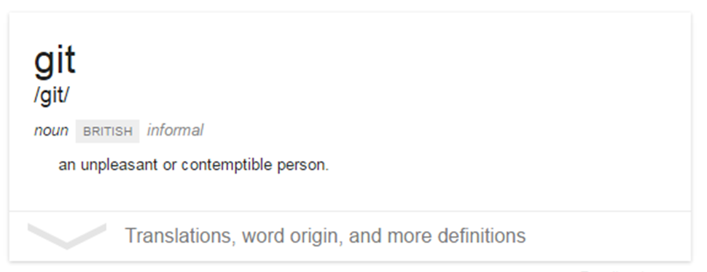
What is git?

Slide 3
What is git?
Git is a version control system
It allows you to keep track of changes to a set of files over time
You can also revert back to the previous state of a file

Slide 4
Git Snapshots
Commit #1 Commit #2 Commit #3
Aaa
Bbb
Ccc
Ddd
Ccc Xxx
Ddd
Ccc Xxx
Ddd Zzz
Eee
Fff
Eee Yyy
Fff

Slide 5
File States
Prior to a commit, files are in one of three states:
Staged
Unstaged
Untracked
Aaa
Bbb

