Slide 1
FUNDAMENTALS OF DATA ENGINEERING (24DEA310)
Data Engineering Pipeline for Public Health Trend Prediction
Review 3 — Methodology, Tools, Implementation & Functionality
Project Team
B. Vaishnavi
2420090026
S. Lahari Krishna
2420090055
K. Yasaswi
2420030053
Guide: Dr. N Sirisha

Slide 2
METHODOLOGY, SYSTEM DESIGN & ARCHITECTURE
Methodology and System Design
1 Ingest
2 Decouple
3 Process
4 Serve
A Python producer reads the 5-region, 60-day CSV dataset row by row and publishes each record as a JSON event, simulating live arrivals instead of a batch upload.
Apache Kafka receives every event on a dedicated topic, partitioned by region, so producers and downstream consumers never block on each other.
Spark Structured Streaming consumes the topic continuously, parses each event, and applies a windowed group-by on region to keep running case/death totals.
Aggregated results are written to a rolling-trends sink that refreshes as each micro-batch completes, rather than on a fixed daily/weekly schedule.
Design principle
Each stage is built as an independent, replaceable component. Kafka insulates the pipeline from slow or unavailable consumers, and Spark's checkpointing lets processing resume from where it left off rather than reprocessing the full stream after a restart.
2

Slide 3
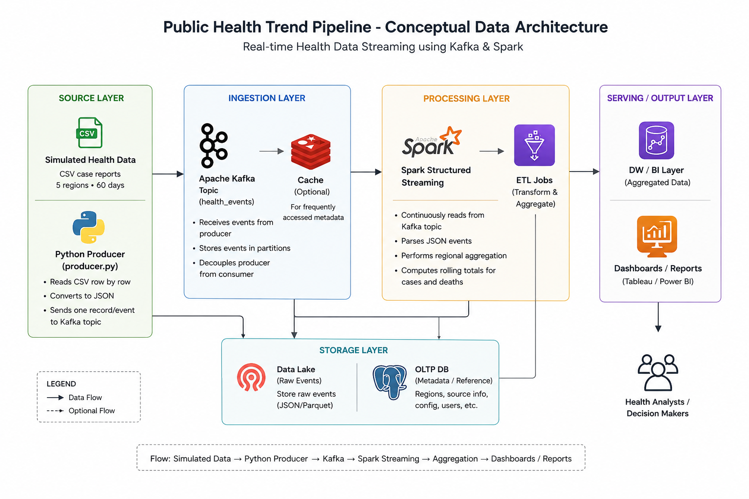
Simulated
Health Data
Kafka
Topic
Spark
Streaming
Rolling
Trends
CSV case reports
5 regions • 60 days
Producer sends
one record/event
Continuous consume
+ regional aggregation
Live case/death
totals by region
Why this design?
Kafka decouples “data arriving” from “data being processed,” helping prevent data loss when processing is temporarily delayed.
3

Slide 4
USE OF MODERN TOOLS AND TECHNOLOGIES
Tools & Technology Stack
Tool | Role | Why it was chosen
Apache Kafka | Real-time message queue | Durable, high-throughput event log that decouples producers from consumers and survives downstream slowdowns
Apache Spark (Structured Streaming) | Stream processing engine | Native micro-batch model for continuous, windowed aggregation with built-in checkpointing
Python | Data producer | Simple, well-supported Kafka client libraries for reading the CSV and emitting one event per record
Docker / Docker Compose | Environment orchestration | Reproducible, one-command setup for Kafka, Zookeeper, and Spark across any machine
4

Slide 5
IMPLEMENTATION, CODING QUALITY & FUNCTIONALITY
Implementation Overview
producer.py
health-events (Kafka topic)
Reads the CSV dataset row by row, builds a JSON event (region, date, cases, deaths), and publishes it to the Kafka topic keyed by region so records for the same region stay ordered.
Single topic, partitioned by region, retains events durably so the Spark job can be restarted without losing or duplicating data.
spark_job.py
docker-compose.yml
Reads the Kafka topic as a stream, parses the JSON schema, applies a group-by-region aggregation with checkpointing, and writes rolling totals to the output sink.
Defines Zookeeper, Kafka broker, and Spark services with mounted volumes for the code and dataset, so the entire pipeline comes up with one command.
5

Slide 6
IMPLEMENTATION, CODING QUALITY & FUNCTIONALITY
Coding Quality & Engineering Practices
✓
Modular structure
✓
Centralized configuration
Producer, streaming job, and configuration are kept in separate files instead of one monolithic script, so each piece can be tested and modified independently.
Broker address, topic name, and batch interval live in one config file / environment variables rather than being hardcoded across scripts.
✓
Structured logging
✓
Defensive error handling
The producer logs each send confirmation and the Spark job logs batch progress, so failures can be traced to a specific stage and record.
Try/except blocks around Kafka connections and malformed CSV rows stop a single bad record from crashing the whole pipeline.
✓
Checkpointing & recovery
✓
Version control
Spark Structured Streaming checkpoints offsets, so a restarted job resumes exactly where it left off instead of reprocessing or skipping events.
Work is committed incrementally on GitHub — producer, then Kafka topic setup, then the Spark job, then Docker Compose — keeping each milestone reviewable.
6

Slide 7
IMPLEMENTATION, CODING QUALITY & FUNCTIONALITY
Functionality Demonstration
Sample rolling-output (illustrative)
Region | Cumulative Cases | Cumulative Deaths | Last Updated
Region A | 1,842 | 37 | Batch 42
Region B | 963 | 14 | Batch 42
Region C | 2,105 | 51 | Batch 42
Region D | 1,320 | 29 | Batch 42
Region E | 877 | 12 | Batch 42
What this shows
Totals update per micro-batch as events stream in, rather than on a fixed daily/weekly refresh.
All 5 regions are tracked independently, matching the simulated 60-day dataset.
Restarting the Spark consumer mid-stream resumes from the last checkpoint with no duplicated or dropped events.
7

Slide 8
SUMMARY
Current Status & Next Steps
Done
Next
Producer, Kafka topic, and Spark streaming job implemented and wired together
Docker Compose environment brings up the full pipeline with one command
Rolling regional aggregation verified across the simulated 60-day dataset
Persist rolling trends to a lightweight store for historical queries
Add a simple dashboard to visualize trends as they update
Introduce alerting when a region's case count crosses a threshold
8

Slide 9
Thank You

