Slide 1

“HealthScope” – A Full-Lifecycle Public Health Analytics & Risk Dashboard
DATA SCIENCE (24AD3107) Project Review-2
^{16th September, 2026}
 | Under the Guidance of Mrs. Bonagani Prathusha Department of Computer Science and Engineering, KLH CSE Bowrampet Campus
Team Members Kunchala Naga Chaitanya Sphoorthy-2420030510 Kolapally Vasavi- 242003078 M. Haswanthi-2420030143

Slide 2
PROBLEM STATEMENT
E-commerce businesses generate large amounts of transaction data.
Raw data is difficult to understand and analyse directly.
Businesses need insights into sales and customer behaviour.
Product performance and country-wise sales need to be analysed.
Businesses also need to understand future revenue trends.
An integrated analytics solution is needed for better business decision-making.

Slide 3
OBJECTIVES
To clean and preprocess e-commerce transaction data.
To analyze sales, customer, product, and country-wise performance.
To perform RFM analysis for understanding customer behavior.
To segment customers into meaningful groups.
To forecast future revenue using historical sales patterns.
To develop an interactive Streamlit dashboard for visualizing insights.

Slide 4
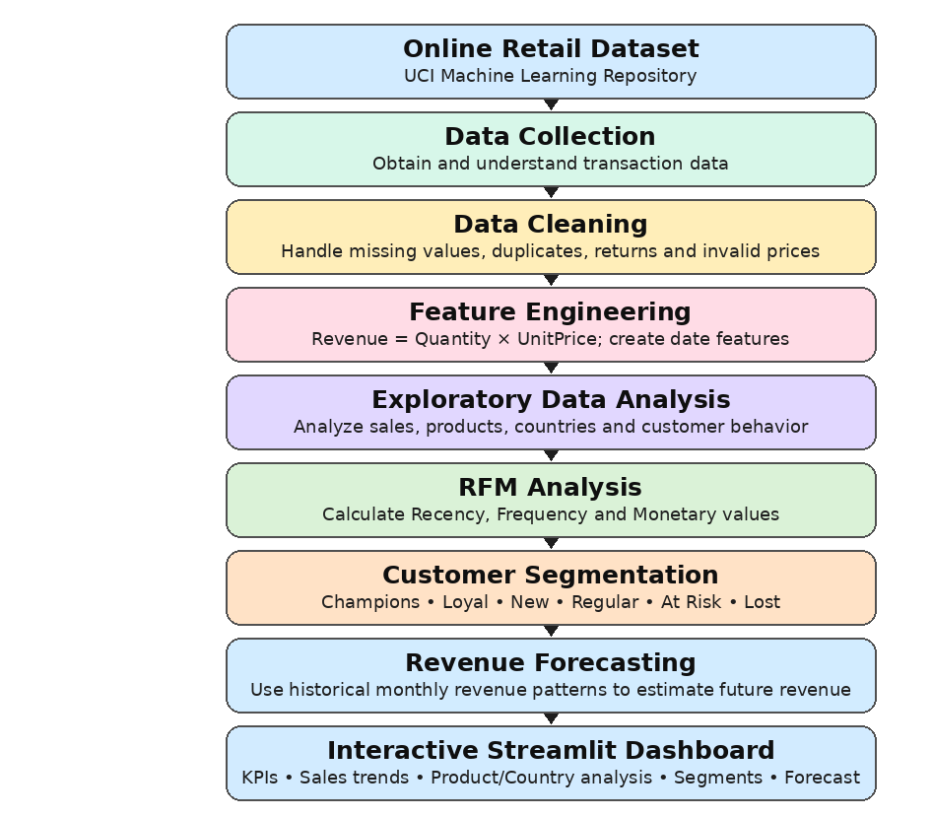
PROJECT DESIGN

Slide 5
METHODOLOGY
1. Data Collection
Collect the Online Retail dataset from UCI Machine Learning Repository.
Understand transaction, product, customer, date, price, and country fields.
2. Data Preprocessing
Handle missing values.
Remove duplicate records.
Identify and handle returned/cancelled transactions.
Remove invalid or non-positive prices.
Convert InvoiceDate into proper date-time format.
3. Feature Engineering
Create Revenue = Quantity × UnitPrice.
Extract Year, Month, Day, and Hour from InvoiceDate.
Prepare customer-level and monthly-level data for further analysis.
4. Exploratory Data Analysis
Analyze overall sales and revenue trends.
Identify top-performing products.
Analyze country-wise sales performance.
Study customer purchasing behavior.

Slide 6
METHODOLOGY
5. RFM Analysis
Calculate:
  Recency – how recently a customer purchased.
  Frequency – how often a customer purchased.
  Monetary – how much a customer spent.
6. Customer Segmentation
Use RFM values to classify customers into:
  Champions
  Loyal Customers
  New Customers
  Regular Customers
  At Risk
  Lost Customers
7. Revenue Forecasting
Aggregate historical revenue month-wise.
Analyze historical monthly revenue patterns.
Generate future monthly revenue estimates.
8. Dashboard Development
Integrate all processed results into Streamlit.
Display KPIs, sales trends, product/country performance, customer segments, and revenue forecasts.

Slide 7
MACHINE LEARNING APPROACH
Model / Technique | Purpose
RFM Analysis | Measures Recency, Frequency, and Monetary value to understand customer purchasing behavior.
Customer Segmentation | Groups customers into meaningful segments based on their RFM behavior.
Revenue Forecasting | Uses historical monthly revenue patterns to estimate future monthly revenue.
Model / Forecast Evaluation
The analytical outputs will be evaluated using:
Customer segment distribution and RFM behavior
Historical monthly revenue patterns
Comparison of forecasted revenue with historical trends
Business interpretability of customer and revenue insights
Output
Customer Segments + Revenue Forecast → Streamlit Dashboard → Business Insights
This wording matches the structure and level of detail of the reference slide, while using only the techniques actually relevant to your RetailIQ project.

Slide 8
DASHBOARD DESIGN
Dashboard Components
Component | Purpose
KPI Cards | Display Total Revenue, Total Orders, Total Customers and Total Products.
Sales Trend | Shows monthly revenue and sales performance over time.
Product Performance | Identifies top-performing products based on sales/revenue.
Country Performance | Displays country-wise sales performance.
Customer Segmentation | Visualizes RFM-based customer segments such as Champions, Loyal, New, Regular, At Risk and Lost.
Revenue Forecast | Displays estimated future monthly revenue based on historical sales patterns.

Slide 9
TECHNICAL STACK
Area | Technology
Programming Language | Python
Data Processing | Pandas, NumPy
Data Visualization | Matplotlib, Seaborn
Machine Learning | Scikit-learn
Dashboard | Streamlit
Development | VS Code, Jupyter Notebook
Version Control | Git / GitHub

Slide 10
PROBLEM GAP
Existing Approach | Identified Gap | RetailIQ Solution
Sales data is analyzed separately. | Lack of an integrated analysis of sales, products, customers, and countries. | Provides a combined e-commerce analytics solution.
RFM is used for customer segmentation. | Customer segmentation is often treated separately from sales analysis and forecasting. | Integrates RFM-based segmentation with overall business analytics.
Sales forecasting is performed using historical data. | Forecasting results are not always presented together with customer and sales insights. | Combines revenue forecasting with other analytics in one dashboard.
Business dashboards mainly focus on visualization. | Limited integration of customer segmentation and predictive insights. | Provides an interactive Streamlit dashboard with segmentation and forecasting.
Data analysis may require separate tools or processes. | Difficult for users to view all important insights in one place. | Presents KPIs, trends, customer segments, product insights, and forecasts in one platform.

Slide 11
INNOVATION, CREATIVITY & NOVELTY
Aspect | RetailIQ – Innovation / Novelty
Integrated Analytics | Combines sales, customer, product, and country-wise analysis in one solution.
Customer Segmentation | Uses RFM analysis to group customers into meaningful segments such as Champions, Loyal, At Risk, and Lost.
Revenue Forecasting | Uses historical monthly revenue patterns to estimate future revenue trends.
Interactive Dashboard | Presents KPIs, analysis, customer segments, and forecasts through an interactive Streamlit dashboard.
End-to-End Approach | Provides a complete flow from data cleaning → analysis → segmentation → forecasting → visualization.
Business Decision Support | Converts raw e-commerce transaction data into actionable insights for better decision-making.

Slide 12
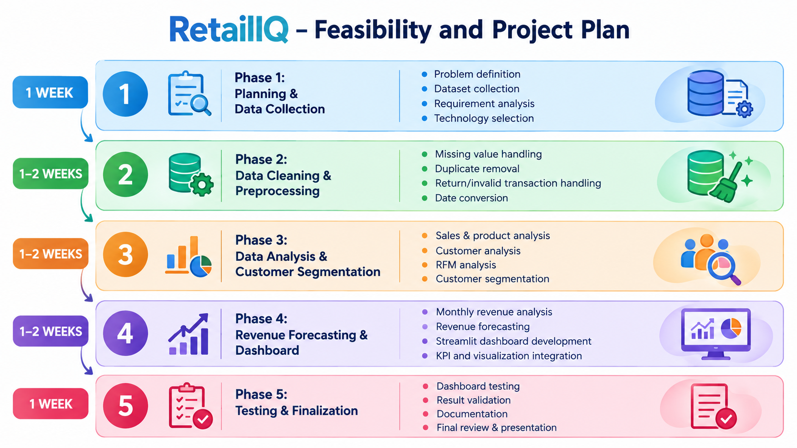
PROJECT PLAN

Slide 13
CONCLUSION
Retail IQ transforms raw e-commerce transaction data into meaningful business insights.
The project combines data preprocessing, feature engineering, EDA, RFM analysis, customer segmentation, and revenue forecasting.
Customer segmentation helps understand different customer purchasing behavior’s.
Revenue forecasting provides an estimate of future monthly revenue.
The Stream lit dashboard presents KPIs, sales trends, product performance, country performance, customer segments, and forecasts in an interactive format.
Overall, Retail IQ provides an end-to-end e-commerce analytics solution to support data-driven business decisions.

Slide 14
THANK YOU

