Slide 1



AI-POWERED BANKING CUSTOMER COMPLAINT MANAGEMENT SYSTEM USING BERT
Presentation by:
B. Kundana Mani (2420030558)
M. Sai Kridhay Kumar (2420030211)
Notes:
Good morning everyone.
Our project is titled AI-Powered Banking Customer Complaint Management System using BERT.
The objective of this project is to automate the complete complaint management process in banks using Artificial Intelligence.
Instead of manually reading complaints, our system uses the BERT language model to understand complaint narratives, classify them into multiple categories, and automatically generate ticket information, assign departments, prioritize complaints, and provide dashboards for customers, employees, and administrators.

Slide 2
PROBLEM DEFINITION
Banks receive a large number of customer complaints.
Manually reading and categorizing complaints takes time and can cause errors.
Incorrect categorization can send complaints to the wrong department.
This can delay complaint resolution and increase manual work.
Existing traditional methods have limited ability to understand the context of complaint text.
Therefore, an intelligent system is needed to classify, prioritize and route complaints automatically.
2

Slide 3
INNOVATION
Combines AI classification + complaint management in one system.
Customer, Employee and Administrator modules.
Automatic complaint routing instead of only predicting a category.
Customer can track the complaint until resolution.
Innovation,
&
Novelty
3

Slide 4
NOVELTY
Existing studies mainly focus on complaint classification, topic detection, intent detection or priority prediction.
They generally do not combine classification with the complete complaint-handling process.
Innovation,
&
Novelty
4

Slide 5
NOVELTY
Use BERT for context-based complaint classification.
Connect the prediction to a Business Rule Engine.
Automatically generate ticket information, priority, department and employee assignment.
Innovation,
&
Novelty
5

Slide 6
OBJECTIVES
To improve the contextual understanding and accuracy of customer complaint classification.
To reduce delays and inconsistencies caused by manual complaint categorization and routing.
To enable automated prioritization and department-wise complaint routing.
To reduce manual effort in complaint handling and improve resolution efficiency.
To provide a centralized platform for transparent complaint tracking and management.
6
Notes:
Previous Project
DistilBERT Fine-Tuned on CFPB Consumer Complaints
Project Link (Hugging Face):
Mahesh9/distil-bert-fintuned-cfpb-complaints-data
Reported Results
Accuracy: 94.57%
Precision: 86.32%
Recall: 83.68%
F1-Score: 84.84%

Slide 7
DATASETS - Datasets used
Dataset | Input (X) | Original Output (Y) | Our Processed Output
CFPB Consumer Complaint Database | Consumer Complaint Narrative | Product, Sub-product, Issue, Sub-issue | Product, Sub-product, Issue, Sub-issue
BANKING77 | Customer Query | Intent | Product, Sub-product, Issue, Sub-issue
Automatic Ticket Classification | Complaint / Ticket Text | Complaint Category | Product, Sub-product, Issue, Sub-issue
All three contain customer complaint, banking or financial-service text.
They are suitable for text classification using NLP.
They provide different types of complaint information.
We convert the different label structures into a common format for comparison and model use.
7
Notes:
Why These Columns?
Complaint Narrative contains the contextual information required for classification.
Product, Sub-product, Issue, and Sub-issue serve as target labels for BERT training.
Other columns (Company, State, ZIP Code, Date Received, Company Response, etc.) were excluded because they are either unavailable during prediction, unrelated to complaint semantics, or may introduce bias and data leakage.
Why CFPB Dataset?
Large real-world banking complaint dataset.
Officially published by the U.S. Consumer Financial Protection Bureau.
Contains diverse financial complaint narratives.
Well-suited for training NLP and BERT-based complaint classification models.

Slide 8
DATASETS – Feature Selection
Main text feature:
Complaint Narrative / Complaint Text
This is used because it contains the actual description of the customer's problem.
Target features
Product → broad complaint category
Sub-product → more specific product/category
Issue → main problem
Sub-issue → detailed problem
8
Notes:
Why These Columns?
Complaint Narrative contains the contextual information required for classification.
Product, Sub-product, Issue, and Sub-issue serve as target labels for BERT training.
Other columns (Company, State, ZIP Code, Date Received, Company Response, etc.) were excluded because they are either unavailable during prediction, unrelated to complaint semantics, or may introduce bias and data leakage.
Why CFPB Dataset?
Large real-world banking complaint dataset.
Officially published by the U.S. Consumer Financial Protection Bureau.
Contains diverse financial complaint narratives.
Well-suited for training NLP and BERT-based complaint classification models.

Slide 9
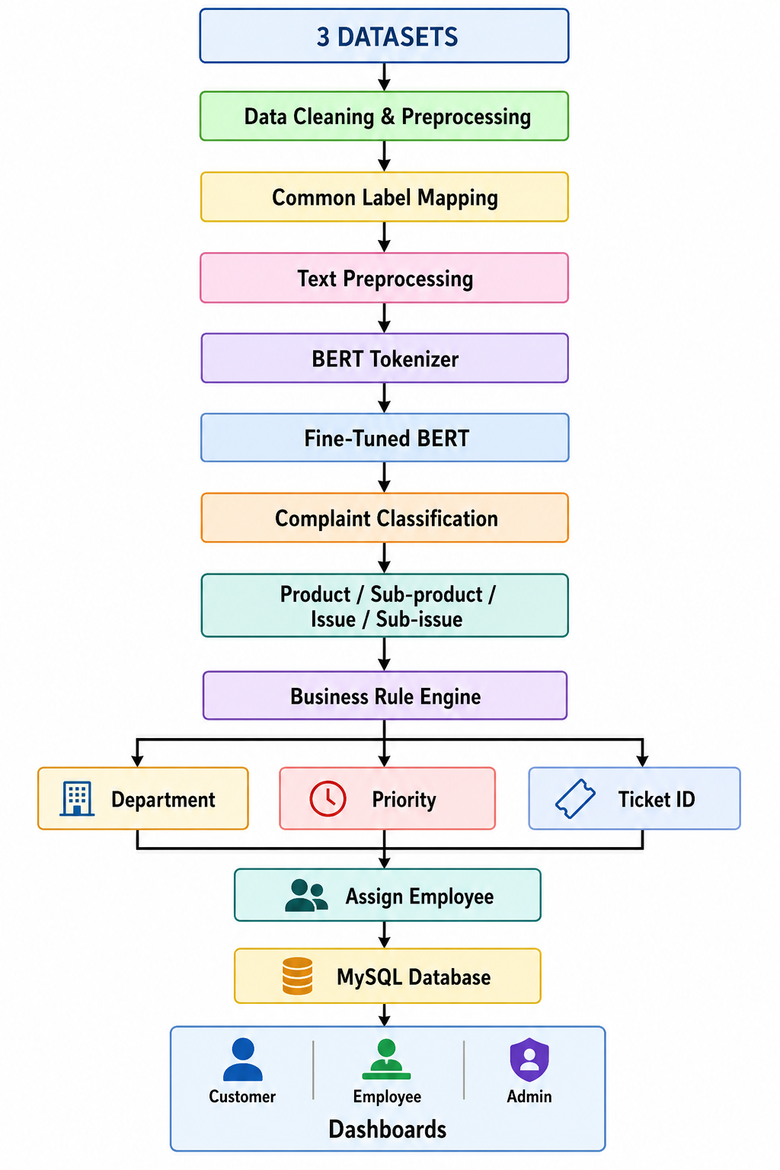
DESIGN, & METHODOLOGY
Input: Customer Complaint Text
AI Output: Complaint Classification
System Output: Department + Priority + Ticket ID + Employee
9
Notes:
Why These Columns?
Complaint Narrative contains the contextual information required for classification.
Product, Sub-product, Issue, and Sub-issue serve as target labels for BERT training.
Other columns (Company, State, ZIP Code, Date Received, Company Response, etc.) were excluded because they are either unavailable during prediction, unrelated to complaint semantics, or may introduce bias and data leakage.
Why CFPB Dataset?
Large real-world banking complaint dataset.
Officially published by the U.S. Consumer Financial Protection Bureau.
Contains diverse financial complaint narratives.
Well-suited for training NLP and BERT-based complaint classification models.

Slide 10
DESIGN, & METHODOLOGY
1. Dataset Collection
Collect CFPB, BANKING77 and Automatic Ticket Classification datasets.
2. Data Preprocessing
Clean complaint text, remove unnecessary data and handle missing values.
3. Common Label Mapping
Convert the different dataset label structures into the common:
Product → Sub-product → Issue → Sub-issue
4. Feature Selection
Use the complaint/query text as X (input) and the four complaint levels as Y (output).
5. BERT Tokenization
Convert complaint text into tokens, token IDs and attention masks.
6. BERT Fine-Tuning
Fine-tune the pre-trained BERT model using the prepared complaint data.
7. Complaint Classification
Predict Product, Sub-product, Issue and Sub-issue.
8. Business Rule Processing
Use the predicted categories to determine department, priority, response time and employee assignment.
9. System Integration
Store complaint details in MySQL and display them through the Customer, Employee and Admin modules.
10. Evaluation
Evaluate the model using Accuracy, Precision, Recall and F1-score.
10
Notes:
Why These Columns?
Complaint Narrative contains the contextual information required for classification.
Product, Sub-product, Issue, and Sub-issue serve as target labels for BERT training.
Other columns (Company, State, ZIP Code, Date Received, Company Response, etc.) were excluded because they are either unavailable during prediction, unrelated to complaint semantics, or may introduce bias and data leakage.
Why CFPB Dataset?
Large real-world banking complaint dataset.
Officially published by the U.S. Consumer Financial Protection Bureau.
Contains diverse financial complaint narratives.
Well-suited for training NLP and BERT-based complaint classification models.

Slide 11
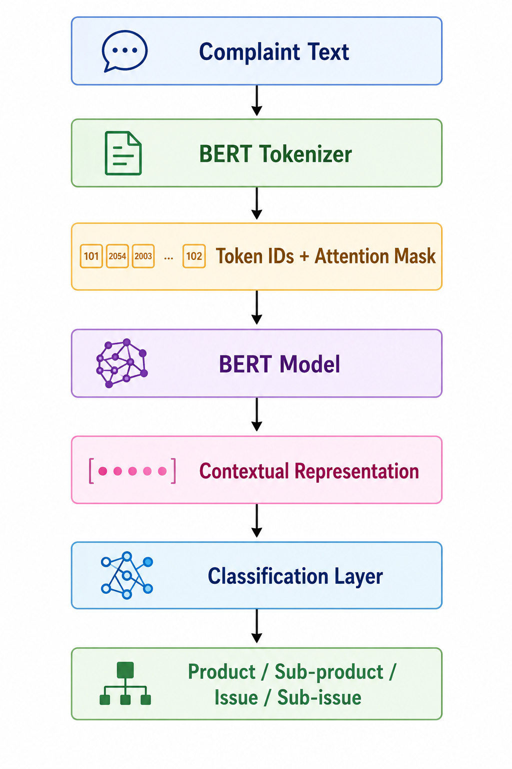
IMPLEMENTATION OF ALGORITHM
BERT — Primary Algorithm
BERT = Bidirectional Encoder Representations from Transformers
BUSINESS RULE ENGINE
The Business Rule Engine takes the output of BERT and applies predefined rules to manage the complaint.
11
Notes:
Why These Columns?
Complaint Narrative contains the contextual information required for classification.
Product, Sub-product, Issue, and Sub-issue serve as target labels for BERT training.
Other columns (Company, State, ZIP Code, Date Received, Company Response, etc.) were excluded because they are either unavailable during prediction, unrelated to complaint semantics, or may introduce bias and data leakage.
Why CFPB Dataset?
Large real-world banking complaint dataset.
Officially published by the U.S. Consumer Financial Protection Bureau.
Contains diverse financial complaint narratives.
Well-suited for training NLP and BERT-based complaint classification models.

Slide 12
Why BERT?
Understands the context of complaint text.
Produces contextual representations of words.
Suitable for long and detailed customer complaints.
Can be fine-tuned for our specific classification task.
Supporting Technologies
PyTorch — training and running the BERT model
Hugging Face Transformers — BERT model and tokenizer
Flask — connects the trained model to the web application
MySQL — stores complaint and system data
12

Slide 13
SYSTEM MODULES
ADMINISTRATOR
Manage customers
Manage employees
Manage departments
Manage complaints
View complaint statistics
Monitor system analytics
CUSTOMER
Register / Login
Submit complaint
Receive Ticket ID
View complaint details
Track complaint status
EMPLOYEE
Login
View assigned complaints
Update complaint status
Add remarks
Resolve complaints
13

Slide 14
THANK YOU
14

