Slide 1



AI-POWERED BANKING CUSTOMER COMPLAINT MANAGEMENT SYSTEM USING BERT
Presentation by:
B. Kundana Mani (2420030558)
M. Sai Kridhay Kumar (2420030211)
Notes:
Good morning everyone.
Our project is titled AI-Powered Banking Customer Complaint Management System using BERT.
The objective of this project is to automate the complete complaint management process in banks using Artificial Intelligence.
Instead of manually reading complaints, our system uses the BERT language model to understand complaint narratives, classify them into multiple categories, and automatically generate ticket information, assign departments, prioritize complaints, and provide dashboards for customers, employees, and administrators.

Slide 2
PROBLEM STATEMENT
Banks receive a large volume of customer complaints, making manual classification and routing time-consuming and prone to errors.
Traditional keyword-based and machine learning approaches have limited ability to understand the contextual meaning of complaint narratives.
Incorrect categorization can lead to improper routing and delayed resolution.
Therefore, an intelligent system is required to automatically understand, classify, prioritize, and route customer complaints.
2

Slide 3
EXISTING SYSTEM
Existing Approach | Limitation
Manual Complaint Processing | Time-consuming and inconsistent
Keyword-Based Routing | Cannot understand semantic context
Logistic Regression | Relies on TF-IDF/Bag-of-Words features
Naïve Bayes | Limited contextual understanding
Support Vector Machine (SVM) | Requires handcrafted feature engineering
3
Notes:
Limitations of Existing Systems:
Complaint classification only
No automated ticket generation
No department or employee assignment
No end-to-end complaint management workflow

Slide 4
LITERATURE SURVEY
Paper / Year | Method Used | Dataset | What They Did | Limitation
Bastani et al. (2019) | LDA | CFPB | Found common topics in consumer complaints | Focuses on topics, not detailed complaint classification or management
Sangaraju et al. (2022) | BERT Embeddings + BERTopic | CFPB | Used BERT-based representations to find complaint topics | Mainly focuses on topic analysis, not complete complaint handling
Vaishnav et al. (2024) | Machine Learning + LDA | CFPB | Used complaint data for analysis and prediction | Does not provide a complete complaint routing system
Marshan et al. (2023) | NLP + Emotion Detection | Customer complaint data | Analyzed customer complaints and emotions | Focuses on emotion/priority, not the complete complaint lifecycle
Mokase et al. (2025) | LSTM vs BERT | Complaint dataset | Compared LSTM and BERT for complaint classification | Mainly focuses on classification rather than complaint management
4
Notes:
Existing studies focus on classification, topic modeling, or priority prediction, but none provides a complete AI-powered banking complaint management system.

Slide 5
LITERATURE SURVEY
Paper / Year | Method Used | Dataset | What They Did | Limitation
Casanueva et al. (2020) | Intent Classification | BANKING77 | Classified banking customer queries into 77 intents | Focuses on intent classification, not detailed complaint management
Jarrar et al. (2023) | AraBERT | ArBanking77 | Applied BERT to Arabic banking intent classification | Focuses on Arabic intent detection
Gao et al. (2023) | NLP + Anomaly Detection | CFPB | Used complaint text to detect unusual complaint patterns | Focuses on anomaly detection rather than complaint routing
Towards Automated Customer Support (2018) | NLP / Neural Models | Customer Support on Twitter | Studied automated responses for customer-support conversations | Focuses on support conversations rather than banking complaint management
Think Before You Classify | LLM-based Classification | Financial complaint data | Studied automated classification of financial complaints | Focuses mainly on classification, not the complete complaint-management process
4
Notes:
Existing studies focus on classification, topic modeling, or priority prediction, but none provides a complete AI-powered banking complaint management system.

Slide 6
RESEARCH GAP IDENTIFICATION
Existing Research | Proposed System
Complaint classification only | Complete complaint lifecycle management
No automatic ticket generation | Automatic ticket ID generation
No department mapping | Business Rule Engine for routing
No employee assignment | Intelligent employee allocation
No complaint tracking | Customer complaint tracking portal
No analytics dashboard | Admin dashboard with complaint analytics
Existing studies do not integrate BERT-based complaint classification, business rule automation, and web-based complaint management into a single intelligent banking solution.
5

Slide 7
OBJECTIVES
To improve the contextual understanding and accuracy of customer complaint classification.
To reduce delays and inconsistencies caused by manual complaint categorization and routing.
To enable automated prioritization and department-wise complaint routing.
To reduce manual effort in complaint handling and improve resolution efficiency.
To provide a centralized platform for transparent complaint tracking and management.
6
Notes:
Previous Project
DistilBERT Fine-Tuned on CFPB Consumer Complaints
Project Link (Hugging Face):
Mahesh9/distil-bert-fintuned-cfpb-complaints-data
Reported Results
Accuracy: 94.57%
Precision: 86.32%
Recall: 83.68%
F1-Score: 84.84%

Slide 8
INNOVATION
Context-aware complaint classification using fine-tuned BERT instead of relying only on keyword-based classification.
Automated routing based on predicted complaint categories through a Business Rule Engine.
Integration of AI classification with ticket generation, priority assignment, department routing, and employee assignment.
Innovation, Creativity &
Novelty
7

Slide 9
Innovation, Creativity &
Novelty
CREATIVITY
Integration of AI, NLP, Flask, and MySQL into a single platform.
Role-based web application for Customers, Employees, and Administrators.
8

Slide 10
NOVELTY
Uses Complaint Narrative as the primary input for prediction.
Predicts four complaint categories simultaneously.
Combines AI-based classification with automated ticket generation and complaint tracking.
Innovation, Creativity &
Novelty
9

Slide 11
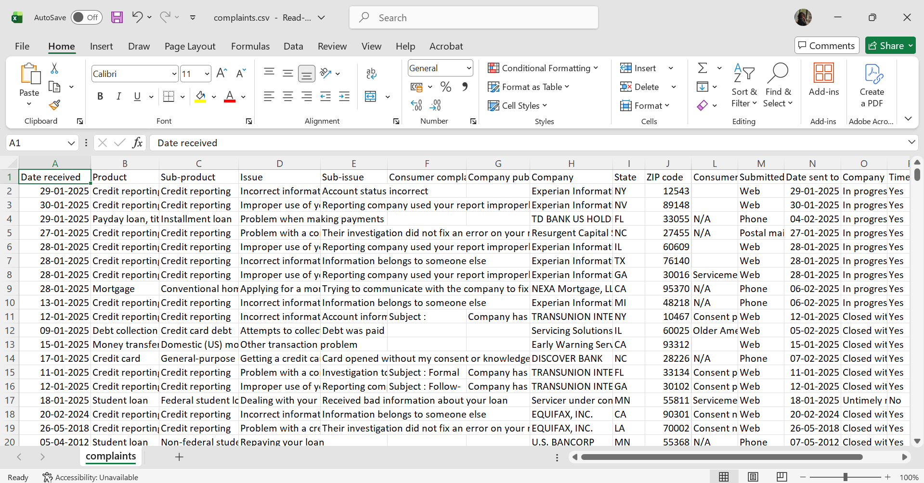
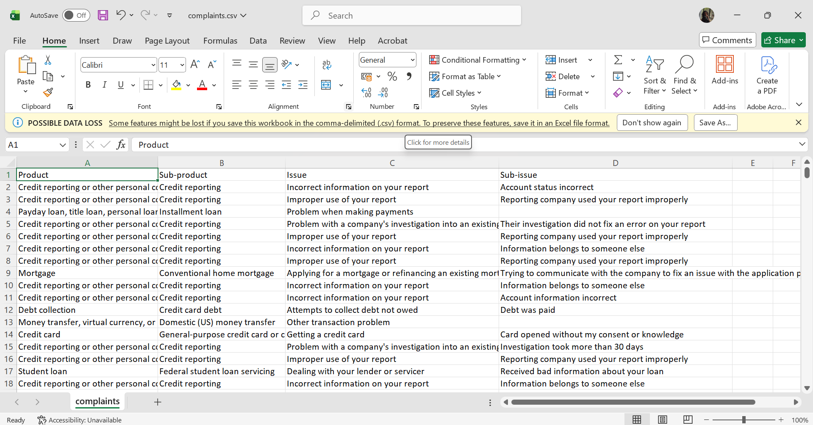
DATASET
Dataset: CFPB Consumer Complaint Database
(CCDB)
Attribute | Details
Dataset Name | Consumer Financial Protection Bureau (CFPB) Consumer Complaint Database
Source | Consumer Financial Protection Bureau (CFPB)
Format | CSV
Domain | Banking & Financial Services
Input Feature | Consumer Complaint Narrative
Target Labels | Product, Sub-product, Issue, Sub-issue
10
Notes:
Why These Columns?
Complaint Narrative contains the contextual information required for classification.
Product, Sub-product, Issue, and Sub-issue serve as target labels for BERT training.
Other columns (Company, State, ZIP Code, Date Received, Company Response, etc.) were excluded because they are either unavailable during prediction, unrelated to complaint semantics, or may introduce bias and data leakage.
Why CFPB Dataset?
Large real-world banking complaint dataset.
Officially published by the U.S. Consumer Financial Protection Bureau.
Contains diverse financial complaint narratives.
Well-suited for training NLP and BERT-based complaint classification models.

Slide 12
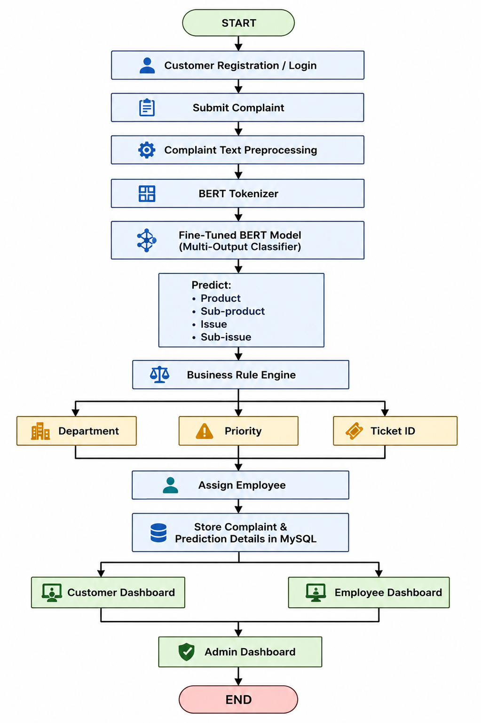
PROPOSED METHODOLOGY
11
Notes:
Why These Columns?
Complaint Narrative contains the contextual information required for classification.
Product, Sub-product, Issue, and Sub-issue serve as target labels for BERT training.
Other columns (Company, State, ZIP Code, Date Received, Company Response, etc.) were excluded because they are either unavailable during prediction, unrelated to complaint semantics, or may introduce bias and data leakage.
Why CFPB Dataset?
Large real-world banking complaint dataset.
Officially published by the U.S. Consumer Financial Protection Bureau.
Contains diverse financial complaint narratives.
Well-suited for training NLP and BERT-based complaint classification models.

Slide 13
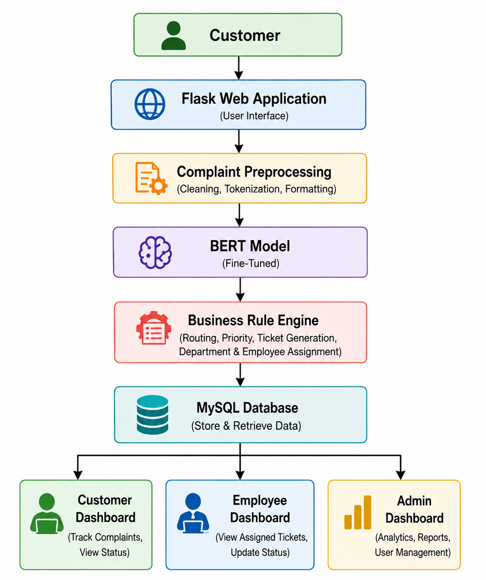
SYSTEM ARCHITECTURE
12
Notes:
Why These Columns?
Complaint Narrative contains the contextual information required for classification.
Product, Sub-product, Issue, and Sub-issue serve as target labels for BERT training.
Other columns (Company, State, ZIP Code, Date Received, Company Response, etc.) were excluded because they are either unavailable during prediction, unrelated to complaint semantics, or may introduce bias and data leakage.
Why CFPB Dataset?
Large real-world banking complaint dataset.
Officially published by the U.S. Consumer Financial Protection Bureau.
Contains diverse financial complaint narratives.
Well-suited for training NLP and BERT-based complaint classification models.

Slide 14
FEASIBILITY
Advantages
Context-aware complaint classification using BERT.
Reduces manual complaint processing.
Improves complaint routing accuracy.
Scalable and easy to integrate with banking systems.
User-friendly dashboards for all stakeholders.
Feasibility Analysis
Type | Description
Technical | Uses proven AI and web technologies
Economic | Open-source tools minimize development cost
Operational | Easy to use and maintain
Schedule | Can be completed within the project timeline
13

Slide 15
PROJECT PLAN
Phase | Activity
Phase 1 | Literature Survey
Phase 2 | Dataset Collection & Preprocessing
Phase 3 | BERT Model Development
Phase 4 | Flask Web Application Development
Phase 5 | Database Integration
Phase 6 | Business Rule Engine Development
Phase 7 | Testing & Evaluation
Phase 8 | Documentation & Final Deployment
14

Slide 16
REFERENCES
CFPB Consumer Complaint Database – https://www.consumerfinance.gov/data-research/consumer-complaints/
Devlin et al., BERT: Pre-training of Deep Bidirectional Transformers for Language Understanding – https://arxiv.org/abs/1810.04805
Bastani et al., LDA for Topic Modeling of CFPB Consumer Complaints – https://arxiv.org/abs/1807.07468
Sangaraju et al., Topic Modelling on CFPB Data Using BERT Based Embeddings – https://arxiv.org/abs/2205.07259
Vaishnav et al., Predictive Analysis of CFPB Consumer Complaints Using Machine Learning – https://arxiv.org/abs/2407.06399
15

Slide 17
THANK YOU
16

