Slide 1



AI-POWERED BANKING CUSTOMER COMPLAINT MANAGEMENT SYSTEM USING BERT
Presentation by:
B. Kundana Mani (2420030558)
M. Sai Kridhay Kumar (2420030211)
Notes:
Good morning everyone.
Our project is titled AI-Powered Banking Customer Complaint Management System using BERT.
The objective of this project is to automate the complete complaint management process in banks using Artificial Intelligence.
Instead of manually reading complaints, our system uses the BERT language model to understand complaint narratives, classify them into multiple categories, and automatically generate ticket information, assign departments, prioritize complaints, and provide dashboards for customers, employees, and administrators.

Slide 2
Complaint Orchestration and Routing Architecture
What is CORA?
An AI-powered banking complaint management system.
Uses BERT to understand customer complaint narratives.
Classifies complaints into four levels:
Product → Sub-product → Issue → Sub-issue
Uses a Business Rule Engine to determine routing and priority.
Generates a ticket and supports complaint assignment, tracking and resolution.
CORA
2

Slide 3
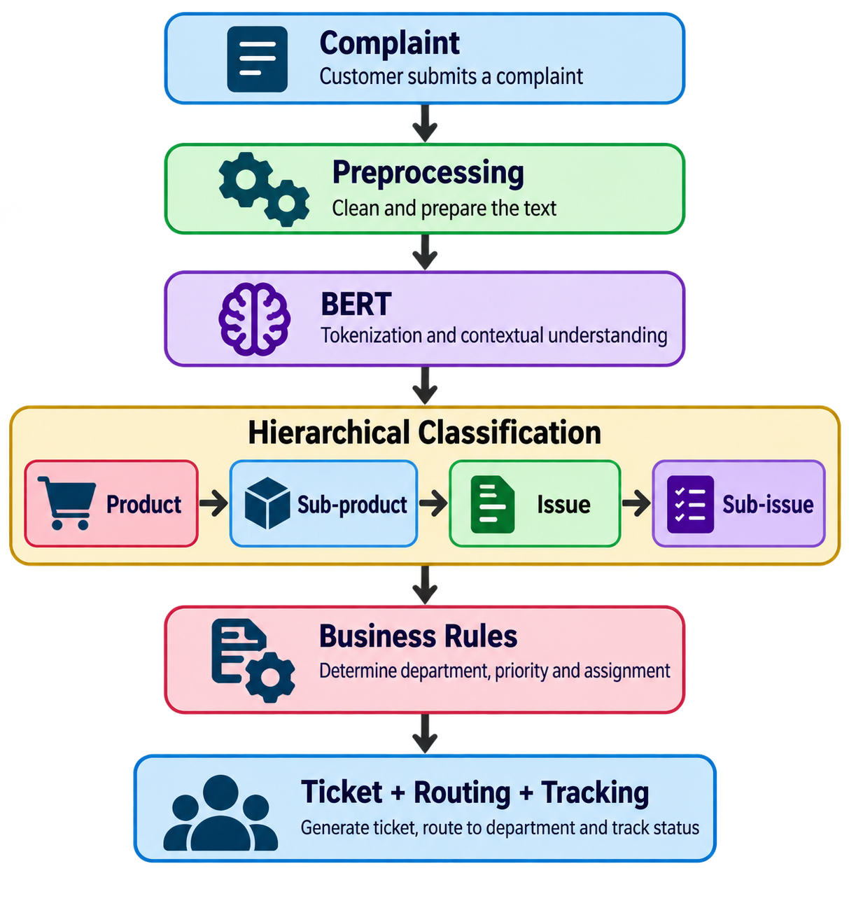
CORA METHODOLOGY
Data Collection – CFPB Consumer Complaint Database
Data Preprocessing – Cleaning, duplicate removal and missing-value handling
BERT Processing – Tokenization and contextual representation
Hierarchical Classification – Product → Sub-product → Issue → Sub-issue
Business Rule Engine – Priority and department-wise routing
Complaint Management – Ticket generation, employee assignment and tracking
Dashboard – Customer and administrator monitoring
3
Notes:
Why These Columns?
Complaint Narrative contains the contextual information required for classification.
Product, Sub-product, Issue, and Sub-issue serve as target labels for BERT training.
Other columns (Company, State, ZIP Code, Date Received, Company Response, etc.) were excluded because they are either unavailable during prediction, unrelated to complaint semantics, or may introduce bias and data leakage.
Why CFPB Dataset?
Large real-world banking complaint dataset.
Officially published by the U.S. Consumer Financial Protection Bureau.
Contains diverse financial complaint narratives.
Well-suited for training NLP and BERT-based complaint classification models.

Slide 4
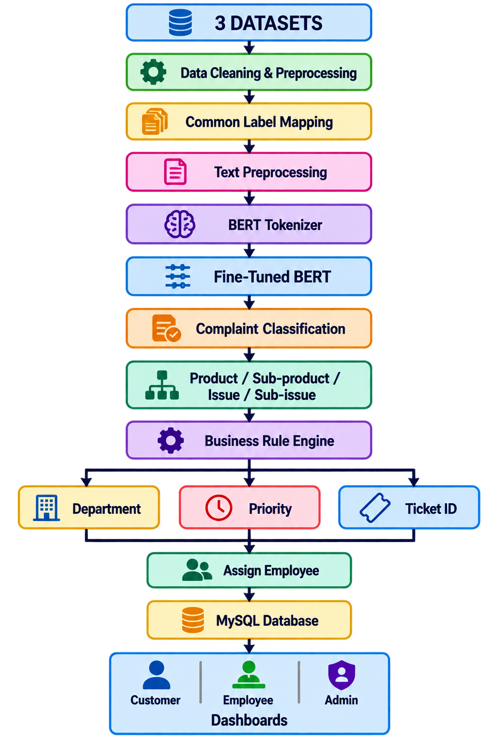
SYSTEM DESIGN
CUSTOMER
Register / Login
Submit complaint
Receive Ticket ID
View complaint details
Track complaint status
EMPLOYEE
Login
View assigned complaints
Update complaint status
Add remarks
Resolve complaints
ADMINISTRATOR
Manage everything
View complaint statistics
Monitor system analytics
4

Slide 5
MODERN TOOLS AND TECHNOLOGY
Category | Technology | Purpose
Programming | Python | Development
AI/NLP | BERT | Complaint classification
Deep Learning | PyTorch | Model training
NLP Library | Hugging Face | BERT & tokenizer
Backend | Flask | Web application
Database | MySQL | Data & ticket storage
Frontend | HTML, CSS, Bootstrap | User interface
Scripting | JavaScript | Interactivity
Data Processing | Pandas, NumPy | Data preparation
Development | VS Code | Project development
5
Notes:
Why These Columns?
Complaint Narrative contains the contextual information required for classification.
Product, Sub-product, Issue, and Sub-issue serve as target labels for BERT training.
Other columns (Company, State, ZIP Code, Date Received, Company Response, etc.) were excluded because they are either unavailable during prediction, unrelated to complaint semantics, or may introduce bias and data leakage.
Why CFPB Dataset?
Large real-world banking complaint dataset.
Officially published by the U.S. Consumer Financial Protection Bureau.
Contains diverse financial complaint narratives.
Well-suited for training NLP and BERT-based complaint classification models.

Slide 6
LITERATURE MODEL COMPARISON
Model | Project Goal | What the Model Does | Reported Result | Limitation
LDA | Discover complaint topics | Finds hidden topics in complaint text | No Accuracy/F1 reported | Topic discovery only
BERTopic | Identify meaningful complaint topics | Uses BERT embeddings to group similar complaints | Topic coherence metrics | No detailed classification
Emotion Detection | Analyze customer emotions | Detects emotional patterns in complaints | Emotion metrics | Does not classify complaint hierarchy
LSTM | Classify complaint text | Learns sequential patterns | Transformer approach performed better in cited comparison | Weaker contextual understanding
LLM Classification | Classify financial complaints | Assigns complaints to broad categories | 77.7% Accuracy / 77.64% F1 | Broad classification; no routing
6
Notes:
Why These Columns?
Complaint Narrative contains the contextual information required for classification.
Product, Sub-product, Issue, and Sub-issue serve as target labels for BERT training.
Other columns (Company, State, ZIP Code, Date Received, Company Response, etc.) were excluded because they are either unavailable during prediction, unrelated to complaint semantics, or may introduce bias and data leakage.
Why CFPB Dataset?
Large real-world banking complaint dataset.
Officially published by the U.S. Consumer Financial Protection Bureau.
Contains diverse financial complaint narratives.
Well-suited for training NLP and BERT-based complaint classification models.

Slide 7
Implemented Components
AI Module
Text preprocessing
BERT tokenization
Fine-tuned BERT
Four-level classification
Class imbalance handling
Application Module
Complaint submission
Ticket generation
Business-rule routing
Employee assignment
Status tracking
Dataset
CFPB Consumer Complaint Database
Training: 10,157 complaints
Validation: 2,540 complaints
Input (X): Complaint Narrative
Output (Y):
  Product
  Sub-product
  Issue
  Sub-issue
7

Slide 8
RESULTS
CORA-BERT Baseline Performance
Classification Level | Accuracy | Precision | Recall | F1-Score
Product | 83.19% | 83.88% | 83.19% | 83.17%
Sub-product | 75.04% | 69.15% | 75.04% | 71.42%
Issue | 47.95% | 41.52% | 47.95% | 40.43%
Sub-issue | 26.06% | 16.05% | 26.06% | 16.98%
8

Slide 9
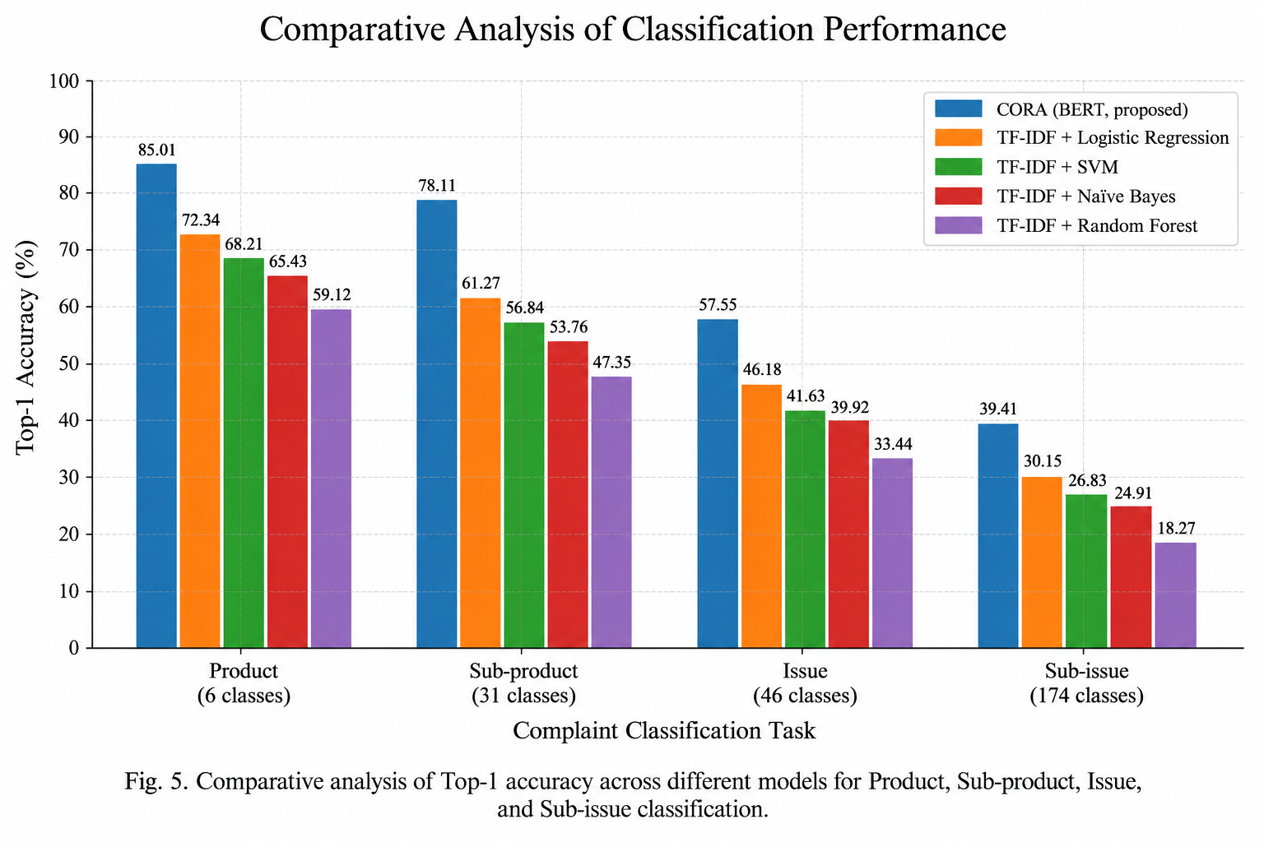
COMPARATIVE ANALYSIS
9

Slide 10
COMPARATIVE ANALYSIS TABLE (CORA)
Classes | Precision | Recall | F1-Score | Support
Checking or savings account | 0.84 | 0.84 | 0.84 | 3439
Credit card or prepaid card | 0.85 | 0.84 | 0.84 | 3981
Credit reporting, credit repair services, or other personal consumer reports | 0.82 | 0.81 | 0.81 | 1579
Debt collection | 0.80 | 0.79 | 0.79 | 743
Student loan | 0.70 | 0.68 | 0.69 | 110
Vehicle loan or lease | 0.73 | 0.71 | 0.72 | 305
Weighted Average | 0.84 | 0.83 | 0.83 | 10157

Slide 11
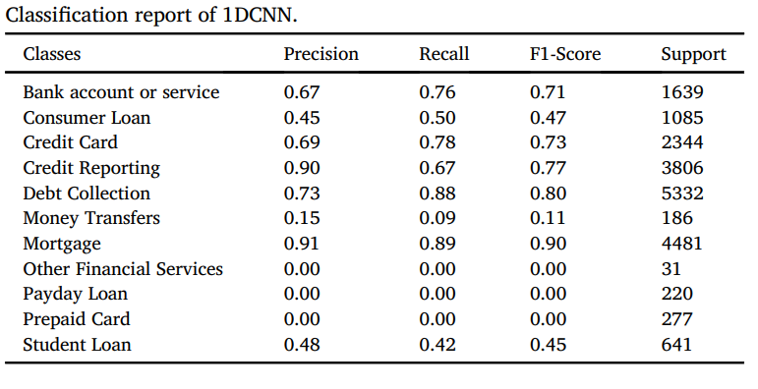
COMPARATIVE ANALYSIS TABLE (Previous)

Slide 12
COMPARATIVE ANALYSIS TABLE
Model / Approach | Project Goal | What the Model Does | Performance | Limitation | CORA Advantage
LDA | Discover complaint topics | Finds hidden topics from complaint narratives | Accuracy/F1 not reported | Topic discovery only | CORA performs supervised complaint classification
BERTopic | Identify meaningful complaint topics | Uses contextual embeddings to group similar complaints | Topic coherence metrics | Does not provide detailed complaint labels | CORA predicts 4 hierarchical complaint levels
Emotion Detection | Analyze customer emotions | Detects emotional patterns in complaints | Emotion-based metrics | Focuses on emotion, not complaint type | CORA identifies complaint type and enables routing
LSTM | Classify complaint text | Learns sequential patterns in complaint narratives | Transformer models performed better in cited comparison | Weaker contextual understanding | CORA uses BERT's contextual representation
LLM Classification | Classify financial complaints | Assigns complaints to broad financial categories | 77.7% Accuracy / 77.64% F1 | Broad categories; no complete routing | CORA provides fine-grained classification + routing
Proposed CORA | Classify, route & manage banking complaints | Fine-tuned BERT + hierarchical classification + Business Rules | Current baseline: 83.19% Product Accuracy / 83.17% F1 | Fine-grained levels still being improved | Product → Sub-product → Issue → Sub-issue → Ticket → Routing → Tracking
8

Slide 13
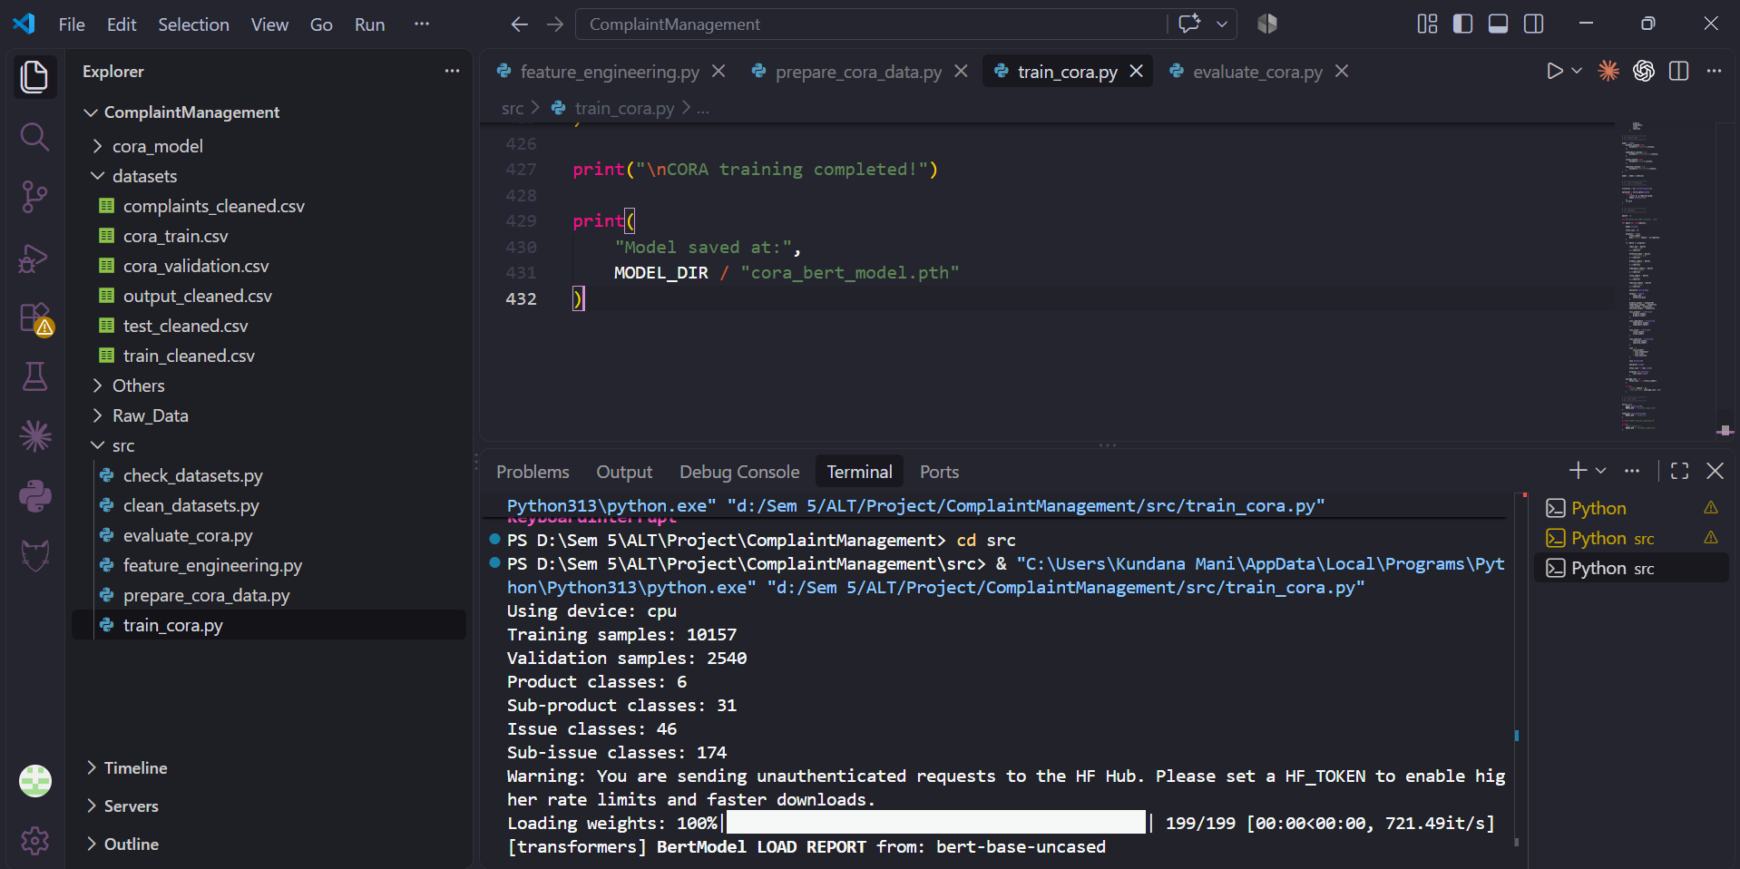
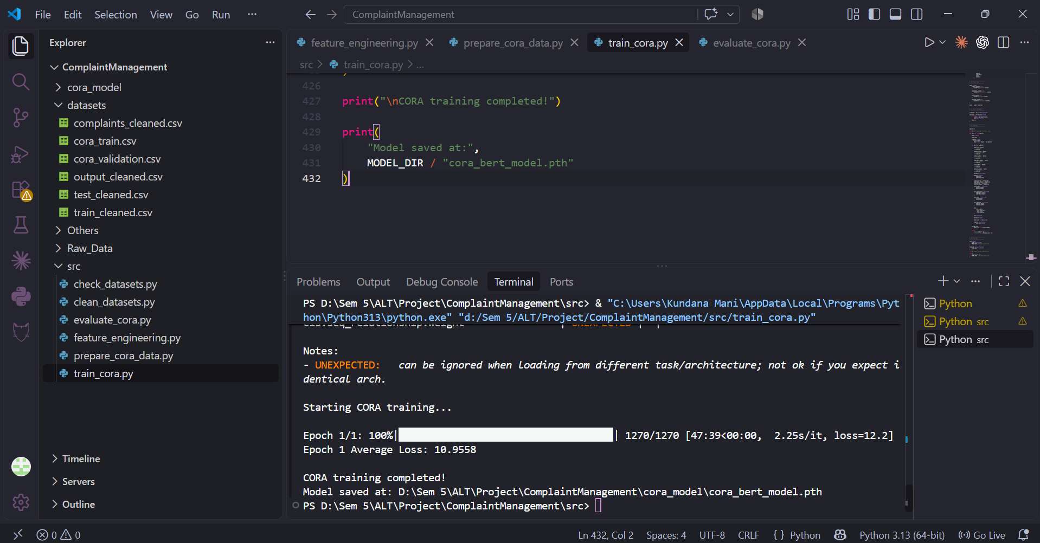
OUTPUT
9

Slide 14
THANK YOU
10

