Slide 1

Smart Campus: Placement Management System
SOA Project Review-1
27th August 2026
 | Under the Guidance of Mrs. R. Navyatha Assistant Professor, Department of Computer Science and Engineering, KLH CSE Bowrampet Campus
Team Members Name: B. Kundana Mani Roll Number: 2420030558 Name: M. Sai Kridhay Kumar Roll Number: 2420030211

Slide 2
Outline of Project Work
Focus
Introduction
Literature Survey
Challenges
Research Objectives
Conclusion & Future Work
References
Publications Details

Slide 3
Problem Statement
Traditional campus placement processes often involve managing student information, company details, job opportunities, eligibility criteria, applications, interviews, and selection results through separate or manual processes.
This can lead to:
Difficulty in maintaining student and recruiter information
Time-consuming application management
Lack of centralized placement information
Difficulty tracking application and interview status
Manual communication between students and recruiters
Limited transparency in the recruitment process
Therefore, there is a need for a centralized, secure, and scalable placement management system that can efficiently connect students, recruiters, and administrators.

Slide 4
Objectives
To develop a centralized platform for managing campus placement activities.
To implement a microservices-based architecture for independent and scalable services.
To allow students to manage profiles and apply for suitable job opportunities.
To enable recruiters to create job postings and manage applications.
To implement eligibility checking and candidate shortlisting.
To provide application, interview, and selection status tracking.
To implement secure authentication using JWT.
To provide role-based authorization for students, recruiters, and administrators.
To enable communication between services using REST APIs.
To improve the overall efficiency and transparency of the campus placement process

Slide 5
Literature Survey
Year | Authors | Title of the Paper | Methodology | Inferences | Limitation/Future Work
2020 | Ganesh D. Praghane, Akshay V. Padghan, Nandkishor V. Rekalwar, Supriya S. Yedme, Ritesh V. Deshmukh | Smart Online Campus Recruitment System | Web-based system with student, company and admin modules | Centralizes student and company recruitment information | Scope for improved automation and scalability
2021 | Sagar Tete | Campus Recruitment Management (Online) System | Online recruitment management for students, companies and placement officers | Simplifies campus recruitment and manages multiple user roles | Scope for more advanced integration and automation
2022 | Alfiya Banu, Dr. Manju Bargavi S. K | A Research on Placement Management System | Web-based placement management system with student and company information | Helps institutions manage student and placement information | Scope for improved automation and modern architecture
2025 | P. Ravi Prakash, G. Lakshmi Venkata Sirisha, A. Manjunadh, D. Snikitha, J. Jagadeesh | Student Placement Management System | Web application using HTML, JavaScript, Flask, MongoDB and Mailjet API | Automates placement forms, submissions, reminders and reports | Scope for more advanced architecture and intelligent matching

Slide 6
Problem Gap Identification
Existing placement systems mainly focus on student registration, job posting, and application management.
Many systems follow a centralized or monolithic architecture, making independent scaling and maintenance difficult.
Limited integration of microservices, service discovery, and API gateway for placement workflows.
Lack of role-based access control for students, recruiters, placement officers, and administrators.
Application and recruitment status tracking can still involve manual communication and updates.
Limited separation of data using independent databases for different services.
Therefore, there is a need for a secure, scalable, modular, and service-oriented placement management system.

Slide 7
Microservices-Based Architecture
Divides placement functions into independent services.
Improves scalability and maintainability.
Centralized API Gateway
Spring Cloud Gateway provides a single entry point.
Routes requests to the appropriate microservice.
Dynamic Service Discovery
Eureka enables automatic registration and discovery of services.
Simplifies communication between microservices.
INNOVATION

Slide 8
Automated Application Tracking
Tracks applications through Applied → Shortlisted → Interview → Selected/Rejected.
Reduces manual follow-ups.
Role-Based Placement Workflow
Provides different functionalities for Students, Recruiters, and Administrators.
Makes the placement process more organized and secure.
Centralized Placement Platform
Brings students, recruiters, companies, and placement activities into one platform.
Improves transparency and accessibility.
CREATIVITY

Slide 9
Integrated Microservices Ecosystem
Combines Student, Company & Job, Application, and Notification services.
Secure and Scalable Architecture
Combines JWT authentication, role-based authorization, Eureka, API Gateway, and database-per-service.
End-to-End Placement Management
Supports the complete workflow from student profile and job search to application, interview, and final selection.
NOVELTY

Slide 10
Feasibility
1. Technical Feasibility
Uses established technologies such as React, Spring Boot, Spring Cloud, PostgreSQL, JWT, Eureka, and REST APIs.
Microservices can be independently developed, tested, and deployed.
2. Economic Feasibility
Uses open-source frameworks and development tools.
Reduces software licensing and development costs.
3. Operational Feasibility
Provides a simple workflow for students: Profile → Job Search → Eligibility → Application → Interview → Selection
Recruiters can manage: Job Posting → Applications → Shortlisting → Interview → Selection
4. Integration Feasibility
Frontend, API Gateway, microservices, and databases can communicate through REST APIs.
Eureka enables service discovery between microservices.

Slide 11
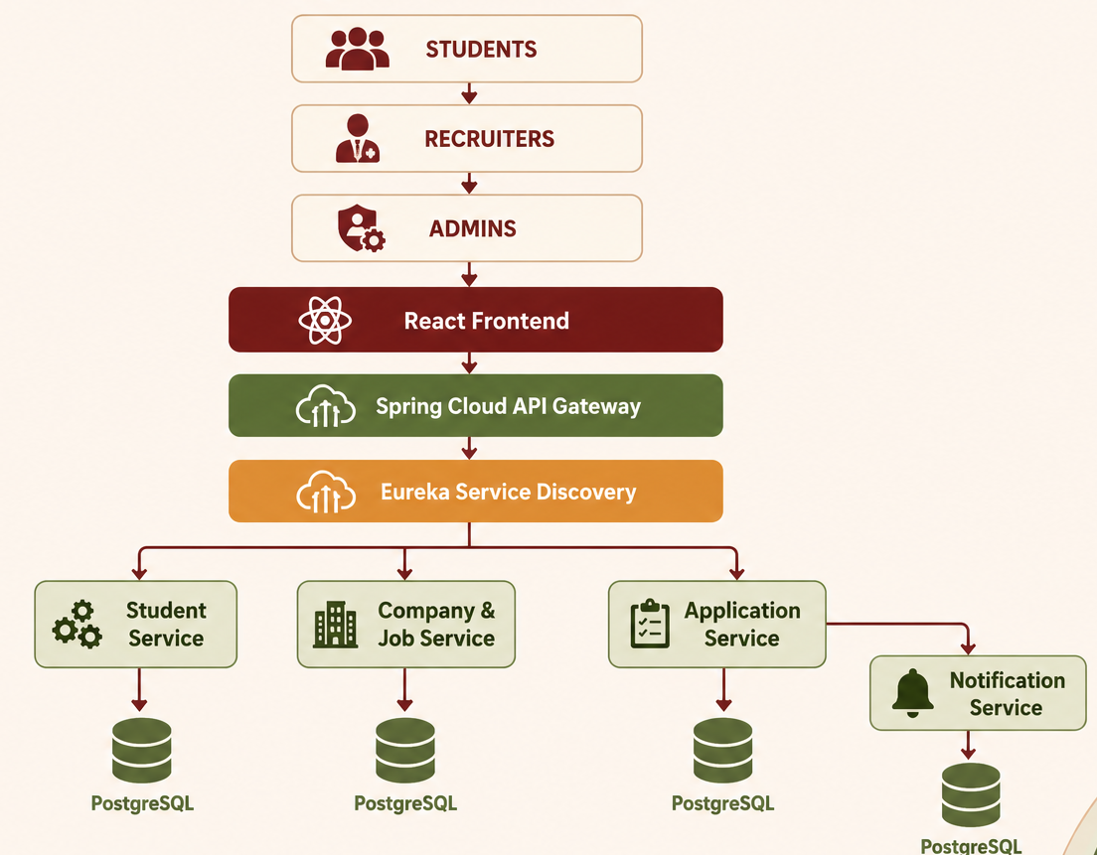


Slide 12
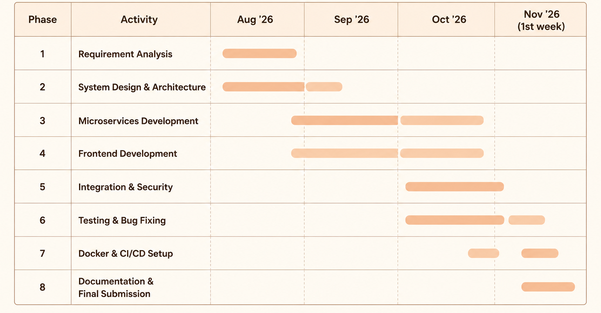
PROJECT PLAN

