Slide 1
Smart Campus: Placement Management System

Slide 2
Traditional campus placement processes often involve managing student information, company details, job opportunities, eligibility criteria, applications, interviews, and selection results through separate or manual processes.
This can lead to:
Difficulty in maintaining student and recruiter information
Time-consuming application management
Lack of centralized placement information
Difficulty tracking application and interview status
Manual communication between students and recruiters
Limited transparency in the recruitment process
Therefore, there is a need for a centralized, secure, and scalable placement management system that can efficiently connect students, recruiters, and administrators.
PROBLEM STATEMENT

Slide 3
MOTIVATION
KEY STAKEHOLDERS
Centralized Placement Management: Manage students, recruiters, jobs, and applications in one platform.
Efficient Application Tracking: Allow students to track their applications from submission to final selection.
Better Recruiter Management: Enable recruiters to create job postings, review candidates, and manage recruitment stages.
Reduced Manual Work: Automate repetitive placement-related activities.
Improved Transparency: Provide students and recruiters with timely and accurate placement information.
Students
Recruiters
Placement Officers
Administrators
Companies

Slide 4
OBJECTIVES
To develop a centralized platform for managing campus placement activities.
To implement a microservices-based architecture for independent and scalable services.
To allow students to manage profiles and apply for suitable job opportunities.
To enable recruiters to create job postings and manage applications.
To implement eligibility checking and candidate shortlisting.
To provide application, interview, and selection status tracking.
To implement secure authentication using JWT.
To provide role-based authorization for students, recruiters, and administrators.
To enable communication between services using REST APIs.
To improve the overall efficiency and transparency of the campus placement process

Slide 5
LITERATURE SURVEY
Year | Existing System | Methodology | Inference | Limitation
2021 | Online Campus Recruitment System | Web-based recruitment management | Centralizes student and recruitment information | Limited microservices and scalability
2022 | Student Placement Management System | Database-driven placement portal | Helps manage student applications and company details | Limited automation and integration
2023 | E-Recruitment Platform | Online job and candidate management | Improves communication between recruiters and candidates | Limited role-based workflows
2024 | Smart Campus Recruitment Platform | Cloud-based recruitment management | Provides centralized access to placement services | Scope for improved service independence and security

Slide 6
RESEARCH GAP
Existing placement management systems generally focus on basic student registration, company management, job postings, and application tracking. There is a need for an integrated placement platform that combines secure authentication, microservices, service discovery, API gateway routing, and independent databases into a scalable campus placement ecosystem.
Independent microservices for different placement functions
Better service-to-service communication
Secure JWT-based authentication
Role-based access for different users
Independent databases for services
Centralized API routing
Service discovery
Scalable architecture for growing placement data

Slide 7
1. Microservices-Based Placement Management
Instead of developing one large application, placement functionalities are divided into independent services.
2. Centralized API Gateway
All client requests are handled through Spring Cloud Gateway, providing a single entry point to the backend services.
3. Service Discovery
Eureka Service Discovery allows microservices to register and discover one another dynamically.
4. Role-Based Placement Workflow
Students, recruiters, and administrators receive different functionalities based on their roles using JWT authentication and Spring Security.
Overall Novelty
The system transforms traditional placement management into a secure, modular, scalable, and service-oriented digital platform.
NOVELTY

Slide 8
TECHNOLOGY STACK
Layer | Technology | Purpose
Frontend | React | User interface for students, recruiters and admins
Backend | Spring Boot | Development of microservices
Microservices | Spring Cloud | Microservices infrastructure
Security | Spring Security + JWT | Authentication and authorization
Service Discovery | Eureka | Service registration and discovery
API Gateway | Spring Cloud Gateway | Centralized API routing
Database | PostgreSQL | Data storage
APIs | REST APIs | Communication between services
Containerization | Docker | Application containerization
Testing | Postman | REST API testing
CI/CD | GitHub Actions | Automated build and deployment

Slide 9
INNOVATION AND CREATIVITY
MODULAR SERVICES
AUTOMATED APPLICATION TRACKING
ROLE - BASED
ACCESS
Existing: Traditional placement systems may use a single application.
Our Approach: Separate services for students, jobs, applications, and notifications.
Benefit: Better scalability and maintainability.
Existing: Students may need to manually check recruitment updates.
Our Approach: Application status is maintained throughout the recruitment process.
Benefit: Improves transparency and reduces manual communication.
Existing: Common access mechanisms may provide limited separation.
Our Approach: Separate permissions for students, recruiters, and administrators.
Benefit: Improves security and protects sensitive information.
4. Service Discovery and API Gateway
Existing: Direct communication between multiple components can become difficult to manage.
Our Approach: Eureka handles service discovery and Spring Cloud Gateway manages routing.
Benefit: Provides a structured and scalable architecture.

Slide 10
FEASIBILITY
1. Technical Feasibility
The system can be implemented using existing technologies such as Spring Boot, Spring Cloud, React, PostgreSQL, JWT, Eureka, and REST APIs.
2. Economic Feasibility
The project can be developed using open-source frameworks and development tools, reducing development costs.
3. Operational Feasibility
The system provides a simple workflow:
Student → Profile → Job Search → Eligibility → Application → Interview → Selection
Recruiters can manage:
Company → Job Posting → Applications → Shortlisting → Interview → Selection
4. Integration Feasibility
Different components can communicate through REST APIs:
Frontend ↔ API Gateway ↔ Microservices ↔ Databases

Slide 11
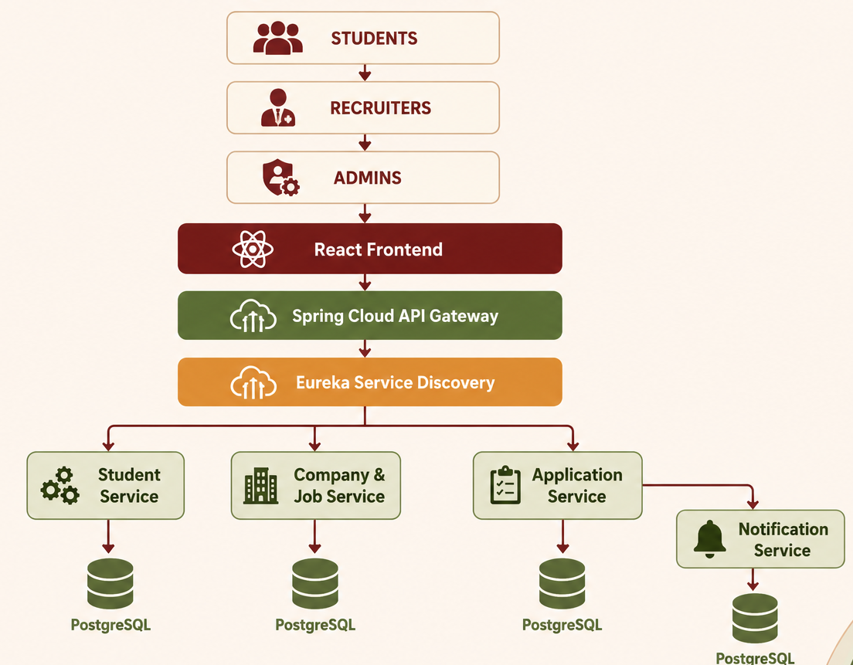
PROJECT ARCHITECTURE
Major Services:
Student Service
Company & Job Service
Application Service
Notification Service
Authentication & Authorization
Security: JWT + Spring Security Communication: REST APIs Routing: Spring Cloud Gateway Discovery: Eureka Database: PostgreSQL — Database per Service

Slide 12
THANK YOU

