Slide 1
Project Deadline Reminder System
By : Jatin Ponam 2420030032
Tejaswi Priyank 2420030276
Pranay Sangam 2420090115

Slide 2
Introduction
In today’s environment, individuals and teams often work on multiple projects and tasks with different priorities and deadlines. Managing these tasks manually can lead to missed deadlines, poor prioritization, and reduced productivity.
The Project Deadline Reminder System provides a centralized platform to manage projects, tasks, deadlines, and progress in one place.
The system combines three major capabilities:
📋 Task & Project Management – Create, organize, and track projects and tasks.
🤖 AI-Based Prioritization – Analyze tasks and recommend which task should be completed first.
⏰ Automated Deadline Reminders – Notify users about upcoming and overdue deadlines.

Slide 3
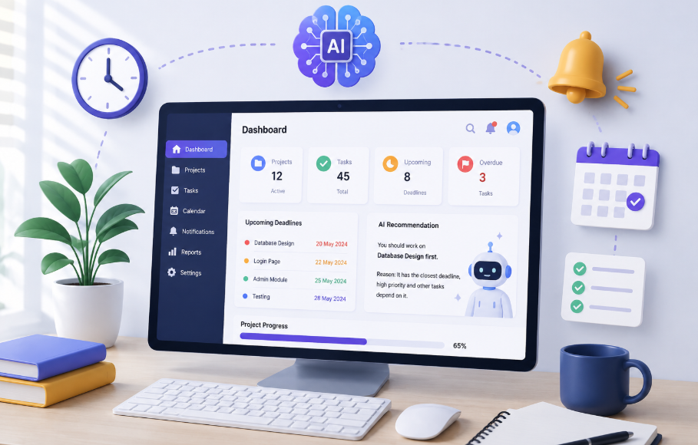
Problem Statement
Managing multiple projects and tasks with different deadlines is difficult.
Users often rely on manual methods such as notes, spreadsheets, or basic task lists.
Important deadlines can be forgotten, resulting in delayed or incomplete tasks.
Users may know their deadlines but may not know which task should be prioritized first.
High-effort or dependent tasks may be overlooked even when they are critical to the project.
Basic task management systems generally provide reminders but lack intelligent task prioritization.
There is a need for a centralized system that combines task management, AI-based prioritization, and automated deadline reminders.
The system should help users reduce missed deadlines, manage workload effectively, and improve productivity.

Slide 4
Proposed Solution
Develop a centralized web-based platform to manage projects and tasks in one place.
Allow users to create projects, add tasks, set deadlines, priorities, and estimated effort.
Use AI to analyze task details such as deadline, priority, effort, dependencies, and project progress.
Provide AI-based recommendations on which tasks should be completed first.
Use an automated deadline monitoring system to track upcoming and overdue tasks.
Send timely reminders and notifications before deadlines.
Provide a dashboard to view project progress, pending tasks, completed tasks, and upcoming deadlines
Integrate React, Spring Boot, MySQL, and an AI/LLM API to build the complete system.

Slide 5
System Architecture
USER
Web Browser
Presentation Layer
React.js + Tailwind CSS
Dashboard
Projects
Tasks
AI Recommendations
Notifications
Application Layer
Spring Boot
Controller Layer
Service Layer
Repository Layer
AI Services Scheduler
REST APIs
MySQL
Users
Projects
Tasks
Notifications
AI / LLM
API
Notification Service
Reminder Engine

Slide 6
Presentation Layer
The frontend is developed using React.js and Tailwind CSS.
It provides interfaces for:
User registration and login.
Project creation and management.
Task creation and management.
Deadline visualization.
Task priority display.
AI recommendations.
Notifications.
Project progress dashboards.

Slide 7
Application Layer
Controller
The backend is developed using Java Spring Boot.
It is responsible for:
Processing user requests.
Managing projects and tasks.
Implementing business logic.
Providing REST APIs.
Managing authentication.
Communicating with MySQL.
Communicating with the AI service.
Running the deadline scheduler.
Service
Repository
MySQL

Slide 8
AI Service
The AI service is integrated with the Spring Boot backend.
The backend collects task information and sends relevant data to the AI model.
Spring Boot
AI Service
Task Analysis
Task Data
React Dashboard
Spring Boot
Explanation
Priority Recommendation

Slide 9
Reminder Engine
The reminder engine uses Spring Scheduler to periodically check task deadlines.
Spring Scheduler
Checks Tasks
Compare Current Date
Upcoming
Overdue
Reminder
Alert

Slide 10
Technology and Stack
Component Technology
Frontend React.js
UI Styling Tailwind CSS
Backend Java+Spring boot
API REST API
AI Integration LLM API
Scheduling Spring Scheduler
Notification e-mail
API Testing Postman
Version Control Git
Development Tools VS Code & STS

Slide 11
