Slide 1

COVID-19 / PUBLIC HEALTH DATA
VISUALIZATION DASHBOARD
Final Project Review | Department of Computer Science and Engineering | KLH CSE Bowrampet Campus
TEAM MEMBERS
2420030515 – K. Vishnu Vardhan
2420030162 – V. Sai Dhanush
Guide: Dr N SUNANDA, Associate Professor
Department of Computer Science and Engineering, KLH CSE Bowrampet Campus
Academic Year:2026-27
Notes:
Title slide. Replace all bracketed text. Use the full project title, list every team member with registration number, and name your guide. Insert the institution logo in the dashed box.

Slide 2
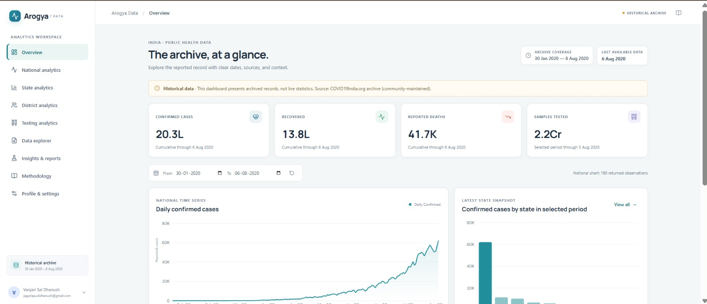



Introduction & Problem Statement
Background
COVID-19 and public-health datasets contain large amounts of information across different dates, regions, and health indicators.
Problem Statement
Raw numerical data is difficult to understand and compare manually. Large and complex datasets, inconsistent records, and the effort required to identify trends make analysis challenging.
Motivation / Need
Users need a simple, interactive way to explore important information without examining raw data.
Notes:
State the domain, the exact problem and why it matters. Keep it to about 2 minutes. Add one real-world statistic if you can, with a citation.

Slide 3


Objectives & Scope
Objectives
1
Collect relevant COVID-19 / public-health data and clean and preprocess it.
2
Perform exploratory data analysis (EDA) to identify trends and patterns.
3
Analyze data across regions and time periods.
4
Visualize insights using charts and graphs in an interactive dashboard with filters.
Notes:
Objectives should be measurable and start with action verbs. The scope slide tells the panel what you did and did not attempt.

Slide 4

Literature Survey
S.No | Author(s) & Year | Method / Technique | Key Findings | Limitation / Gap
1 | Salehi et al. (2023) | R-Shiny interactive dashboard; time-series visualization; Logistic and Gompertz growth models; spatial analysis using Moran’s Index | Enables interactive COVID-19 tracking; country/continent comparison; trend visualization and forecasting. | Developed mainly using R-Shiny; forecasting and spatial modules add complexity; scope for more user-focused features.
2 | Clarkson (2023) | Survey of 111 COVID-19 dashboards; analysis of data sources, visualization types, dashboard designs and data-quality issues. | Dashboards improve public access to COVID-19 information; visualization quality varies; transparency and standardization are important. | Heterogeneous/ad-hoc data sources; some visualizations may obscure or mislead; better standardization and transparency are needed.
3 | Schulze et al. (2021) | Systematic review of 65 studies; analysis of data sources, functions, visualization methods, user studies and usability. | Dashboards support public-health communication, surveillance, quick analysis and decision-making. | Technical functionality often prioritized; user-specific information needs less explored; more user-centered evaluation is needed.
Research Gap
Limited integration of data preprocessing, EDA and visualization; need for interactive region/time-based analysis; and lack of a simple, user-friendly platform for clear visual insights.
Notes:
Summarise four to six relevant papers or existing systems. End with the research gap, because that gap justifies your project.

Slide 5





Proposed System & Methodology
STEP 1
STEP 2
STEP 3
STEP 4
STEP 5
Define Problem
Collect Data
Design
Implement
Test & Evaluate
Large and complex public-health datasets are difficult to interpret; raw data is challenging to compare.
Public India COVID-19 data in CSV files, including daily, state-level, district-level, testing and patient data.
React.js, JavaScript and CSS frontend; Python API backend; Pandas and NumPy for data processing.
Data preprocessing, exploratory analysis, interactive filters, summary cards, trend analysis and regional comparison.
Key Novelty / Contribution
Integrates data preprocessing, EDA and interactive visualization in one user-friendly platform for region-, category- and time-based public-health data analysis.
Notes:
Walk through the five steps left to right. Rename the steps to match your project (for example, Requirement Analysis, Design, Coding, Testing, Deployment). End with your novelty.

Slide 6
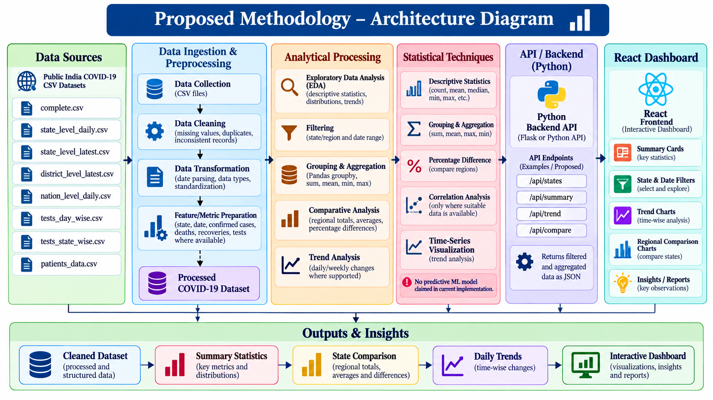
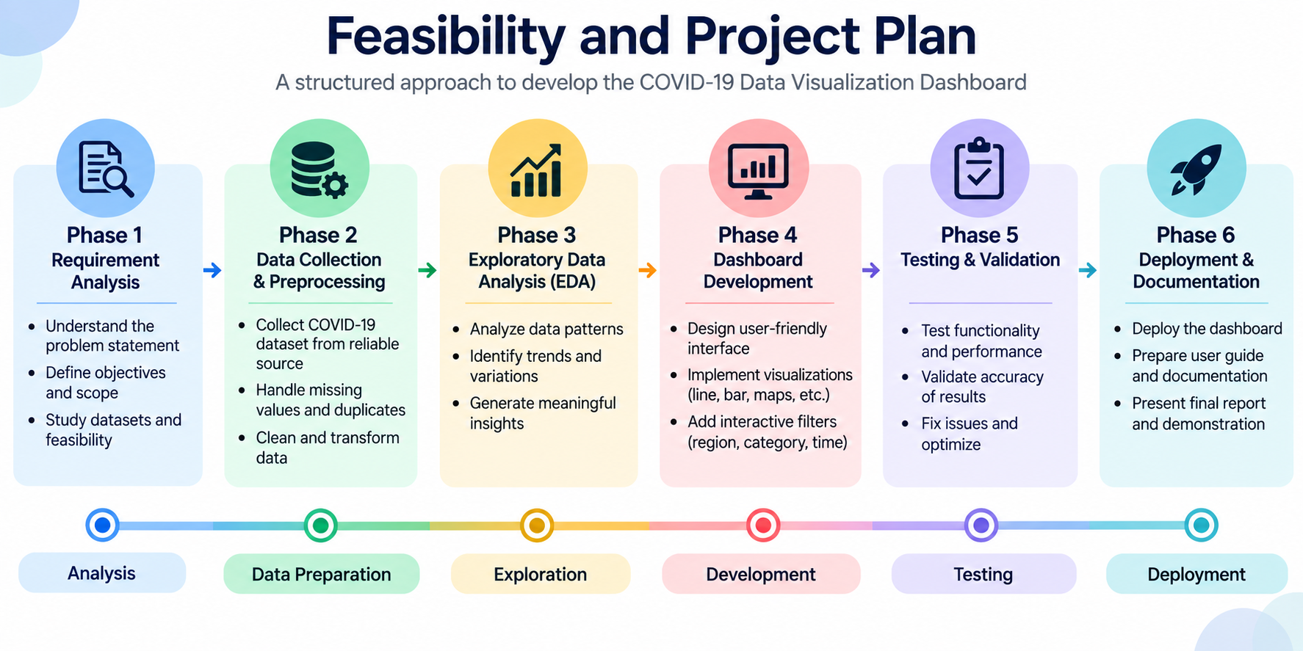
System Architecture
Components
1
Data Input
COVID-19 CSV datasets
2
Data Processing
Pandas and NumPy
3
Analysis
EDA and regional/time trends
4
Dashboard
React.js, JavaScript and CSS
Notes:
Insert a clear block diagram: input, processing, storage, output. Number each block and explain them on the right. Redraw the figure yourself rather than copying it.

Slide 7


Hardware & Software Requirements
Hardware
Software & Tools
Libraries / Frameworks
Laptop / Desktop Computer
Minimum 4 GB RAM (8 GB recommended)
Dual-core processor or higher
Sufficient storage for datasets and project files
Internet connection for accessing online resources
Python 3
JavaScript, HTML and CSS
React.js with Vite
Flask REST API
SQLite Database
Visual Studio Code
Node.js and npm
Pandas: Data manipulation and analysis
NumPy: Numerical operations
Flask: Backend API development
React.js: Interactive user interface
SQLite: Account and preference storage
pytest: Automated testing
Deployment / Platform: Frontend: React + Vite (localhost:5173), Backend: Flask (localhost:5000), Database: SQLite
Notes:
List only what you actually used, with versions. For a pure software project, shorten the hardware list and add cloud or deployment resources.

Slide 8
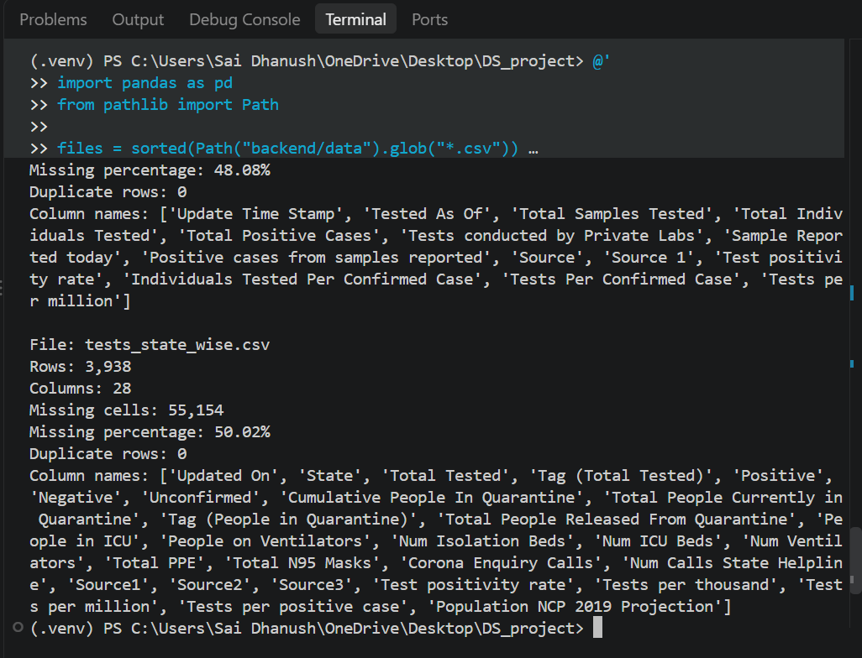
Dataset / Data Understanding
Records (rows)
4,692
Features (columns)
10
0 (0.00%)
Not applicable
Missing values
Target classes
Source: Public India COVID-19 Data
Files: complete.csv; state_level_daily.csv; state_level_latest.csv; district_level_latest.csv; nation_level_daily.csv; tests_day_wise.csv; tests_state_wise.csv; patients_data.csv
Features: COVID-19 indicators, regional and daily statistics, testing and patient information
Notes:
Explain where the data came from and what it contains. Show a screenshot of the first rows or the info summary. For non-data projects, replace this slide with “Requirement Analysis” or “Input Specification”.

Slide 9
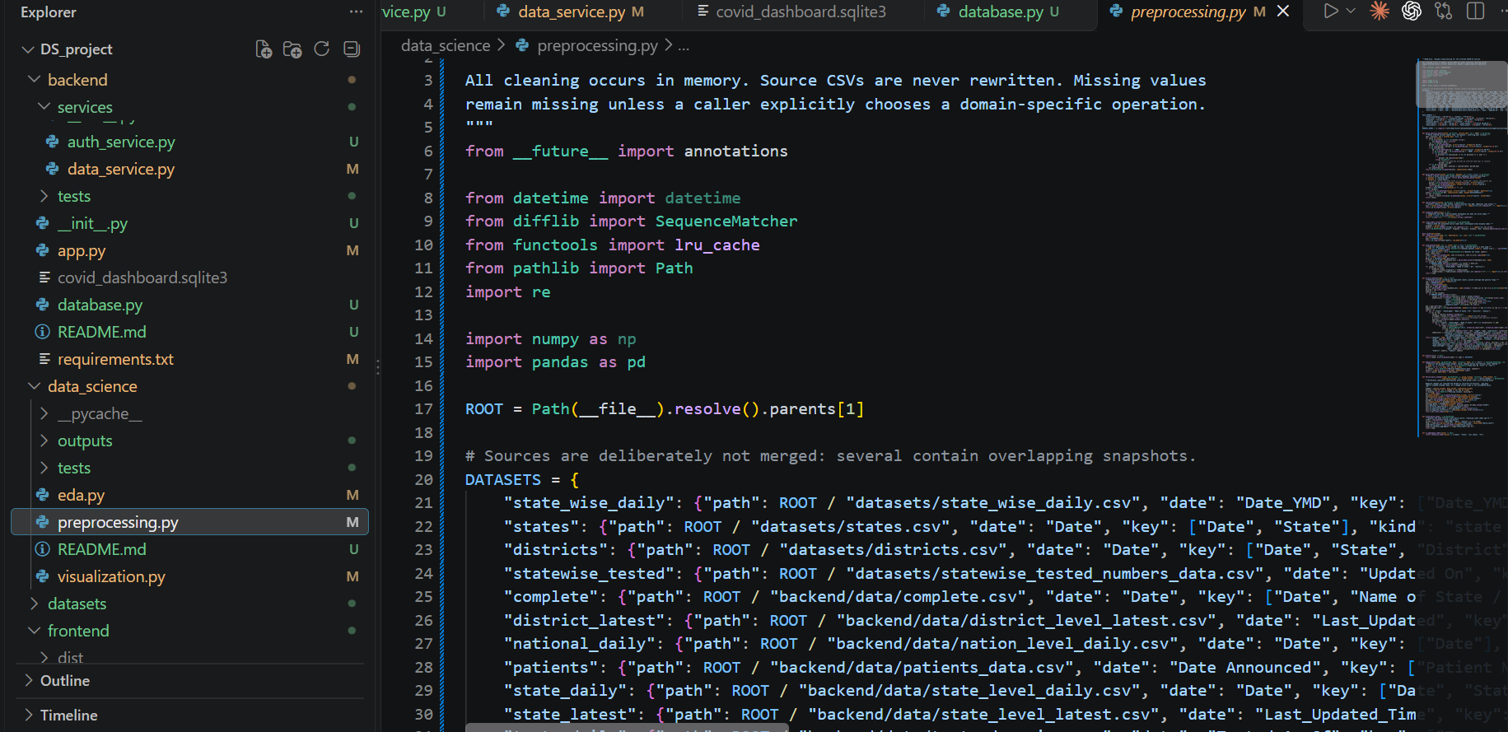
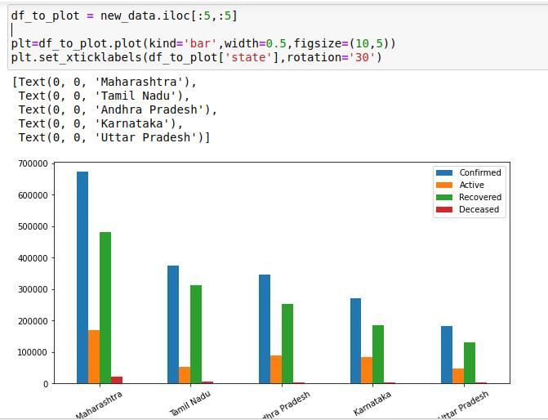



Data Preprocessing & Exploratory Analysis
Cleaning
Transformation
Feature Selection
Convert dates and numerical fields into suitable formats, organize records by date and region, and prepare data for analysis and visualization.
Use relevant fields such as Date, State/UT, Confirmed Cases, Deaths, Recoveries, and New Cases to analyze trends and compare regions.
Analyze missing values, identify duplicate records, and check data consistency. The primary dataset (complete.csv) contains 4,692 rows, 10 columns, and no missing or duplicate rows.
Notes:
Show two or three plots that tell a story: distributions, correlations, outliers. Explain what each plot told you and what you did about it.

Slide 10
Module-wise Description
1
Dataset Management
2
Data Preprocessing
Purpose: Handle COVID-19 CSV datasets
Input → Output: CSV files → available dataset records
Developed by:
Purpose: Clean and organize data
Input → Output: Raw data → prepared data
Developed by:
3
Exploratory Data Analysis
4
Dashboard Visualization
Purpose: Identify trends and patterns
Input → Output: Prepared data → statistical summaries
Developed by:
Purpose: Display statistics and comparisons
Input → Output: Processed data → charts and dashboard
Developed by:
Notes:
Divide the project into three to five modules. For each, state its purpose, inputs, outputs and who built it. Duplicate a card if you have more modules.

Slide 11

Algorithms & Technologies Used
React.js, JavaScript and CSS
Python API
Pandas and NumPy
Builds an interactive, responsive dashboard.
Supports reusable UI components and visualizations.
Key parameters
Component-based architecture
State and event handling
Responsive layouts
Connects the frontend to COVID-19 datasets.
Processes requests and returns data in JSON format.
Key parameters
Flask REST API
HTTP endpoints
JSON responses
SQLite integration
Supports data cleaning, filtering, and numerical analysis.
Helps prepare COVID-19 data for exploration.
Key parameters
DataFrame operations
Missing-value analysis
Statistical calculations
Date-wise and state-wise analysis
Selection criteria:Ease of integration, efficient data processing, open-source availability, maintainability, responsive visualization, and compatibility with the existing project architecture.
Notes:
Name each model, algorithm or technology, say why you chose it, and list the key settings. Then explain how you picked the final one.

Slide 12
Implementation / Model Building
Feature Selection
import pandas as pd
df = pd.read_csv("backend/data/complete.csv")
df["Date"] = pd.to_datetime(df["Date"], errors="coerce")
features = [
"Date",
"Name of State / UT",
"Total Confirmed cases",
"Death",
"Cured/Discharged/Migrated"
]
analysis_data = df[features].copy()
analysis_data = analysis_data.dropna(subset=["Date"])
summary = (
analysis_data
.sort_values("Date")
.groupby("Name of State / UT")
.tail(1)
)
print(summary.head())
Code snippet / pseudocode
Select relevant features such as Date, State/UT, Confirmed Cases, Deaths, Recoveries, New Cases, and Testing Statistics for meaningful analysis and visualization.
Preprocessing Pipeline
Load CSV datasets using Pandas. Inspect missing values, duplicate records, inconsistent formats, and data types before preparing the data for analysis.
Data Splitting
Organize data by date, state, and district according to the selected analysis. Apply filters to retrieve the required records for each dashboard view.
Configuration
Frontend: React.js
Backend: Python Flask REST API
Database: SQLite
Data Processing: Pandas and NumPy
Communication: HTTP requests and JSON responses
Notes:
Describe the build in the order you did it. Paste only the most important code or pseudocode, not entire files. For hardware projects, show the circuit or wiring summary instead.

Slide 13
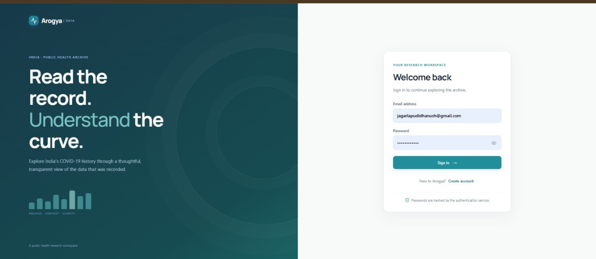

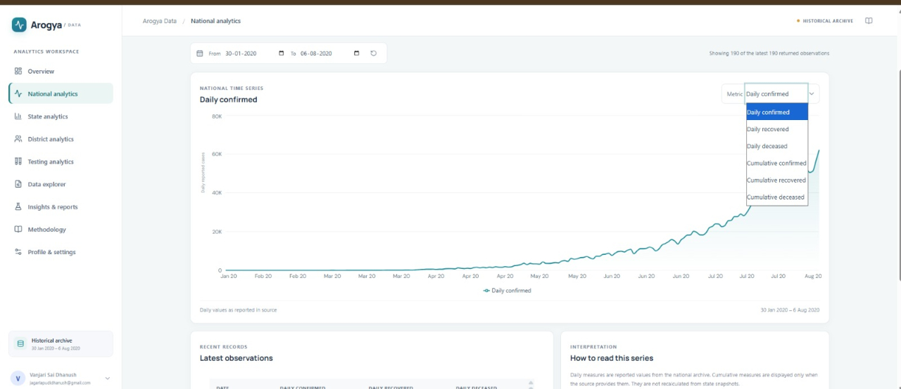
Working Prototype / Output Screens
Notes:
Show real screenshots, photos of the hardware or a short demo video link. Caption each one with what the viewer should notice.

Slide 14
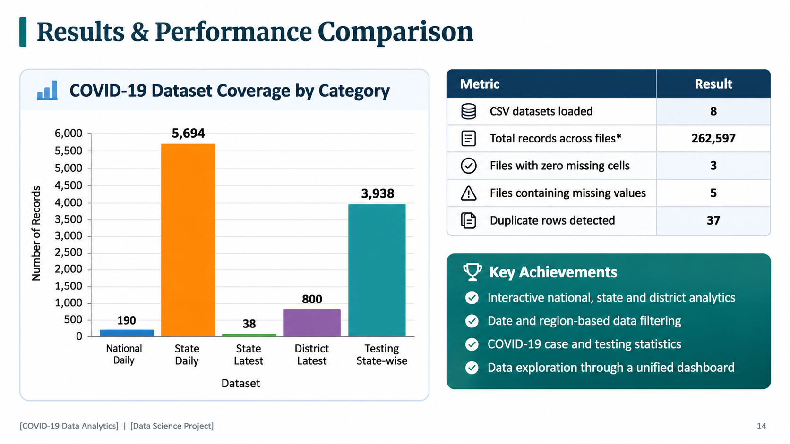
Notes:
Right-click the chart and choose Edit Data to enter your real numbers. Replace the metrics with the ones that fit your project (accuracy, latency, power, throughput, user rating). State clearly which option performed best.

Slide 15
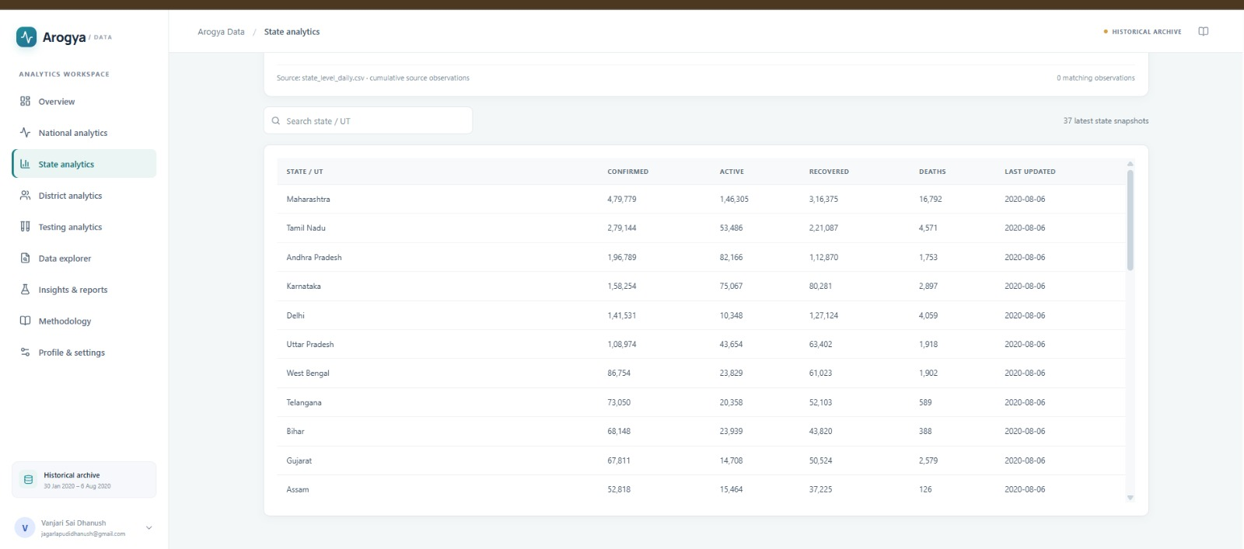
Analysis & Key Findings
Major Findings
• COVID-19 cases vary across states and time periods.
• Daily and cumulative statistics reveal changes in case trends.
• Testing data helps provide additional public-health context.
Interpretation: The dashboard presents COVID-19 data through interactive charts and summaries.
Error Analysis: Missing values and duplicate patient records may affect data interpretation.
Key Drivers:
• Time period
• State and district
• Confirmed cases, recoveries and deaths
• Testing statistics
Notes:
Explain what the numbers mean. Use a confusion matrix, ROC curve, feature-importance chart or output comparison. Be honest about weak results; panels value that.

Slide 16

Testing & Validation
Test ID | Test Description | Expected Result | Actual Result | Status
T01 | Backend API health check | API responds successfully | Health endpoint tested | PASS
T02 | COVID-19 data summary | Correct summary statistics | Validated by automated tests | PASS
T03 | State and district filtering | Relevant records returned | Filtering tests passed | PASS
T04 | Data Explorer pagination | Correct records and pagination | Explorer tests passed | PASS
Functional Testing
Validation Method
Performance Testing
Verified API endpoints and data filtering.
Tested summary statistics and data exploration.
Checked authentication and session behavior.
Automated testing using Pytest.
Tested backend APIs and data-processing logic.
Result: 24 tests passed.
Checked API responses during functional tests.
Verified data filtering and pagination.
No formal load or stress testing performed.
Notes:
List representative test cases with expected and actual outcomes. Name the validation methods you used. Delete rows you do not need.

Slide 17


Challenges & Limitations
Challenges Faced
Limitations
• Integrating multiple CSV datasets with different structures and columns.
• Handling missing values and inconsistent data formats.
• Identifying duplicate records in patient data.
• Ensuring accurate date-wise and state-wise comparisons.
• Connecting the React frontend with the Flask backend API.
• Data quality depends on the original public datasets.
• Some datasets contain missing or incomplete historical records.
• Patient-level data contains substantial missing information.
• Historical records may not reflect current COVID-19 conditions.
• The dashboard provides descriptive analytics, not disease predictions or medical advice.
Notes:
Be candid. Pair every challenge with how you solved it, and list limitations that the panel would otherwise spot themselves.

Slide 18

Conclusion
1. Converts COVID-19 datasets into meaningful visual summaries.
2. Provides interactive analysis of confirmed cases, recoveries, deaths, and testing statistics.
3. Supports state-wise and time-wise comparisons and improves accessibility and interpretation of public-health data.
1
Final Outcome
An interactive COVID-19 Data Analytics Dashboard built using React.js, Flask, Python, Pandas, and NumPy.
Objectives achieved:
Integrated multiple COVID-19 datasets.
Presented key statistics through visualizations.
Enabled data filtering and exploration.
Supported national, state, district, and testing analytics.
Final Outcome
An interactive COVID-19 Data Analytics Dashboard built using React.js, Flask, Python, Pandas, and NumPy.
Objectives achieved:
Integrated multiple COVID-19 datasets.
Presented key statistics through visualizations.
2
Supports state-wise and time-wise comparisons and improves accessibility and interpretation of public-health data.
3
Notes:
Revisit each objective and say whether you met it. Quote your headline result with numbers. Do not introduce new material here.

Slide 19



Future Scope & Applications
Improve Performance
Enhance dashboard performance and usability.
Applications
Public Health: Monitor COVID-19 trends and case statistics.
Government: Support data-driven planning and resource allocation.
Researchers: Compare state-wise and date-wise COVID-19 trends.
Students: Learn data analysis and visualization using real-world datasets.
Healthcare Planning: Understand testing, recovery, and mortality trends.
Expand Data / Features
Integrate updated datasets.
Deploy & Build an Interface
Scale & Secure
Notes:
Give concrete next steps, ideally tied to the limitations. Then name two or three real-world uses.

Slide 20
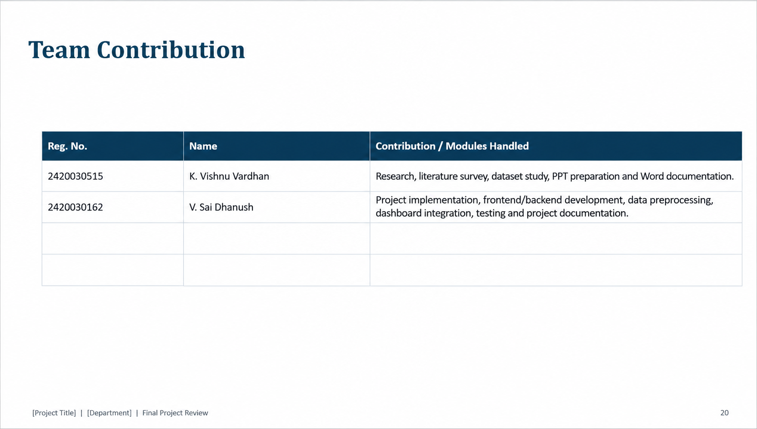
Notes:
Show that work was planned and shared. Every member should be able to explain their own module.

Slide 21
References
[1] Salehi et al., “A Synergetic R-Shiny Portal for Modelling and Tracking of COVID-19 Data,” 2023.
[2] Clarkson, “Web-Based COVID-19 Dashboards and Trackers in the United States: Survey Study,” 2023.
[3] Schulze et al., “Digital Dashboards Visualizing Public Health Data: A Systematic Review,” 2021.
Pandas Documentation: https://pandas.pydata.org/docs/
React Documentation: https://react.dev/
Notes:
Use IEEE style, numbered in order of first citation in the deck. Include datasets, documentation and code repositories.

Slide 22
THANK YOU
Questions & Discussion
Dr N SUNANDA, Associate Professor
Department of Computer Science and Engineering, KLH CSE Bowrampet Campus
Notes:
Leave this slide up during questions. Make sure every team member can answer questions about their own module.

