Slide 1
PROJECT REVIEW
AI-Based Resume Screening System
An intelligent NLP + Machine Learning pipeline to rank resumes against a job description
TEAM MEMBERS
PROJECT GUIDE
Sai Teja Bandari
2420030008
Dr. N. Sunanda
Mani Charan Chava
2420030545
Dept. of Computer Science & Engineering
Batch-28 | Data Science (24AD3107) | A.Y. 2026–2027

Slide 2
01
1
2
3
Problem
Statement
The Problem
Real-World Relevance
Motivation
Recruiters receive hundreds of resumes per opening. Manually reading each one is slow, inconsistent between reviewers, and prone to unconscious bias unrelated to a candidate's actual skills.
Delayed or inconsistent shortlisting directly costs companies time-to-hire and can cause well-qualified candidates to be overlooked simply due to reviewer fatigue or subjective judgment.
NLP and ML can automatically read, understand and rank resumes against a job description objectively — motivating an automated, explainable screening pipeline for this project.
Why manual resume screening no longer scales
AI-Based Resume Screening System | Review-2
2

Slide 3
Objectives
Specific, measurable goals for the proposed AI-based screening pipeline
SPECIFIC & MEASURABLE OBJECTIVES
EXPECTED OUTCOMES
Automatically parse and pre-process resumes (PDF/text) using NLP: tokenization, stop-word removal, lemmatization.
A working end-to-end pipeline: upload → parse → score → rank → shortlist.
1
Extract contextual features via TF-IDF and word embeddings, representing resumes and job descriptions in one vector space.
Quantifiable accuracy / F1-score improvement over keyword-only baseline.
2
Rank candidates by relevance using cosine similarity plus supervised classifiers (SVM, Naive Bayes, XGBoost) with measurable accuracy targets.
Reduced average screening time per job opening.
3
Consistent, explainable ranking with no dependency on paid external APIs.
Deliver a transparent, score-explained shortlist through a recruiter-facing web dashboard, reducing manual screening time and bias.
4
AI-Based Resume Screening System | Review-2
3

Slide 4
Literature Survey / Existing System
What current AI resume-screening research does — and where it stops short
!
Category-only output
!
Shallow keyword matching
Several systems classify resumes into broad job categories but never rank candidates within that category against a specific opening.
Cosine-similarity-only approaches over-weight keyword overlap and can miss relevant experience phrased differently from the job description.
!
Costly external dependency
!
Inconsistent manual evaluation
Generative-AI-driven tools rely on paid third-party APIs, adding recurring cost, latency, and data-privacy risk for bulk resume processing.
Even with partial automation, studies report persistent manual review, delays and inconsistent criteria between recruiters.
AI-Based Resume Screening System | Review-2
4

Slide 5
Literature Survey — Comparative Table
Six existing works vs. how the proposed system closes each gap
# | Paper (Source, Year) | Method Used | Limitation | Gap / Our Improvement
1 | AI-Powered Resume Screening Using NLP & ML (IEEE, 2025) | NLP pre-processing + ML classifier for category tagging | Categorizes only; no ranking vs. a specific JD; no explanation | Direct JD matching + ranked, score-explained shortlist
2 | ReSage AI: AI-Enhanced Resume Screening (IEEE, 2025) | Generative AI (Gemini) + OpenCV content scoring | Applicant-facing, paid external API, cost/latency/privacy risk | Recruiter-facing, local lightweight NLP/ML, no paid API
3 | ML-based Resume Screening & Ranking (IEEE, 2024) | SVM / Naive Bayes / XGBoost comparison | Shallow BoW/TF-IDF features; no bias handling | Adds embeddings for context + bias-aware feature screening
4 | Resume Screening using Machine Learning (IEEE, 2024) | NLP + ML with cosine similarity | Keyword overlap bias; weak recruiter interaction | Similarity + trained classifier + interactive dashboard
5 | Automation of Resume Classification (IEEE, 2024) | AI/NLP/ML classification into job categories | No fine-grained ranking; scalability untested | Adds in-category ranking; built for bulk uploads
6 | Intelligent Resume Screening Tool (Applied AI Letters, 2025) | AI-driven analysis & recommendation | Manual review, delays, inconsistent criteria persist | One uniform automated scoring pipeline for every resume
#
Paper (Source, Year)
Method Used
Limitation
Gap / Our Improvement
AI-Based Resume Screening System | Review-2
5

Slide 6
How the Proposed System Closes the Gap
Ranking, not just category tags
Cosine similarity + SVM/Naive Bayes/XGBoost rank every resume against the specific job description.
✓
Contextual matching
TF-IDF + word embeddings capture meaning, not just keyword overlap.
✓
No paid external API
Locally trainable NLP/ML models — lower cost, no data leaves the organization.
✓
Consistent, explainable scoring
One uniform pipeline applied to every resume, with a transparent score for recruiters.
✓
AI-Based Resume Screening System | Review-2
6

Slide 7
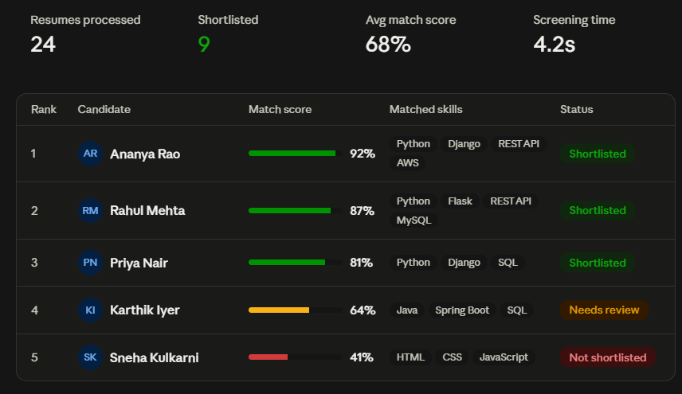
That's the expected output of your AI-Based Resume Screening System — a recruiter dashboard showing the job description, summary stats, and a ranked shortlist with match-score bars, matched skills, and status for each candidate.

