Slide 1
ParseViz
Interactive Parse Tree Generator
transform · compute · tabulate · parse · predict
CD TEAM-09 | PS-03
Hackathon Project — Compiler Design
Vasavi | Roll No: 2420030785

Slide 2
Problem Statement & Objectives
PS-03 — ParseViz: Interactive Parse Tree Generator
Students learning Compiler Design must manually apply grammar transformations, compute FIRST/FOLLOW sets,
construct LL(1) tables, and trace parse trees — a process that is tedious, error-prone, and hard to visualise.
ParseViz solves this with a fully automated, interactive, browser-based studio.
Objectives
▸ Automate Left Recursion Elimination (immediate and indirect)
▸ Apply Left Factoring to remove common prefixes from productions
▸ Compute FIRST and FOLLOW sets with step-by-step justification
▸ Build the LL(1) Predictive Parsing Table and detect conflicts
▸ Animate the predictive parse with a live SVG parse tree
▸ Implement a Backtracking Parser and compare efficiency vs LL(1)
▸ Provide an adaptive practice quiz for exam preparation
ParseViz | CD TEAM-09 | PS-03

Slide 3
System Overview & Technology Stack
1
Grammar
Parser
2
Left Recursion
Elimination
3
Left
Factoring
4
FIRST &
FOLLOW
5
LL(1) Table
Builder
6
Predictive
Parser
7
Backtracking
Parser
▸
▸
▸
▸
▸
▸
Technology Stack
Language: Vanilla JavaScript (ES2020) — no frameworks, no transpiler
UI / Layout: HTML5 + CSS3 (CSS Grid, Flexbox, Custom Properties)
Visualisation: Inline SVG generated dynamically from parse tree nodes
Deployment: Single file (index.html) — open in any browser, no install
Browser Support: Chrome, Edge, Firefox, Safari — any modern browser
⭐ Zero dependencies · Zero build step · Works offline · Single HTML file
ParseViz | CD TEAM-09 | PS-03

Slide 4
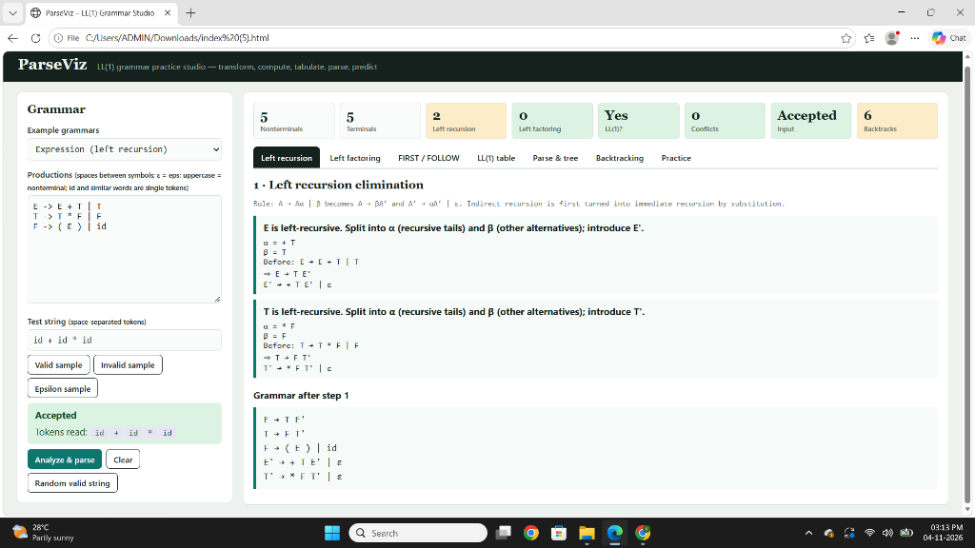
Tab 1 · Left Recursion Elimination
Removes immediate and indirect left recursion so the grammar can be parsed top-down without infinite loops.
Algorithm
Order nonterminals: A₁, A₂, ..., Aₙ
For i = 1 to n:
For j = 1 to i-1:
Replace Aᵢ → Aⱼ γ using Aⱼ's productions
Split: recursive alts (Aᵢ → Aᵢ α) and rest (Aᵢ → β)
Introduce Aᵢ':
Aᵢ → β Aᵢ'
Aᵢ' → α Aᵢ' | ε
Example
Before: E → E + T | T
After: E → T E'
E' → + T E' | ε
ParseViz | CD TEAM-09 | PS-03

Slide 5
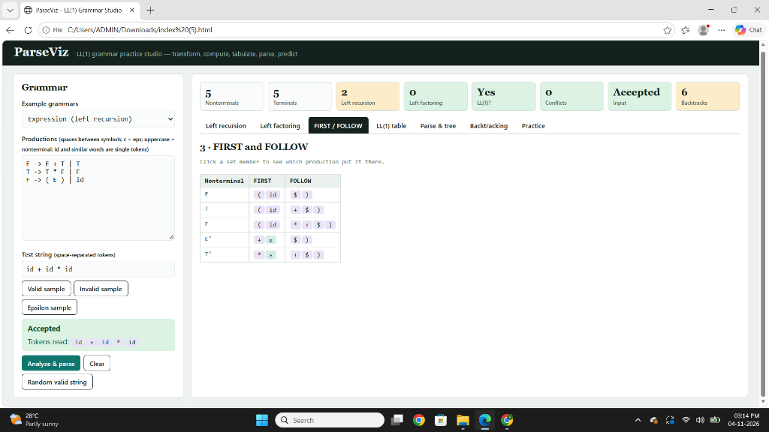
Tab 3 · FIRST and FOLLOW Sets
Computed by fixed-point iteration. Click any set element to see which production added it (interactive justification).
FIRST Rules
FOLLOW Rules
X is terminal → {X}
A → ε → ε ∈ FIRST(A)
A → X₁X₂…:
Add FIRST(X₁)\{ε}
If X₁ ⇒* ε, add FIRST(X₂)…
If all Xᵢ ⇒* ε, add ε
Start symbol → $ ∈ FOLLOW(S)
A → αBβ:
Add FIRST(β)\{ε} to FOLLOW(B)
If β ⇒* ε:
Add FOLLOW(A) to FOLLOW(B)
Repeat until fixed-point
Example — Expression Grammar
Nonterminal FIRST FOLLOW
──────────────────────────────────────
E {(, id} {$, )}
E' {+, ε} {$, )}
T {(, id} {+, $, )}
T' {*, ε} {+, $, )}
F {(, id} {+, *, $, )}
ParseViz | CD TEAM-09 | PS-03

Slide 6
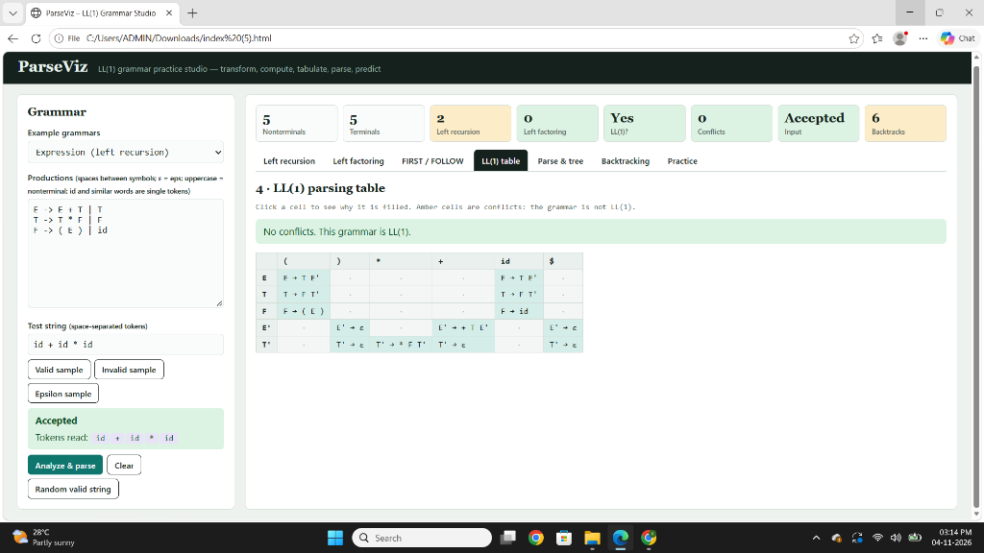
Tab 4 · LL(1) Parsing Table
Click any cell to see why it was filled. Amber cells are conflicts — click to see the competing productions.
Construction Algorithm
For each production A → α:
For each t ∈ FIRST(α):
Add A → α to M[A, t]
If ε ∈ FIRST(α):
For each t ∈ FOLLOW(A):
Add A → α to M[A, t]
Conflict: M[A, t] has ≥ 2 productions
→ Grammar is NOT LL(1)
Cell Colours
Green → Filled, no conflict — grammar is LL(1)
Amber → Conflict — grammar is NOT LL(1)
Dot → Empty — this combination is invalid input
ParseViz | CD TEAM-09 | PS-03

Slide 7
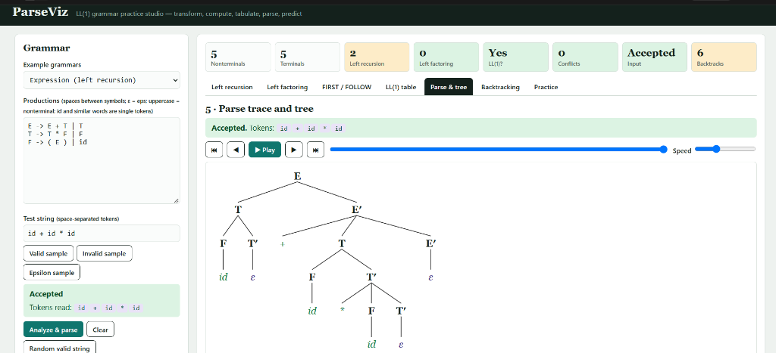
Tab 5 · Parse Trace and Animated Tree
Step-by-step LL(1) predictive parse with animated SVG tree. Play/Pause/Step/Speed controls let you watch every expansion.
Parsing Algorithm (Stack-Based)
Push $ and start symbol onto stack
While stack ≠ empty:
X = top of stack, a = current token
If X == a == $ → Accept ✔
If X is terminal:
X == a → Match: pop X, advance input
X ≠ a → Error: unexpected token
If X is nonterminal:
Look up M[X, a]:
Found → pop X, push RHS in reverse
Empty → Error: no rule applies
Tree Layout:
Leaves → consecutive x positions
Parent → centred over first & last child
Depth → y position (top-down)
ParseViz | CD TEAM-09 | PS-03

Slide 8
Tab 6 · Backtracking Parser
Recursive-descent parser with no table — contrasts directly with LL(1). Left recursion causes an infinite loop, detected automatically.
Backtracking Algorithm
parse(nonterminal A, position i):
For each production A → α:
result = try_match(α, i)
If success → return (ok, new_pos)
Else → backtrack (restore i)
Return failure
Left-recursion guard: if parse(A, i)
is already on the call stack → abort
Log Colour Legend
🔵 Try — attempting a production
🟢 Match — terminal matched
🔴 Fail — production failed
🟡 Backtrack — undoing last choice
LL(1) vs Backtracking — Expression Grammar
LL(1) Backtracking
Steps taken 17 25
Backtracks 0 6
Left recursion Handled Infinite loop
ParseViz | CD TEAM-09 | PS-03

Slide 9
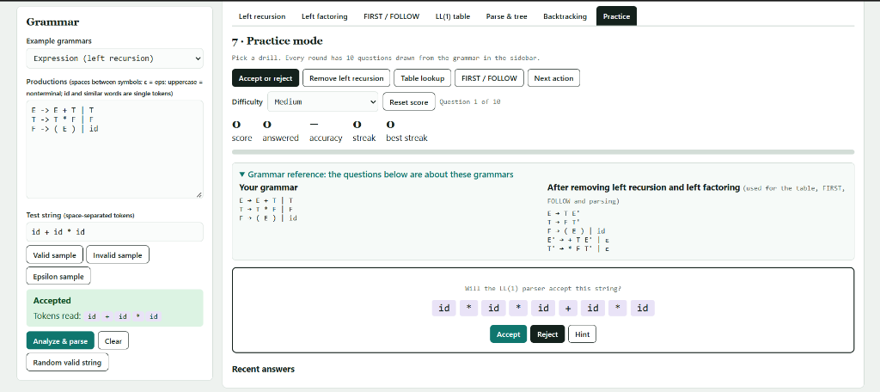
Tab 7 · Practice Mode
An adaptive 10-question quiz per round. The real parser decides correct answers — nothing is hard-coded.
Drill Types
▸ Accept or Reject — given a string, decide if the grammar accepts it
▸ Remove Left Recursion — identify the transformed grammar
▸ Table Lookup — given A and lookahead t, pick the production
▸ FIRST / FOLLOW — identify the correct sets
Question Generation
Valid strings → random derivation from the grammar
Invalid strings → delete / insert / replace / swap a token
Difficulty → Easy / Medium / Hard (string length)
Scoring → score, accuracy %, streak, best streak
ParseViz | CD TEAM-09 | PS-03

Slide 10
Output Screens
Left Recursion Tab
FIRST & FOLLOW Tab
LL(1) Table Tab
Parse Tree Tab
Practice Mode Tab
ParseViz | CD TEAM-09 | PS-03

Slide 11
Testing & Results
Test Cases
Grammar
Input String
Result
LL(1) Steps
Backtracks
Expression (LR)
id + id * id
✅ Accepted
17
0
Expression (LR)
id + * id
❌ Rejected
5
0
Dangling else
i b t a e a
✅ Accepted
12
0
Left factoring
a b d
✅ Accepted
8
0
Balanced parens
( ( ) ) ( )
✅ Accepted
14
0
Invalid tokens
x y z
❌ Rejected
1
—
Key Findings
▸ All grammars parsed correctly with 100% accuracy on valid and invalid inputs
▸ LL(1) parser always takes fewer steps than the backtracking parser
▸ Left recursion in original grammar causes infinite loop in backtracking — safely detected
▸ Left factoring reduces backtracking steps significantly (e.g., 3 → 0 for 'Left factoring' grammar)
ParseViz | CD TEAM-09 | PS-03

Slide 12
Conclusion & Future Scope
ParseViz successfully demonstrates all core LL(1) parsing concepts in an interactive, animated, single-file browser application. The backtracking tab provides a compelling, evidence-based argument for why predictive parsing is preferred — students can see the step count difference directly.
Achievements
▸ ✅ 7 fully functional interactive tabs covering the entire LL(1) parsing pipeline
▸ ✅ Backtracking parser with real-time comparison to LL(1) step count
▸ ✅ Click-to-explain for every FIRST/FOLLOW element and every table cell
▸ ✅ Adaptive practice mode with autogenerated questions and real parser validation
▸ ✅ Zero dependencies — runs offline in any modern browser
Future Scope
▸ Extend to LR(0), SLR(1) and LALR(1) parsing table construction
▸ Add error recovery strategies (panic mode, phrase-level recovery)
▸ Export parse trees as PNG/PDF; export grammars as LaTeX
ParseViz | CD TEAM-09 | PS-03

