Slide 1


HUMAN-IN-THE-LOOP HR INTELLIGENCE
Explainable Predictive Analytics for Employee Attrition Risk Assessment
An Explainable AI (XAI) & HR Decision-Support System Powered by ML and SHAP
DEPARTMENT OF COMPUTER SCIENCE AND INFORMATION TECHNOLOGY · KLEF
Boya vinay
2420090054
Y Manikanta sai
D Sai Srujan
Golla Rahul
2420030082
2420030083
2420040098
Notes:
Introduce the engineering team and project scope. State the core goal: moving beyond black-box classification to transparent, human-in-the-loop decision intelligence for human resource leaders.

Slide 2

THE OPERATIONAL CHALLENGE
Why Traditional Attrition Prediction Fails
The Business Cost: High turnover raises recruitment costs, causes knowledge loss, and delays projects.
The Black-Box Dilemma: Traditional AI predicts “who leaves” without “why”, so HR can't trust or act on it.
The Solution: XAI combines predictive accuracy with transparent, employee-level reason codes.
“Predictions without explanations cannot support responsible HR decisions.”
Notes:
Contrast legacy black-box HR attrition scoring with Explainable AI. Emphasize that knowing an employee might leave is worthless if management cannot discover the specific friction factors to address.

Slide 3
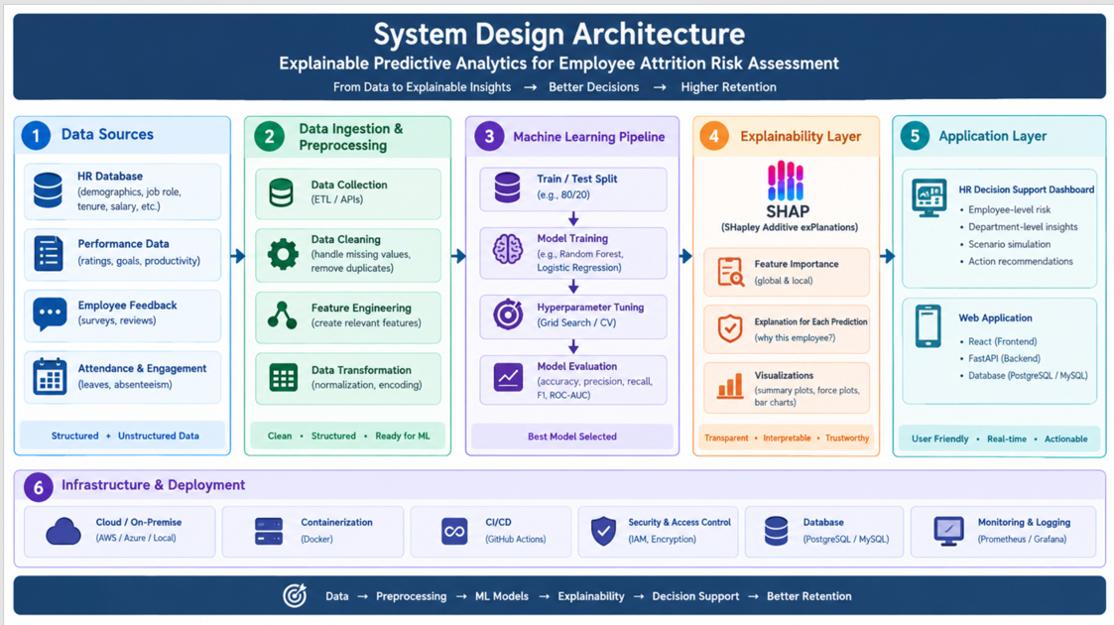

Slide 4
END-TO-END ARCHITECTURE
A Complete 5-Layer Analytical Workflow
From structured benchmark intake to real-time decision-support software.
01
02
03
04
05
Data Layer
Preprocessing
ML Modeling
Explainability
Application
IBM HR benchmark dataset: 1,470 records across 35 multi-modal attributes.
One-Hot Encoding, StandardScaler normalization, and 80/20 stratified partition.
Benchmarked Logistic Regression, Decision Tree, Random Forest, and Gradient Boosting.
SHAP TreeExplainer: global rankings and driver weights, individual per-employee attributions.
Interactive React UI and FastAPI REST decision support dashboard for scenario simulation and logging.
Input
ETL
Models
XAI
Interactive
Evaluated across stratified 80/20 train-test splits ensuring class distribution consistency.
Notes:
Walk the five architectural tiers left to right. Point out how the Explainability Layer acts as the bridge translating mathematical tree ensembles into the end-user Application Layer.

Slide 5
MODEL EVALUATION BENCHMARK
Random Forest Wins on Balance and Explainability
Production Selected Model
Evaluated on 294 held-out test samples under identical stratified conditions.
Algorithm | Accuracy | Precision | Recall | F1-Score | ROC-AUC
Random Forest (Selected) | 82.65% | 45.24% | — | 42.70% | 78.55%
Logistic Regression | 75.51% | 35.63% | 65.96% (High Sensitivity) | 46.27% | 80.35%
Decision Tree | 77.21% | 34.48% | — | 42.74% | 65.17%
Gradient Boosting | 85.03% | 57.89% | — | 48.35% | 81.46%
Key Architectural Rationale: Random Forest was chosen for optimal generalization stability and seamless compatibility with native SHAP TreeExplainer, preventing extreme decision boundary shifts common in high-learning-rate boosters.
Notes:
Highlight the trade-off analysis. While Gradient Boosting achieved slightly higher raw accuracy, Random Forest offered reliable tree-ensemble generalization and faster, exact SHAP TreeExplainer calculations.

Slide 6
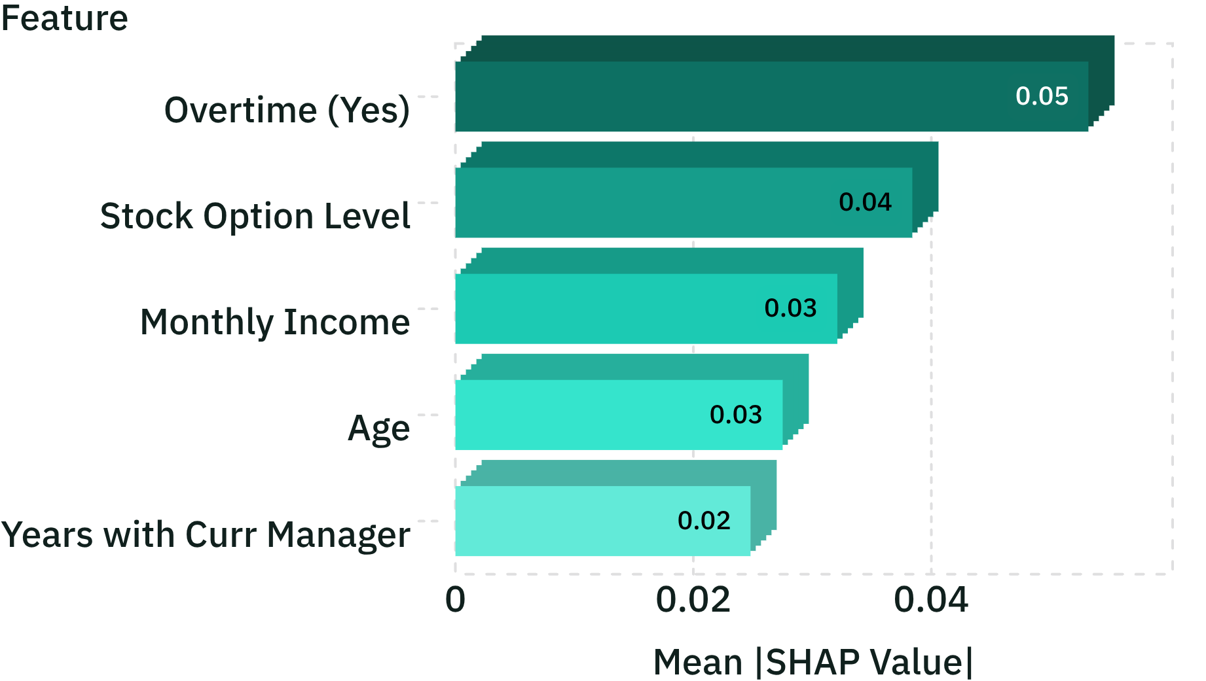
FEATURE ATTRIBUTION ANALYSIS
Peeking Inside the Model with SHAP
Global feature importance alongside individual force decomposition.
Global SHAP Importance Drivers
Risk Pushers (+ Forces)
Overtime (Yes): Primary positive driver of turnover risk (+0.0532 SHAP).
Low Stock Options: Tier 0/1 equity accelerates exit velocity among senior staff.
Protective Anchors (− Forces)
Manager Tenure: Extended rapport with immediate supervisor acts as retention buffer.
Competitive Income: Market-aligned salary mitigates outside recruiter attraction.
Computed across 1,470 records via TreeExplainer game-theoretic Shapley values.
Notes:
Explain how SHAP converts complex tree votes into additive feature contributions. Overtime emerged as the single largest positive predictor of departure across all cohorts.

Slide 7
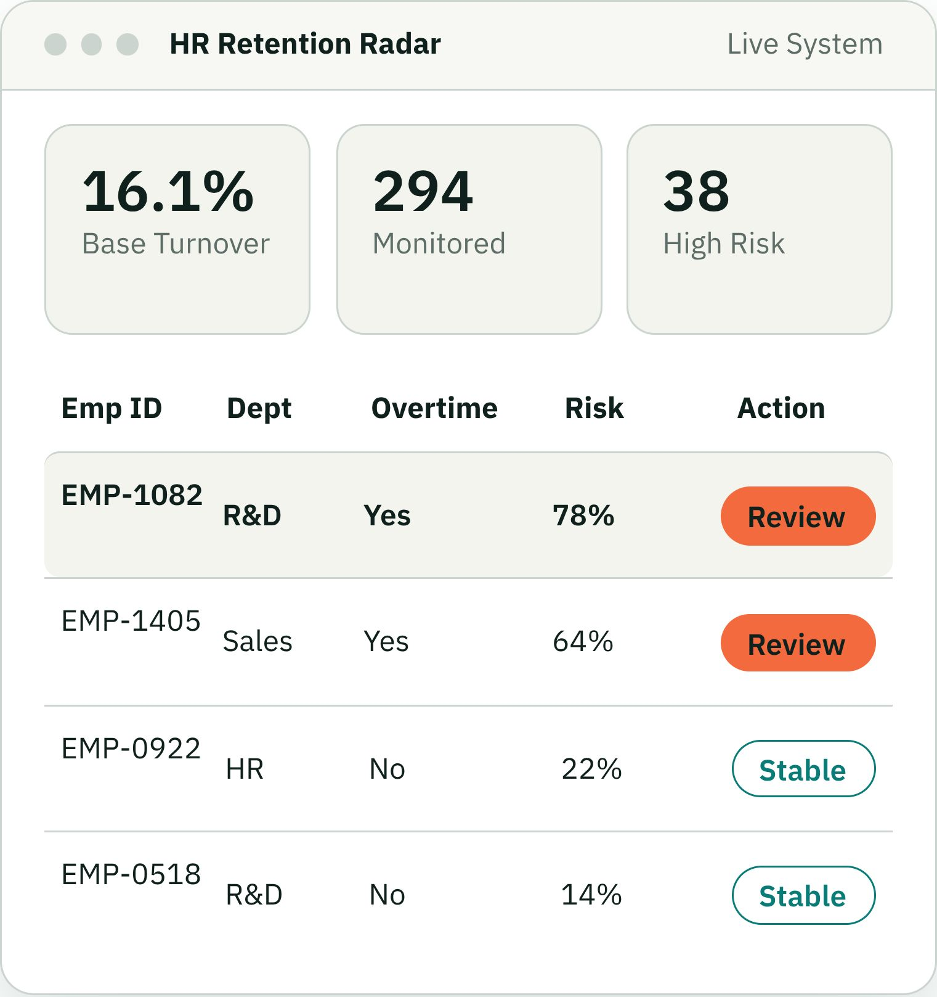
PRODUCTION IMPLEMENTATION
Turning Machine Learning into Practical HR Software
Executive Risk Radar
Live enterprise-wide KPI tracking, 16.1% baseline turnover benchmark, and department vulnerability heatmaps.
Filterable Workforce Directory
Instant cohort sorting by role, overtime flags, and calibrated risk tiers: Low (<30%), Medium (30–59%), High (≥60%).
Modern Technology Stack
Vite + React + Tailwind CSS client, Python FastAPI asynchronous REST endpoints, and SQLAlchemy ORM on SQLite.
Notes:
Demonstrate the engineering delivery. This is not just a Jupyter notebook analysis; it is packaged into an operational executive console where HR business partners can triage flight risks.

Slide 8

DECISION SIMULATION ENGINE
Proactive Intervention Before Resignations Occur
Simulating policy changes to measure risk reduction before taking action.
Interactive Counterfactual Testing
HR tests employee-level policy changes: removing overtime, a +15% salary raise, and hybrid work; risk is re-scored in real time.
Case Example: Workload Rebalancing
Eliminating mandatory overtime reduces high-risk technical staff flight probability by up to 23–35% instantly in the model.
Proactive Retention Logging
Workload balancing, compensation parity, and skip-level check-ins are tracked in the database with scheduled 30-day reviews.
Notes:
Emphasize counterfactual simulation. Instead of passively reading risk scores, managers test hypothetical interventions to identify the lowest-cost, highest-impact retention move.

Slide 9
ACADEMIC & ETHICAL GOVERNANCE
Human-Centered AI for the Future Workplace
Balancing machine intelligence with ethical accountability and organizational care.
Responsible AI Principles
Project Summary & Impact
Attribution is not causation: Predictions guide supportive dialogue, never automated firing or disciplinary action.
Data Minimization: Predictions exclude sensitive personal protected classes; models process job-relevant operational attributes.
Human Oversight: Retention actions require informed human judgment, active consent, and empathetic dialogue.
Explainability Bridge: Connects random forest ensembles to interpretable local SHAP decision paths, bridging machine learning with human interpretability.
Full-Stack Delivery: A production-ready React and FastAPI decision-support platform for modern HR management.
Actionable Retention: Shifted HR from reactive exit interviews to quantifiable, proactive retention.
Department of Computer Science and Information Technology · KLEF · 2026 Academic Project
Ready for Evaluation
Notes:
Conclude the presentation by reinforcing the project's ethical foundation and technical rigor. Open the floor to the evaluation committee for questions.

