Slide 1


Department of CSE
PROJECT REVIEW – 2
AI MULTI-AGENT RESEARCH ASSISTANT
Methodology, System Design, Tools, Implementation & Evaluation
Subject: Applied Machine Learning for Text Analysis | Code: 24ALT3101
Team Members
Y. Srija
T. Deepak
Bharat
2420030480
2420030106
2420090068
Plan • Research • Retrieve • Validate • Synthesize • Report

Slide 2








Project Snapshot
Tools & Technologies
Role
Python
FastAPI
AI Systems Developer (Multi-Agent Architecture)
Description
Designed and implemented a hierarchical multi-agent research system that decomposes complex queries into structured sub-tasks using LLM-based planning.
Integrated hybrid RAG (vector search + keyword retrieval) to fetch verified sources, extract statistical insights, and minimize hallucinations through cross-agent validation.
Developed automated structured report generation with source citations and confidence scoring, following scalable production-ready architecture principles.
LangGraph
FAISS
LLM APIs (GPT / Llama)
SerpAPI
ReportLab
Docker
AI Multi-Agent Research Assistant | Applied Machine Learning for Text Analysis
2

Slide 3


Problem Statement
Overwhelming Volume
Manual Effort
Single-Agent Limits
No Verification Layer
Large volumes of unstructured web text make reliable, manual research slow and difficult to scale.
Users must manually search, compare sources, and judge credibility before synthesizing evidence.
Single-agent LLM systems can miss evidence, hallucinate facts, or provide weak citation support.
There is no automated framework that grounds answers in retrieved evidence and validates claims before delivery.
AI Multi-Agent Research Assistant | Applied Machine Learning for Text Analysis
3

Slide 4


Objectives & Proposed Framework
1
Decompose complex questions into focused, structured research sub-tasks.
2
Generate entity-preserving search queries and collect multiple candidate sources.
3
Combine keyword retrieval with semantic FAISS vector search for hybrid RAG.
4
Filter sources by quality and relevance to minimize hallucination risk.
5
Validate claims before final generation using cross-agent verification.
6
Generate a structured, citation-backed answer with confidence scoring.
AI Multi-Agent Research Assistant | Applied Machine Learning for Text Analysis
4

Slide 5

Methodology
The proposed methodology follows a multi-stage research pipeline. First, the Planner Agent decomposes the user's research question into smaller research tasks. Then the Research Agent generates search queries and retrieves information from web sources using Tavily. The collected sources are filtered for relevance and quality. Next, Hybrid RAG combines vector-based retrieval using FAISS with keyword-based retrieval to find relevant evidence. The Validation Agent checks whether the claims are supported by the collected sources. Finally, the Synthesis Agent generates the final answer from the validated evidence, and the Report Agent generates a structured PDF report.
Task Decomposition — Planner Agent breaks the question into research tasks.
Information Retrieval — Research Agent retrieves web sources through Tavily.
Source Filtering — unsuitable or lower-quality sources are filtered.
Hybrid Retrieval — FAISS semantic search + keyword search identify relevant evidence.
Evidence Validation — Validation Agent checks whether claims are supported.
Evidence-Grounded Generation — Synthesis Agent generates the final answer and Report Agent creates the PDF.
Research Query
Merge, Rank & Deduplicate Sources
Evidence-Grounded, Citation-Backed Answer
AI Multi-Agent Research Assistant | Applied Machine Learning for Text Analysis
6

Slide 6
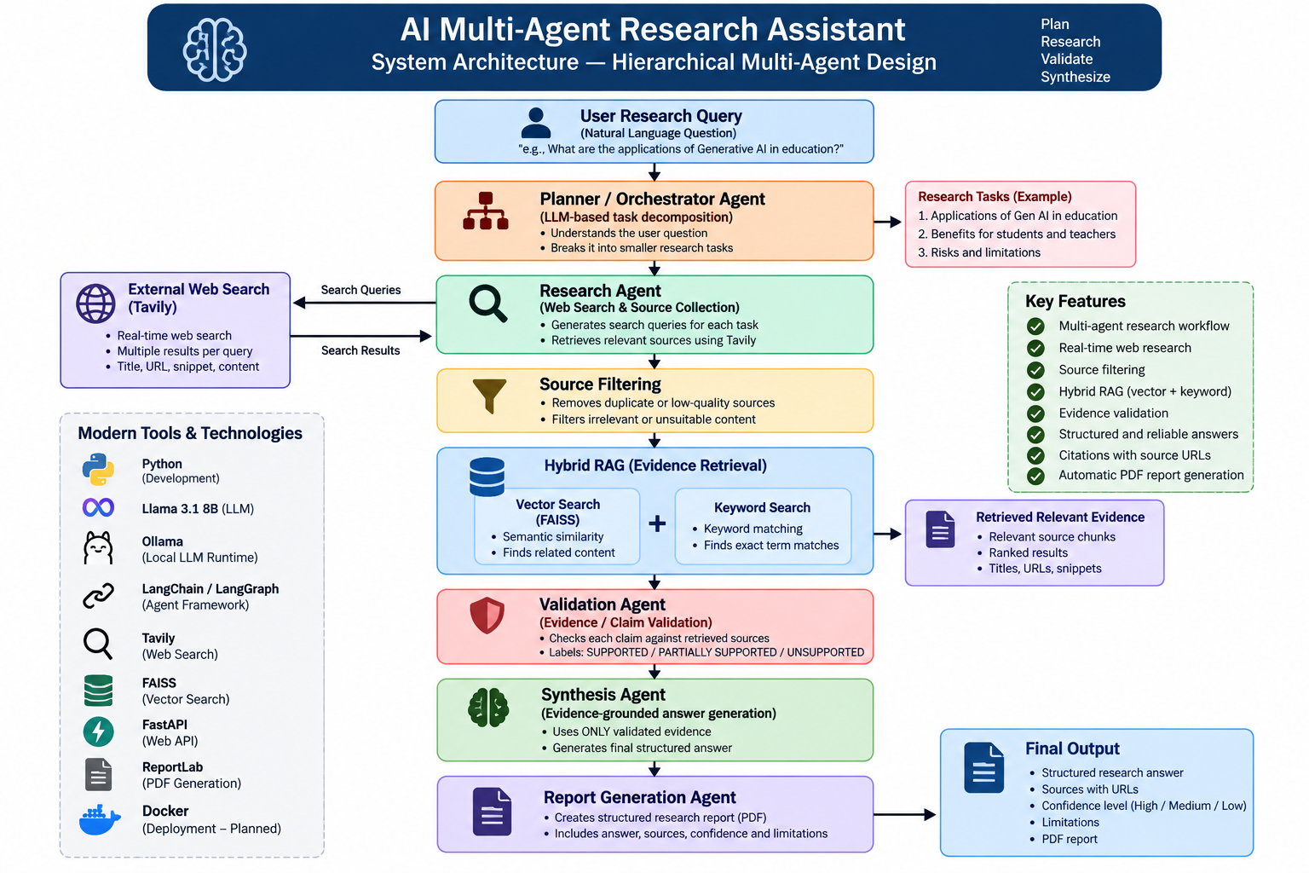
System Architecture — Hierarchical Multi-Agent Design
User Research Query
Planner / Orchestrator Agent
(LLM-based decomposition)
Structured Report + Citations + Confidence Score
AI Multi-Agent Research Assistant | Applied Machine Learning for Text Analysis
5

Slide 7


Hybrid RAG Pipeline — Retrieval & Evidence Fusion
Research Query
Semantic Vector Search
FAISS embeddings
Keyword & Web Search
Tavily retrieval
Merge, Rank & Deduplicate Sources
Evidence / Claim Validation
Evidence-Grounded, Citation-Backed Answer
AI Multi-Agent Research Assistant | Applied Machine Learning for Text Analysis
6

Slide 8
Modern Tools and Technologies
Python
FastAPI
LangChain
FAISS
Core orchestration & agent logic
Scalable service-layer deployment
LLM and agent integration
Vector similarity retrieval component
Llama 3.1 8B + Ollama
Tavily
ReportLab
Docker (planned)
Local LLM inference for planning and synthesis
Web search and source collection
Automated PDF report generation
Future packaging and deployment
AI Multi-Agent Research Assistant | Applied Machine Learning for Text Analysis
7

Slide 9
Innovation & Key Features
Hierarchical Multi-Agent Design
True Hybrid Retrieval
A planner agent decomposes queries and coordinates specialized sub-agents, rather than relying on a single monolithic prompt.
Combines semantic FAISS vector search with keyword and live web search for both conceptual and factual coverage.
Dedicated Validation Agent
Confidence-Scored Output
An independent agent checks whether generated claims are actually supported by retrieved evidence before synthesis.
Final reports carry explicit confidence levels and traceable source citations for every claim.
AI Multi-Agent Research Assistant | Applied Machine Learning for Text Analysis
8

Slide 10

End-to-End Workflow
01
02
03
04
05
06
User Query
Task Decomposition
Parallel Agent Dispatch
Hybrid RAG Retrieval
Cross-Agent Validation
Cited Report + Confidence
A single, domain-independent pipeline that plans, retrieves, verifies, and synthesizes — end to end.
Task-Aware Planning
Grounded Validation
Traceable Output
Each sub-task is scoped to what the query actually needs.
Claims are checked against retrieved evidence, not assumed.
Every statement in the final report links back to a source.
AI Multi-Agent Research Assistant | Applied Machine Learning for Text Analysis
9

Slide 11

Reliability — Validation, Citations & Confidence
Cross-Agent Validation
Citations & Confidence Scoring
A dedicated validation agent checks whether generated claims are actually supported by retrieved sources.
Reduces hallucination by rejecting or flagging unsupported statements before they reach the final report.
Runs independently of the synthesis agent, mirroring a reviewer role in a research pipeline.
Every claim in the structured report is linked to its supporting source for full traceability.
A confidence score reflects source agreement and validation outcome, not just model certainty.
Reports are generated automatically with ReportLab in a clean, consistent, presentation-ready format.
AI Multi-Agent Research Assistant | Applied Machine Learning for Text Analysis
10

Slide 12


Deployment & Production-Ready Architecture
FastAPI Service Layer
Docker (Planned)
Modular Agents
Local LLM Runtime
Exposes the multi-agent pipeline as a lightweight, well-documented REST API.
Container packaging is a future deployment step.
Planner, retrieval, and validation agents can be scaled, replaced, or improved independently.
Ollama runs Llama 3.1 8B in the current setup.
AI Multi-Agent Research Assistant | Applied Machine Learning for Text Analysis
11

Slide 13
Implementation and Project Execution
AI Multi-Agent Research Assistant | Applied Machine Learning for Text Analysis
1. Proposed Model
Workflow includes planning, web research, retrieval, validation, synthesis and report generation.
2. Implementation
Python modules integrated with FastAPI, Tavily, hybrid retrieval and ReportLab.
3. Code Execution
Local execution through Ollama with Llama 3.1 8B; web interface served by Uvicorn.
4. Preliminary Results
Functional checks: web UI, research endpoint, source collection, validation and PDF generation.
5. Research Paper
Draft includes introduction, literature review, methodology, implementation, preliminary results and limitations.
Review-2 | 14

Slide 14
Implementation — Module-Level Design
AI Multi-Agent Research Assistant | Applied Machine Learning for Text Analysis
planner.py
research_agent.py
validation_agent.py
Planner
• task decomposition
Research Agent
• Tavily web search
Validation Agent
• claim/evidence checks
synthesis_agent.py
report_agent.py
api.py
Synthesis Agent
• evidence-grounded answer
Report Agent
• PDF generation
FastAPI
• /research endpoint
Execution path
Query
Plan
Retrieve
Validate
Synthesize
Report
Review-2 | 16

Slide 15
Implementation — Research Pipeline
AI Multi-Agent Research Assistant | Applied Machine Learning for Text Analysis
Implemented stack
Python + LangChain
Llama 3.1 8B via Ollama
Tavily web search + FAISS/hybrid retrieval
FastAPI + ReportLab
# Current execution flow
plan = create_research_plan(query)
for task in tasks[:3]:
queries = generate_search_queries(task)[:2]
sources = research_task(task, queries)
validation = validate_research(task, sources)
filtered = filter_sources(all_sources)
rag_results = hybrid_search(query, filtered)
answer = synthesize_answer(query, validated_results)
report = generate_report(query, answer, validated_results)
Python + scikit-learn
TF-IDF semantic proxy + lexical keyword score
Planner → retrieval → validation flow
Evaluation note
The application has run end-to-end locally. Formal benchmark accuracy, precision, recall, F1, latency and cost have not yet been measured on a representative test set.
Review-2 | 17

Slide 16
Results & Performance Evaluation
AI Multi-Agent Research Assistant | Applied Machine Learning for Text Analysis
Web interface
Research endpoint
Web retrieval
Pass
Pass
Pass
FastAPI homepage
POST /research
Tavily sources collected
Evidence validation
PDF reporting
Pass
Pass
Supported / partial / unsupported
ReportLab output
Functional test evidence
Functional verification only. No benchmark performance scores are claimed; quantitative evaluation remains future work.
Check
Expected behavior
Status
1
Homepage loads
Passed
2
Research request executes
Passed
3
Sources are collected
Passed
4
Evidence validation runs
Passed
5
PDF report is generated
Passed
Review-2 | 18

Slide 17
Research Paper Draft Preparation
AI Multi-Agent Research Assistant | Applied Machine Learning for Text Analysis
Abstract
1. Introduction
Problem, architecture, hybrid retrieval and preliminary prototype findings.
Motivation and limits of manual/single-agent research workflows.
2. Problem Statement
3. Proposed Method
Web volume, manual source comparison, hallucination and verification.
Planner → Research → Filter → Hybrid RAG → Validate → Synthesize → Report.
4. Implementation
5. Results
Python modules, retrieval prototype, FastAPI boundary and report generation.
3 subtasks, 5 ranked sources, 3/3 validated claims in the demo.
6. Limitations & Future Work
7. Conclusion
Live web, FAISS, LLM integration, benchmark, latency and cost evaluation.
Evidence-grounded multi-agent research with traceable output.
Review-2 | 19

Slide 18
Review-2 Summary & Next Implementation Steps
AI Multi-Agent Research Assistant | Review-2
Completed
Working FastAPI UI, live Tavily research, local Llama 3.1 8B inference, evidence validation and PDF report generation.
Real Retrieval
Source quality
Expand source-quality scoring, deduplication and metadata checks.
Quantitative evaluation
Measure retrieval relevance, claim support, citation correctness, latency and cost on a test set.
Orchestration
LangGraph is planned; current workflow uses modular Python/LangChain components.
Deployment
Docker and public hosting are future work.
Final Deliverables
Working FastAPI service, report generation, UI/demo, research paper and final PPT.
Review-2 | 20

Slide 19
Conclusion
Project Outcome
The proposed system combines hierarchical multi-agent planning, hybrid retrieval, validation and structured report generation.
Research Contribution
Multi-agent decomposition improves coverage of complex research questions, while hybrid retrieval combines lexical and semantic evidence.
Reliability Layer
Source filtering and claim validation provide an evidence-checking layer beyond a single LLM generation step.
Technology Stack
Python, FastAPI, LangGraph, FAISS and Docker provide a modular foundation for implementation and deployment.
Next Step
Extend the prototype with live web retrieval, FAISS embeddings, LLM integration and larger-scale evaluation.
AI Multi-Agent Research Assistant | Review-2

Slide 20
Proposed Model — Hierarchical Multi-Agent + Hybrid RAG
AI Multi-Agent Research Assistant | Applied Machine Learning for Text Analysis
User Query
Planner / Orchestrator
Research Agent
Source Filter
External Evidence
Hybrid RAG
Semantic + Keyword
Validation Agent
Traceability
Tavily / SerpAPI
Web sources, titles, URLs, snippets
Validation maps claims to supporting evidence.
Synthesis Agent
Report Agent
Final Report
Citations + Confidence
Review-2 | 15

