Slide 1
IBM University Engagement Project Submission
“Exploring the Power of Machine Learning with IBM Cloud”

Slide 2

Project Title – Predictive Maintenance of Industrial Machinery Using Machine Learning
Domain of Project – Mechanical Engineering / Industrial IoT & Manufacturing
Student Name | Recent Passport Photo | Email ID | Mobile number [WhatsApp]
SYED MUSAIB |  | 2420090109csit@gmail.com | 9000773786
Recommended font style and size: Font Style: Arial Font Size (Heading): 28
Font Size (Content): 20

Slide 3
Problem Statement -
Predictive Maintenance of Industrial Machinery using Machine Learning
Industrial machines such as lathes, mills, pumps, and CNC systems are subject to continuous operational stress, and unplanned failures lead to costly downtime, safety hazards, and lost productivity. Traditional maintenance practices are either reactive – fixing machines only after they break down – or based on fixed schedules that replace parts regardless of their actual condition. Both approaches are inefficient and fail to make use of the rich sensor data that modern machines already generate. The task is to develop a predictive maintenance model for a fleet of industrial machines that can anticipate failures before they occur, by analyzing sensor data such as temperature, rotational speed, torque, and tool wear. The goal is to build a classification model that accurately predicts the type of failure – such as tool wear, heat dissipation, power failure, overstrain, or random failure – enabling proactive maintenance that reduces downtime and operational costs.

Slide 4
Proposed Solution -
(IBM watsonx.ai Studio – Jupyter Notebook):
We propose an AI-powered Machine Failure Prediction System using IBM watsonx.ai Studio and a Jupyter Notebook environment. Sensor data (air temperature, process temperature, rotational speed, torque, tool wear, and product type) from the AI4I 2020 Predictive Maintenance dataset will be uploaded to watsonx.ai Studio as a project data asset. The notebook performs data pre-processing (encoding categorical variables, train-test split) and trains a Random Forest Classifier using scikit-learn. Multiple evaluation metrics (accuracy, precision, recall, F1-score, confusion matrix) are used to assess the model’s performance for failure-type prediction. The selected model classifies each machine reading into failure categories such as Tool Wear Failure, Heat Dissipation Failure, Power Failure, Overstrain Failure, Random Failure, or No Failure – enabling proactive maintenance.

Slide 5
Technology Used
IBM Cloud – It provides the infrastructure to build, deploy, and scale the Predictive Maintenance model efficiently. IBM Cloud Lite enables a reliable, secure, and scalable environment for hosting the watsonx.ai Studio notebook, the dataset, and the trained model
ML Algorithm/ Model Used: Random Forest Classifier (scikit-learn)
Accuracy Obtained: 98.05% (baseline) / 97.2% (after SMOTE rebalancing)
Enhancements: class_weight=‘balanced’ baseline, then SMOTE oversampling on training data – improved rare-class recall by up to 37 points

Slide 6
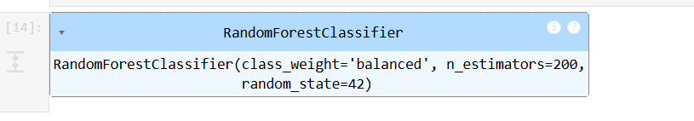
Training Screenshots-

Slide 7
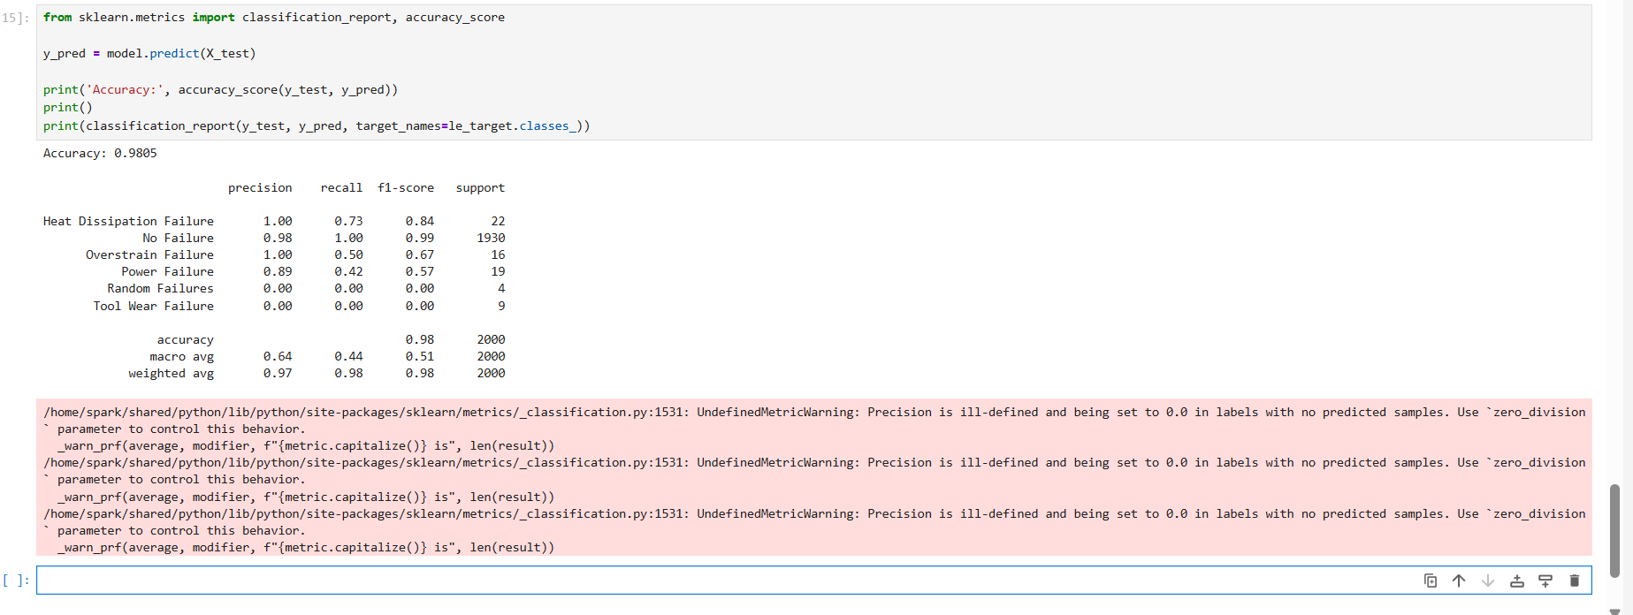
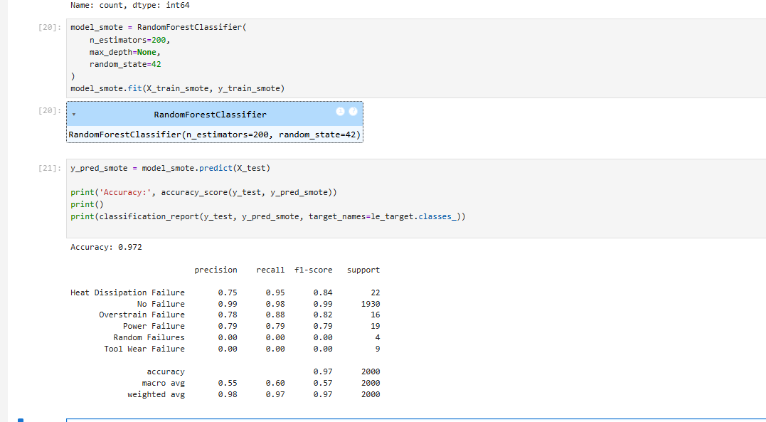
Best Model Screenshot:

Slide 8
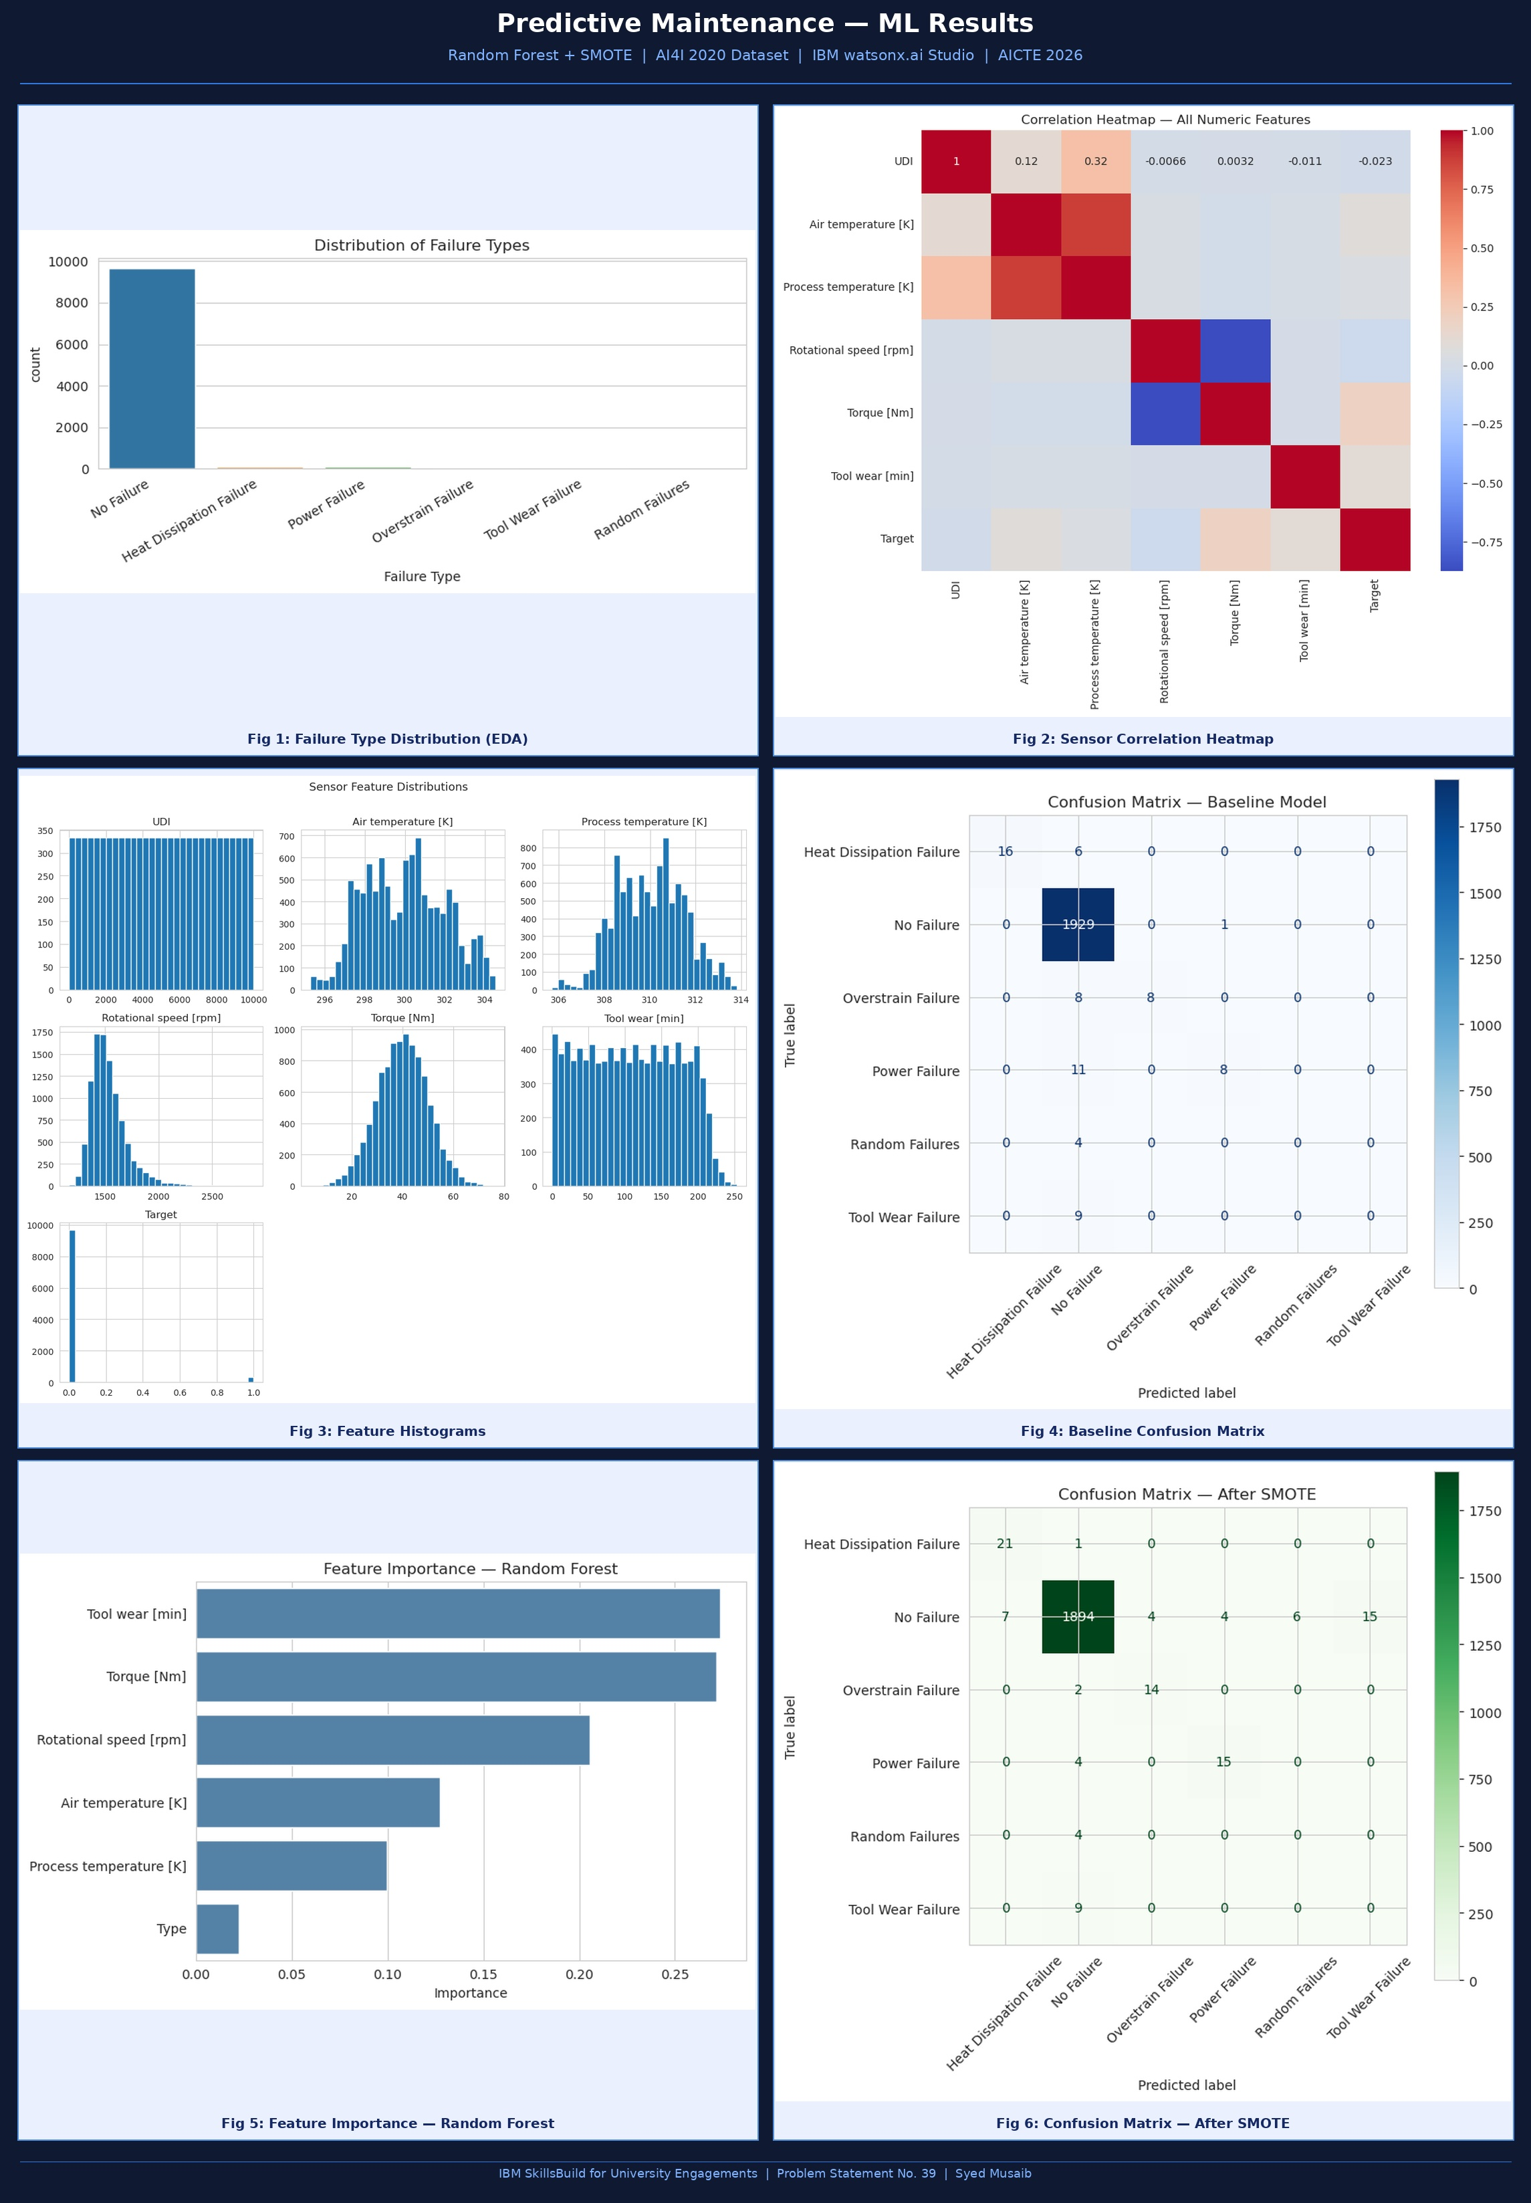
Testing Screenshot:

Slide 9
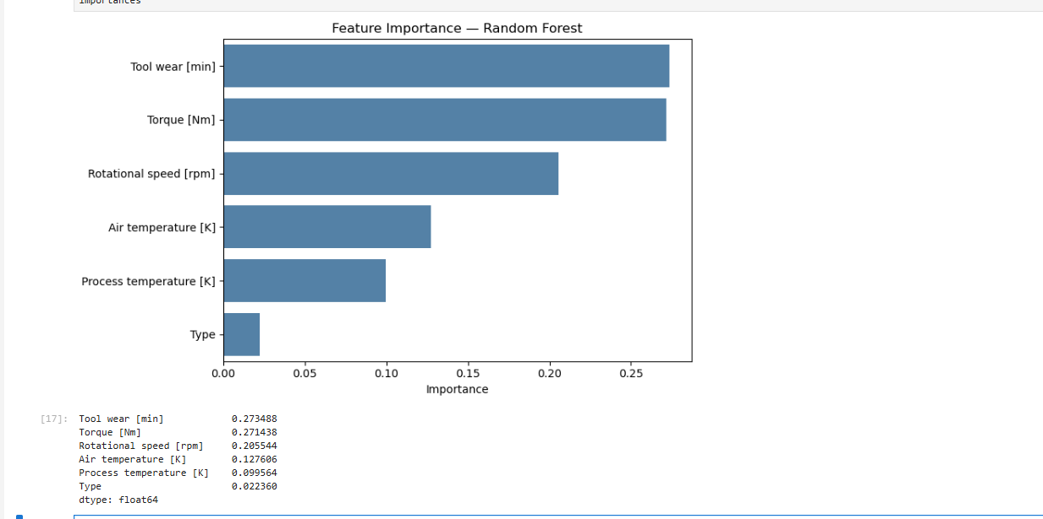
Testing Screenshot:

Slide 10
Novelty and Uniqueness
The solution predicts the specific type of machine failure before it occurs, shifting maintenance from reactive/scheduled to truly predictive.
It uses a single Random Forest model on IBM watsonx.ai Studio to classify readings into six failure categories using only standard sensor data.
Built entirely on IBM Cloud Lite, requiring no paid infrastructure – making it accessible for institutions and students alike.
Feature importance analysis reveals which operating conditions (e.g., torque, tool wear) most strongly drive failures, giving actionable engineering insight.
Reduces unplanned downtime and maintenance cost by enabling early, data-driven intervention rather than fixed-schedule servicing.

Slide 11
Future Scope
The system can integrate real-time IoT sensor streaming for continuous, live failure-risk monitoring rather than batch sensor data.
The model can be extended to additional machine types (CNC, pumps, conveyors) and additional failure modes beyond the current six categories.
The model can be deployed as a live REST API using IBM watsonx.ai Runtime, connected directly to plant SCADA systems.
Advanced algorithms (e.g., XGBoost) and resampling techniques (e.g., SMOTE) can be used to improve detection of rare failure types.
The solution can be scaled from a single fleet to plant-wide deployment, giving maintenance teams advance alerts before failures occur

Slide 12
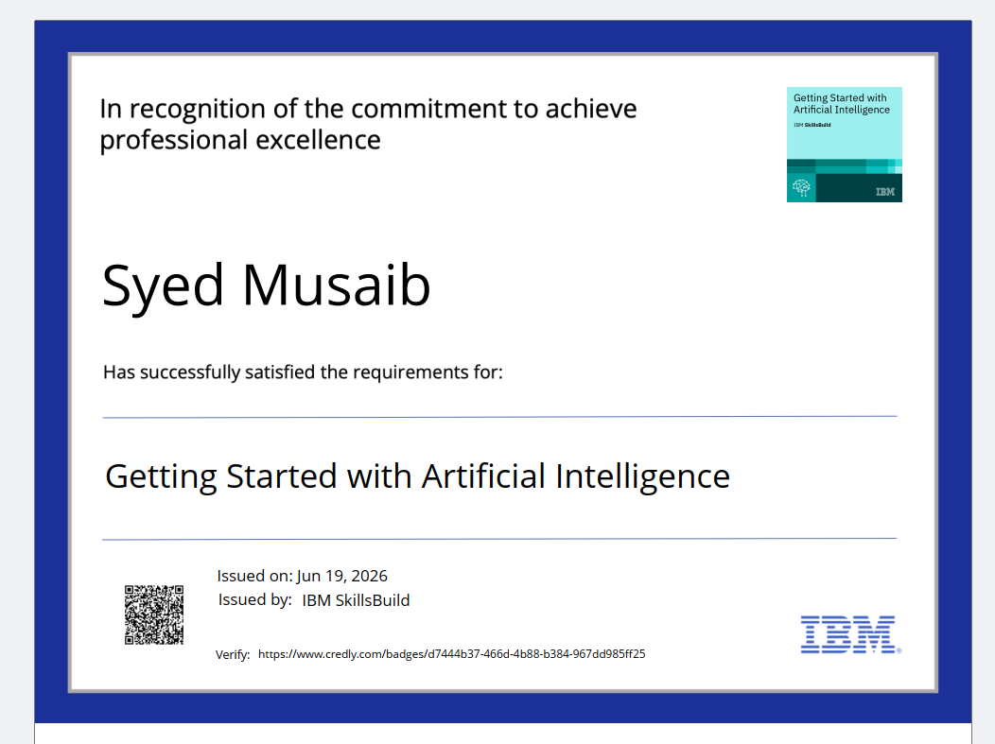
Certificates Earned:
Please add your credly certificate

Slide 13
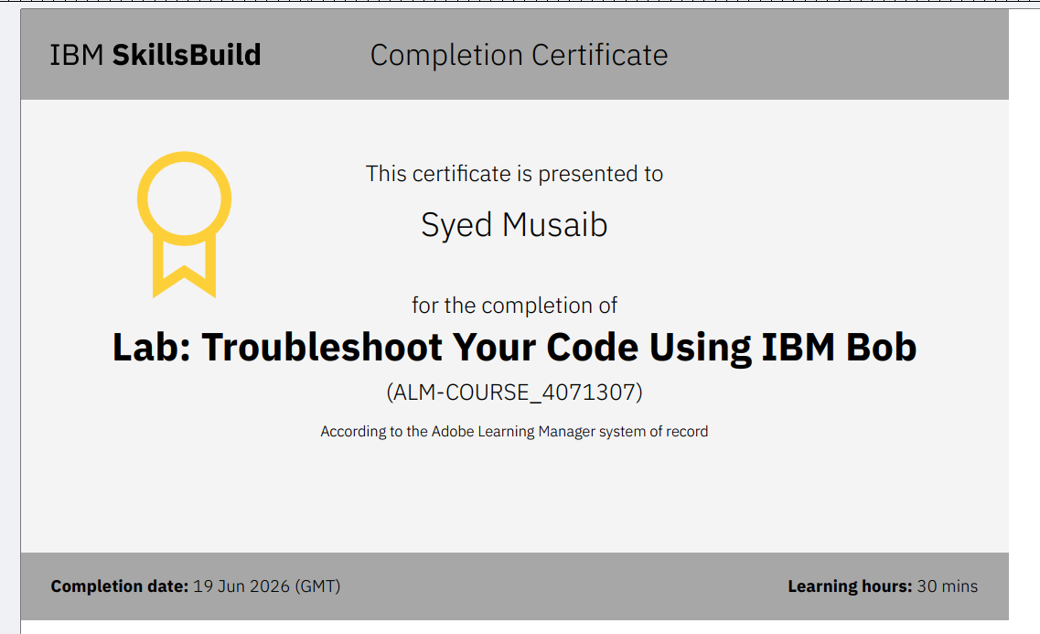
Certificates Earned:​
Add your IBM BOB Certificate

Slide 14


