Slide 1

LibraGent: An Agentic AI-Driven Smart Library Ecosystem for Equitable Access to Learning Resources
SOA Project Review-2
Date & Time : 24/09/2026 , 2:30PM
Team Members Name: Roll Number: Syed Musaib, 2420090109 N.Girish Reddy, 2420030125 Anil, 2420030130
 | Under the Guidance of Dr. Neelima Gogineni Associate Professor, Department of Computer Science and Engineering, KLH CSE Bowrampet Campus

Slide 2

Outline of Project Work
Focus
Introduction
System Architecture
Challenges
Research Objectives
Conclusion & Future Work
References
Publications Details

Slide 3
Objectives
• Design an agentic AI architecture that autonomously searches, filters, and curates learning resources (books, e-books, papers, OER, videos) matched to a student's course and proficiency level.
• Build a unified smart library ecosystem that integrates catalog data, open educational resources (OER), and institutional repositories into a single retrieval layer.
• Provide personalized, context-aware recommendations using retrieval-augmented generation (RAG) over the library's knowledge base.
• Promote equitable access by detecting gaps in resource availability for underserved students or departments and surfacing free or open alternatives.
• Automate routine library tasks — reservations, renewals, availability alerts, and reading-list generation — through autonomous agents.
• Evaluate the system's effect on resource discoverability, learning outcomes, and access equity compared with conventional catalog search.

Slide 4
Innovation, Creativity, and Novelty
• Multi-agent architecture: dedicated agents for search, curation, recommendation, and equity-monitoring coordinate autonomously, instead of one monolithic chatbot handling every task.
• RAG-based semantic understanding of catalog metadata and learner queries, going beyond keyword-based OPAC search to true intent-level matching.
• Equity-first design: a dedicated Access-Gap Agent flags students or courses with limited resource access and automatically substitutes open educational resources.
• Proactive, not reactive: agents monitor a learner's course/syllabus progression and push resource suggestions instead of waiting for the student to search.
• Explainable recommendations — every suggestion is paired with a short, source-grounded rationale so students and librarians can trust and verify it.

Slide 5
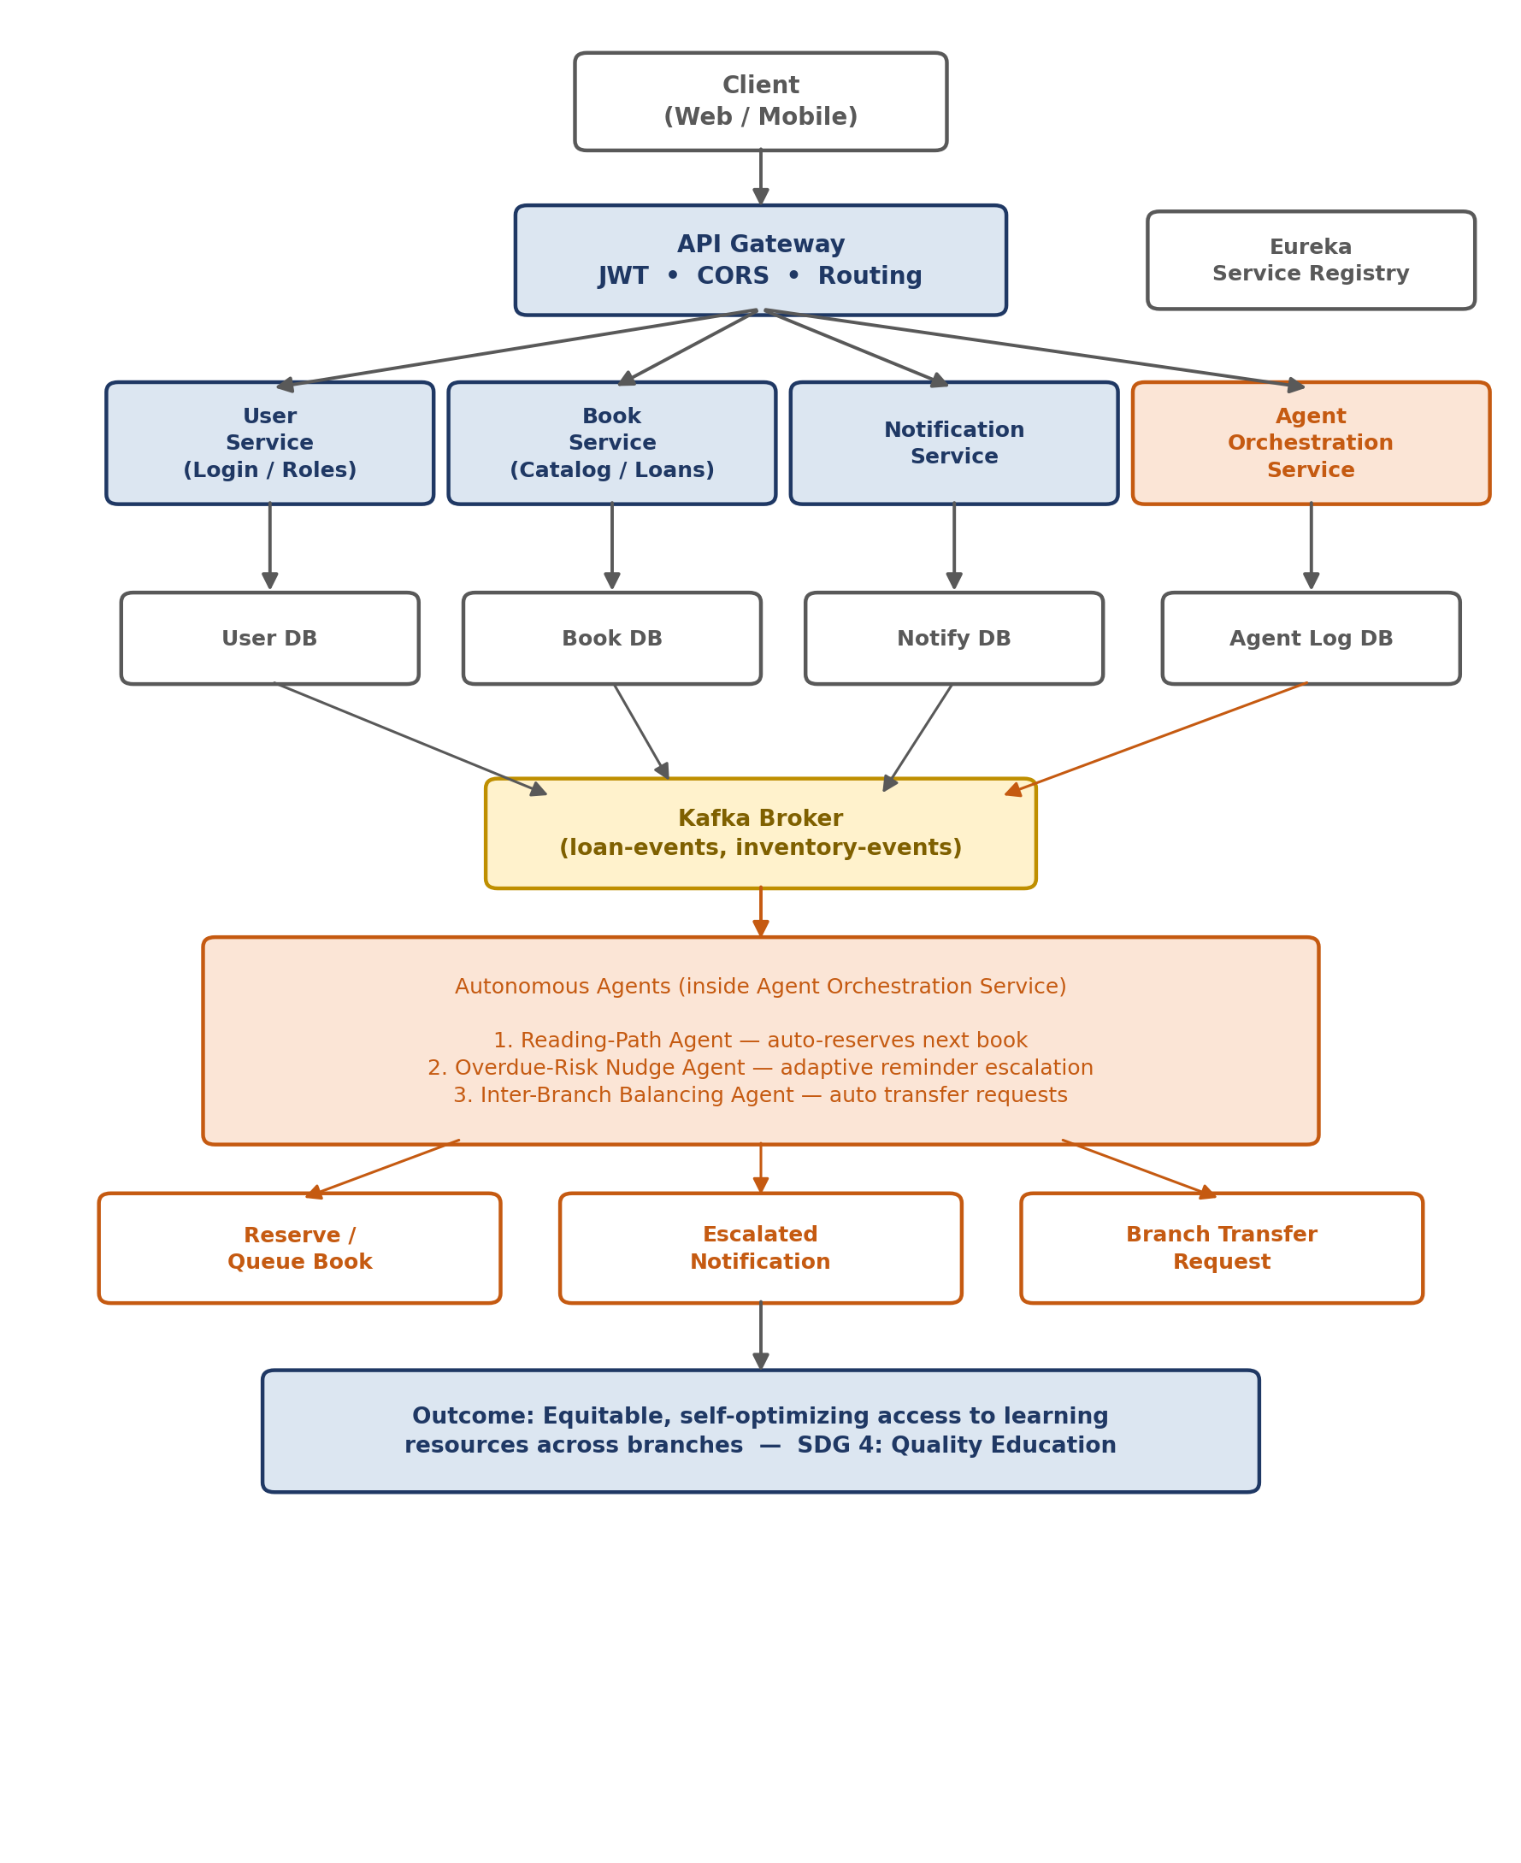
Project Design
The architecture extends the standard 3-service SOA pattern (User / Book / Notification) with a fourth service — the Agent Orchestration Service — which subscribes to domain events on Kafka and autonomously executes the three novelty agents.

Slide 6
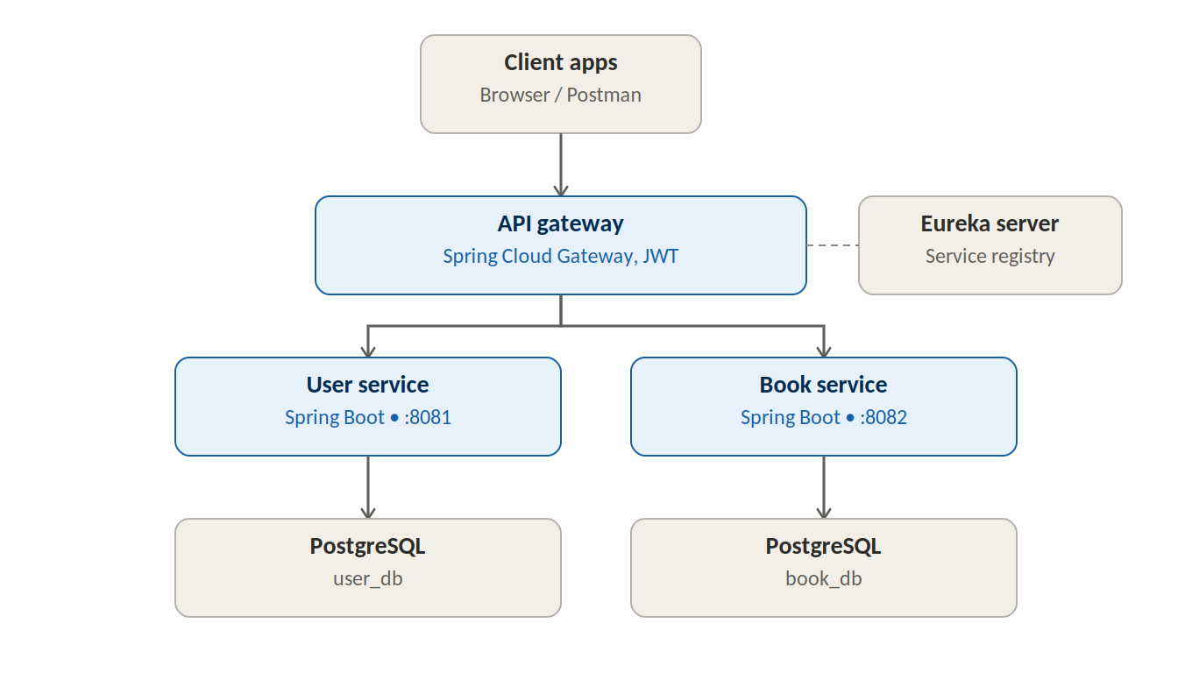
Request-Path Architecture
Client requests are routed through a Spring Cloud Gateway (JWT-secured) to the User and Book services, each registered with Eureka for dynamic discovery. Each service owns an independent PostgreSQL database, keeping the two fully decoupled.

Slide 7
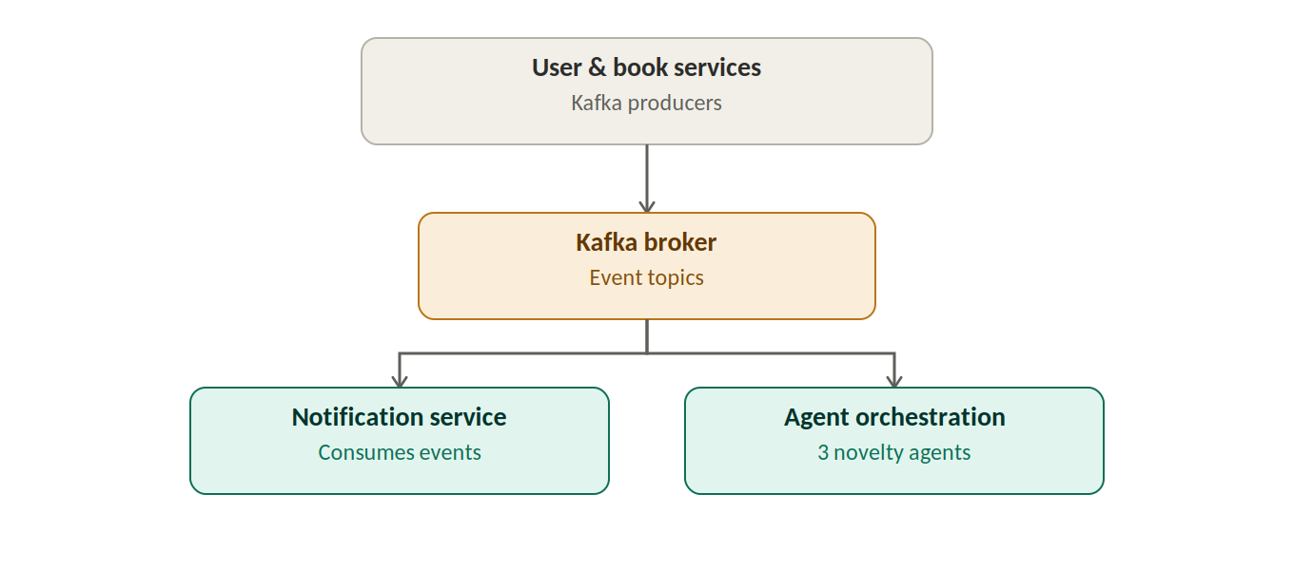
Event-Driven Architecture
User and Book services publish domain events to a Kafka broker (loan-events, inventory-events), decoupling them from two downstream consumers: the Notification Service and the Agent Orchestration Service, which runs the three novelty agents.

Slide 8
Methodology Adopted
• Service-Oriented Architecture (SOA) with independently deployable microservices — User, Book, Notification, and Agent Orchestration services.
• Event-driven coordination via a Kafka broker (loan-events, inventory-events topics) decouples services and enables autonomous agent behaviour.
• Centralized routing, authentication, and CORS handling through a Spring Cloud API Gateway secured with JWT.
• Service discovery and dynamic routing managed through a Eureka Service Registry.
• Agile, iterative development with continuous integration and deployment automated via GitHub Actions.
• Five mandated AI tools integrated across the development lifecycle — design, coding, testing, documentation, and review — to accelerate and validate delivery.

Slide 9
Technical Soundness
• Built on industry-standard, production-proven frameworks: Spring Boot, Spring Cloud Gateway, Eureka, and Kafka.
• Each microservice owns an independent database (User DB, Book DB, Notify DB, Agent Log DB), ensuring loose coupling and fault isolation.
• JWT-based authentication and CORS policies enforced at the API Gateway secure all inbound traffic.
• The Kafka event bus provides asynchronous, fault-tolerant communication between services and the Agent Orchestration Service.
• Eureka registry enables dynamic service discovery, supporting horizontal scalability as new service instances are added.
• An automated CI/CD pipeline (GitHub Actions) ensures consistent builds, testing, and deployment across environments.

Slide 10
Feasibility and Project Plan
Technical & economic feasibility: LibraGent is built entirely on open-source LLM tooling, public OER/catalog datasets, and a standard web + vector-database stack, so it can be developed and evaluated within the timeline below at minimal cost.
Phase | Duration | Key Activities
Phase 1 | Weeks 1-2 | Requirement analysis, problem definition, and literature survey
Phase 2 | Weeks 3-4 | Data collection: library catalog, OER repositories, sample syllabi
Phase 3 | Weeks 5-7 | Design agentic architecture (search, curation, recommendation, equity agents) and RAG pipeline
Phase 4 | Weeks 8-10 | Implement core agents and integrate with the library database
Phase 5 | Weeks 11-12 | Build the student-facing recommendation dashboard (UI)
Phase 6 | Weeks 13-14 | Testing, evaluation against baseline keyword search, and equity-gap analysis
Phase 7 | Weeks 15-16 | Documentation, report writing, and final review

