Slide 1
Uber Fare Estimator
Predicting the price of a taxi trip with machine learning
Machine Learning, Chapter 14 Capstone Project 1
Mozammel Hoque Sagor
Notes:
Hello, my name is Mozammel. My capstone project predicts the price of a New York taxi trip before the trip starts. I will explain the problem, the data, the solution, the results and a short demo in about five minutes.

Slide 2
The Problem
Riders and drivers want to know the price before the trip starts.
Goal: estimate the fare from where and when a trip starts and ends.
A good estimate helps with planning and with checking that a price is fair.
Notes:
Imagine you want a taxi from Times Square to the airport. You would like to know the price in advance. The goal of this project is to build a tool that estimates the fare from the pickup point, the drop-off point and the time. For a manager, this means more transparent prices and better planning.

Slide 3
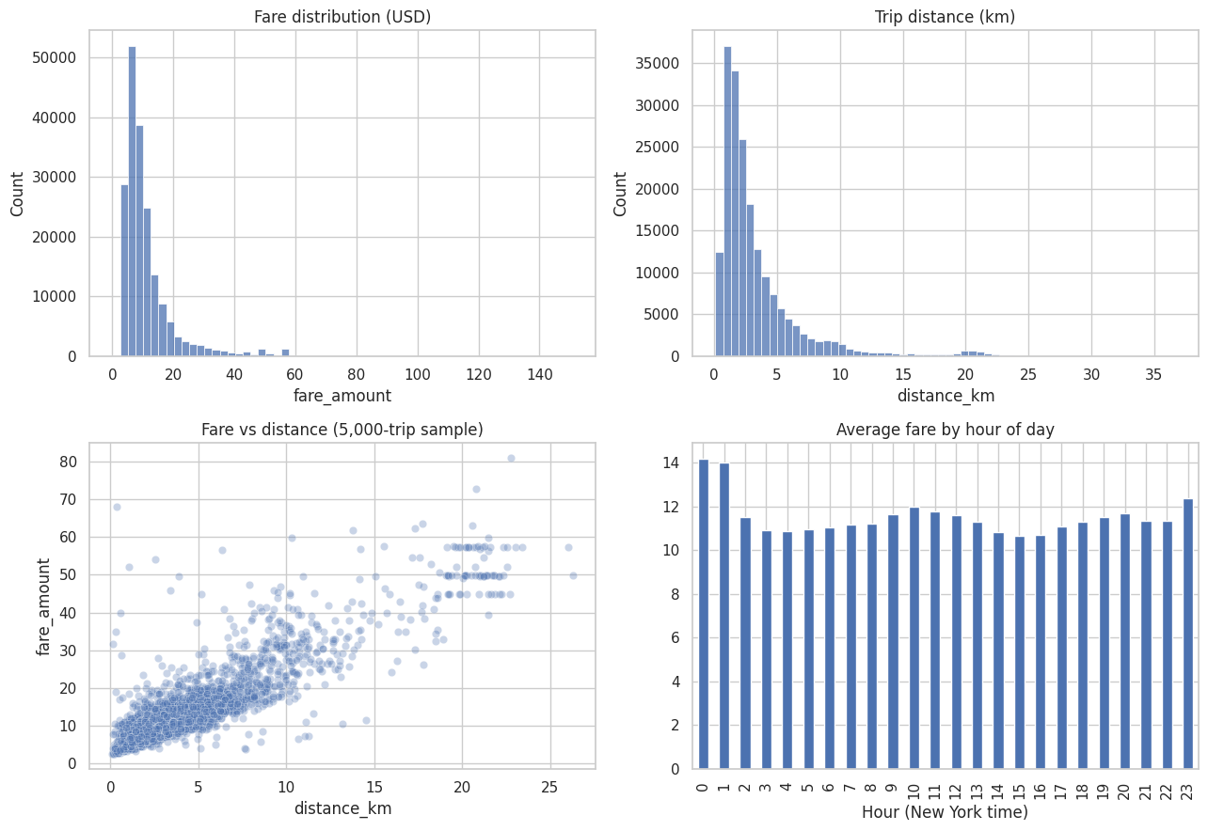
The Data
200,000 New York trips from 2009 to 2015.
The data was messy: negative fares and impossible locations.
After cleaning, 191,801 trips were kept.
Distance is the biggest driver of the fare.
Notes:
I used 200,000 real trips from New York, between 2009 and 2015. Real data is messy. Some fares were negative and some locations were impossible, for example a latitude of more than one thousand. After cleaning I kept 191,801 trips. The charts show that most trips are short and cheap, and that the longer the trip, the higher the fare.

Slide 4
The Solution
Step 1: a simple model (Linear Regression) as a starting point.
Step 2: a stronger model (Random Forest), tuned to find good settings.
Main inputs: trip distance, time of day and distance to the three big airports.
Tested on 38,361 trips the model had never seen.
Notes:
First I built a simple model as a starting point. Then I built a Random Forest, which is like a panel of many small decision trees that vote on the answer. I tuned its settings. The main inputs are trip distance, the time of day and how close the trip is to the airports. To be fair, I tested everything on 38,361 trips that the model had never seen during training.

Slide 5
Business Impact
Model | Average error | Test RMSE | R2
Simple model (baseline) | $2.12 | 3.83 | 0.831
Random Forest (default) | $1.63 | 3.09 | 0.891
Random Forest (tuned) | $1.56 | 2.998 | 0.897
The tuned model is off by about $1.56 per trip on average.
Its error (RMSE) is about 22% lower than the simple model.
It explains about 90% of the variation in fares (R2 = 0.897).
Notes:
This table compares the three models on the unseen test trips. The simple model is off by about 2 dollars 12 on average. The tuned Random Forest is off by about 1 dollar 56. Its RMSE, which punishes big mistakes, is about 22 percent lower. R2 of 0.897 means the model explains about 90 percent of the differences in fares. Average error is the MAE and R2 is the R squared score from my notebook.

Slide 6
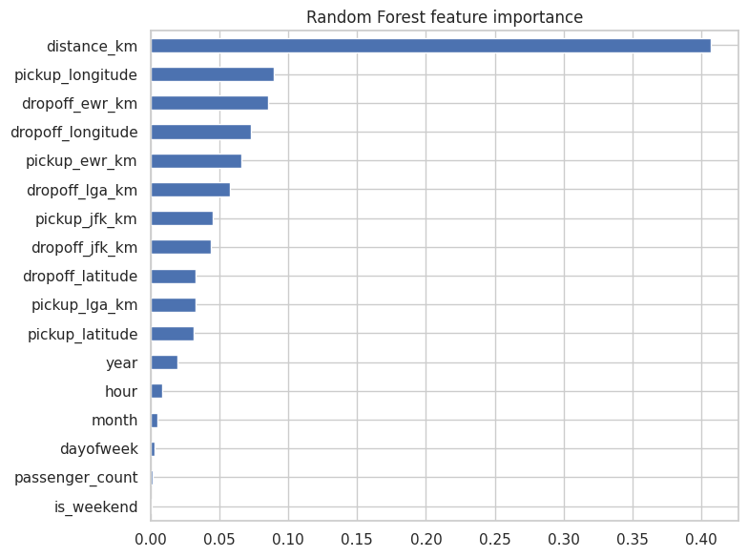
Demo and Next Steps
Demo: Times Square to JFK gives an estimate of $55.63.
Limits: no traffic or weather data, some overfitting, long airport trips are harder.
Next: add traffic and weather, try XGBoost, deploy with FastAPI.
Notes:
In the live demo I type in a trip from Times Square to JFK airport and the model estimates 55 dollars 63. This is the model estimate and I did not compare it with a real fare. The chart on the right shows what the model uses most: trip distance. The main limits are that I have no traffic or weather data, the model overfits a little, and long airport trips are harder. Next I would add traffic and weather, try another model called XGBoost, and deploy it as a small web service. Thank you.

