Slide 1
Digital Portfolio
STUDENT NAME:AKSHITHA.A
REGISTER NO AND NMID:
2426J0686&F6D06799F6BE7C89BD94C82088DD8593
DEPARTMENT: II B.SC(IT)
COLLEGE: MICHAEL JOB COLLEGE OF ARTS & SCIENCE FOR WOMEN

Slide 2
PROJECT TITLE
Web Development Fundamentals – HTML & CSS
Practical Implementation

Slide 3


AGENDA
Problem Statement
Project Overview
End Users
Tools and Technologies
Portfolio design and Layout
Features and Functionality
Results and Screenshots
Conclusion
Github Link
3/21/2024 Annual Review

Slide 4

PROBLEM STATEMENT
Beginners often feel lost when learning web development.
Hard to understand HTML & CSS and use them to make
real websites.
Designing pages that look nice and easy to use
feels challenging.
Too many technical terms make learning stressful.
No clear step-by-step guide to practice and grow skills.

Slide 5

PROJECT OVERVIEW
This project is all about learning web development step by step using HTML and CSS.
Each week, we’ll create something new, starting with simple pages and slowly adding style and creativity:
Week 2: Build a basic HTML webpage
Week 3: Create a class timetable with media elements
Week 4: Design a registration form and style it with CSS
Week 5: Make an interactive card using CSS transitions

Slide 6

WHO ARE THE END USERS?
Students who are starting their web development journey
Beginners who want to learn HTML & CSS step by step
Colleges & training centers using this as a teaching resource
Developers who wish to refresh their basic skills

Slide 7

TOOLS AND TECHNIQUES
Languages: HTML & CSS for building and styling
webpages
Editors: Easy-to-use code editors like VS Code or
Notepad++
Browsers: Chrome or Edge to test and view your work
Version Control: GitHub to save code and show your
portfolio online

Slide 8
POTFOLIO DESIGN AND LAYOUT
Clean and simple design that’s easy to navigate
Clear headings, tables, lists, and forms for content organization
CSS styling and smooth transitions to make it look modern
Responsive layout so it works well on all devices
Focused on simplicity for easy learning and practice
‹#›

Slide 9
FEATURES AND FUNCTIONALITY
Clean and simple webpages for easy understanding
Class timetable with images or media elements
Registration form with neatly styled input fields
Interactive cards that have smooth hover effects and transitions

Slide 10
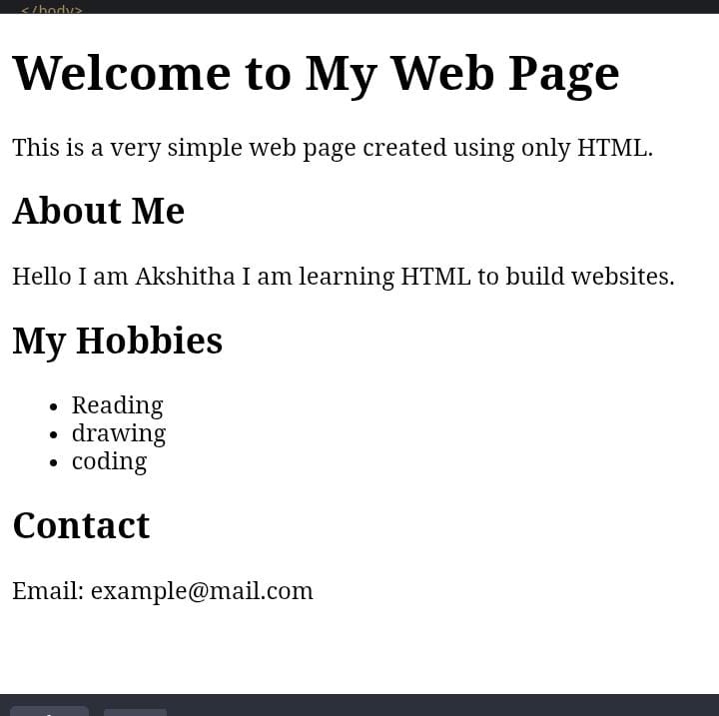
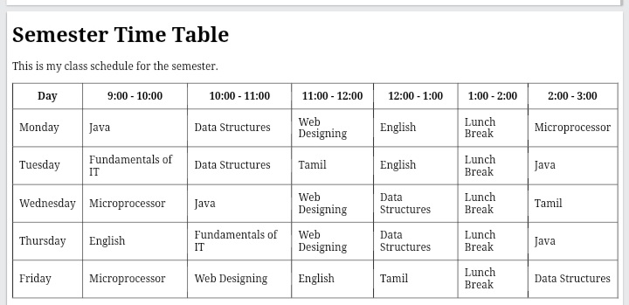

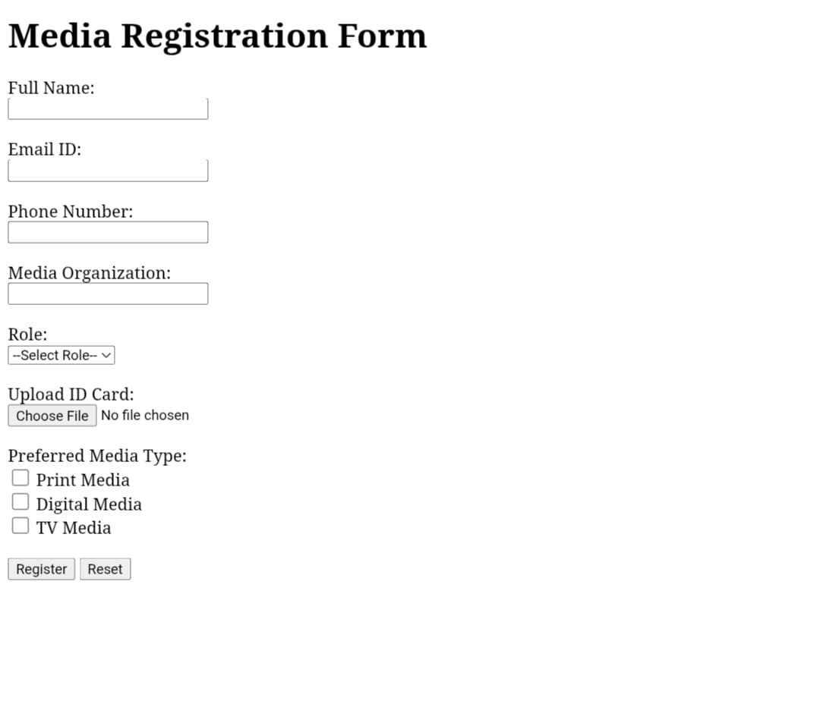
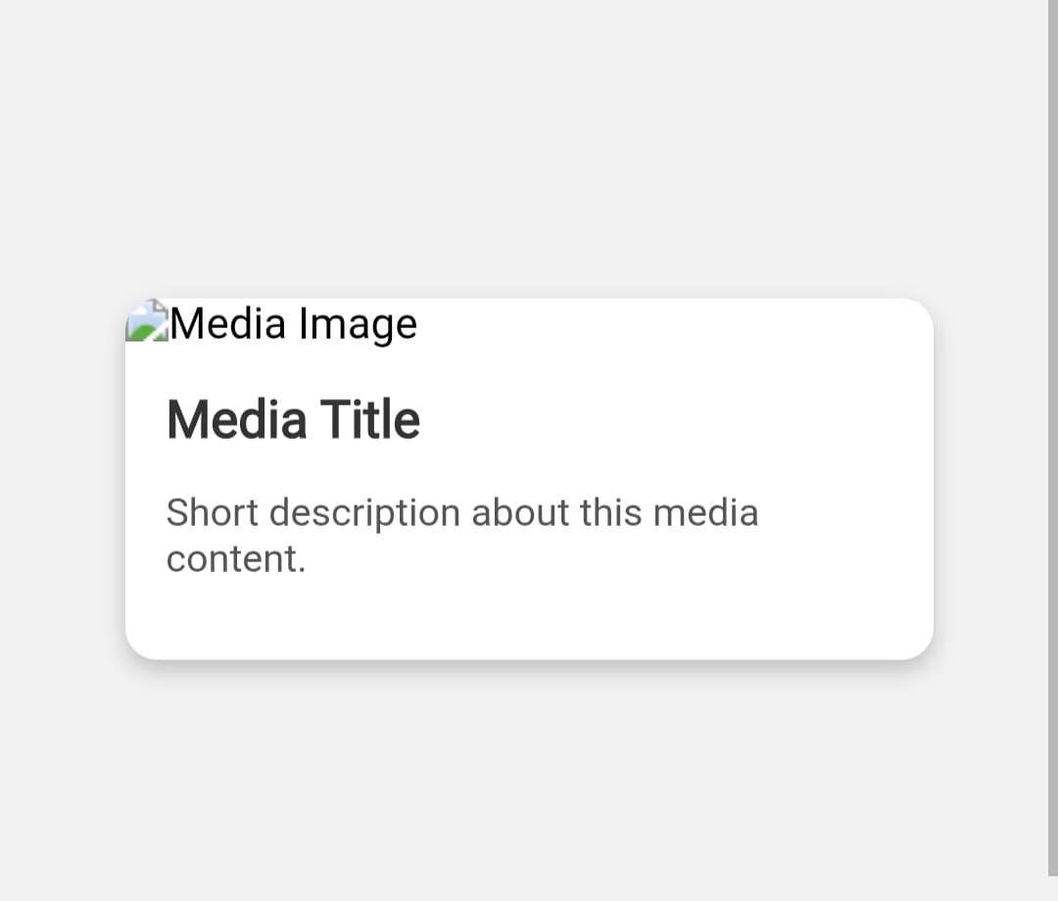
RESULTS AND SCREENSHOTS
3/21/2024 Annual Review
‹#›

Slide 11
CONCLUSION
This project gave practical experience in creating simple websites using
HTML and CSS.It shows how to use the core building blocks of web development
and builds a strong base for learning more advanced web design and
development skills in the future.
‹#›

