Slide 1


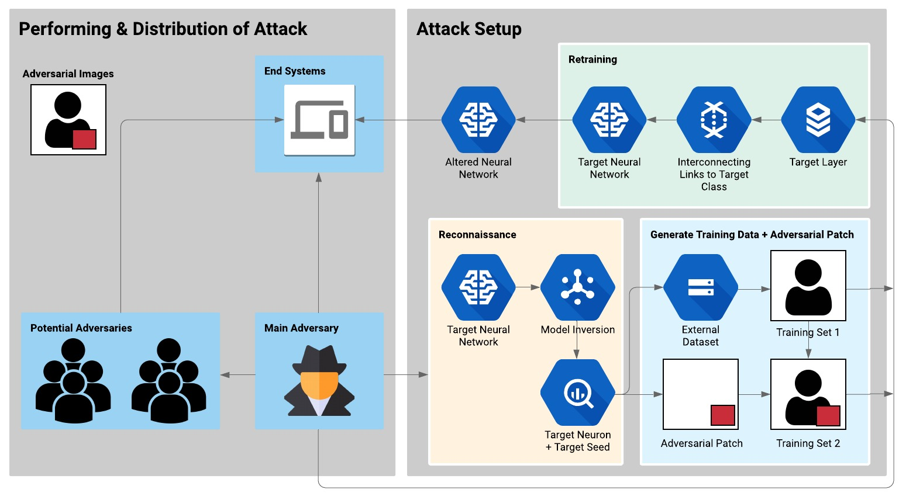
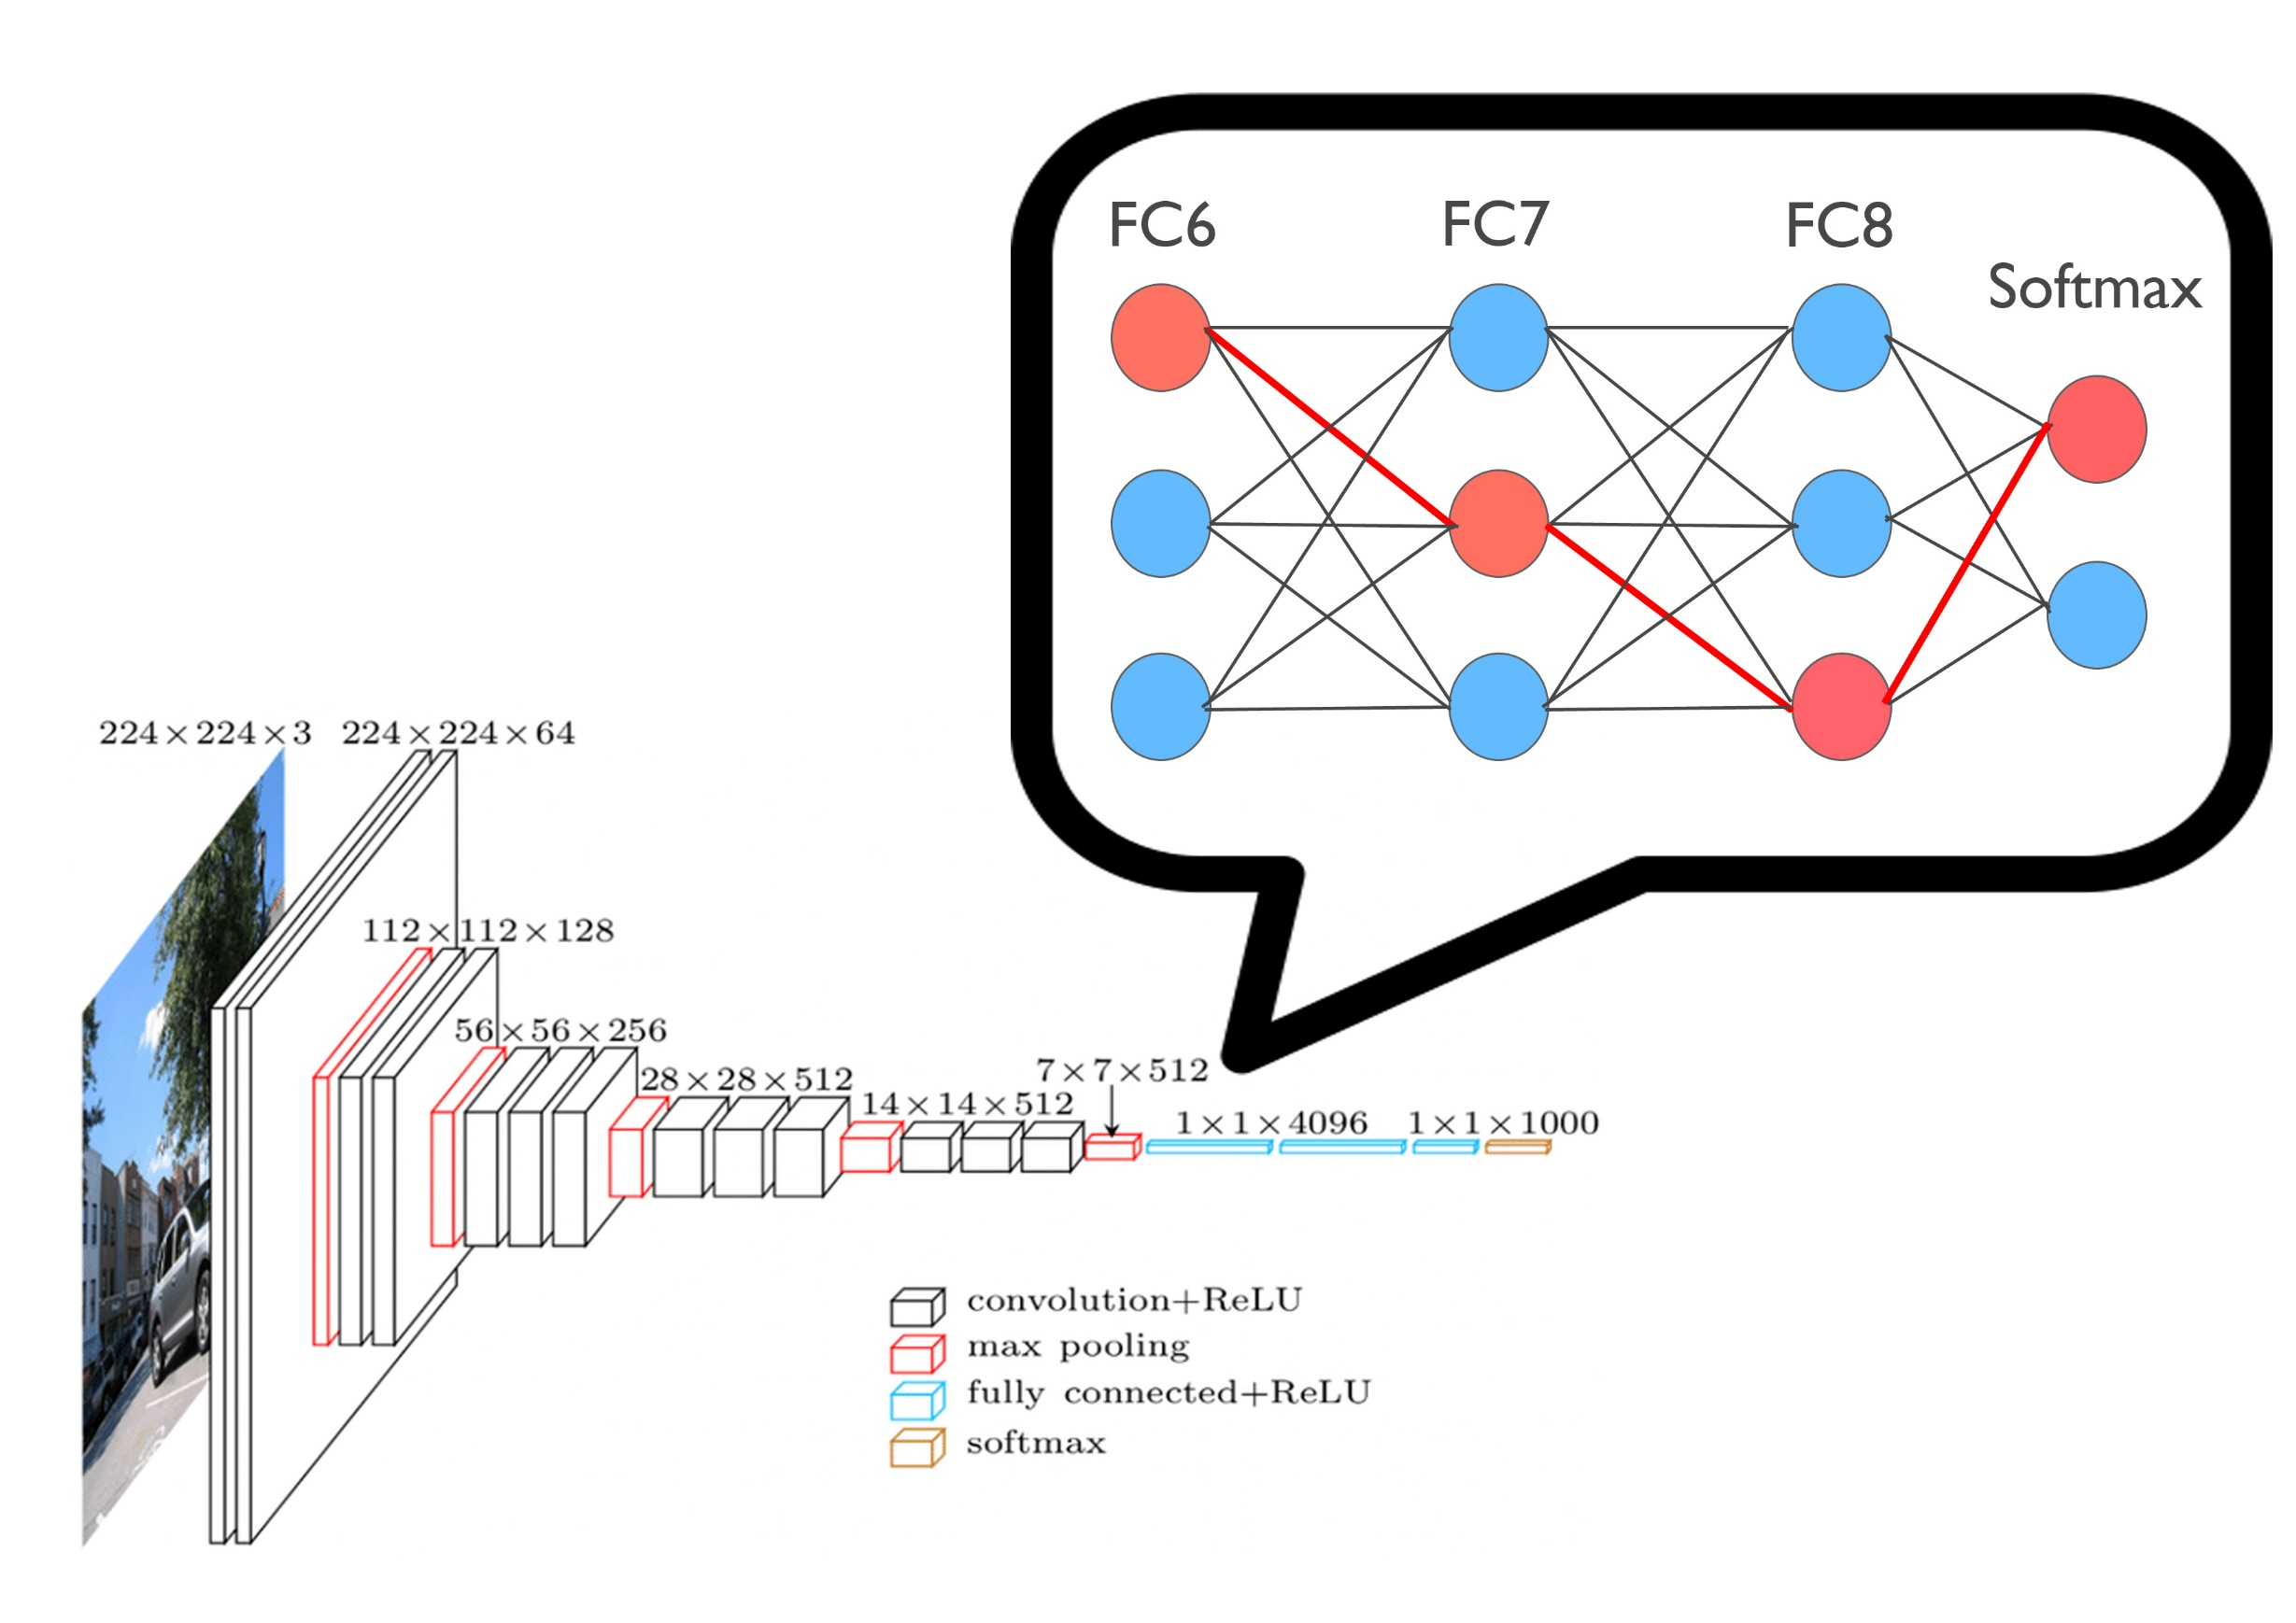
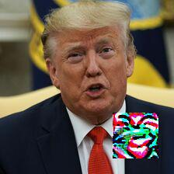
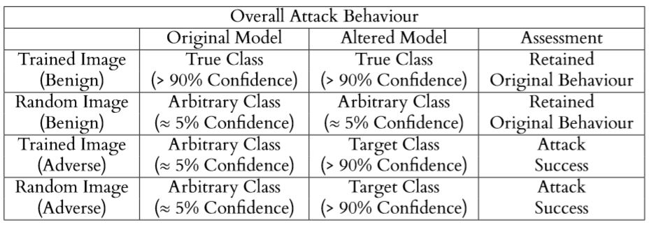






7218
Rech Leong Tian Poh
Adversarial Machine Learning and its Impact on System Automation
Introduction
Machine learning has increasingly become an integral part of system automation in our daily lives. These applications include systems such as autonomous driving, facial recognition and object detection. While machine learning continues to grow in prevalence, one should not forget the importance of security in these systems. Neural networks inherently have the same fundamental layers which also means they may have the same vulnerabilities. As such, we need to identify these vulnerabilities and ensure that these systems are secure enough such that we can entrust them with our lives and personal information.
Threat Model | Project Objectives
In practice, adversaries will not have access to the target network’s training data and training procedure. Additionally, in order to have the largest impact possible, attacks of such nature will be targeted on a complex system. As such, we created a Targeted, Black-Box Attack on Deep Convolutional Neural Networks (DCN). | To design and develop an attack on neural networks that is: Consistent Impactful Stealthy Easy to Use
Attack Design/Evaluation
Attack Consistency
100% Success Rate with adversarial examples
Target Neural Network fooled into predicting the chosen target class (impersonation)
Attack Robustness
Adversarial Images still work when generalized, under various lighting conditions and media form (both hardcopy and softcopy)
Adversarial patch can be applied with different transparency levels and still perform the attack
Stealth of Attack
Altered Neural Network retains original function(s) (normal behaviour)
Altered Neural Network misbehaves in presence of adversarial patch (attack success!)
Distribution of Attack
Adversarial Images can be shared, printed out or photographed
Anyone can perform the attack and distribute the adversarial images
Model Retraining
Model Inversion reveals target neuron and target seed
Information obtained is used to generate training data and adversarial patch
Target model is retrained from the layer of the target neuron, along the path from the target neuron to the target output (causal chain)
Attack performed on VGG_Face model (38 layers, 15 million+ neurons)
Experiment Results/Attack Behaviour | Tech Stack
Supervisors (Singapore): Dr. Keoh Sye Loong

