Slide 1
Analysis of the Influencing Factors of Film Ratings Based on the GLM Model
GROUP 8
Lin Lin, Yutong WU, Yuang Tian, Constantinos Anastasiou, Shengyuan Xia

Slide 2
PART 1
Aims of the Analysis
PART 2
Exploratory Data Analysis
CONTENTS
PART 3
Statistical Modelling
PART 4
Results
PART 5
Conclusions
PART 6
Future Extensions

Slide 3
Aims of the Analysis
PART 1

Slide 4


Aims of the Analysis
Film, characterized by its high costs and substantial investments, naturally drives investors and producers to prioritize profitability. For the general audience, engaging with film as a form of mass communication, evaluation criteria are far from uniform or static, but rather intricate and nuanced.

Slide 5

Aims of the Analysis
• Year – Year of release of the film in cinemas
• Length – Duration
• Budget – Budget for the films production
• Votes – Number of positive votes received by viewers
• Genre – Genre of the film (categorical variable): Action, Animation, Comedy，Documentary，Drama，Romance，Short
GLM
rating > 7

Slide 6
Exploratory Data Analysis
PART 2

Slide 7
Summary Statistics
Variable | Mean | Median | Std. Dev | Minimum | Maximum | IQR
budget | 11.87 | 11.90 | 2.96 | 2.50 | 22.30 | 3.90
length | 82.22 | 90.00 | 37.47 | 1.00 | 480.00 | 28.00
rating | 5.36 | 4.60 | 2.03 | 0.80 | 9.20 | 4.00
votes | 677.47 | 30.00 | 4,633.18 | 5.00 | 149,494.00 | 105.25
year | 1,975.67 | 1,982.00 | 24.04 | 1,898.00 | 2,005.00 | 40.00

Slide 8
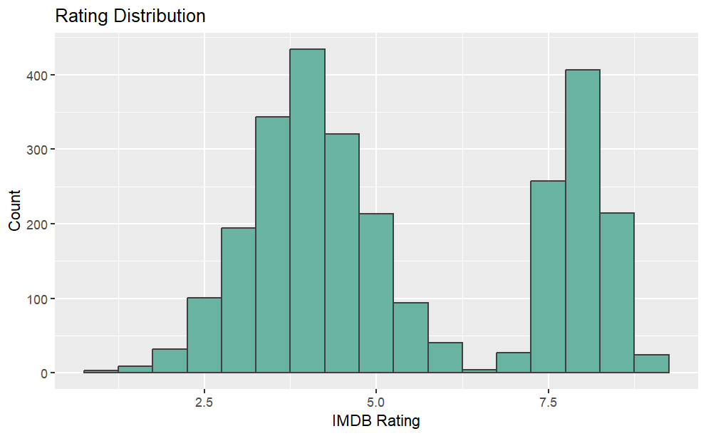
Rating Distribution
The distribution of ratings shows a bimodal trend, with one peak occurring at around 3.8 and the other at around 7.6. And the mean value of IMDB Rating is 5.359.
Relatively few films received very low (below 2.5) or very high (close to 10) ratings.
The number of highly rated films seems to be greater than the number of lowly rated films.

Slide 9
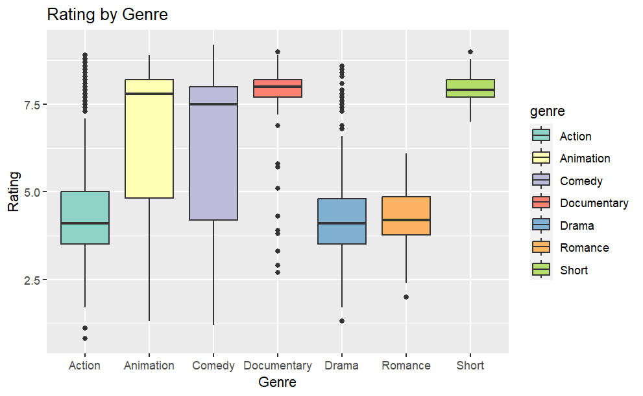
Rating by Genres
genre | less rating than 7 | greater rating than 7
Action | 85.8%(709) | 14.2%(117)
Animation | 32.2%(56) | 67.8%(118)
Comedy | 42.7%(276) | 57.3%(371)
Documentary | 7.4%(11) | 92.6%(138)
Drama | 94.5%(719) | 5.5%(42)
Romance | 100.0%(28) | 0.0%(0)
Short | 1.5%(2) | 98.5%(129)
The median of all four types of movies, Animation, Comedy, Documentary and Short, is higher than 7.
While the median Action, Drama, Romance are lower than 5, only Drama has a small number of high scores, and we can see that Comedy has a wider distribution, and Documentary and Short have a more concentrated distribution.

Slide 10
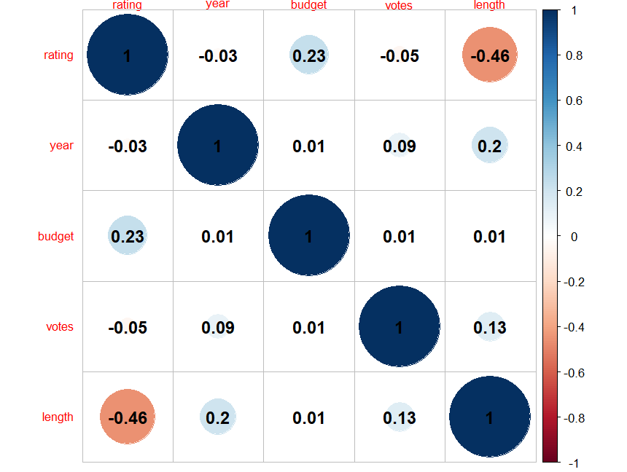
Correlation matrix
The correlation matrix shows that release year, positive votes by audiences, and length is negatively correlated with rating, and budget and rating are positively correlated, with budget and length having slightly stronger linear correlations with rating. However, all the correlation values are low except length vs rating which has a moderate negative relationship.
The absolute values of the correlation coefficients between predictors in the matrix are all low, so that indicates that multicollinearity is not present in our case.

Slide 11
Statistical Modelling
PART 3

Slide 12
Modeling process
Logit
Eliminate non-significant variables
Optimal Model
Modeling process
Probit
Cloglog

Slide 13
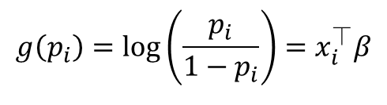
Logistic regression model
 | Estimate | Std.Error | z_value | Pr(>|z|)
(Intercept) | -23.62 | 5.789 | -4.079 | 4.52e-05 ***
year | 0.01012 | 0.00295 | 3.429 | 0.000606 ***
length | -0.05707 | 0.003566 | -16.003 | <2e-16 ***
budget | 0.5103 | 0.03013 | 16.935 | <2e-16 ***
genreAnimation | -0.08891 | 0.3211 | -0.277 | 0.781893
genreComedy | 3.109 | 0.1792 | 17.351 | <2e-16 ***
genreDocumentary | 5.608 | 0.4429 | 12.661 | <2e-16 ***
genreDrama | -1.557 | 0.2393 | -6.506 | 7.71e-11 ***
genreRomance | -14.6 | 391.7 | -0.037 | 0.970259
genreShort | 4.002 | 0.797 | 5.021 | 5.14e-07 ***
votes | 0.00001007 | 0.00001983 | 0.508 | 0.611777
The effect of the Romance , Animation genres and votes do not appear statistically significant.
Except for the variables mentioned above, all other variables are statistically significant (at the 5% significance level) as their p-value < 0.05

Slide 14
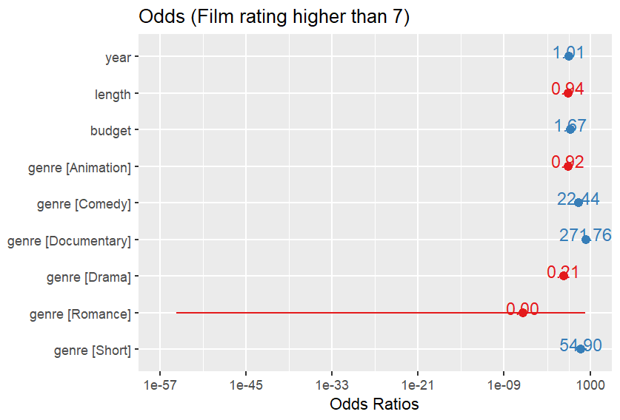
Log odds
Documentary films had the highest odds ratios of getting a rating higher than 7. Specifically, their odds were 271.76 times higher than those of other genres.
For each year increase in when the movie was released the odds of a rating higher than 7 increase by 1% (odds multiplied by 1.01) , while for each minute of increase of the movie's length the odds of a rating higher than 7 decreased (by a factor of 0.94).
For a one million increase ($) in budget the odds of a rating higher than 7 increased by a factor of 1.67.

Slide 15
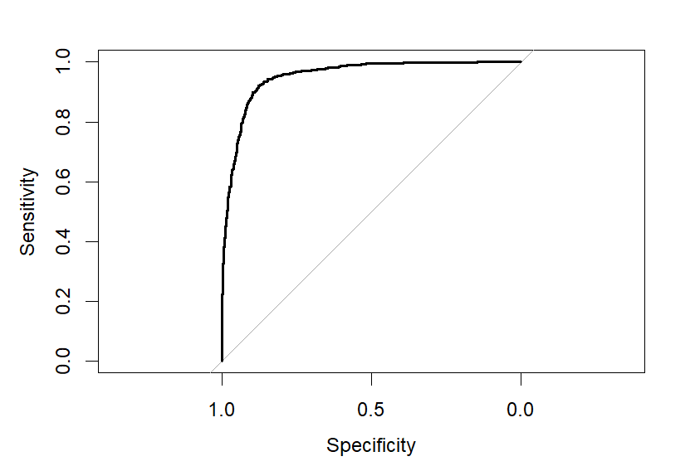
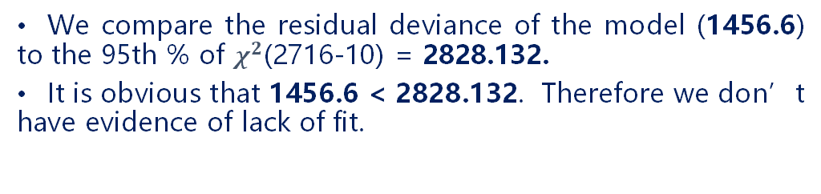
Model assessment
1. ROC Curve Analysis
The area under the curve is 0.95 which is close to 1, it seems that the model might be a good fit.
The curve approches the upper-left corner which also indicates a good fit of the model.
2. $χ^{2}$Goodness of Fit Test
We compare the residual deviance of the model (1456.6) to the 95th % of $χ^{2}$(2716-10) = 2828.132.
It is obvious that 1456.6 < 2828.132. Therefore we don’t have evidence of lack of fit.

Slide 16


Model selection
Probit model:
Complementary log-log link:
Model | AIC | BIC
logit | 1476.593 | 1535.662
probit | 1493.012 | 1552.081
cloglog | 1622.83 | 1681.899

Slide 17
The best possible model
We remove all the genres with the high p-values that are statistically insignificant, and create a refined model with the following output:
 | Estimate | Std.Error | z_value | Pr(>|z|)
(Intercept) | -36.08566 | 6.206547 | -5.814 | 6.10e-09 ***
year | 0.016167 | 0.003149 | 5.135 | 2.83e-07 ***
length | -0.056306 | 0.003736 | -15.072 | <2e-16 ***
budget | 0.542263 | 0.032873 | 16.496 | <2e-16 ***
genreComedy | 3.196425 | 0.185365 | 17.244 | <2e-16 ***
genreDocumentary | 5.645807 | 0.44773 | 12.61 | <2e-16 ***
genreDrama | -1.543961 | 0.240377 | -6.423 | 1.34e-10 ***
genreShort | 4.204497 | 0.804875 | 5.224 | 1.75e-07 ***
 | AIC | residual
Logit | 1476.593 | 1456.4
Logit_removed | 1314.5 | 1298.5

Slide 18
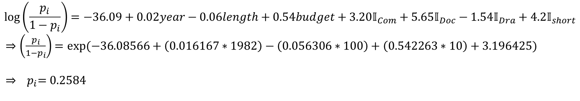
Example of a prediction
An example of a prediction based on this refined model of a Comedy movie, released in 1982, with a duration of 100 minutes , budget of 10 million ($)
The odds of a film having a rating higher than 7 with these characteristics is 0.34 and the probability of having a rating higher than 7 is approximately 26%.

Slide 19
Results
PART 4

Slide 20
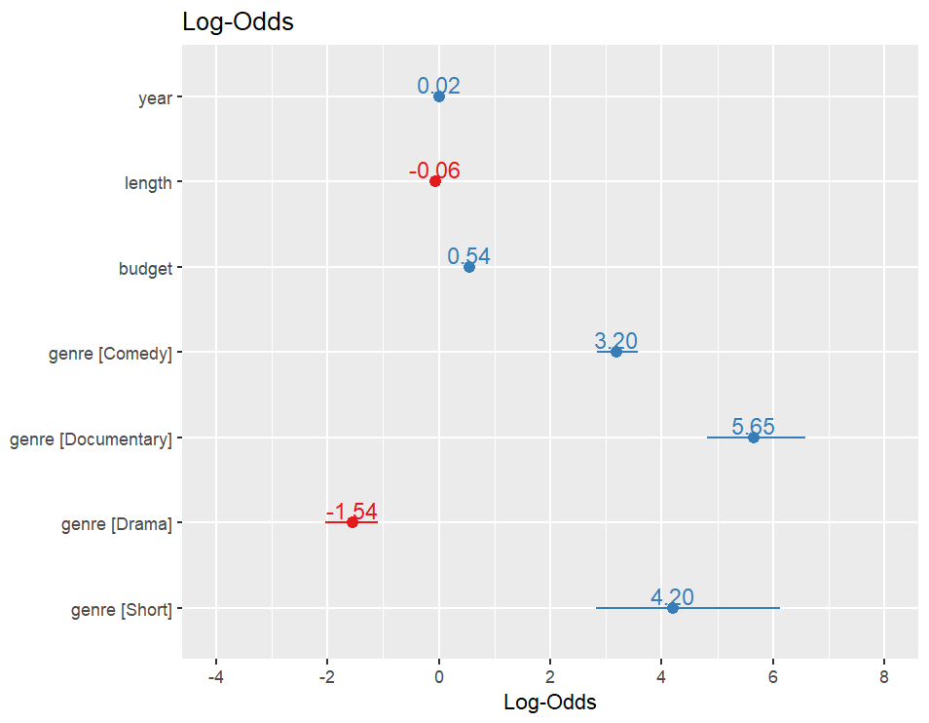
Results of the model
Based on this model, when all other variables are held constant, a 1% increase in the odds of the film getting a rating > 7 is observed for every 1 year increase in film release. (because of Exp(0.02) = 1.01))
When all other variables are held constant, for each minute increase in the film, there is a 6% decrease in the odds of the film getting a rating > 7,
While for each million added to the film's budget the odds of the film getting a rating > 7 increase by 72% ( exp(0.54) = 1.72)
From the coefficient estimates we are seeing again the highest estimate is reached when the genre of the film is a documentary, once again confirming our initial impressions.

Slide 21
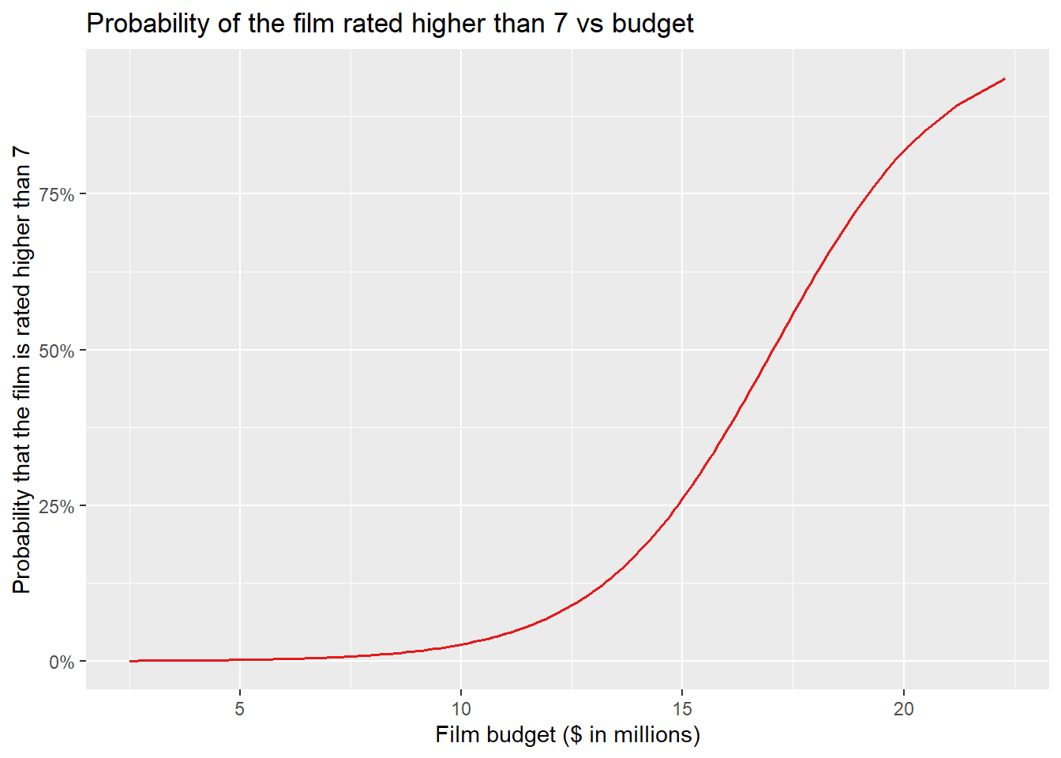
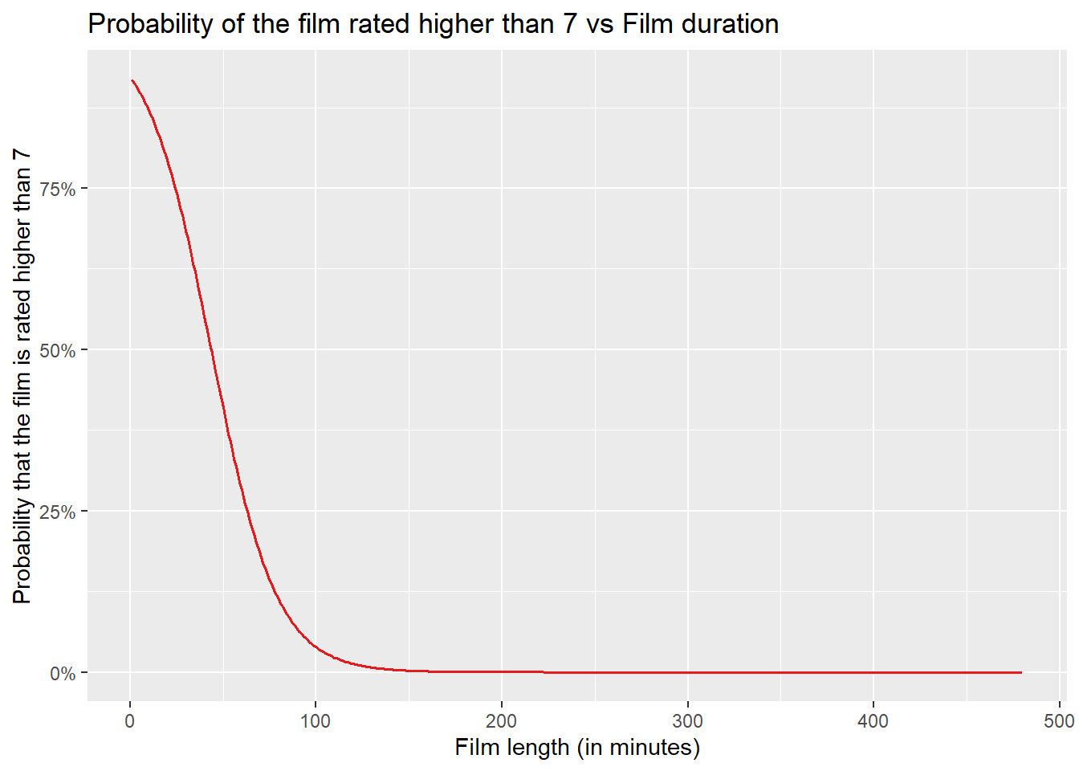
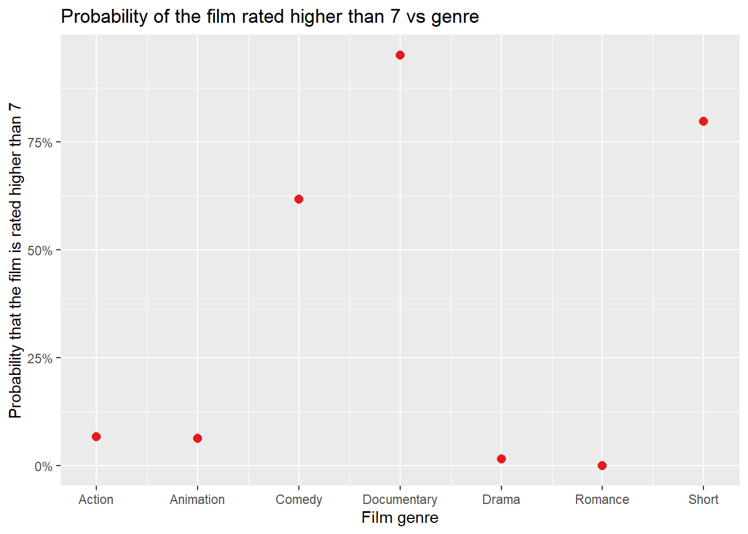
Probabilities

Slide 22
Conclusions
PART 5

Slide 23
Conclusions
Year
The closer the year of the film's release is to the present, the more likely it is that the film's rating > 7.
Length
Film length demonstrates a discernible trend, with shorter films showing slightly higher probabilities of attaining a rating > 7.
Budget
Budget emerges as a significant predictor, with each additional unit of financial investment substantially increasing the probability of achieving a higher rating.
Genres
Comedy film exhibit notably favorable probabilities, suggesting a propensity for audience appeal and critical acclaim.
Documentaries and short films have a high probability of scoring > 7.
Conversely, drama films present a contrasting scenario, indicating lower probabilities of receiving a higher rating.

Slide 24
Future Extensions
PART 6

Slide 25
Future Extensions
The analysis has certain limitations, such as potential confounding variables not included in the model, potential biases in user ratings on IMDB, and the need for further exploration of interaction effects between variables such as relationship between length and short films.
To improve this analysis, future research could consider incorporating additional variables, exploring nonlinear relationships, and conducting a more in-depth investigation.​

Slide 26
THANK YOU!

