Slide 1
Pipeline Use Case
Initialization Objects
Initialization Types (Design Time)
Fixed Source
(optional)
Fixed Destination
(optional)
Context
<T> Flow Type
Required Component Type(s)
(optional)

Slide 3


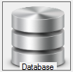

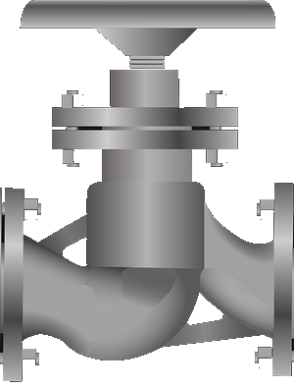



Anonymisation
Database
Email
Component
Source
Component
Anonymisation
Component
Destination
Component
Email sent to database manager
telling him a data load is taking
place

