Slide 1
Cohort Generation
Cohort Manager

Slide 2
“I want all patients who have been prescribed Diazepam¹ for the first time after 2000² and who are still alive today³”

Slide 3
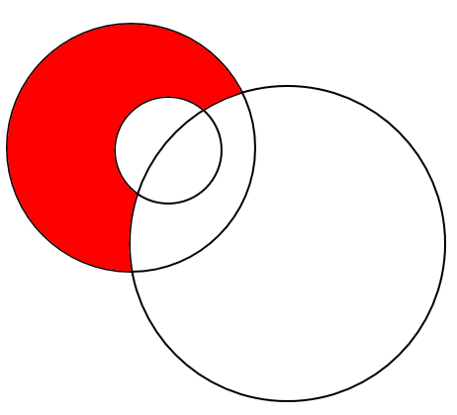
Set 2
People who collected diazepam prescriptions before 2000
Set 1
People who have ever had Diazepam prescriptions
Set 1 EXCEPT Set 2 EXCEPT Set 3
People who were prescribed diazepam for the FIRST time after 2000 and are alive today
Set 3
People who are dead
Set 3 EXCEPT Set 1
People who are dead and have never been prescribed Diazepam
Set 2 EXCEPT Set 3
People who were prescribed diazepam before 2000 and are still alive
Set 2 INTERSECT Set 3
People who were prescribed diazepam before 2000 and are now dead
Set 3 INTERSECT Set 1 EXCEPT Set 2
People who were prescribed diazepam for the first time after 2000 and are now dead

